Slide 1
Introduction to Hospitality Industry
Chapter 1 introducing hospitality

Slide 2
After learning this chapter, you will be able to
Discuss hospitality through the ages
Describe hospitality characteristics
Explain corporate philosophy and Total Quality Management
Discuss why “service” is so important
Suggest ways to improve service
Discuss current trends in the hospitality industry

Slide 3
Definition: Hospitality
Ojibwe: minodoodaadig
“treat one another in a good way”
French: hospice
“Provide care/shelter for travelers”
English
“the friendly and generous reception and entertainment of guests, visitors, or strangers”

Slide 4
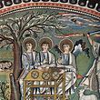
Hospitality
Hospitality refers to the relationship between a guest and a host,
wherein the host receives the guest with goodwill,
including the reception and entertainment of guests, visitors, or strangers.
Louis, chevalier de Jaucourt describes hospitality in the Encyclopédie
as “the virtue of a great soul that cares for the whole universe
through the ties of humanity.”
Wikipedia

Slide 5
Early examples of “renting space to travelers”
Native American nations (3000 B.C.)
long houses, clan hospitality
Ancient Sumerian Civilization (2500 BC)
“houses of the go far people”
Caravansary (Persia, 200 BC)
fortified area that housed animals, goods and travelers
Post Houses (China, 250 BC – 100 AD)
post houses every 10 miles for 300,000 miles
Roman Empire(30 BC -400 A.D)
religious and military travel
Greek Games
hotel in Olympus for visitors to games (4 BC)
Dark Ages(400 -500 )
monasteries
Renaissance(1300 -1600)
Monasteries, inn keeping flourishes

Slide 6
Time Line
House of the
“Go Far” People
Native American
Lodges
Religious,
Military
Travel
Caravansary
Post House
Modern
Hotel
Monastery
Inn
3000 B.C.-1000 A./D.
200 BC
100 AD
400 AD
1300 AD
1900 AD

Slide 7
Ojibwe Wigwam – Grand Portage

Slide 8
Anasazi Adobe Dwellings, 900 A.D.

Slide 9
Catawba Village, circa 1000 A.D.
The Catawba Indian Nation is one of the
indigenous Indian tribes that settled the Carolina
Piedmont over 10,000 years ago. They hunted
and farmed their ancestral lands in the Piedmont
area of North Carolina and South Carolina. The
Catawba were once one of the most powerful
tribes in the Carolinas.

Slide 10
Chinook Cedar Plank House, c. 1000 A.D.
The modern Chinook Indian Nation consists of the
Clatsop and Kathlamet of what is now Oregon
and the Lower Chinook, Wahkiakum and Willapa
of Washington State. Our five historically important
Tribes have existed since time immemorial in our
aboriginal territory at the mouth of the Columbia
River. It is here that our Chinook families welcomed
Lewis and Clark to the Pacific Ocean and helped
them survive the winter of 1805 and 1806.

Slide 11
Mississippi Housing, c.1000 A.D.
The Mississippian culture was a mound-building Native
American civilization archeologists date from approximately 800 CE to 1600 CE, varying regionally. Maize-based agriculture. In most places, the development of Mississippian culture coincided with adoption of comparatively large-scale, intensive maize agriculture, which supported larger populations and craft specialization.

Slide 12
Earliest Western Urban Civilization (city of Ur)

Slide 13
Earliest Western Urban Civilization (city of Ur)
Circa 3000 B.C.

Slide 14
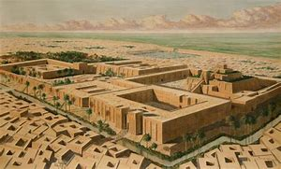
Sumerian Early Home
Circa 2500 B.C.

Slide 15
Early Central American Urban Civilization (Central America)

Slide 16
Temple of the Warriors
Chichen Itza , circa 1000 AD

Slide 17
Caravansary
200 B.C.

Slide 18
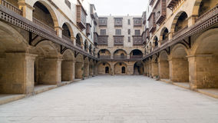
Remodeled Caravansary
Facade of caravansary Wikala of Bazaraa, Medieval Cairo, Egypt

Slide 19
Monastery
Europe, circa 1300 A.D.

Slide 20
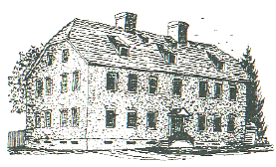
Colonial America: Ordinary
The Sun Inn, Bethlehem, PA Circa 1750 AD

Slide 21
Colonial America: Ordinary

Slide 22
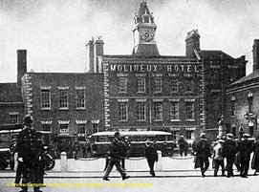
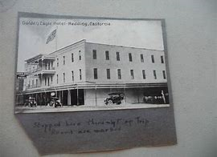
Early 20th century hotels

Slide 23
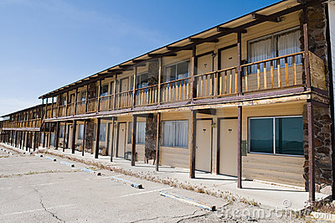
Motels/ Motor Hotels
Circa 1950

Slide 24
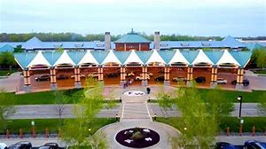
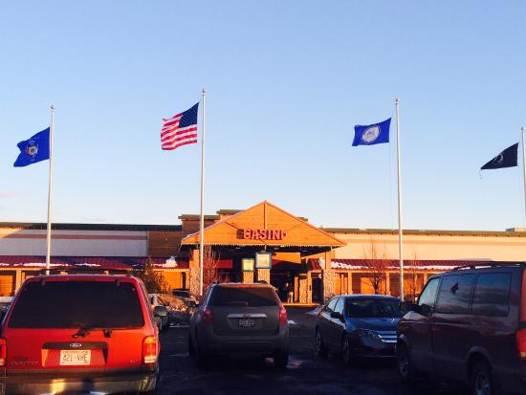
21st century hotels

