Slide 1
Introduction to Hospitality Industry
Chapter 2 the hotel business

Slide 2
After learning this chapter, you will be able to
Describe hotel ownership
Explain the diamond rating classification
Classify hotels by rating system type, location and price
Describe vacation ownership
Describe sustainable/green lodging
Identify hotel business trends

Slide 3
Hotel Historical Highlights
Colonial America | Early 20th Century | Late 20th Century | Early 21st Century
1634 Samuel Coles Inn | 1919 Conrad Hilton’s Mobley Hotel | 1980s-90s Market segmentation | Boutique hotels, sustainability Social media
1790 First use of “hotel” | 1929-45 Hotel occupancy drops | Voice mail, in-room Internet | Meta-search marketing
1824 First resort hotel | 1946 Golden Nugget & Flamingo
1829 First genuine hotel built | 1950s-60s Interstate Highway System
1880s-90s Resort boom in Florida | 1954 First Holiday Inn
1887 First luxury hotel | 1960s-70s International Hotels
1888 Del Coronado Hotel | 1970s Hotels hit by energy crisis

Slide 4
Hotel Ownership
Wyndam | Choice | Accor | Inter -continental | Marriott | Black-stone | Carlson Rezidor | Starwood
Days Inn | Comfort Inn | Sofitel | Crowne Plaza | Ritz-Carlton | Hilton | Radisson | Sheraton
Howard Johnsons | Quality Inn | Novotel | Holiday Inn | Marriott | Waldorf -Astoria | Country Inns | Four Points
Ramada | Clarion | Mercure | Staybridge Suites | Renais-sance | Double-Tree | Park Inn | St. Regis
Super 8 | Econo- Lodge | Ibis | Candlewood Suites | Courtyard | Embassy Suites | Park Plaza | Le Meridien
Travelodge | Sleep Inn | Adagio | Hotel Indigo | Fairfield | Hampton Inn |  | W Hotels
 |  |  | Inter -continental | Resi-dence |  |  | Westin Hotels
 |  |  | Evan | Bulgari
 |  |  | Hualuxe

Slide 5
Hotel Ownership: Revenues
Source: http://lodgingmagazine.com/wp-content/uploads/2017/08/June-Drilldown-US-Lodging-Industry-Revenues-and-Profit-copy.jpg

Slide 6
Hotel Ownership: Properties U.S.
Source:https://www.statista.com/statistics/197847/us-hotel-companies-by-number-of-properties-in-the-us/

Slide 7
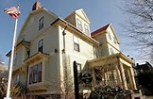
Samuel Cole Inn, Boston

Slide 8
Hotel Del Coronado San Diego, CA

Slide 9
Conrad Hilton’s Mobley Hotel, Cisco, TX

Slide 10
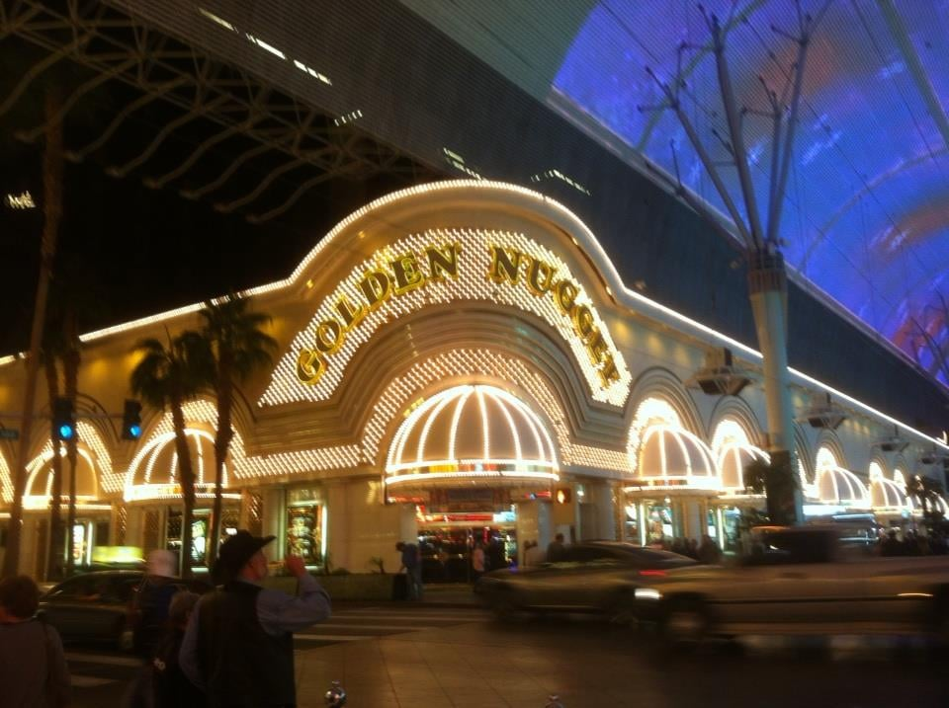
Flamingo and Golden Nugget, Las Vegas, NV

Slide 11
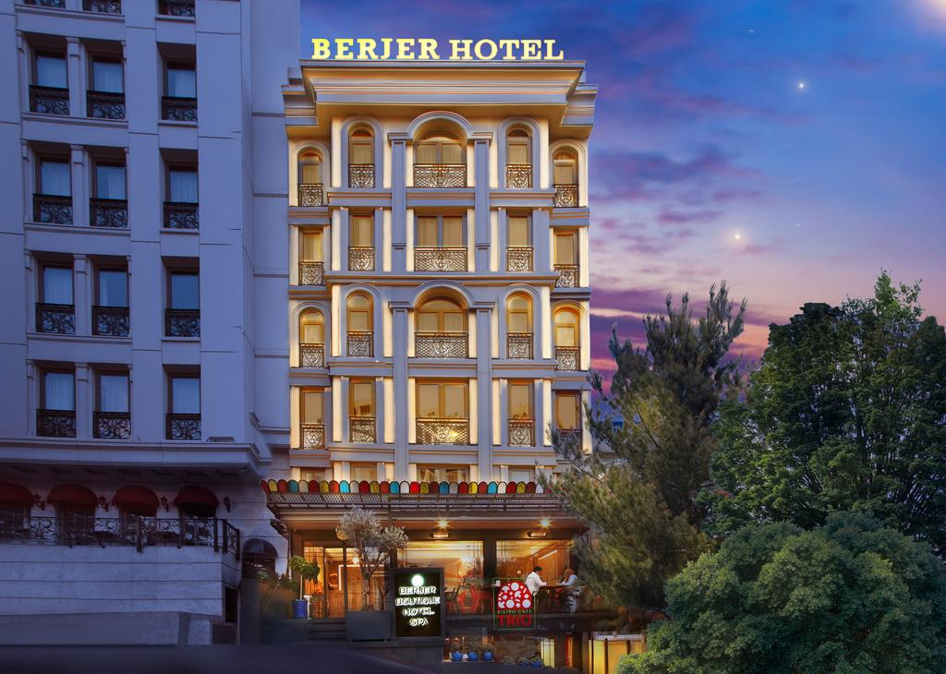
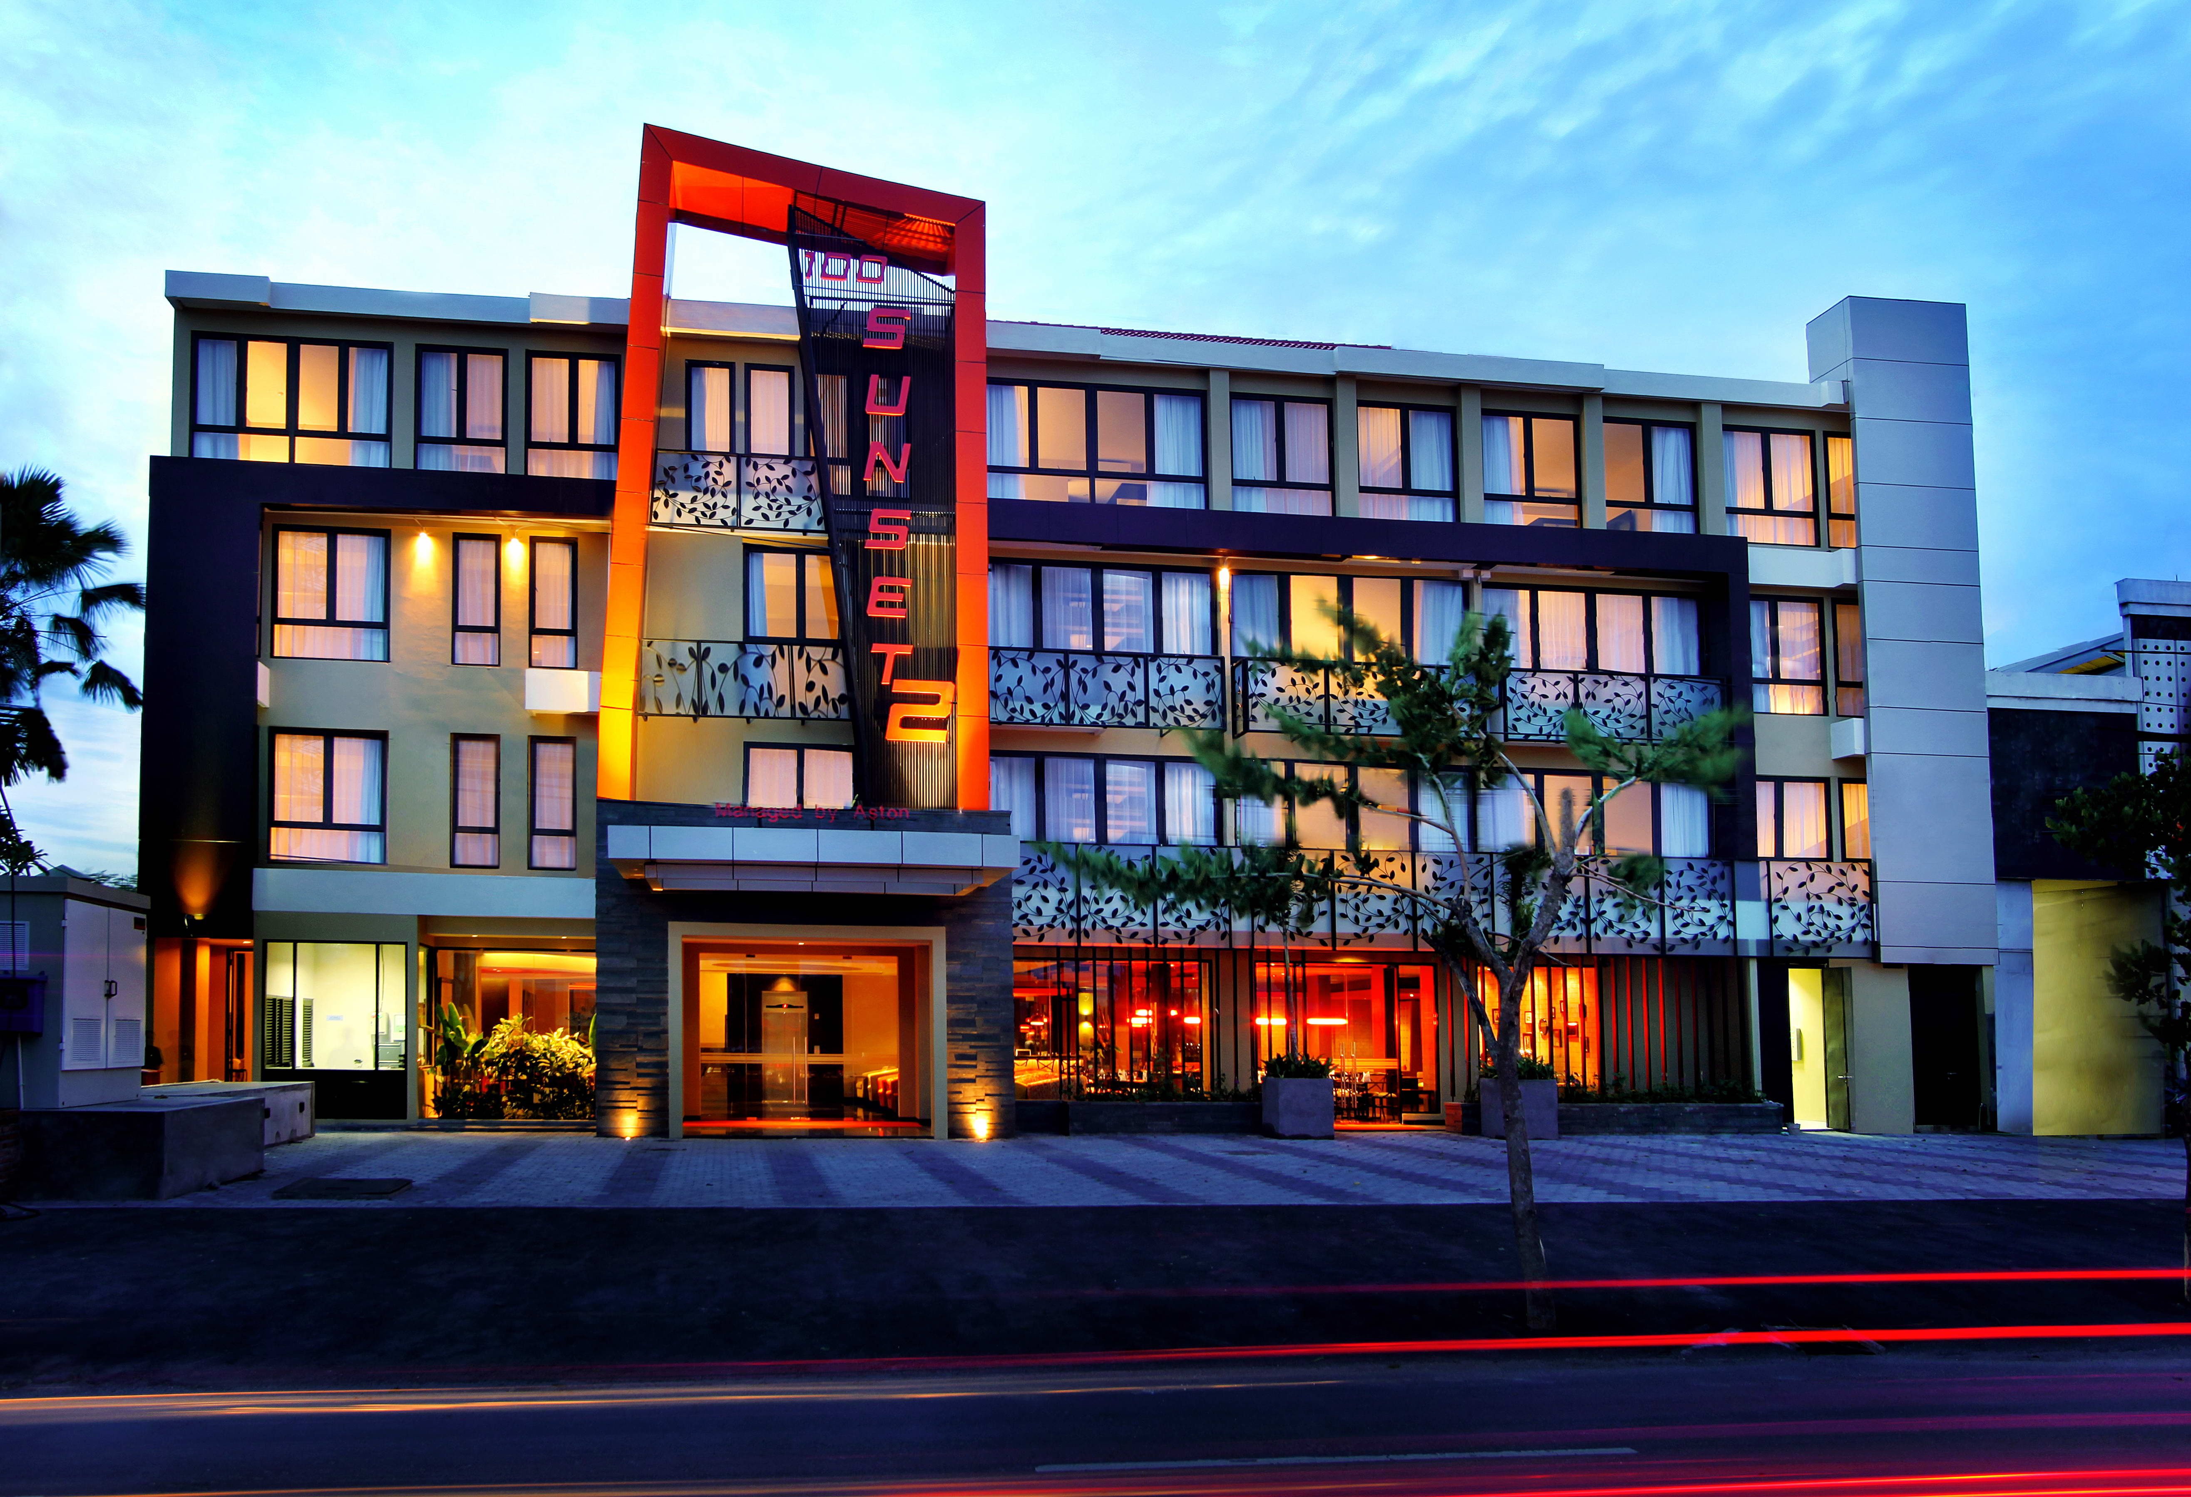
Boutique Hotels

Slide 12
FRANCHISE Two parties
Franchisor
Franchisee

Slide 13
FRANCHISE Definition
“…an agreement between the holder of a named brand or product (franchisor) and another entity (franchisee) giving the franchisee the rights to use and market the franchisor’s name.”

Slide 14
Example of a Franchise Agreement
The LCO Nation offers the “Seven Winds” brand to individuals to open businesses in entertainment, lodging and food & beverage service (much like the “Hard Rock Café” brand of the Seminole Tribe

Slide 15
Franchising Advantages
Least expensive way to gain access to central reservations and national advertising
Customer recognition
Brand loyalty

Slide 16
Franchising Disadvantages
Loss of autonomy
Need to meet brand and operational standards

Slide 17
Franchising Fees
Initial fee
Monthly franchise fee
Advertising fees
Training fees

Slide 18
Franchise Financing
Franchisee is responsible for obtaining the mortgage
Franchisor may acquire the land and construct the facility
Then, a joint venture is created that gives the franchisee 50% of the operation
Degree of franchisee investment varies

Slide 19
Other franchise considerations
How long should the franchise agreement last?
The longer the term, the better for the franchisee
Should be a termination clause
Financial settlement paid to the franchisor

Slide 20
Other franchise considerations
What kind of protection against competition?
Minimum distance between new franchise and any future franchise
Specification of a protected or exclusive territory
Or, in effect until certain level of operating performance has been achieved
Or, financial arrangements in the case of growth in area could sustain another franchise

Slide 21
Other franchise considerations
What kind of technical assistance?
Number of employees to be trained
Period over which training takes place
Purchasing services that define maximum markup or commission franchisor can receive
Replacement costs of new systems to reside with franchisor

Slide 22
Other franchise considerations
What kinds of fees?
Reservation system services
Advertising services
Franchise reporting systems
Timing, methods of inspections and audits
Transfer of franchise agreement
Termination procedures

Slide 23
Other franchise considerations Issues to resolve before signing…
Guest perception
Market segment
Reservation system bookings
Referral opportunities
Competition

Slide 24
Ask the 9 deadly questions
Product concepts franchised?
How many franchise terminations?
What kind of technology is available?
How many reservations will come my way?
Does the system cooperate with airlines?
How many no-shows?
What kind of training?
Any guest relations reports?
Do I qualify?

Slide 25
Referral Associations
Similar to franchise, but at lower cost
Hotels share CRS, common image, logo or advertising slogan
Referrals to group participants
Group-buing discounts
Management training
Initial fee to join referral organization

Slide 26
Management Contract
OWNER
OPERATOR

Slide 27
Management Contract Definition
“a management contract stipulates that the operator of the property, acting fully and completely as an agent of the owner and for the owner, assumes full responsibility for operating and managing the property.”

Slide 28
Example of Management Contract
Buffalo Brothers to finance, open, train and manage the St. Croix Casino and Hotel and the LCO Casino and Lodge

Slide 29
Buffaloed: casino cowboys take Indians for a ride by Bill Lueders
Bellecourt sees such discord as an ominous portent for the St. Croix and other tribes. "I believe that gaming is a major conspiracy against Indian people," he says. "I think it's a form of termination." Once tribal corruption reaches critical mass, he fears, "the Federal Government will step in and put us in receivership." National Indian Gaming Commission chair Hope offers a divergent, though equally dismal, prognosis. Gambling, he observes, is an inherently wasteful endeavor: "It's not a product, provides no product, does nothing. It's a net drain on any economy." In ten or twenty years, he predicts, the current gambling boom will reach a saturation point and communities will no longer stand for it. "Gambling died out in the 1840s and 1890s," he says. "It's going to die out again."
Reprinted from the Free Library by TABLEX

Slide 30
Advantages of Management Contracts
Low level of investment
Useful for chain expansion
No investment in operating deficits
Physical and operational quality remains with owner, not operator

Slide 31
Disadvantages of Management Contracts
Operator may not retain financial rewards when property is sold or refinanced
Owner retains little control over transfer of ownership when property is sold
Reliance on creditworthiness of owner
Cancellation provisions may adversely affect management personnel and public relations

Slide 32
Types of Management Contracts
Long Term (10-20 year contracts)
Category I
Day to day management and supervision
Pre-opening planning
Staff recruitment and training
High level of name recognition
Basic fees of 3-4% of total revenue
Category 2
Day-to-day management and supervision
Preopening planning (option)
Staff recruitment and training (option)
Basic fees of up to 5% of total revenue

Slide 33
Management Contract: Types of Services Contracted
Preopening Services
Recruitment, training, direction
Promotion/ publicity
Negotiations/procurement of leases, licenses, etc.
Any other services needed to open the property

Slide 34
Management Contract: Types of Services Contracted
Operational Services
Manner of operation and maintenance
Hiring, promotion, discharge, supervision
Establishment and supervision of accounting department
Complaint handling
Procurement and maintenance of contracts
Maintenance and repair of property
Service in collection of receivables
Advertising
Designation of reserve fund

Slide 35
Management Contract: Types of Services Contracted
Central Services
Accounting
Reservations
Engineering
Architectural design
Labor relations
Insurance
Purchasing

Slide 36
Hotel Management Companies
Company | Total Hotels | Hotels Managed
Marriott | 1686 | 870
Societe du Lourve | 601 | 550
Accor | 2666 | 368
Tharoldson Enterprises | 288 | 288
Bass Hotels | 2738 | 216
Sol Media | 246 | 196
Starwood Hotels/Resorts | 694 | 194
Hyatt Hotels/ Hyatt International | 186 | 183

Slide 37
Real Estate Investment Trust
Own property outright
At least 75% of assets in real estate
About 500 REITs in business; $70 Billion in market value
Do not pay corporate income tax
Required to distribute at least 95% of net income to shareholders

Slide 38
Hotel Development Feasibility Study
Determine degree of financial success
Project revenue based on occupancy, average daily rate and revenue per available room
Determine the type of hotel that would best suit the market need
Examine market
area’s demand
and supply

Slide 39
Hotel Development Hotel Operating Statement

Slide 40
Hotel Development Revenues & Cost and Expenses

Slide 41
Hotel Development Costs and Expenses

Slide 42
Hotel Development Costs and Expenses

Slide 43
Hotel Development Economic Impact of Hotels – Multiplier Effect
Guest pays hotel
Hotel pays salaries
Employees buy housing, food
Hotel buys services
Utilities pay wages and buy goods and services
Hotel buys
food and
supplies
Vendors pay
salaries and
buy goods
and services

Slide 44
Classification of Hotels and Lodging Properties Lodging Industry Classification
Smith Travel Research
Forbes Travel Guide *****
American Automobile Association ♦♦♦♦♦

Slide 45
Classification of Hotels and Lodging Properties Hotel Affiliations
Chain
Parent Company
Operation
Corporation, franchise or independent
Management Company
Owner
Asset Management Company/membership or marketing group

Slide 46
Classification of Hotels and Lodging Properties Hotel Affiliations
Operation
Corporation
Owned or managed by the chain or parent company
Franchise
A chain hotel owned by a 3rd party where the chain receives a franchise fee
Independent
Not affiliated with a chain or parent company
Management Company
Operates the hotel on behalf of another party

Slide 47
Classification of Hotels and Lodging Properties How to Earn a Five-Diamond Award
♦ Simple, roadside appeal and the basic lodging needs
♦ ♦ Average roadside appeal, some landscaping noticeable enhancement in interior décor
♦ ♦ ♦ higher service and comfort
♦ ♦ ♦ ♦ excellent roadside appeal/ service levels that give guests what they need before they ask for it
♦ ♦ ♦ ♦ ♦ highest service levels, sophistication and offerings

Slide 48
Classification of Hotels and Lodging Properties Type of hotel
 | ♦ | ♦♦ | ♦♦♦ | ♦♦♦♦ | ♦♦♦♦♦
Type of hotel
Location of hotel
Price of hotel

Slide 49
Classification of Hotels and Lodging Properties Type of hotel
City center and suburban
Resort
Airport
Freeway
Casino
Rural and Small Town
Price

Slide 50
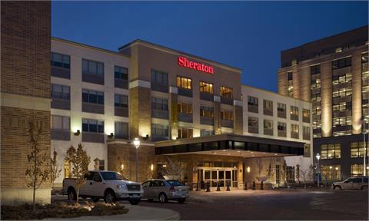
Classification of Hotels and Lodging Properties City center and suburban
Marriott City Center, Minneapolis
Sheraton, suburban Minneapolis

Slide 51
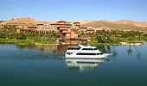
Classification of Hotels and Lodging Properties Resort hotels
Lakewoods Resort Cable, Wisconsin
Lake Las Vegas Resort

Slide 52
Classification of Hotels and Lodging Properties Airport hotels
Intercontinental Hotel, MSP International Airport

Slide 53
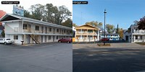
Classification of Hotels and Lodging Properties Freeway & Interstate Hotels and Motels
Holiday Inn Express, Madison WI
Motels, Wisconsin Dells, WI

Slide 54
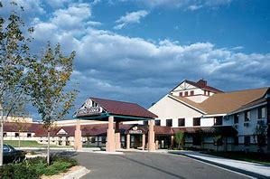
Classification of Hotels and Lodging Properties Casino Hotels
Sevenwinds Casino Lodge and Resort,
Hayward, Wi
Legendary Waters Resort & Casino
Bayfield, WI

Slide 55
Classification of Hotels and Lodging Properties Conference and Convention Hotels
Wintergreen Convention Center, Wisconsin Dells, WI

Slide 56
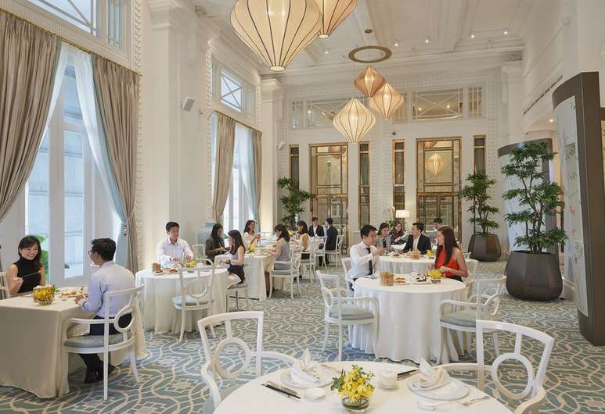
Classification of Hotels and Lodging Properties Full Service Hotels
Fullerton Hotel, Singapore

Slide 57
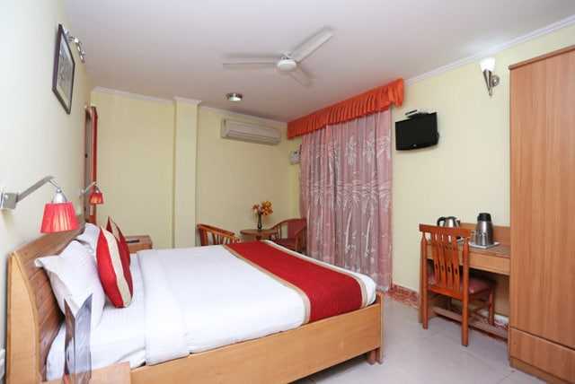
Classification of Hotels and Lodging Properties Economy Budget Hotels
Sun Hotel, Hardiware, India

Slide 58
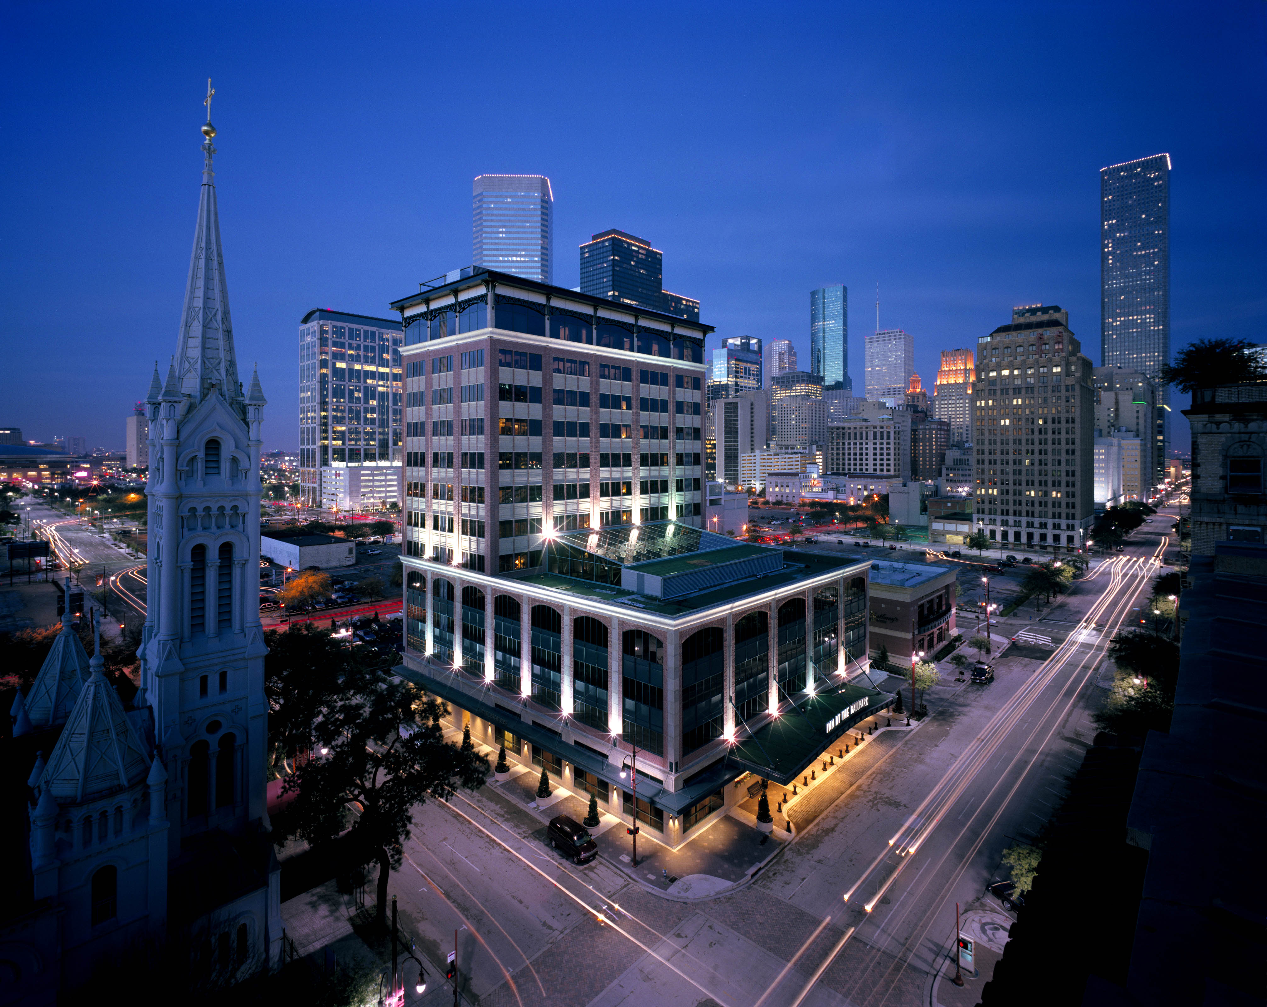
Classification of Hotels and Lodging Properties Boutique Hotels

Slide 59
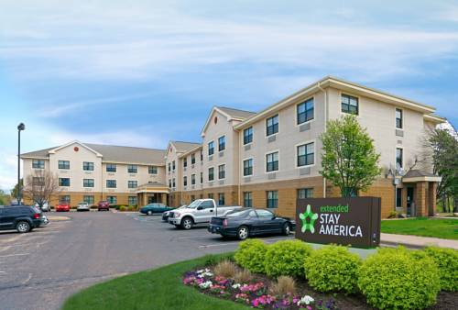
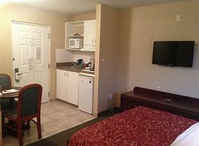
Classification of Hotels and Lodging Properties Extended-Stay Hotels and All-Suites Extended-stay Hotels

Slide 60
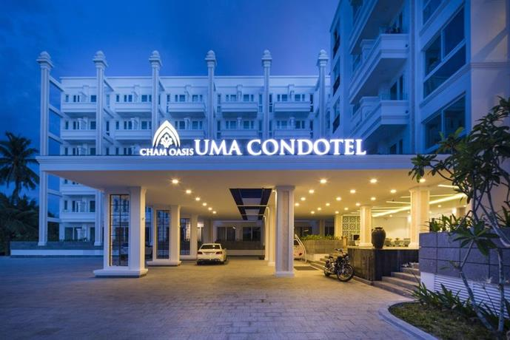
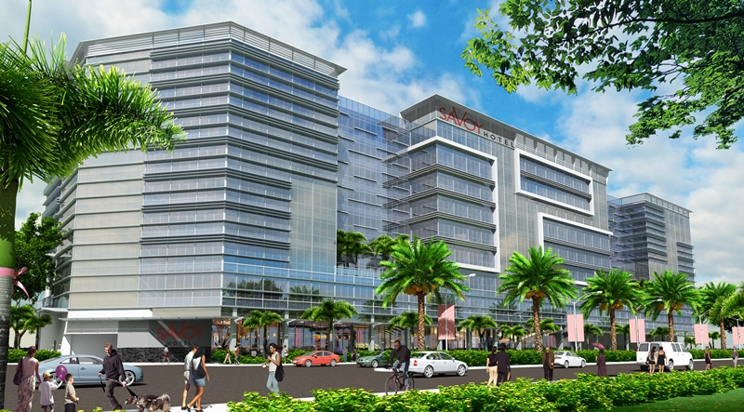
Classification of Hotels and Lodging Properties Condotels, Timeshare and Mixed-Use Hotels

Slide 61
Classification of Hotels and Lodging Properties Bed and Breakfast Inns
Stewart Inn, Wausau, WI

Slide 62
Classification of Hotels and Lodging Properties Timeshare, Vacation Ownership and Fractional Ownership
Time Share or Vacation Ownership
“…the right to use a vacation destination during a specific time period.”
“…the pre-purchase of a vacation experience”
“…it does not generally make a good investment”

Slide 63
Classification of Hotels and Lodging Properties Timeshare, Vacation Ownership and Fractional Ownership
Types of Vacation Ownership
Deed
Outright ownership
Lease
Similar to apartment lease
License
Similar to club membership

Slide 64
Classification of Hotels and Lodging Properties Timeshare, Vacation Ownership and Fractional Ownership
Time share or vacation ownership time slots
Fixed
A specific week during the year
Floating
A chosen week within a certain season
Vacation exchange
Allows vacation owner to “swap” with another timeshare at another resort

Slide 65
Classification of Hotels and Lodging Properties Timeshare, Vacation Ownership and Fractional Ownership
Today
“Vacation ownership is …the fastest growing segment of the travel and tourism industry...
over $4 billion in sales volume”

Slide 66
Classification of Hotels and Lodging Properties Timeshare, Vacation Ownership and Fractional Ownership
Target Markets
Upper middle income
Well-educated couple
Average age of 49
High income households
Singles
Older couples
Higher educational attainment

Slide 67
Sustainable or Green Lodging
WATER REDUCTION/RECYCLING PROGRAMS | ENERGY REDUCTION STRATEGIES
Organize a waste reduction team | Use lighting when necessary, employ motion detectors
Conduct a waste assessment | Use energy efficient fixtures and lamps
Establish waste reduction goals | Use low wattage lighting for signs and decor
Secure recycling markets | Avoid over lighting wherever possible
Set up collection and storage system
Buy recycled products

Slide 68
Trends in Hotel Development and Management
Capacity Control | Diversification
Safety and Security | Rapid growth in vacation ownership
Assets and Capital | Increase in spas/treatments offered
Technology | Gaming
New Management | Mixed use properties
Globalization | Sustainable lodging development
Consolidation | Culinary selectiveness

