Slide 1
Introduction to Hospitality Industry
Chapter 3 rooms division

Slide 2
After learning this chapter, you will be able to
Outline key duties and responsibilities of key executives and department heads
Draw an organizational chart of the rooms division
Describe the main functions of the rooms division departments
Describe property management systems and yield management
Calculate: occupancy percentages, average daily rates and actual percentage of potential room revenue
Describe reservation and guest services functions
List complexities of concierge, housekeeping and security/loss prevention departments

Slide 3
Functions and Departments of a Hotel
General Manager
Department Heads
Revenue Centers
Cost Centers
Division
Managers

Slide 4
General Manager
Leadership
Attention to Detail
Follow –through (getting the job done)
People skills
Patience
Ability to delegate effectively

Slide 5
Executive Committee
Guest satisfaction | Renovations
Employee satisfaction | Ownership relations
Total quality management | Energy conservation
Occupancy forecasts | Recycling
Sales and marketing plans | New legislation
Training | Profitability
Major items of expenditure

Slide 6
Executive Committee
General Manager
Director Human Resources
Director
Food &
Beverage
Director
Rooms Division
Director
Marketing &
Sales
Director
Engineering
Director
Accounting

Slide 7
The Departments
Typical NW Wisconsin Casino Hotel
Resident
Manager
Front
Office
Housekeeping
Rooms
Laundry
Assistant
Manager
Security
Engineering
Night
Audit
Reservations
Guards
Technicians

Slide 8
The Departments
Rooms Division
Responsibilities include…
  Financial responsibility
  Employee satisfaction goals
  Guest satisfaction goals
  Guest services
  Guest relations
  Security
  Gift shop

Slide 9
The Departments
Rooms Division: Reservations
Reservations: “The Guest Cycle”
Reservations
Guest
Incurs
Charges
Room Guest/Post Charges
Verification Night Audit
More Guest Charges/ Checkout Confirmation
Arrival
Registration

Slide 10
The Departments
Rooms Division: Front Office Functions
Sell Rooms
Maintain Balanced Guest Accounts
Offer Services (mail, messages, information)

Slide 11
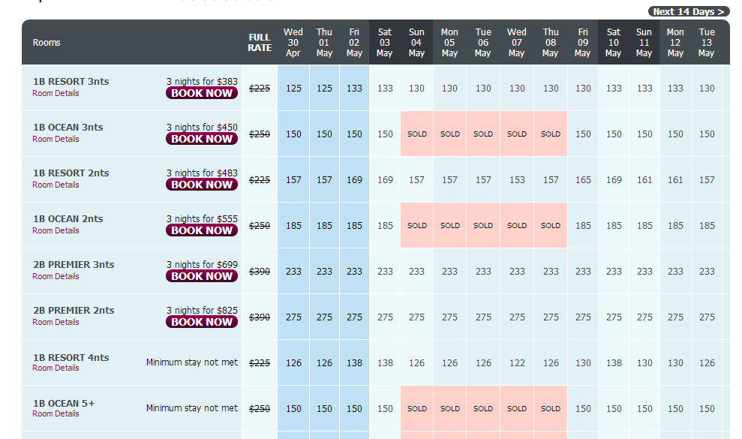
The Departments
Rooms Division: Room Rates

Slide 12
The Departments
Rooms Division: Front Office
Duties
Check night clerk report | Review arrivals/departures | Review next day arrivals
Review night’s occupancy | Attend to guest inquiries | Do staff adjustments
Review night’s average rate | Review VIP/prepare | Log important items
Review market mix | Organize room changes | Check key issue/control
Handle check-outs/ins | Arrange pre-registration | Review week schedule
Check comp rooms | Attend meetings | Meet with GSA*s
Verify group rooms | Advise housekeeping | *guest service agents

Slide 13
The Departments
Rooms Division: Night Auditor
Duties
Run preliminary reconciliation report | Post charges evening shift not able to post
Investigate all errors | Post discrepancies to shift mgrs., post room + tax charges to each folio
Post and balance all changes | Run backup reports
Match preliminary and actual charges | Reconcile point-of-sale and PMS* to guest accounts
Verify credit card, rooms operations, F&B and incidental charges | Complete/distribute daily report
“roll the date” | Determine areas where theft could occur
* Property Management System

Slide 14
The Departments
Rooms Division: Night Auditor
Daily report: Room Occupancy Percentage (ROP)
Rooms Occupied
Rooms Available
622 = .73 or 73%
850

Slide 15
The Departments
Rooms Division: Night Auditor
Daily report: Average Daily Rate (ADR)
Rooms Revenue
Rooms Sold
$75,884 = $114.63
622

Slide 16
Revenue Management
A Tool: Yield Management
A combination of ways to
  Do things
  Think about things
  Devise plans to…
keep rooms full
get as much as possible for the rooms
“…a set of maximization strategies and techniques to improve profitability of a lodging establishment.”

Slide 17

Revenue Management
A Tool: Yield Management
Started in 1970s with airline deregulation
A way for airlines to control and manage profitability

Slide 18
Revenue Management
A Tool: Yield Management
EXTERNAL HOTEL ENVIRONMENT INTERNAL HOTEL ENVIRONMENT
Wars in Afghanistan and Iraq | Fixed capacity environment
Weekly terroristic threats | Time-varied demand
Gas prices | Product has similarity
Sluggish economy | High proportion of fixed to variable cost items
Weather
Crime

Slide 19
Revenue Management
A Tool: Yield Management
Get the Guest to Pay as much as possible for a room
  Sell as many higher room rates as possible
  Inelastic demand
  Elastic demand

Slide 20
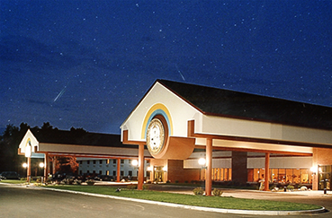
Revenue Management
A Tool: Yield Management
Inelastic Demand
Elastic Demand

Slide 21
Revenue Management
A Tool: Yield Management
Inelastic demand | Elastic demand
Every day, someone will come into your hotel, simply because it’s there | Guests can be induced to purchase a room from you if the price or circumstances are right.
These people will pay any price, within reason, because they NEED a room! | You want to encourage this, because the alternative is EMPTY rooms.
No reason to discount | Active discounting

Slide 22
Revenue Management
A Tool: Yield Management
Yield management mathematics
CALCULATE ADR*
Rooms revenue ÷ # of rooms sold = ADR
CALCULATE REVPAR**
ADR x occupancy % = REVPAR
* Average Daily Rate
**Revenue per available room

Slide 23
Revenue Management
A Tool: Yield Management
Yield management mathematics
CALCULATE ADR*
Rooms revenue ÷ # of rooms sold = ADR
$4450 ÷ 100 = 44.5
CALCULATE REVPAR**
ADR x occupancy % = REVPAR
44.5 x 90% = 40.05
* Average Daily Rate
**Revenue per available room

Slide 24
Determine REVPAR
Rooms Revenue | # of Rooms Sold | ADR | Occupancy % | REVPAR
$5250 | 150 | 23.3 | 100%
$4000 | 140 | 28.6 | 93%
$4500 | 130 | 34.6 | 86%
$5000 | 120 | 41.7 | 80%
$5500 | 110 | 5o.0 | 73%

Slide 25
Determine REVPAR
Rooms Revenue | # of Rooms Sold | ADR | Occupancy % | REVPAR
$5250 | 150 | 23.3 | 100% | 23.3
$4000 | 140 | 28.6 | 93% | 26.6
$4500 | 130 | 34.6 | 86% | 29.8
$5000 | 120 | 41.7 | 80% | 33.3
$5500 | 110 | 5o.0 | 73% | 36.5

Slide 26
Determine REVPAR
Rooms Revenue | # of Rooms Sold | ADR | Occupancy % | REVPAR
$5250 | 150 | 35 | 100%
$5600 | 140 | 40 | 93%
$5850 | 130 | 45 | 86%
$6000 | 120 | 50 | 80%
$6050 | 110 | 55 | 73%

Slide 27
Determine REVPAR
Rooms Revenue | # of Rooms Sold | ADR | Occupancy % | REVPAR
$5250 | 150 | 35 | 100% | 35
$5600 | 140 | 40 | 93% | 37.2
$5850 | 130 | 45 | 86% | 38.7
$6000 | 120 | 50 | 80% | 40
$6050 | 110 | 55 | 73% | 40.15

Slide 28
Revenue Management
A Tool: Energy Management Systems
Room occupancy status reporting
Automatic lighting control
Minibar access reporting
Smoke detector alarm reporting
Central electronic lock control
Guest control amenities

Slide 29
Revenue Management
A Tool: Call Accounting Systems
Track guest room phone charges
Monitor phone usage on property
Offer different rates for local and long distance guest calls

Slide 30
Revenue Management
A Tool: Guest Reservation Systems
Global Distribution Systems (GDS) are electronic markets for travel, hotel, car rental and attraction bookings
Central Reservation Systems (CRS) offer best available rates to guests; hotels benefit by avoiding overselling rooms and help hotels manage yield management efforts
Application Service Providers (ASP) facilitate reservations over the Web

Slide 31
Revenue Management
A Tool: Guest Billing
High speed and reliable computer systems provide hotels with fast access to guest accounts for billing
Software is available to permit guest checking of his/her bill by television and remote control, including capability to mail the final bill to the guest’s home

Slide 32
Revenue Management
A Tool: Security
Hospitality information technology systems include surveillance systems, door locking systems, smart cards
In-room safes and biometric technology (thumbprints and retinal scans) are now available to increase security in hotels
from safesigh speed and reliable computer systems provide hotels with fast access to guest accounts for billing
Software is available to permit guest checking of his/her bill by television and remote control, including capability to mail the final bill to the guest’s home

Slide 33
Revenue Management
A Tool: Guest Comfort and Convenience
In-room services and amenities like dining, television, telephones, Internet connectivity, minibars, hygiene products
In-room e-mail, movies, music, games, hotel and concierge services,

Slide 34
Sustainable Lodging
A Model for Implementation of Sustainable Lodging Practices
Physical Building
Develop Green Goals & Plan
Formulate Green Building Operation Strategies
Review Certifications
Decide on Best Certification
Implement Strategies/
Assess
Conduct Green Audit & Create Goals
Develop Action Plan
Strategies
Operations

Slide 35
Sustainable Lodging
Practices/Initiatives
Reduce energy needs
Conserve water
Reduce waste
Reduce hazardous waste

Slide 36
Sustainable Lodging
Practices/Initiatives
Guest Shuttle
Guest Bicycles
Greening the Guest Room

Slide 37
Security/Loss Prevention
Comprehensive Security Plan
Security Officers
Equipment
Safety Procedures
Identification Procedures

Slide 38
Trends in Hotel & Rooms Division Operations
Diversity of work force
Increase use of technology
Continued quest for increases in productivity
Increasing use of revenue management
Greening of hotels and guest rooms
Security
Diversity of guests
Compliance with the ADA
Use of hotel web sites
In-room technology updates
Television service upgrades

