Slide 1
Introduction to Hospitality Industry
Chapter 5 beverages

Slide 2
After learning this chapter, you will be able to
List and describe the main grape varieties
Suggest appropriate pairings of wine with food
Identify the various types of beer
List the types of spirits and their main ingredients
Explain a restaurant’s liability in terms of serving alcoholic beverages

Slide 3
Introduction to Hospitality Beverages
Alcoholic
Non-alcoholic
Wine
Beer
Spirits
Non-alcoholic Beer
Coffee/Tea
Carbonated Soft/Energy
Drinks
Juices
Bottled
Water

Slide 4
Introduction to Hospitality Beverages
Why shouldn’t you mix grain-based drinks
with grape-based drinks?
According to Kevin Strang, PhD,
if you start drinking something with
a lower alcohol content, your body
gets used to getting drunk at a certain rate.
When you switch to something with a higher
alcohol content, your body still thinks
it’s getting drunk at the rate of the first drink,
so you drink faster… and subsequently,
you get sicker.
Wine
Beer
Spirits

Slide 5
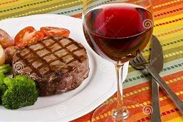
Introduction to Hospitality Wine Grapes
Chardonnay
Sauvignon blanc
Riesling
Pinot blanc
Gewürztraminer
Cabernet sauvignon
Merlot
Pinot noir
Shiraz

Slide 6
Introduction to Hospitality Wines
“Wine is the fermented juice of freshly gathered ripe grapes or other sugar-containing fruits.”
Light | Still | Fortified | Aromatic | Sparkling
White Red Rose | Free of carbon dioxide | Brandy or wine alcohol added | Fortified and flavored with herbs, roots, flowers and barks | Champagne (carbon dioxide added)

Slide 7
Introduction to Hospitality Naming of Wines
In the U.S. wines are typically named after the grape.
Chardonnay
Cabernet sauvignon
Merlot
In Europe, wines are typically named after the region.
Pouille Fuisse
Chablis

Slide 8
Introduction to Hospitality History of wines/spirits
Egyptians
Greeks
Romans
Europeans
Aztec, Mayan, Inca
“chica”
Chinese
7000 B.C. 200 B.C. – 100 A.D. 1200 A.D.

Slide 9
Introduction to Hospitality Matching wine with food
White | Best served with white meat, shellfish or fish
Red | Best served with red meat
Heavy Food | Heavy, robust wine
Champagne | Served anytime
Port/Red wine | Serve with cheese
Dessert wine | Best complement not highly acidic desserts/fresh fruits
Cooked with wine | Serve with same wine
Regional wine | Serve with regional food
Salads with vinegar | Do not serve wine
Sweet wines | Serve with foods that are less sweet

Slide 10
Introduction to Hospitality Major wine growing regions
Germany
France
United
States
Spain,
Portugal
Italy
Australia

Slide 11
Introduction to Hospitality How to read a wine label
Producer
Vintage
Grape Varietal
Vineyard Name
Growing Area

Slide 12
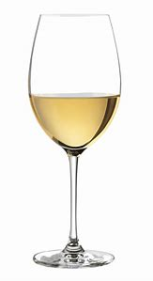
Introduction to Hospitality Wine and health
French drink 76 liters (nearly 20 gallons) of wine/year
Suffer 1/3 less heart attacks than Americans
Wine attacks blood platelets, which causes blood to clot
Platelets also cling to artery walls
Wine has a “flushing” affect

Slide 13
Introduction to Hospitality Beer
“Beer is a brewed and fermented beverage made from malted barley and other starchy cereals and flavored with hops.”
Type of Beer | Description
Lager | Normally referred to as beer: clear, light-bodied, refreshing
Ale | Fuller bodied, more bitter than lager
Stout | Dark ale with sweet, strong malt flavor
Pilsner | Not really a beer, made in the style of the famous beer brewed in Pilsen, Czech Republic

Slide 14
Introduction to Hospitality Beer: the brewing process

Slide 15
Introduction to Hospitality Sustainable Brewing
Efficient brewhouse
Sustainable brew process
Reduce/reuse/recycle
Community-wide practices

Slide 16
Introduction to Hospitality Sustainable Brewing: Bluemap Principles
Utilize biochar processing to reuse spent grains
Implement water use reduction measures
Implement various speed fans/motors
Ensure regular maintenance schedule
Capture methane at on-site water treatment facilities
Recapture carbon dioxide during fermentation
Optimize thermal resources within the brewing process
Implement alternatives to diatomaceous earth filtering
Optimize refrigeration, lighting, construction and other building controls
Utilize renewable technologies

Slide 17
Introduction to Hospitality Spirits
“ Spirit or liquor is made from a liquid that has been fermented and distilled.”
Spirit | Type | Description
Whiskey | Scotch | Made to exacting standards of Scotch Whiskey Act
 | Irish Whiskey | Malted or unmalted barley, corn, rye
 | Bourbon | Malted with corn and rye
 | Canadian | Produced mainly from corn
White spirits | Gin | Made from juniper berries
 | Rum | Fermented sugar cane or molasses
 | Vodka | Made from barley, corn, wheat, rye or potatoes
 | Tequila | Distilled from tequilana, a type of cactus
Other | Brandy | Distilled from wine
 | Cognac | Made only in the Cognac region of France

Slide 18
Introduction to Hospitality Spirits : Cocktails
Factors in a “good” cocktail
The balance of ingredients
The quality of ingredients
The skill of the bartender

Slide 19
Introduction to Hospitality Non-alcoholic Beverages
Nonalcoholic Beverage | Description
Nonalcoholic beer | Lower caloric content/ 65-99% alcohol removed
Coffee | Roasted from coffee beans
Tea | Steeping leaves of the tea plant in boiling water
Carbonated Soft Drinks | FDA limits caffeine to 71 mg for 12 ounces
Energy Drinks | Designed to give consumer a burst of energy
Juices | Made from fruit, healthy and refreshing
Bottled Water | Available as sparkling, mineral or spring waters

Slide 20
Introduction to Hospitality Bars and Beverage Operations
Forecast
Determine
Order
Select
supplier
Place
Order
Receive
Order
Store
Serve
Issue
Account
Control

Slide 21
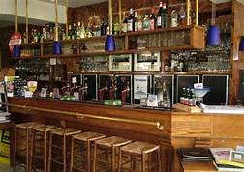
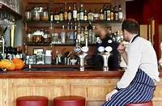
Introduction to Hospitality Bar Setup

Slide 22
Introduction to Hospitality Bar Setup
Effective Bar Management
Solid working knowledge of making drinks
Staffing enough bartenders and/or “bar back”
Always be aware of your environment

Slide 23
Introduction to Hospitality Inventory Control
Effective inventory controls
Treat inventory as cash
Giving away drinks
Overpouring
Mischarging
Selling call liquor at a well price
Outright stealing
Establish results: one bottle gin = 25 one ounce measures
Actual physical count of inventory: once week/month
Design forms to account for types of liquor
25/50/75/100%

Slide 24
Introduction to Hospitality Inventory Control
Effective inventory controls
Treat inventory as cash
Giving away drinks
Overpouring
Mischarging
Selling call liquor at a well price
Outright stealing
Establish results: one bottle gin = 25 one ounce measures
Actual physical count of inventory: once week/month
Design forms to account for types of liquor
25/50/75/100%
Beverage management technology
Personnel procedures

Slide 25
Introduction to Hospitality Restaurants and Hotel Bars
Beverages generally account for 25-30% of sales
Well packages vs. Call packages
Profit margins
Grey Goose (premium) @ $41.25 liter
25 13/4 oz.@ $7.25
$7.25 x 25 = $185.25
185.25 – 41.25 = $144.00
Liquor Pouring Cost % 12
Beer 25
Wine 38

Slide 26
Introduction to Hospitality Nightclubs
Risky business
Know the market
Develop a new and exciting concept
Budget
Know legal issues
www.nightclubbiz.com
<a href="https://www.freepik.com/free-photos-vectors/happy-new-year">Happy new year image created by Freepik</a>

Slide 27
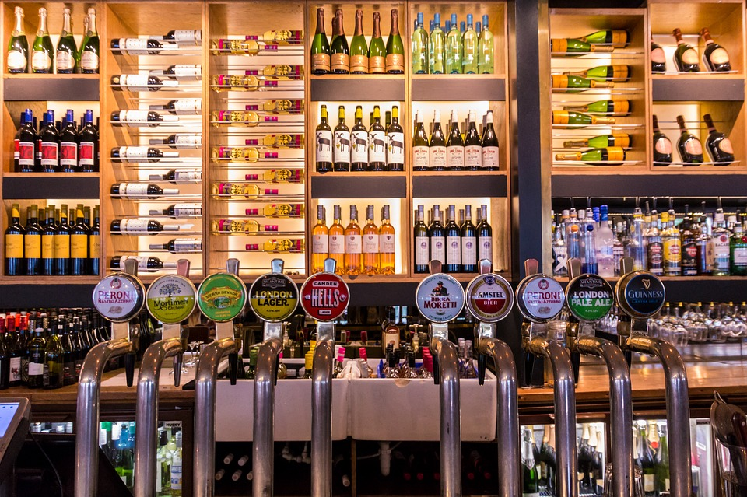
Introduction to Hospitality Brewpubs and Microbreweries
Brewpubs: combination brewery and pub/restaurant that brews its own fresh beer on site
Microbreweries: craft breweries that produce up to 15,000 barrels of beer/year
Success comes from wide variety of styles/flavors
Expensive to start: $200-800K

Slide 28
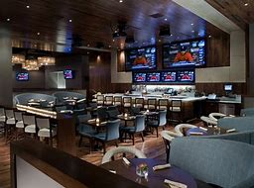
Introduction to Hospitality Sports Bars
Replacing discos and singles bars
Satellite TV coverage of top sporting events
More of an entertainment concept geared toward a more diverse patron base
Some feature music, interactive games
Evolution to arcades
Menus becoming more diverse
Increase in tv programming and technology expand product offering

Slide 29
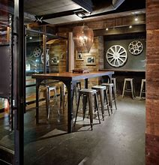
Introduction to Hospitality Coffee Shops
Based on Italian bars
Create a place for conversation of a personal, social or business nature
Product expanded to include wider variety of beverages and coffees, pastries
Wireless cafes natural outgrowth to include use of computers

Slide 30
Introduction to Hospitality Liquor Liability
Dram shop legislation
Awareness programs
Mandatory training
Designated drivers and chauffeured services
Reduction in insurance premiums and legal fees

Slide 31
Introduction to Hospitality Trends in the Beverage Industry
Seasonal lattes
Cocktails
Ice alternatives
Less mixer is more
Infusing spirits with fresh flavor
Cocktails synched with food concepts
Different and unique scotches, herbaceous liquors and bitters
microbreweries and local craft beer
Fresh-pressed juices, enhanced ice teas and craft sodas
Freestyle beverages

