Slide 1
Chapter 8
Payroll accounting: Employee earnings and deductions

Slide 2
Learning Objective 1
Distinguish between employees and independent contractors

Slide 3
Employees and Independent Contractors
Employee
An employee works under the control and direction of an employer.
Examples include secretaries, maintenance workers, salesclerks, and plant supervisors

Slide 4
Contractor
In contrast an independent contractor performs a service for a fee and does not work under the control and direction of the company paying for the service.
Examples of independent contractors include public accountants, real estate agents, and lawyers.

Slide 5
The difference between an employee and independent contractor are important for payroll purposes.
Government laws and regulations are more complex for employees than for contractors.
Employers must deduct certain taxes, maintain payroll records, and file numerous reports for all employees.
For independent contractors, only one form needs to be filled out (Form 1099)
The payroll accounting procedures described in this chapter only apply to employees/employer relationships.

Slide 6
Learning Objective 2
Calculate Employee earnings and deductions

Slide 7
3 Steps are required to determine how much to pay an employee for a pay period.
Calculate total earnings
Determine the amount of deductions
Subtract deductions from total earnings to compute net pay

Slide 8
Salaries and Wages
Compensation for managerial and administrative services usually is called salary.
Salary is normally expressed in biweekly, monthly, or annual terms.
Compensation for skilled or unskilled labor usually is referred to as wages.
Wages are expressed in terms of hours, weeks, or units produced
The Fair Labor Standards Act (FSLA) requires employers to pay overtime at 11/2 times the regular rate to an hourly employee that works over 40 hours a week.
Some salaried employees are exempt from the FSLA rules and are not paid the overtimes rate.

Slide 9
Computing Total Earnings
Compensation is based on the time worked during the payroll period or based on sales or units of output during that period.
When compensation is based on time worked, a record must be kept such as; time cards, time keeping systems with badges or cards.
Terminals with badge readers are able to clock in and out the employee and retain the record of the hours worked.
There are also fingerprint readers that also have the ability to record time, and add additional security.

Slide 10
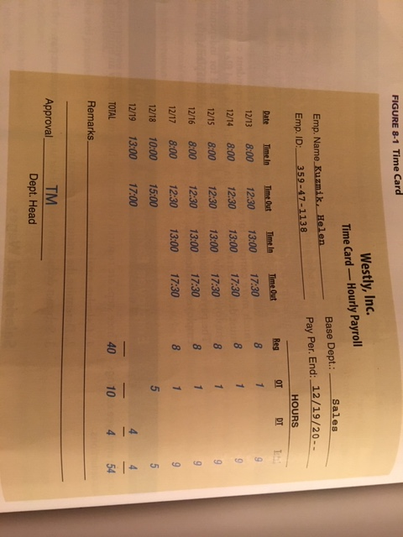
Badge Readers
Time Card

Slide 11
Illustration for total earnings for Wages:
Regular hours 40 hours
Overtime 10
Double time (Sunday only) 4
54 hours
Regular rate of pay is $14/hrly
11/2 for hours that exceed 40
2X’s the rate for hours worked on Sunday
40 hours x $14 $560
10 hours x $21 (11/2x$14=21 210
4 hours (on Sunday)x$28 (2x$14=28) 112
$882

Slide 12
Salaried Employees who are not exempt from FSLA rules may be entitled to premium pay for OT.
For these types of employees it is necessary to compute the regular hourly rate of pay before computing the OT rate.
There are 52 weeks in the year, but not always 4 weeks in each month. That is why monthly salaries must be annualized in order to determine the hourly rate.

Slide 13
To illustrate, assume the employee has a salary of $2,600 a month, plus 1 ½ X’s the regular hourly rate for hours worked over 40 for the week.
Compute as follows:
$2,600 x 12 months $31,200 annual pay
$31,200 divided by 52wks $600 pay per week
$600 divided by 40 hours $15.00 per regular hours
$15.00 x 1 ½ $22.50 OT pay per hour
If this salaried employee worked 50 hours during the week, the total earnings would be computed as follows;
40 hours x $15.00 $600.00
10 hours x $22.50 225.00
Total earnings for the week $825.00

Slide 14
Deductions from Total Earnings
Employees total earnings is gross pay
After deductions from gross pay, yield take-home or net pay.
3 Major categories for deductions
Federal (and possibly state and city) income tax withholdings
Employee FICA tax withholding
Voluntary deductions

Slide 15
Income Tax Withholding
These withholdings are applied toward the payment of the employee’s federal income tax.
The following four factors determine the amount of deduction to the gross pay of an employee.
Total earnings
Marital status
Number of withholding allowances
Length of the pay period

Slide 16
Withholding Allowances- are reported on an employee’s withholding allowance certificate, form W-4.
The marital status and number of allowances claimed on a W-4 determine the amount of dollars that are subject to withholding.
In general, each employee is permitted 1 personal withholding allowance, one for a spouse, and one for each dependent.
Wage-bracket method/percentage method-Employers use this method to determine the amount of tax to be withheld.
Wage bracket tables are provided by the IRS
These tables cover various time periods, and there are separate tables for single and married taxpayers

Slide 17
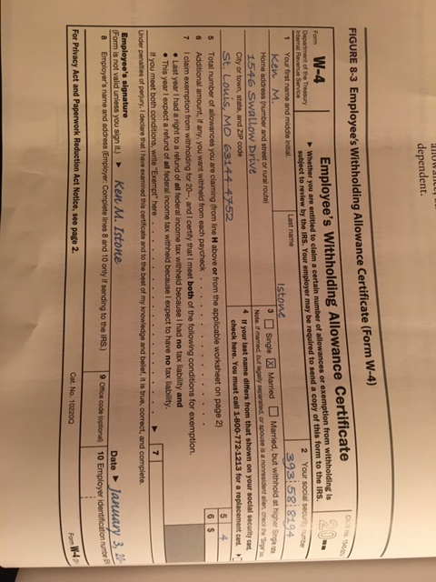
Employees Withholding Allowance Certificate

Slide 18
For state or city income taxes, withholding generally is handled in one of two ways:
Forms and tables similar to those provided by the IRS are used or
An amount equal to a percentage of the federal withholding amount withheld.

Slide 19
Employee FICA Tax Withholding
The Federal Insurance Contributions Act
FICA taxes include amounts for Social Security & Medicare Programs
Social Security provides pensions & disability benefits.
Medicare provides health insurance
Tax rates and amounts of earnings change frequently that are subject to FICA tax
Currently Social Security rate is 6.2% on a maximum of $128,400
Medicare rate is 1.45% on all earnings; no maximum

Slide 20
Voluntary Deductions
These are voluntary and depend on specific agreements between the employee & employer
U.S savings bond purchases
Health insurance premiums
Credit union deposits
Charitable contributions
Compute Net Pay
To compute net pay you must subtract all tax withholdings and voluntary deductions from the gross pay.

Slide 21
Learning Objective 3
Describe and prepare payroll records

Slide 22
Payroll Records
Payroll records should include the following information for each employee
Name, address, occupation, social security number, marital status, and number of withholding allowances
Gross amount of earnings, date of payment, and payroll period
Gross amount of earnings accumulated for the year
Amount of taxes and other items withheld
3 types of payroll records are used
The payroll register
The payroll check (or record of direct deposit) with earning records attached
The employee earnings records

Slide 23
Payroll Register
A payroll register is a form used to assemble the data required at the end of each payroll period.
Detailed information on earnings, taxable earnings, deductions, and net pay is provided for each employee
Column headings may vary, depending on which deductions are commonly used by a particular business.
An error in the payroll register could result in an incorrect amount paid to the employee, government agency, or other agencies for whom funds are withheld.

Slide 24
Paying Employees
Employees are paid by check or direct deposit
Data to prepare a check are contained in the payroll register
Computerized payroll systems; pay checks and payroll register are normally prepared at the same time.
The employer furnishes a earnings statement and paycheck for each employee.
Paychecks are detachable earnings statements.

Slide 25
Paying Employees Cont.
When direct deposits are used, the employee does not handle the paycheck.
Payment is deposited directly by the employer into the employees bank account using an electronic funds transfer (EFT).
Employee only receives earning statement from the check indicating the deposit.
Payment by check or direct deposit provides better internal accounting control than payment by cash.

Slide 26
Employee Earnings Record
A separate record of each employee’s earnings is called an employee earnings record.
Information for this record is obtained from the payroll register.
In a computer based payroll system, the employee earnings record and payroll register can be updated and prepared at the same time.
The payroll register provides a summary of the earnings of all employees for each pay period.
The earnings record provides a summary of the annual earnings of an individual employee
The employer needs this information to prepare several reports.

Slide 27
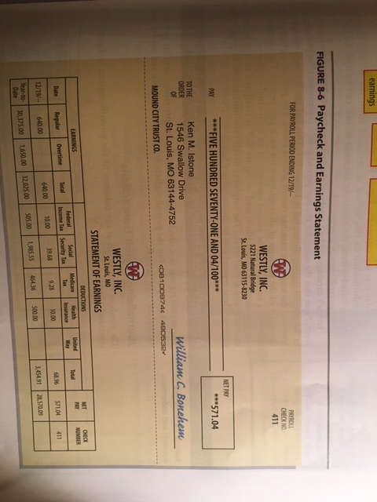
Paycheck and Earnings Statement

Slide 28
Learning Objective 4
Accounting for employee earnings and deductions

Slide 29
Journalizing Payroll Transactions
A payroll register is not a journal. Journal entries still need to be prepared.
Totals at the bottom of the columns of the payroll register are recorded in the journal
The numbered amounts in the payroll register column totals thus provide the basis for recording the payroll.
An alternative to crediting cash immediately for the net amount due to employee is to credit this amount to Wages and Salaries Payable.
Then Wages & Salaries Payable is debited and cash is credited when employees are paid.

Slide 30
Journalizing Payroll Transactions Cont.
Employee paychecks can be written from a special payroll bank account. Large companies often used this method.
In these circumstances the company would journalize the transaction first.
Second, the company would transfer funds from the regular bank account to the payroll bank account.
Wages & Salaries Expense is debited for the gross pay.
A separate account is kept for each earnings deduction. Cash is redited for the net pay.

Slide 31
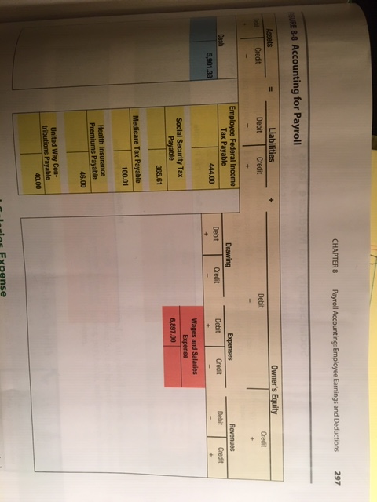
Accounting for Payroll

Slide 32
Wages and Salaries Expense
This account is debited for the gross pay of all employees for each pay period.
Sometimes separate expense accounts are kept for the employees of different departments.
Thus, separate accounts may be kept for Office Salaries Expense; Sales Salaries Expense, and Factory Wages Expense.

Slide 33
Wages and Salaries Expense

Slide 34
Employee Federal Income Tax Payable
This account is credited for the total federal income tax withheld from employees’ earnings.
The account is debited for amounts paid to the IRS.
When all of the income taxes withheld are paid, the account will have a zero balance.
State and city income tax payable account is used in a similar manner.

Slide 35
Social Security and Medicare Taxes Payable
Income, Social Security, and Medicare taxes are withheld from earnings when employees are paid
Thus when wages & salaries are accrued at year end, these tax liabilities are not accrued.
These accounts are credited for Social Security & Medicare taxes withheld from employee’s earnings and the taxes imposed on the employer
The accounts are debited for amounts paid to the IRS.
When all accounts of the Social Security and Medicare taxes have been paid, the accounts will have a zero balance.

Slide 36
Social Security and Medicare Taxes Payable

Slide 37
Other Deductions
Health Insurance Premiums Payable is credited for health insurance contributions deducted from an employee’s pay. The account is debited for the subsequent payment of these amounts to the health insurer.
United Way Contributions Payable is handled in a similar manner

Slide 38
Learning Objective 5
Describe various payroll record-keeping methods.

Slide 39
Payroll Record Keeping Methods
If all records are prepared by hand (a manual system), the same information would be recorded several times.
Payroll processing center is a business that sells payroll record-keeping services
The processing center maintains all payroll records and prepares all payroll checks.
An electronic system is a computer system based on a software package that performs all payroll record keeping and prepares payroll checks or EFT records.
All payroll data can be stored in the computer.
Key to remember- In a manual payroll system, the same information needs to be recorded several times. An electronic payroll system is much more efficient.

Slide 40
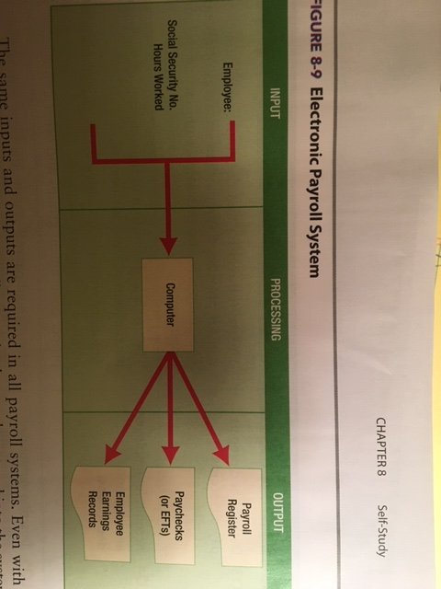
Electronic Payroll System Flow

