Slide 1

Payroll Accounting:
Employer Taxes and Reports
Chapter 9

Slide 2
Learning Objective 1
Describe and calculate employer payroll taxes

Slide 3
Employer Payroll Taxes
In addition to the gross pay for each employee, the employer must pay payroll taxes:
  FICA (Federal Insurance Contributions Act)
  FUTA (Federal Unemployment Tax Act)
  SUTA (State Unemployment Tax Act)
These taxes add substantially to the cost of having employees

Slide 4
Employer FICA Taxes
Both the employee and employer pay FICA taxes
  Each pays an equal share
Social Security = 6.2% on maximum earnings of $128,400
Medicare = 1.45% on ALL earnings
The amount of earnings subject to Social Security tax is obtained from the payroll register (see next two slides)

Slide 5
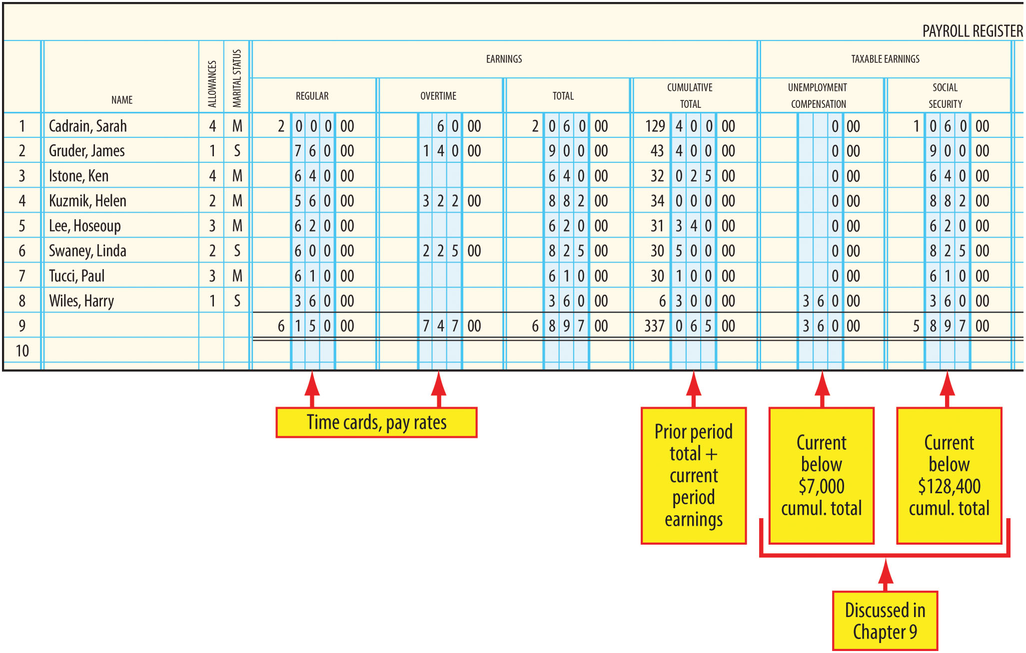
Payroll Register (Left Side) – Figure 9-1

Slide 6
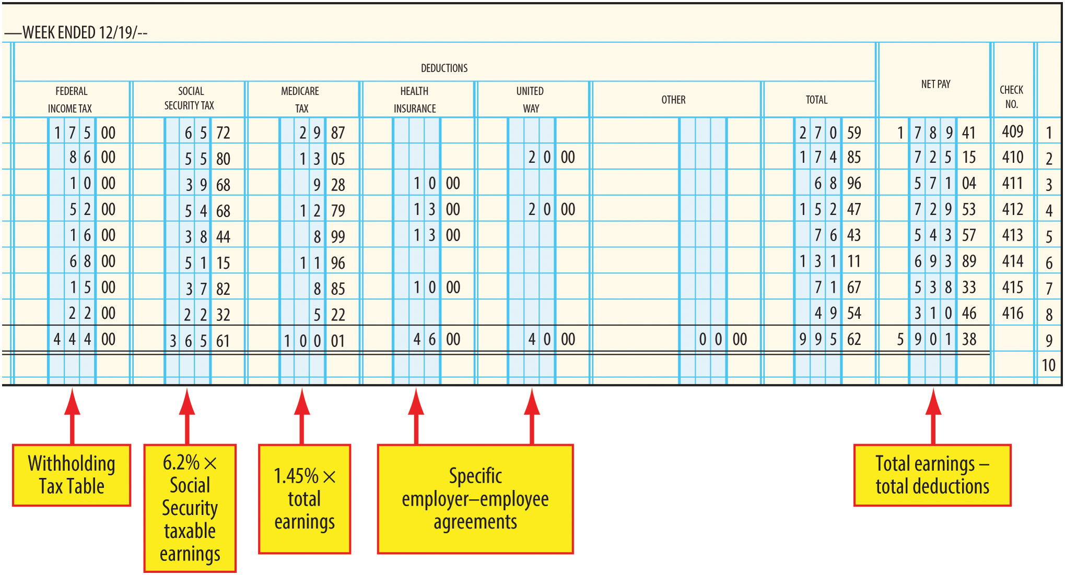
Payroll Register (Right Side) – Figure 9-1

Slide 7
Self-Employment Tax
Paid by individuals who own and run their own business if they earn net self-employment income of $400 or more
  They do not receive salary or wages from the business, but they do have earnings in the form of the business net income (self-employment income)
  Self-employment tax is contribution to the FICA program
Self-employment tax rates are double the Social Security and Medicare rates
  Self-employed individuals pay both the employer and the employee share of FICA taxes

Slide 8
Employer FUTA Tax
FUTA (Federal Unemployment Tax Act) tax
  Levied only on employers
    Not deducted from employees’ earnings
  Funds the combined federal/state unemployment compensation programs
Current rate is 6.0% applied to maximum earnings of $7,000 for each employee
  Employers are allowed a credit of up to 5.4% for participation in state unemployment programs
  Effective rate is usually .6%
FUTA taxes also calculated from information in the Payroll Register

Slide 9
Employer SUTA Tax
Levied on employers in most states
Tax funds used to pay unemployment benefits
Tax rates and unemployment benefits vary among the states
  In this text, the SUTA rate is 5.4% applied to maximum earnings of $7,000 for each employee
Most states have an experience-rating system to encourage employers to provide regular employment to workers
  If an employer has very few former employees receiving unemployment compensation, the employer qualifies for a lower state unemployment tax rate
  Full federal credit of 5.4% is still allowed even if employer pays a lower state rate

Slide 10
Computation of Employer Taxes
Using information from the Payroll Register, the calculation of employer taxes is as follows:
  Social Security Taxable Earnings × Tax Rate = Tax
  $5,897 x 0.062 = $365.61
  Medicare Taxable Earnings (total earnings) × Tax Rate = Tax
  $6,897 x 0.0145 = $100.01
  FUTA Taxable Earnings × Tax Rate = Tax
    $360 x 0.006 = $2.16
  State Unemployment Taxable Earnings x Tax Rate = Tax
    $360 x 0.054 = $19.44

Slide 11
Learning Objective 2
Account for employer payroll taxes expense

Slide 12
Steps Needed to Prepare Journal Entry
Step 1 – Obtain the total earnings and taxable earnings amounts from the Earnings Total and Taxable Earnings columns of the payroll register
Step 2 – Compute the amount of employer Social Security tax by multiplying the Social Security taxable earnings by 6.2%.
Step 3 – Compute the amount of employer Medicare tax by multiplying total earnings by 1.45%.
Step 4 – Compute the amount of FUTA tax by multiplying the Unemployment Taxable earnings by 0.6%.
Step 5 – Compute the amount of SUTA tax by multiplying the Unemployment Taxable earnings by 5.4%.
Step 6 – Prepare the appropriate journal entry using the amounts computed in steps 2-5.

Slide 13
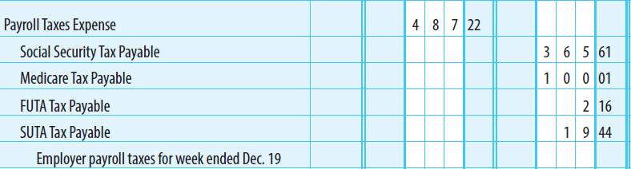
Journalizing Payroll Taxes
A journal entry is needed to record the expense and liabilities for payroll taxes
Usually debit all expense to one account
Credit separate accounts for each type of tax liability

Slide 14
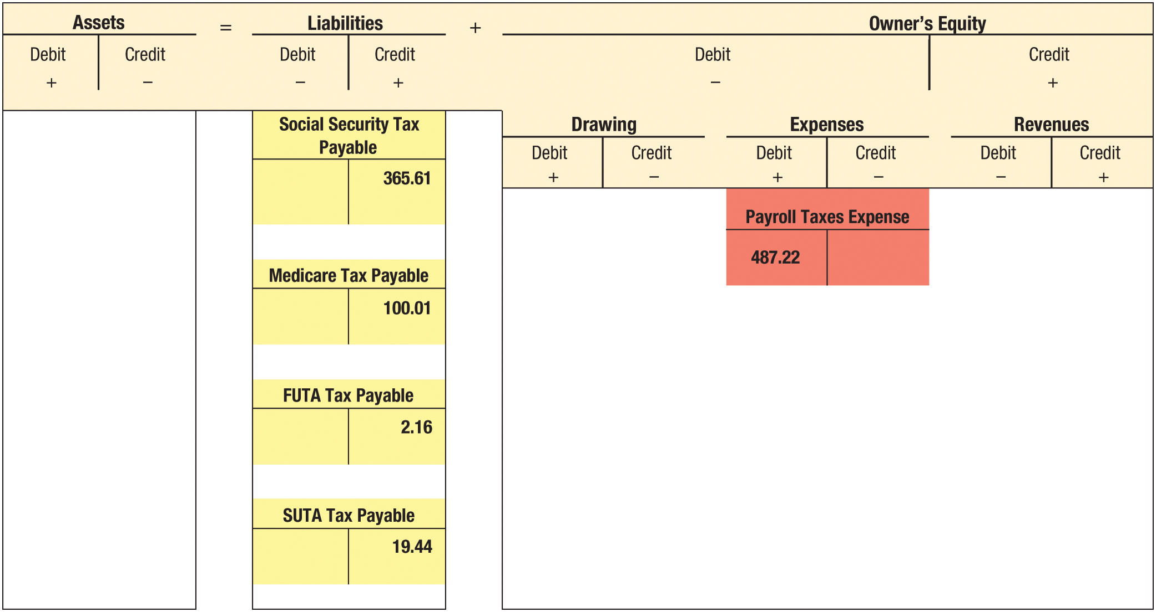
Accounting For Payroll Taxes (Figure 9-4)

Slide 15
Accounts Used In Payroll Tax Accounting
Payroll Taxes Expense
  Social Security, Medicare, FUTA, and SUTA taxes imposed on the employer are expenses of doing business
Social Security and Medicare Taxes Payable
  Credited when taxes imposed on employer or withheld from employees
  Debited when paid
FUTA Tax Payable
  Credited when taxes imposed on employer
  Debited when paid
SUTA Tax Payable
  Credited when taxes imposed on employer
  Debited when paid

Slide 16
Total Cost of an Employee
Description | Amount
Gross wages | $26,000
Employer Social Security tax, 6.2% of $26,000 | 1,612
Employer Medicare tax, 1.45% of $26,000 | 377
State unemployment tax, 5.4% of $7,000 | 378
FUTA tax, 0.6% of $7,000 | 42
Total Cost | $28,409

Slide 17
Learning Objective 3
Describe employer reporting and payment responsibilities

Slide 18
Employer Payroll and Payment Responsibility Areas
Federal income tax withholding and Social Security and Medicare taxes
FUTA taxes
SUTA taxes
Employee Wage and Tax Statement (Form W-2)
Summary of employee wages and taxes (Form W-3)
Employment eligibility verification (Form I-9)

Slide 19
Federal Income Tax Withholding and Social Security and Medicare Taxes
Three important aspects of employer reporting and payment responsibilities
  Determining when payments are due
  Use of electronic funds transfer (EFT) to make federal tax deposits
  Use of Form 941, Employer’s Quarterly Federal Tax Return

Slide 20
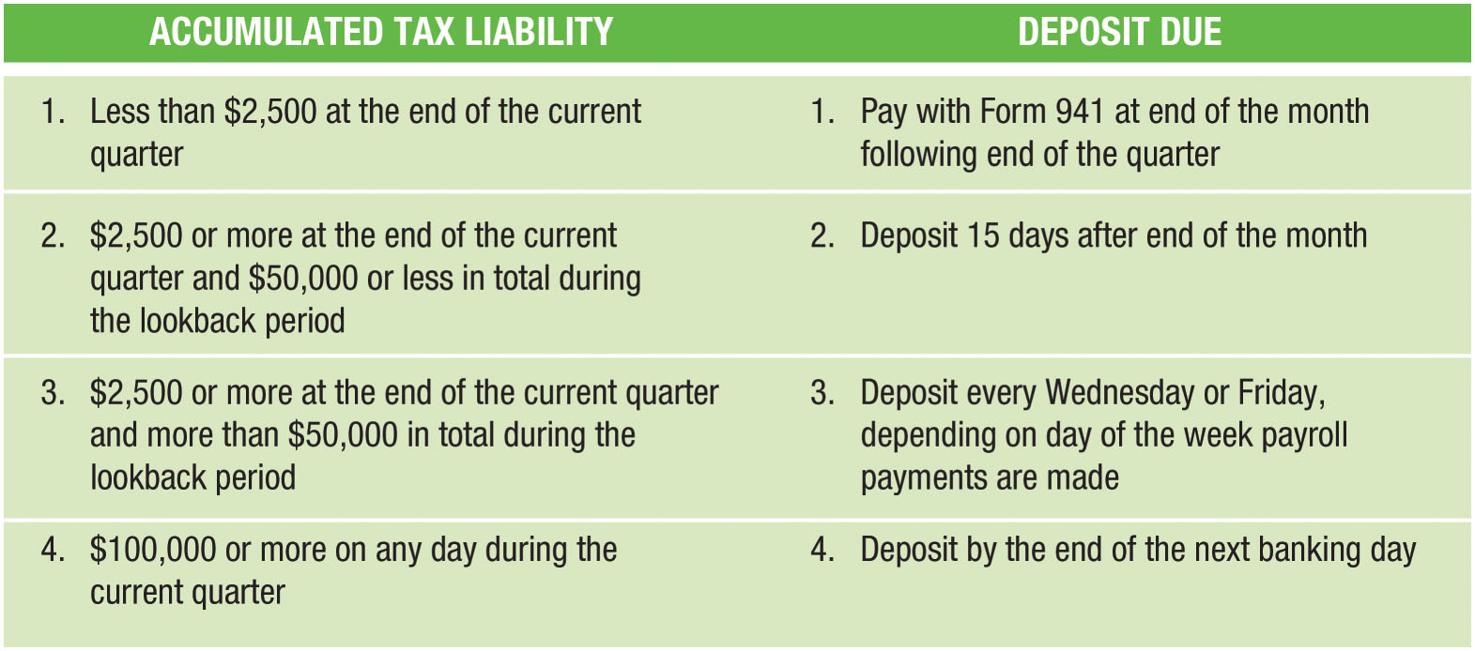
Summary of Deposit Rules (Figure 9-5)

Slide 21
Lookback Period
The “lookback period” identified in Figure 9-5 is the four quarters beginning July 1, two years ago, and ending June 30, one year ago
Large amounts of payroll taxes in the “lookback period” require frequent future deposits

Slide 22
Making Federal Tax Deposits
Deposits must be made using electronic funds transfer (EFT)
Use Electronic Federal Tax Payment System (EFTPS)
  An electronic funds transfer system designed for making federal tax deposits
Each deposit requires a journal entry
Deposits include both the employer imposed taxes and employee’s withholding

Slide 23
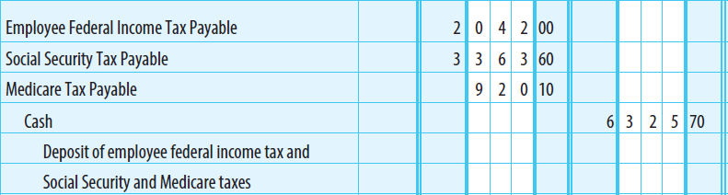
Journalizing Federal Income Tax and Social Security Tax Payment

Slide 24
Form 941
Employer’s Quarterly Federal Tax Return
  Must be filed with the IRS at the end of the month following each calendar quarter
    Due April 30, July 31, October 31, and January 31
  Reports the following taxes for the quarter:
    Employee federal income tax withheld
    Employee Social Security and Medicare taxes withheld
    Employer Social Security and Medicare taxes

Slide 25
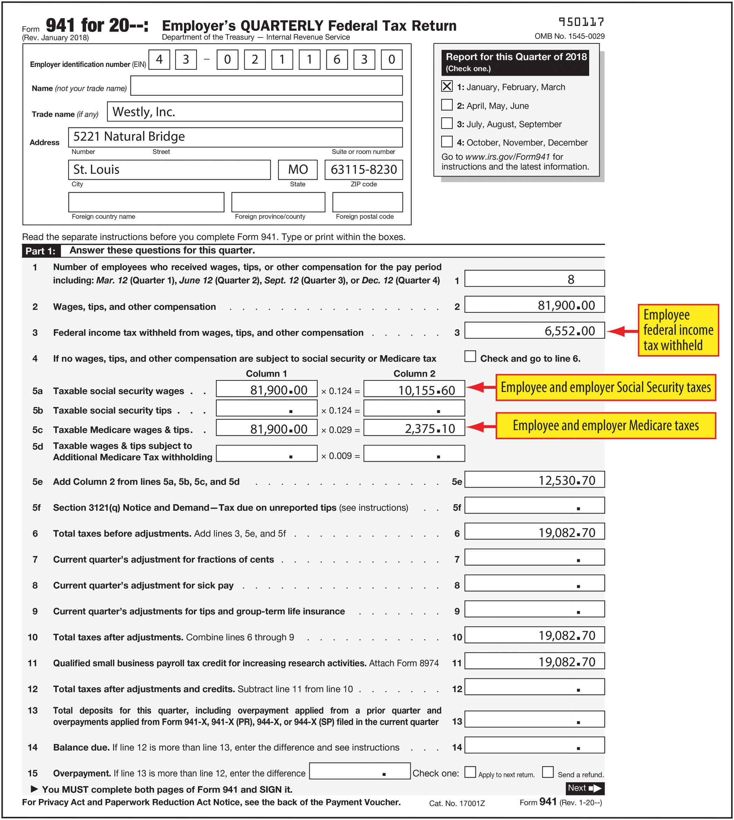
FIGURE 9-7 Employer’s Quarterly Federal Tax Return (Form 941)

Slide 26
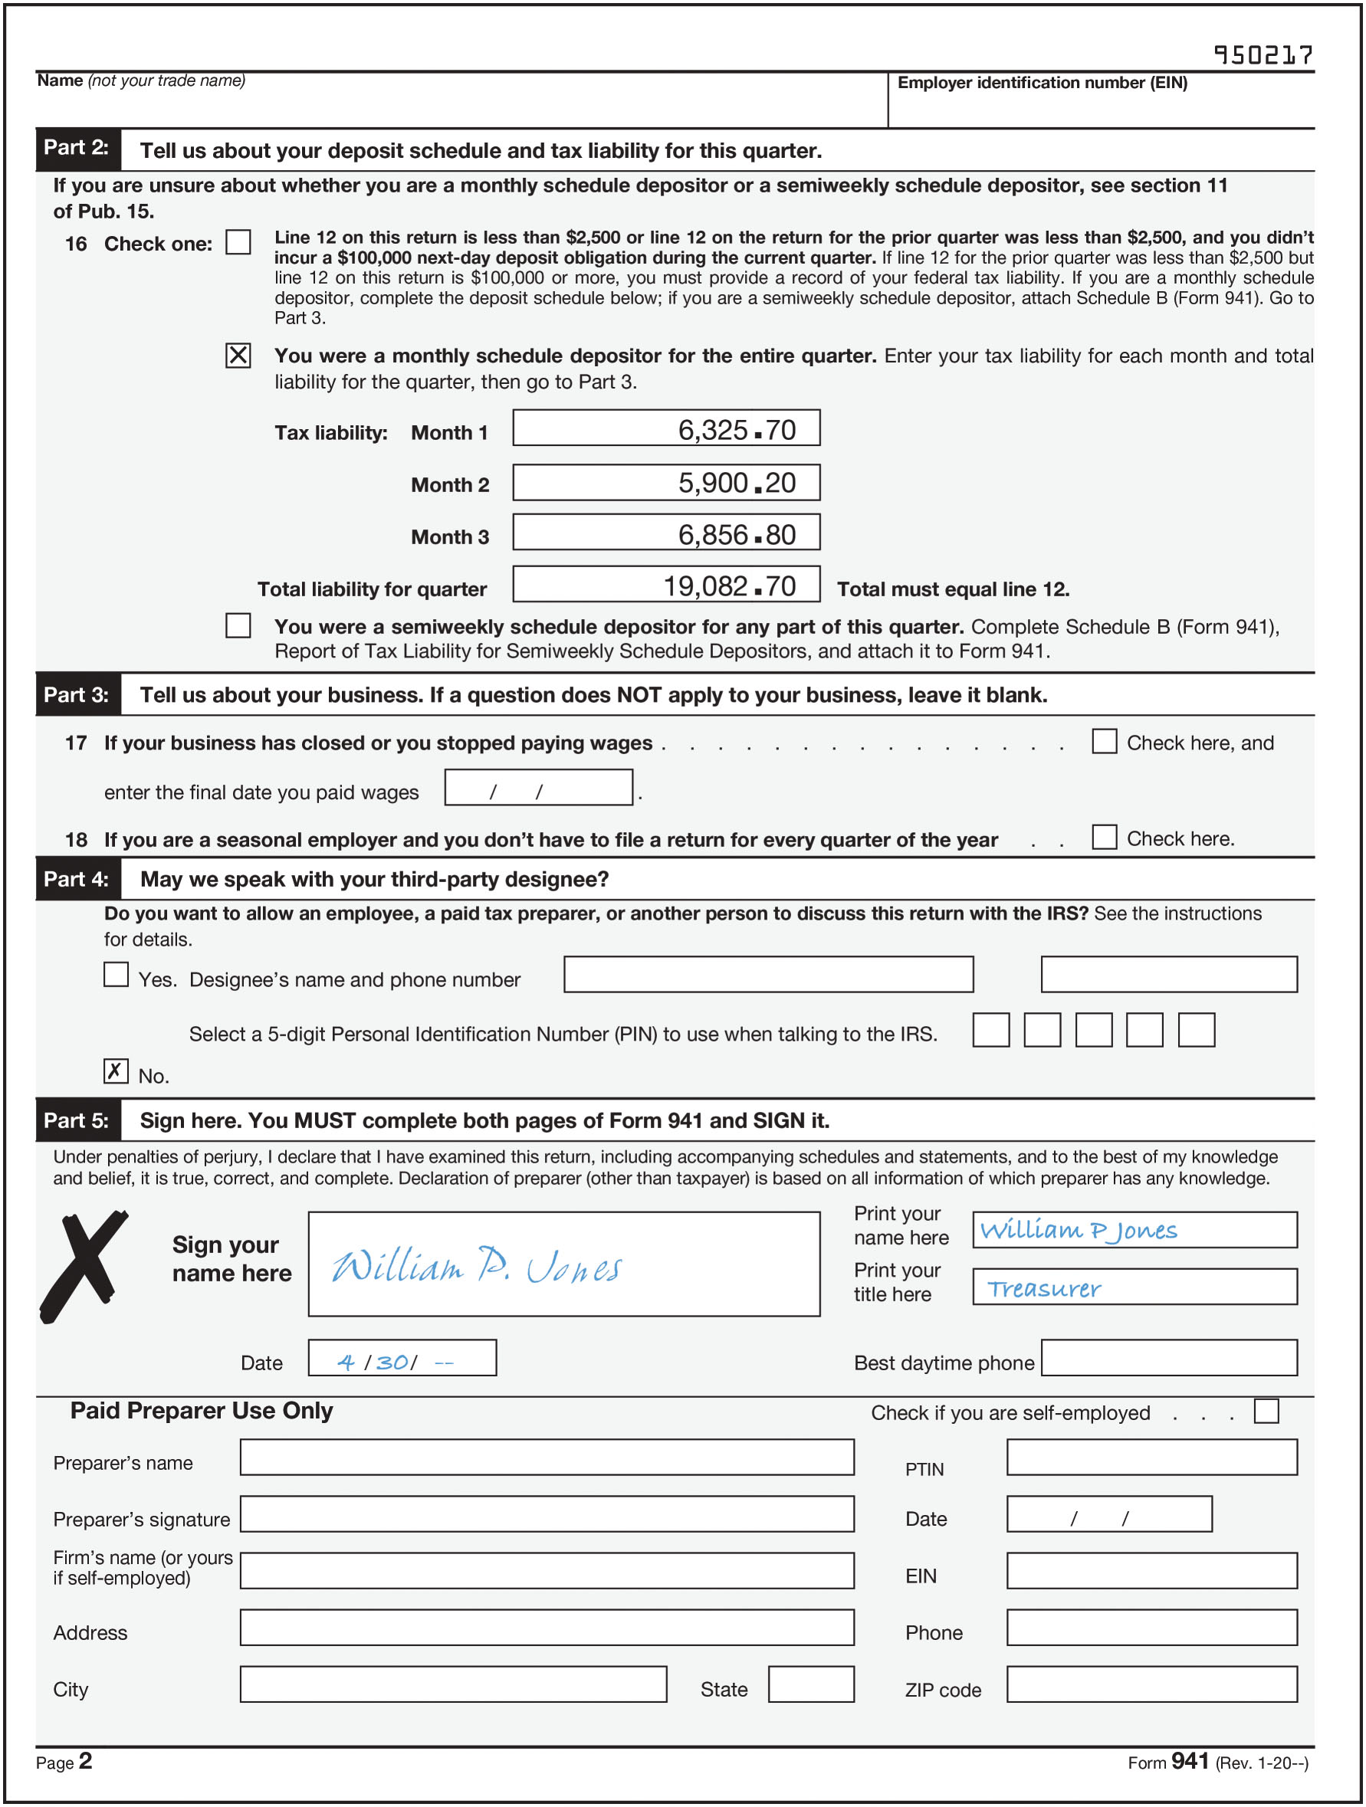
FIGURE 9-7 Employer’s Quarterly Federal Tax Return (Form 941) (concluded)

Slide 27
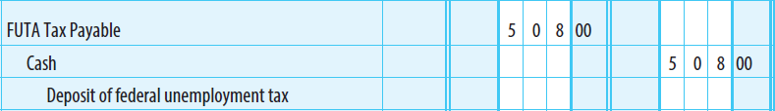
FUTA Taxes
Calculated quarterly
Deposit is due end of the month following the close of the quarter
  A deposit is required only when the accumulated liability exceeds $500
    Liability is $500 or less, amount is added to amount to be deposited for next quarter
  FUTA taxes are deposited using EFTPS

Slide 28
Form 940
Annual report of federal unemployment tax
  All quarterly deposits have been made – due beginning of the second week of February
  Otherwise, must be filed by January 31
Balance due – paid using EFTPS or Form 940-V (if $500 or less)

Slide 29
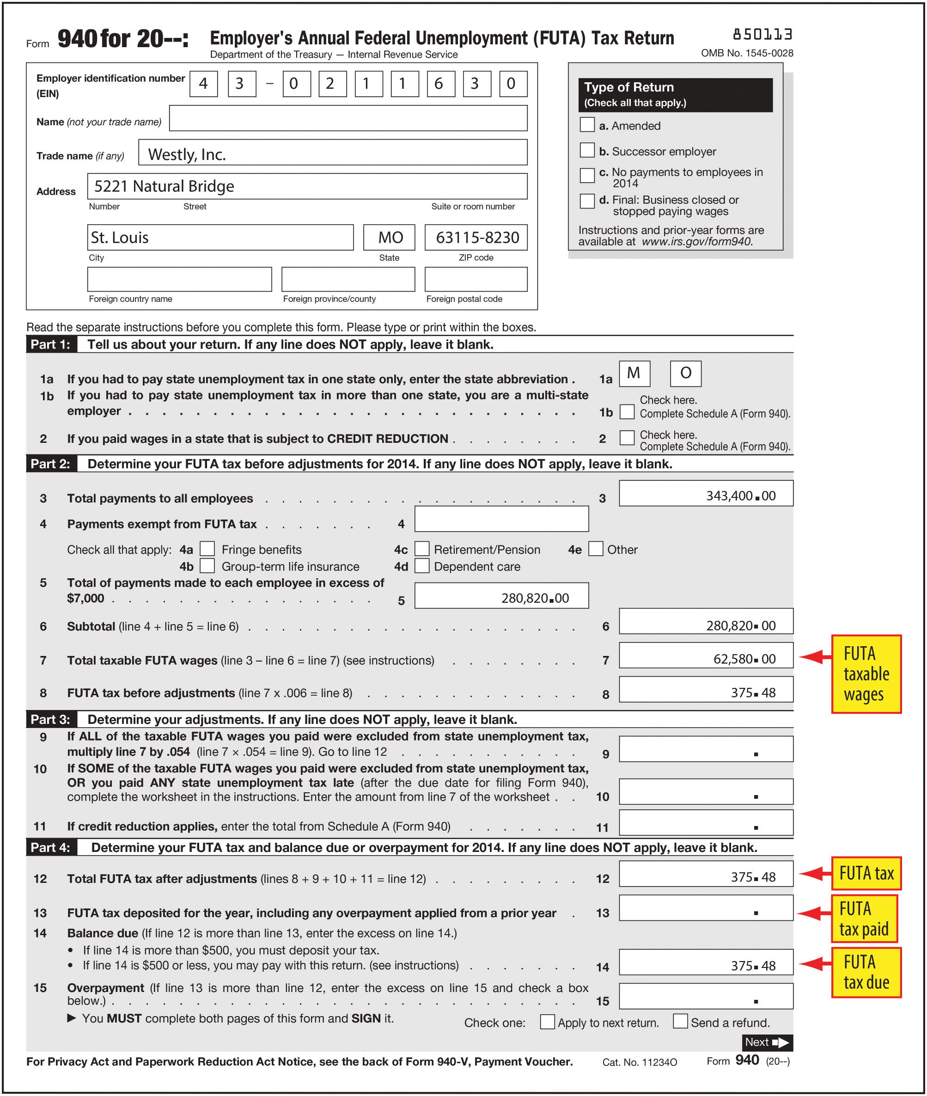
FIGURE 9-8 Employer’s Annual Federal Unemployment (FUTA) Tax Return (Form 940)

Slide 30
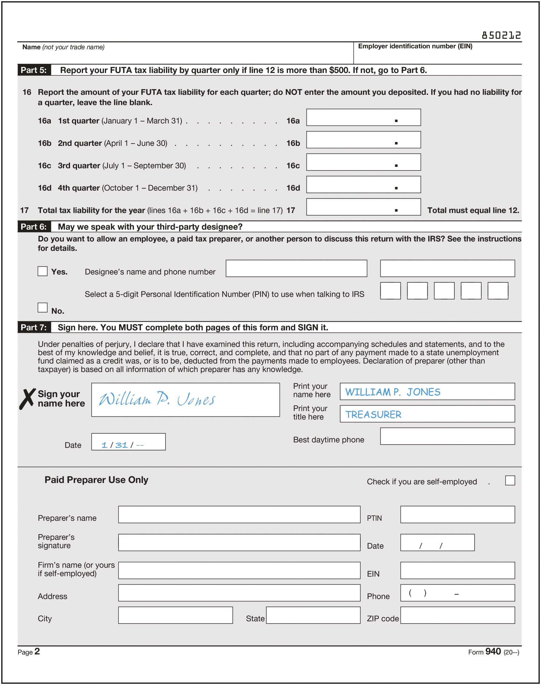
FIGURE 9-8 Employer’s Annual Federal Unemployment (FUTA) Tax Return (Form 940) (concluded)

Slide 31
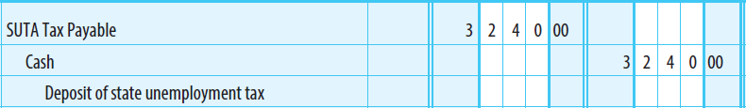
SUTA Taxes
Deposits usually required on a quarterly basis
Forms required vary by state

Slide 32
Wage and Tax Statement (Form W-2)
Given to each employee by January 31
  Shows the total amount of wages paid and taxes withheld during the preceding taxable year
  Prepared from the employee earnings record
  Multiple copies are needed for the following purposes:
    Copy A—Employer sends to Social Security Administration
    Copy B—Employee files with federal income tax return
    Copy C—Employee retains for his or her own records
    Copy D—Employer retains for business records
    Copy 1—Employer sends to state, city, or local tax department
    Copy 2—Employee files with state, city, or local income tax return

Slide 33
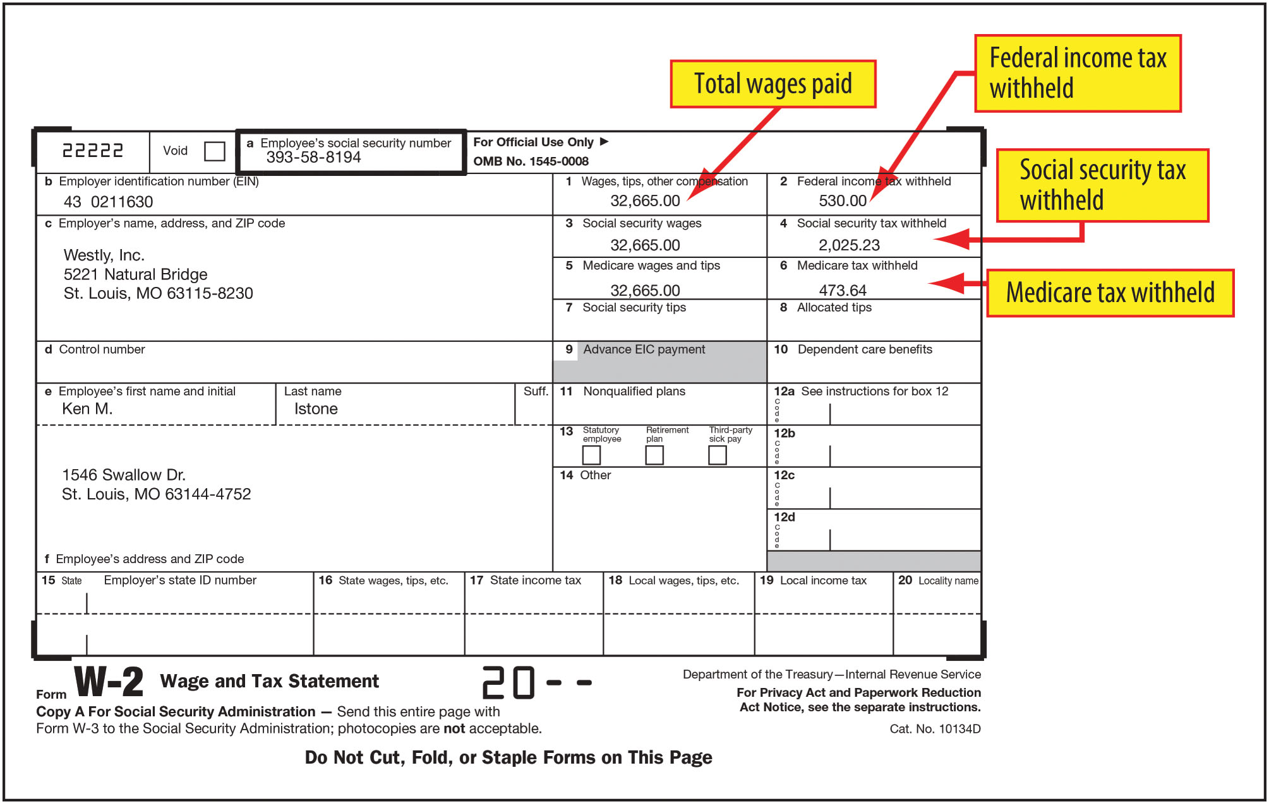
FIGURE 9-10 Wage and Tax Statement (Form W-2)

Slide 34
Transmittal of Wage and Tax Statements
(Form W-3)
Sent by employers with Copy A of Forms W-2 to the Social Security Administration
Due by February 28 following the end of each taxable year
Summarizes employee earnings and tax information presented on Forms W-2 for the year

Slide 35
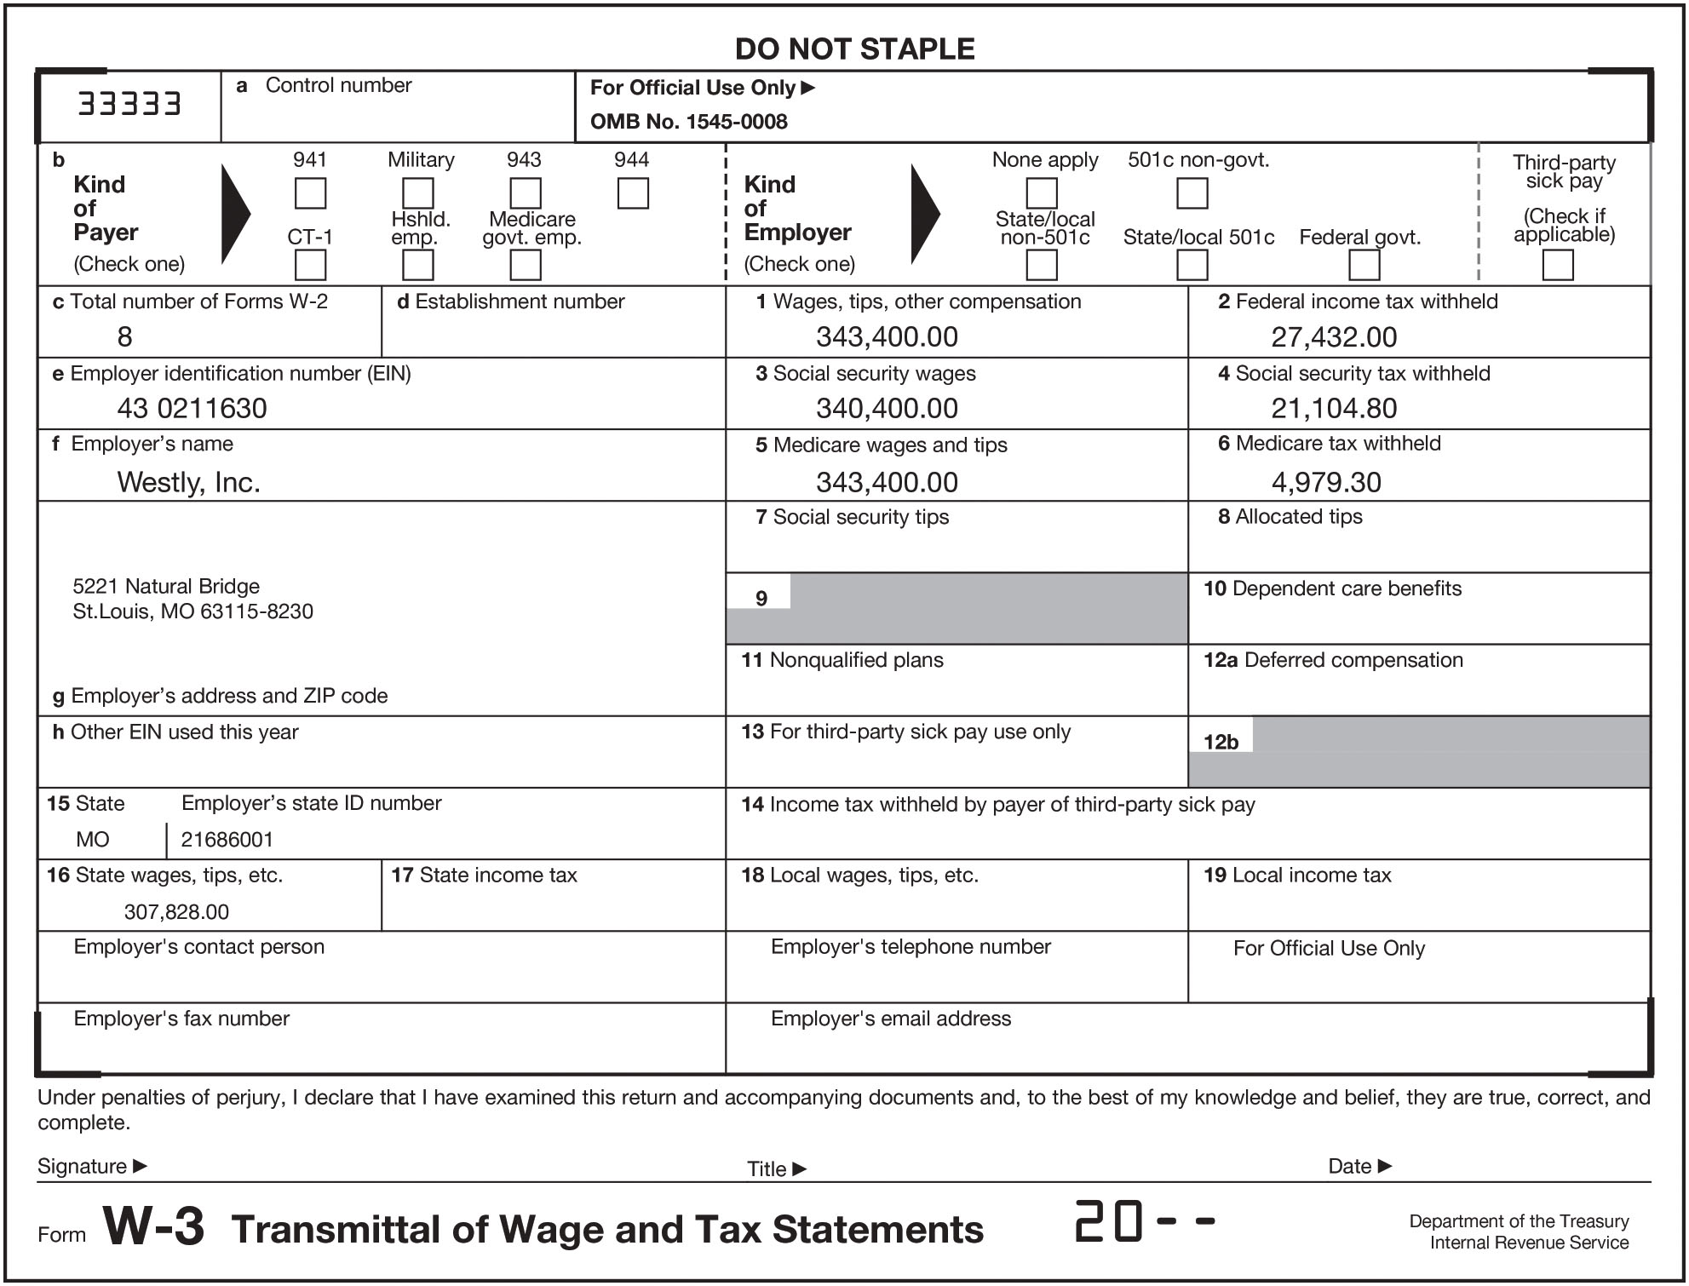
FIGURE 9-11 Transmittal of Wage and Tax Statements (Form W-3)

Slide 36
Employment Eligibility Verification
Every employee hired after November 6, 1986, must complete Form I-9 (Employment Eligibility Verification)
  To document that each employee is authorized to work in the United States
  Not filed with any government agency
  Must be retained by the employer and made available for inspection if requested by the Department of Homeland Security or the Department of Labor

Slide 37
Learning Objective 4
Describe and account for workers’ compensation insurance

Slide 38
Workers’ Compensation Insurance
Provides insurance for employees who suffer a work-related illness or injury
Required by most states
Employer usually pays the entire cost
  Cost depends on the number of employees, riskiness of the job, and the company’s accident history
    Rate is higher for commercial fishermen compared to office workers
Employer usually pays premium at beginning of year, based on estimated payroll
  A year-end adjustment is made when the actual amount of payroll is known

Slide 39
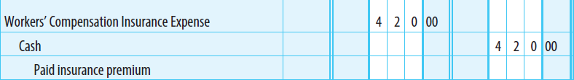
Workers’ Compensation Insurance – Example 1
Lockwood Co. expects its payroll for the year to be $210,000
Lockwood’s workers’ compensation insurance rate is 0.2%
Estimated Payroll x Rate = Estimated Insurance Premium
  $210,000 x 0.002 = $420.00

Slide 40

Workers’ Compensation Insurance – Example 2
Lockwood’s actual payroll for the year is $220,000
What adjustment is required?
  Actual Payroll × Rate = Estimated Insurance Premium
  $220,000 × 0.002 = $440.00
  Premium paid previously $420.00
  Additional premium due $20.00

Slide 41
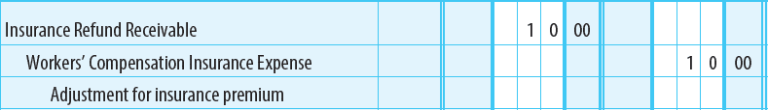
Workers’ Compensation Insurance – Example 3
What if Lockwood’s actual payroll had been $205,000 instead?
  Actual Payroll × Rate = Estimated Insurance Premium
  $205,000 × 0.002 = $410.00
  Premium paid $420.00
  Refund due $(10.00)

