Slide 1

Accounting for Sales and Cash Receipts
Chapter 10

Slide 2
Learning Objective 1
Describe merchandise sales transactions

Slide 3
Merchandising Business
Purchases merchandise from vendors/suppliers and sells that merchandise to customers
A sale is a transfer of merchandise from one business or individual to another in exchange for cash or a promise to pay cash

Slide 4
Retailer
Sells to final consumers
Evidence of a retail sale:
  Cash register receipt – given to customer
  Cash register tape summary – sent to accounting
  Sales ticket
    One copy of the sales ticket is given to the customer, and the other copy is sent to accounting

Slide 5
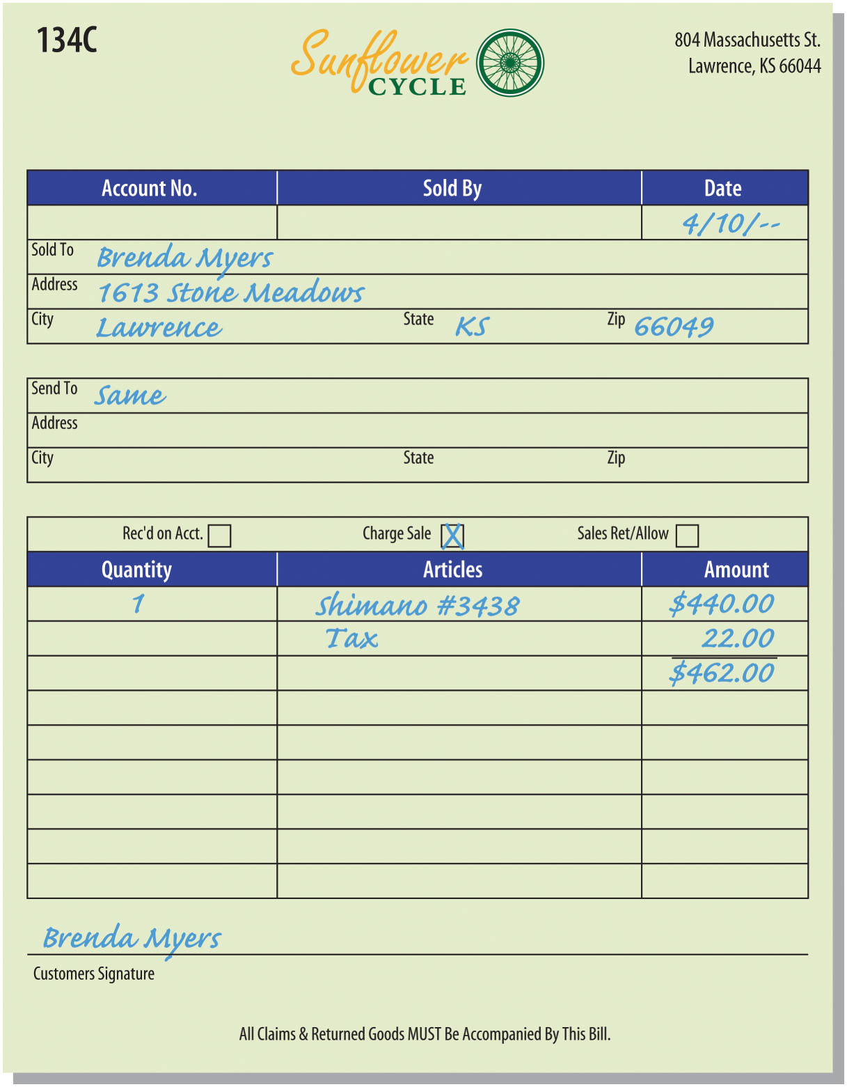
Sales Ticket Example (Figure 10-2)

Slide 6
Wholesaler
Purchases merchandise from the manufacturer
Sells to retailers
  Usually “on account”
A sales invoice is generated for each sale:
  One copy is sent to the customer as a bill for the merchandise
  One is sent to accounting to record the sale
  One is shipped with the merchandise

Slide 7
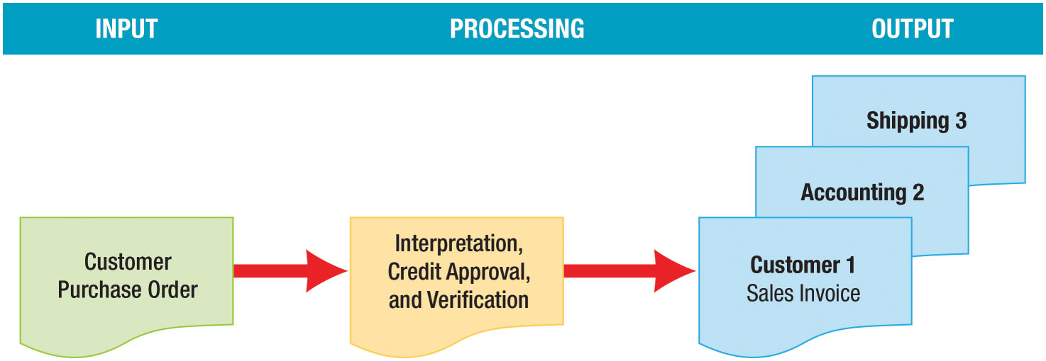
Wholesale Sales Transaction Process (Figure 10-4)

Slide 8
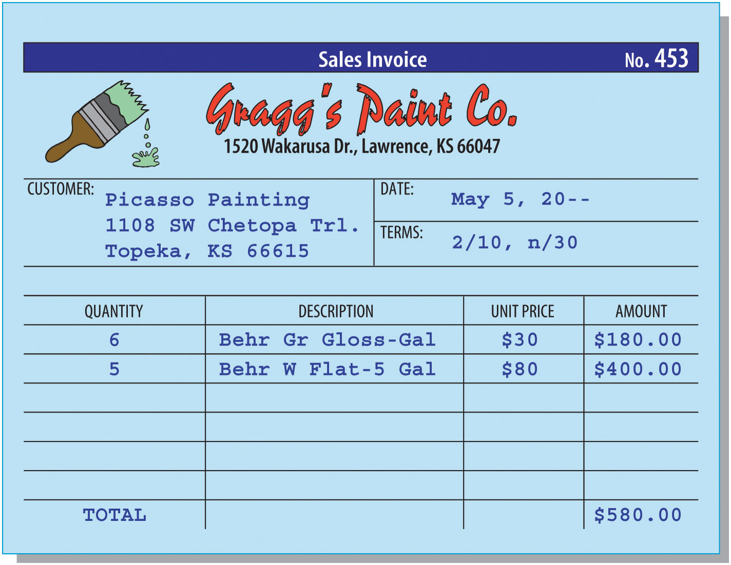
Sales Invoice (Figure 10-5)

Slide 9
Credit Memorandum
Issued by the seller indicating the customer’s accounts receivable account has been credited for the amount of a:
  Sales return
    Merchandise returned for a refund
  Sales allowance
    Price reduction granted by the seller because of defects or other problems with the merchandise
One copy of the credit memo is sent to the customer
One copy is sent to accounting

Slide 10
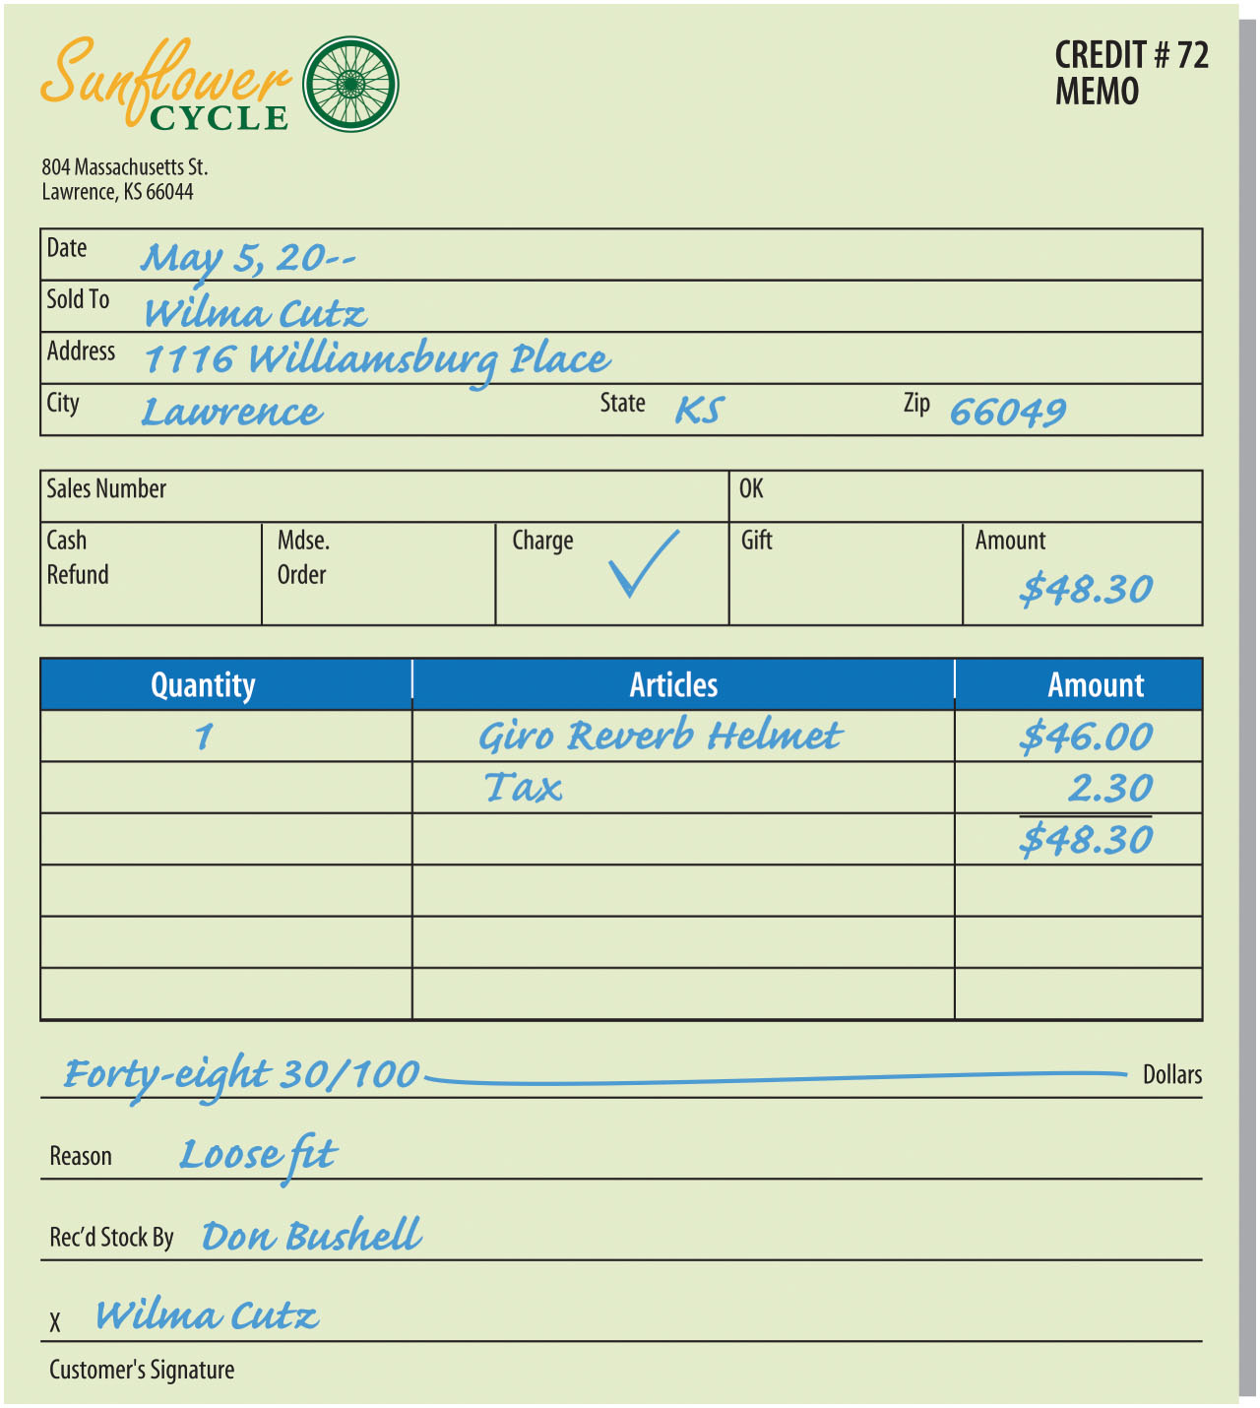
Credit Memorandum Figure 10-6

Slide 11
Learning Objective 2
Describe and use merchandise sales accounts

Slide 12
Merchandise Sales Accounts
To account for merchandise sales transactions, we will use five new accounts:
  Sales
  Sales Tax Payable
  Sales Returns and Allowances
  Customer Refunds Payable
  Sales Discounts
The position of these accounts in the accounting equation and their normal balances are shown on the next slide

Slide 13
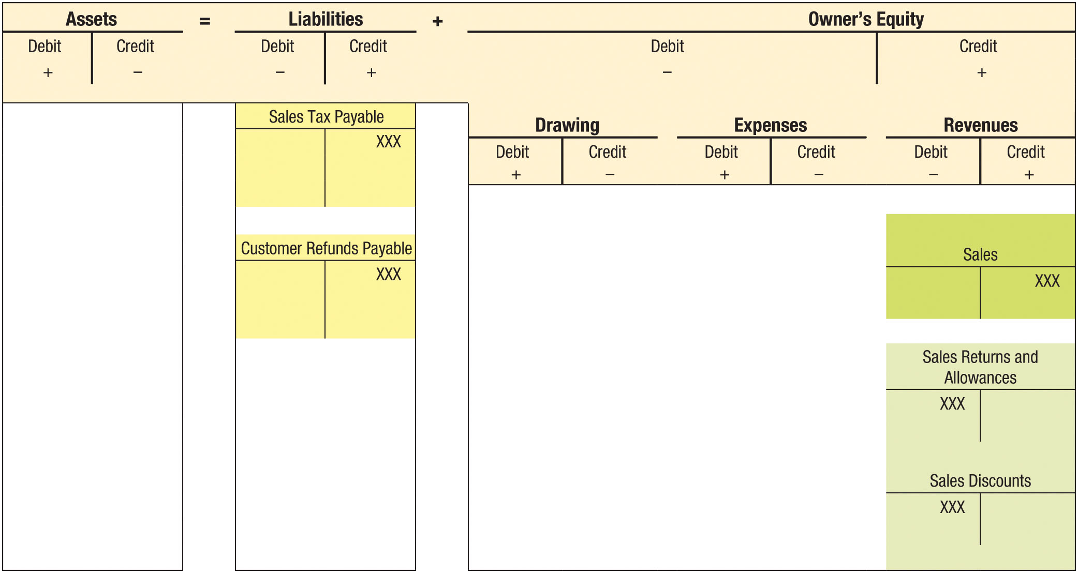
FIGURE 10-7 Accounting for Merchandise Sales Transactions

Slide 14
Sales Account
A revenue account used to record sales of merchandise
Is credited for the selling price of merchandise sold during the period
If a $100 sale is made for cash, the following entry is made:
  DR Cash $100
  CR Sales $100
If the same sale is made on account, use this entry:
  DR Accounts Receivable/Customer Name $100
  CR Sales $100
  Sales account is credited, even though company has not yet been paid

Slide 15
Sales Tax Payable Account (1 of 3)
A liability account used to record the taxes collected on sales and owed to the taxing authority
Most states require retailers to collect sales tax on sales to final consumers
Credited when taxes are collected on sales made (owed to tax authority)
Debits made to the account:
  When merchandise is returned by customers
  When funds are remitted to tax authority

Slide 16
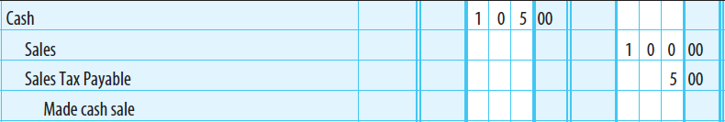
Sales Tax Payable Account (2 of 3)
If a cash sale for $100 plus 5% sales tax (5% x $100 = $5) occurs, the following entry is made:

Slide 17
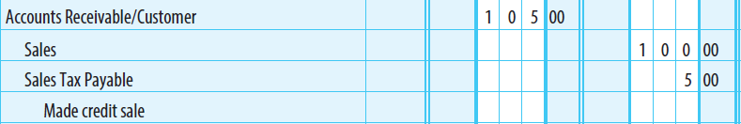
Sales Tax Payable Account (3 of 3)
If a credit sale for $100 plus 5% sales tax (5% x $100 = $5) occurs, the following entry is made:

Slide 18
Sales Returns And Allowances Account (1 of 2)
A contra-revenue account used to record sales returns and sales allowances
Has a debit balance
Shown as a deduction from Sales on the income statement
This account is debited rather than Sales so that the business can more readily keep track of this activity

Slide 19
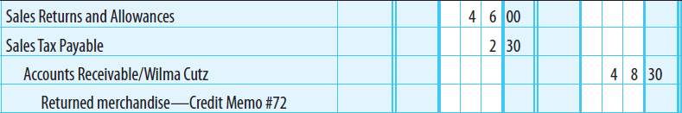
Sales Returns And Allowances Account (2 of 2)
Refer to the credit memo previously shown
The entry for the return of a riding helmet is shown below
  Sales Returns and Allowances is debited for the amount of the sale, excluding the sales tax

Slide 20
Sales Returns and Allowances – Subsequent Year
Timing differences occur between periods when customers return merchandise sold in one fiscal year in a subsequent fiscal year
An estimate of returns to be made in the future should be recorded as an adjusting entry at year end

Slide 21
Sales Discounts Account
A contra-revenue account used to record discounts given to customers who buy merchandise on account
  Businesses offer cash discounts to encourage prompt payment
  Prompt collection of accounts receivable reduces risk that receivables will become uncollectible
Has a debit balance
Reported as a deduction from Sales on the income statement

Slide 22
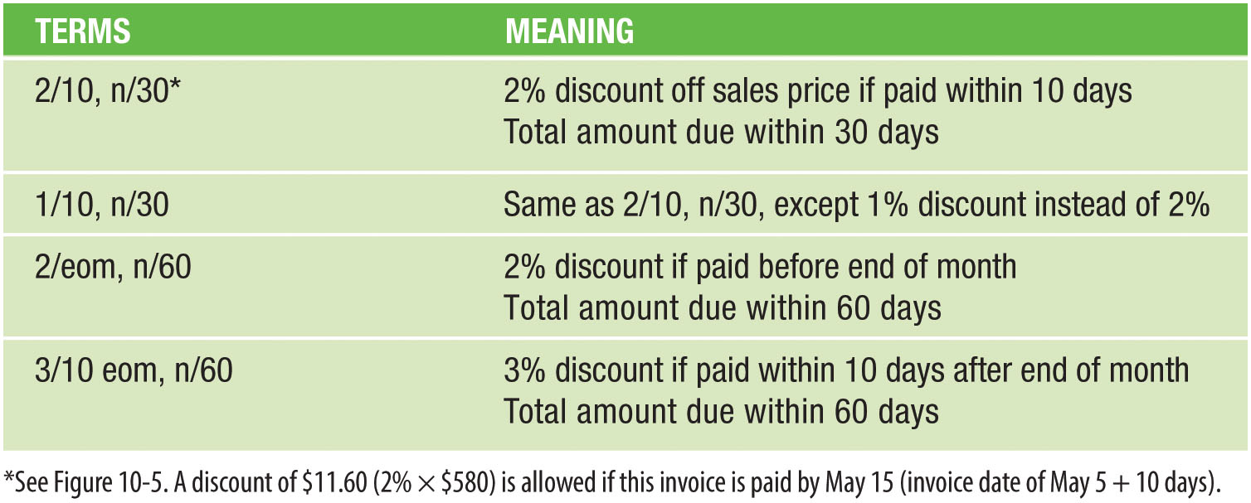
Typical Credit Terms (Figure 10-10)

Slide 23
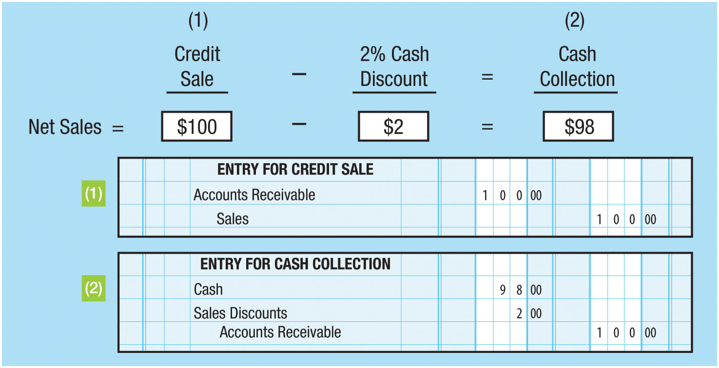
Sales Discount Journal Entry (Figure 10-12)
If merchandise is sold for $100 with credit terms of 2/10, net/30, and cash is received within the discount period, two entries are made:

Slide 24
Learning Objective 3
Describe and use the accounts receivable ledger

Slide 25
Journalizing Sales
Assume the following sales transactions occurred during April:
  Apr. 4 Sale No. 133C on account to Enrico Lorenzo, $1,520 plus $76 sales tax
  Apr. 10 Sale No. 134C on account to Brenda Myers, $440 plus $22 sales tax
  Apr. 18 Sale No. 105D on account to Edith Walton, $980 plus $49 sales tax
  Apr. 21 Sale No. 202B on account to Wilma Cutz, $620 plus $31 sales tax
  Apr. 24 Sale No. 162A on account to Heidi Schwitzer, $1,600 plus $80 sales tax

Slide 26
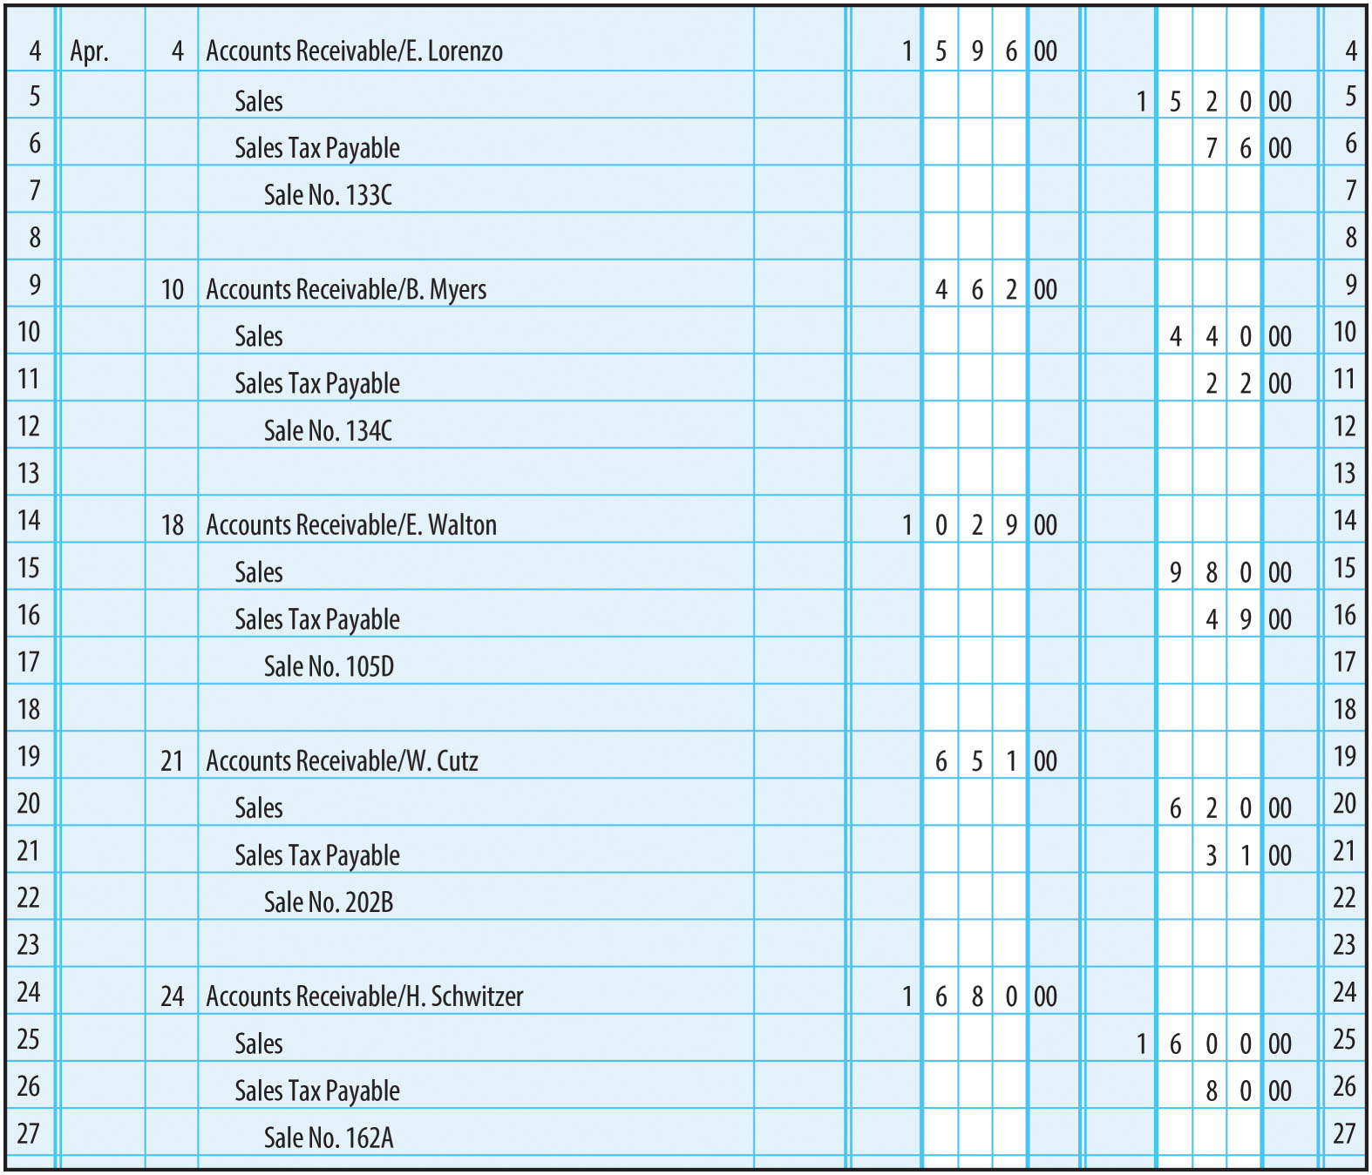
General Journal Entry for Sales on Account (Figure 10-13)

Slide 27
Posting to the General Ledger
In the general ledger account:
    Step 1: Enter the date of the transaction
    Step 2: Enter the amount of the transaction
    Step 3: Enter the new balance
    Step 4: Enter the journal page number
In the journal:
    Step 5: Enter the ledger account number in the PR column

Slide 28
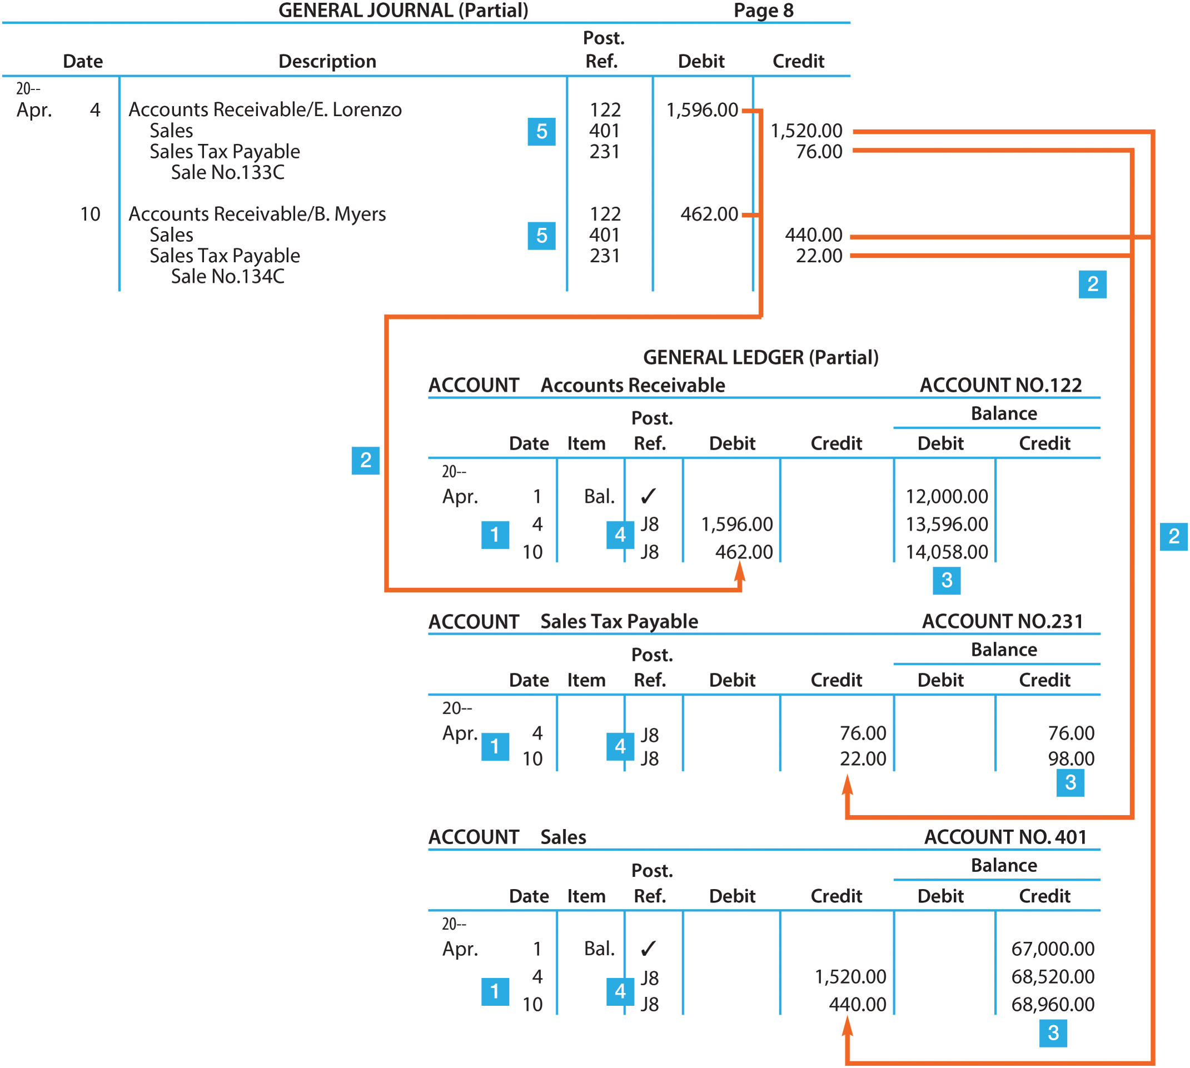
FIGURE 10-14 Posting Sales to the General Ledger

Slide 29
Accounts Receivable Ledger
A separate subsidiary ledger
Contains an individual accounts receivable account for each customer
Each customer assigned an account number
A summary accounts receivable account maintained in the general ledger is the controlling account

Slide 30
Posting from General Journal to the Accounts Receivable Ledger
In the accounts receivable ledger account:
    Step 1: Enter the date of the transaction
    Step 2: Enter the amount of the transaction
    Step 3: Enter the new balance
    Step 4: Enter the journal page number
In the journal:
    Step 5: Enter a slash (/) followed by a check mark (✓) in the PR column

Slide 31
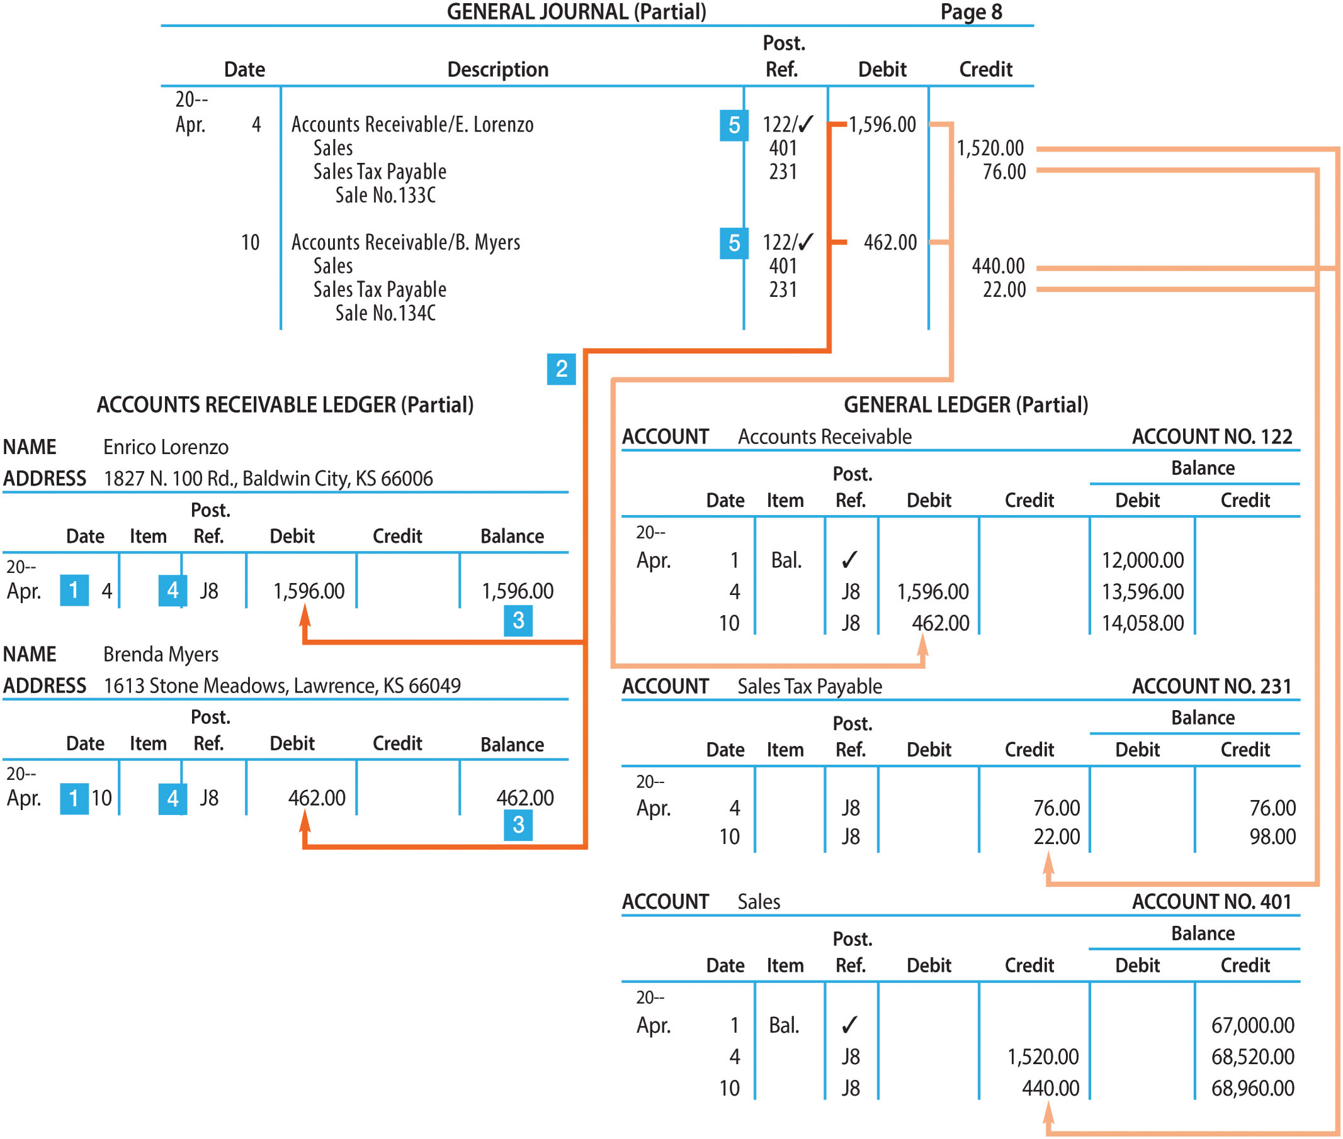
FIGURE 10-15 Posting Sales to the Accounts Receivable Ledger

Slide 32
Relationships to Remember
Entries in the general journal are posted to the general ledger and accounts receivable ledger
After the posting of the accounts receivable ledger and the general ledger is completed:
  Total of the accounts receivable ledger balances should equal the Accounts Receivable balance in the general ledger
  Accounts Receivable ledger is a detailed listing of the same information that is summarized in Accounts Receivable in the general ledger

Slide 33
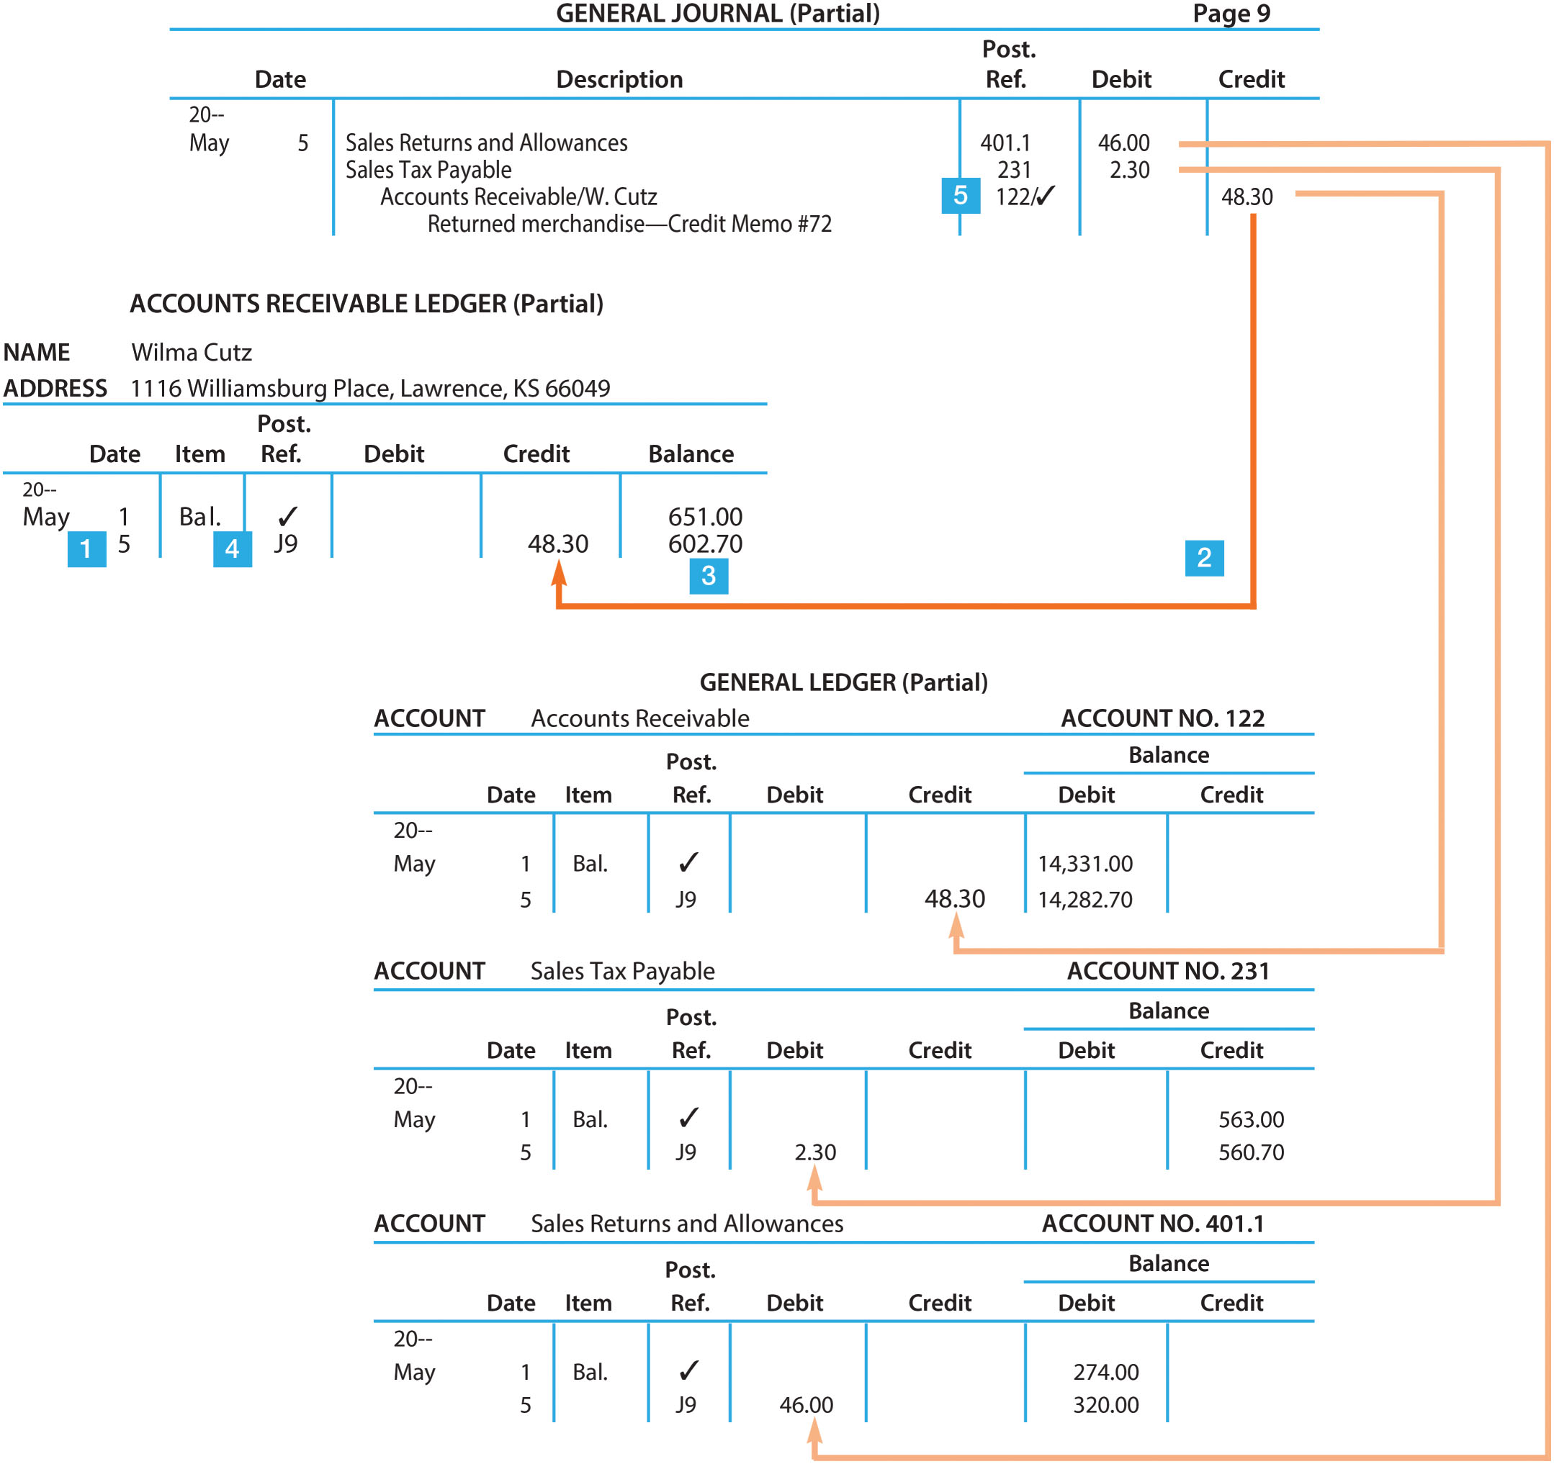
FIGURE 10-16 Accounting for Sales Returns and Allowances

Slide 34
Bank Credit Card Sales (1 of 2)
Similar to cash sales – cash is available to business as soon as an electronic deposit is made at days end
Credit card company makes electronic deposit to merchandiser’s bank account for gross amount of credit card sales less a processing fee
Fee is based on the gross amount of sale, including sales tax

Slide 35
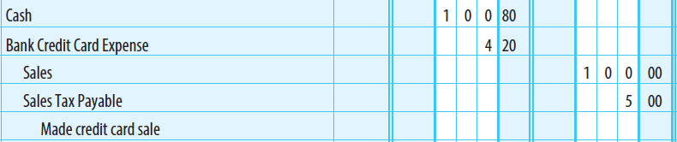
Bank Credit Card Sales (2 of 2)
On a sale of $100 plus sales tax of $5, the credit card fee at 4% would be $4.20
  4% x $105 = $4.20
Journal entry shown below

Slide 36
Journalizing Cash Receipts
Assume the following cash receipts transactions related to sales occurred during April:
  Apr. 14 Received cash on account from Enrico Lorenzo for Sale No. 133C, $1,596
  Apr. 20 Received cash on account from Brenda Myers for Sale No. 134C, $462
  Apr. 28 Received cash on account from Edith Walton for Sale No. 105D, $1,029
  Apr. 30 Cash sales for the month are $3,600 plus tax of $180
  Apr. 30 Bank credit card sales for the month are $22,500 plus tax of $1,125
    Bank credit card expenses on these sales are $900

Slide 37
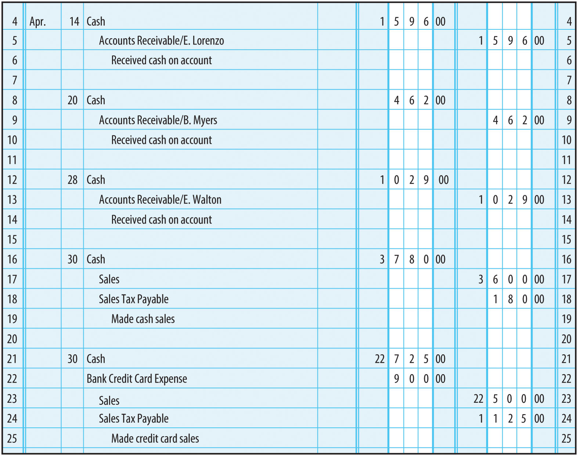
FIGURE 10-17 Cash Receipts Entered in General Journal

Slide 38
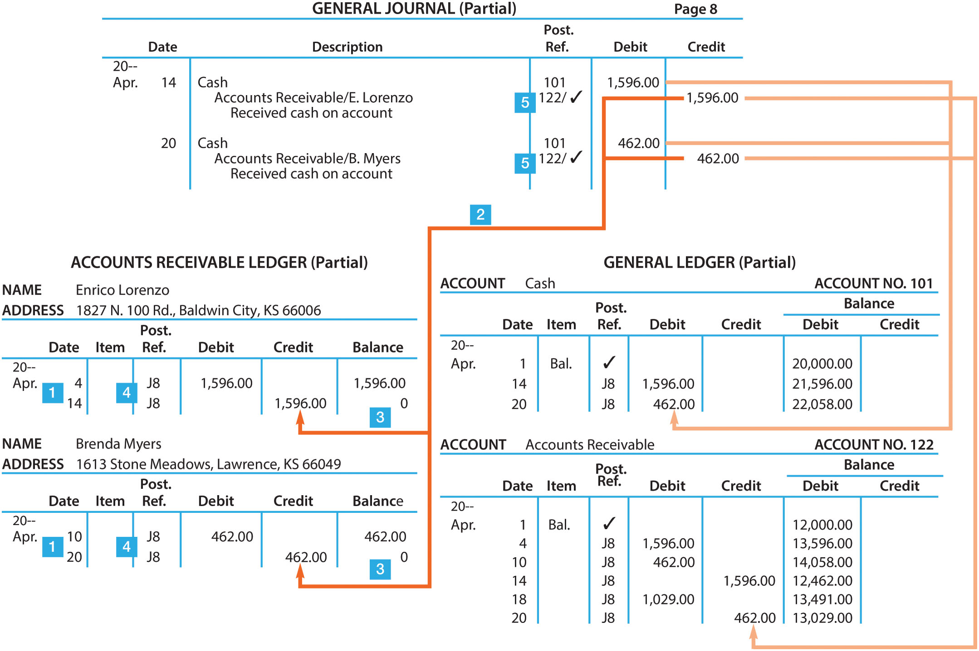
FIGURE 10-18 Posting Cash Receipts to the General Ledger and Accounts Receivable Ledger

Slide 39
Learning Objective 4
Prepare a schedule of accounts receivable

Slide 40
Schedule Of Accounts Receivable
Prepared to verify that the sum of the accounts receivable ledger balances equals the Accounts Receivable balance
An alphabetical or numerical listing of customer accounts and their balances
Usually prepared at the end of the month
The total calculated in the schedule is compared with the balance in Accounts Receivable in the general ledger

Slide 41
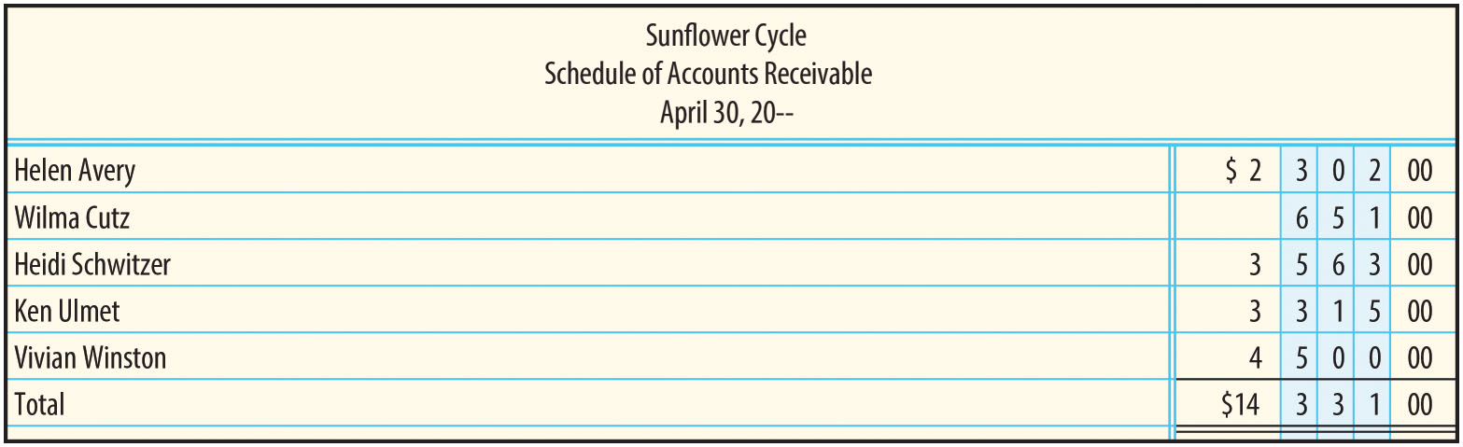
FIGURE 10-20 Schedule of Accounts Receivable

Slide 42
Finding Accounts Receivable Errors
If the total on the schedule of accounts receivable and the Accounts Receivable balance do not agree:
  Step 1: Verify the total of the schedule
  Step 2: Verify the postings to the accounts receivable ledger
  Step 3: Verify the postings to Accounts Receivable in the general ledger

