Slide 1

Special Journals
Chapter 12

Slide 2
Learning Objective 1
Describe, explain the purpose of, and identify transactions recorded in special journals

Slide 3
Special Journals Explained
Designed for recording only certain kinds of transactions
Can be created for almost any type of transaction
Save time journalizing and posting transactions
  Transactions are entered on a single line
  Summaries of column totals are posted periodically
A general journal is still needed for some transactions
  Adjusting and closing entries
  Transactions that occur infrequently

Slide 4
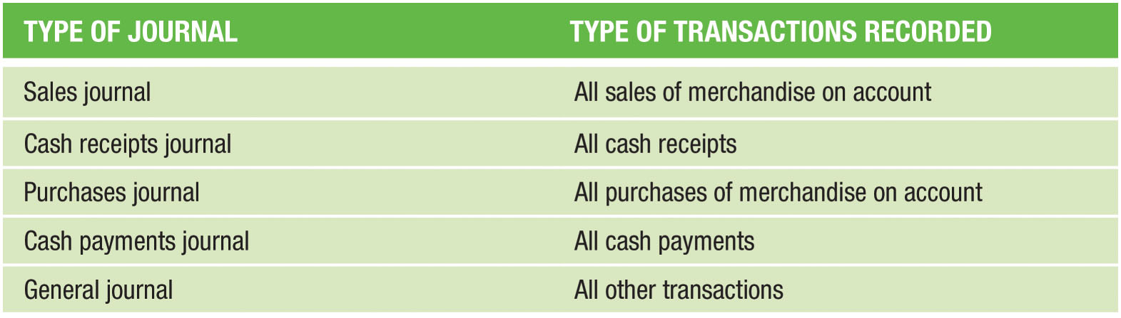
Types of Journals and Transactions (Figure 12-1)

Slide 5
Learning Objective 2
Describe and use the sales journal

Slide 6
Sales Transactions
These five transactions occurred:
  April 4 Made Sale No. 133C on account to Enrico Lorenzo, $1,520, plus $76 sales tax
  April 10 Made Sale No. 134C on account to Brenda Myers, $440, plus $22 sales tax
  April 18 Made Sale No. 105D on account to Edith Walton, $980, plus $49 sales tax
  April 21 Made Sale No. 202B on account to Wilma Cutz, $620, plus $31 sales tax
  April 24 Made Sale No. 162A on account to Heidi Schwitzer, $1,600, plus $80 sales tax

Slide 7
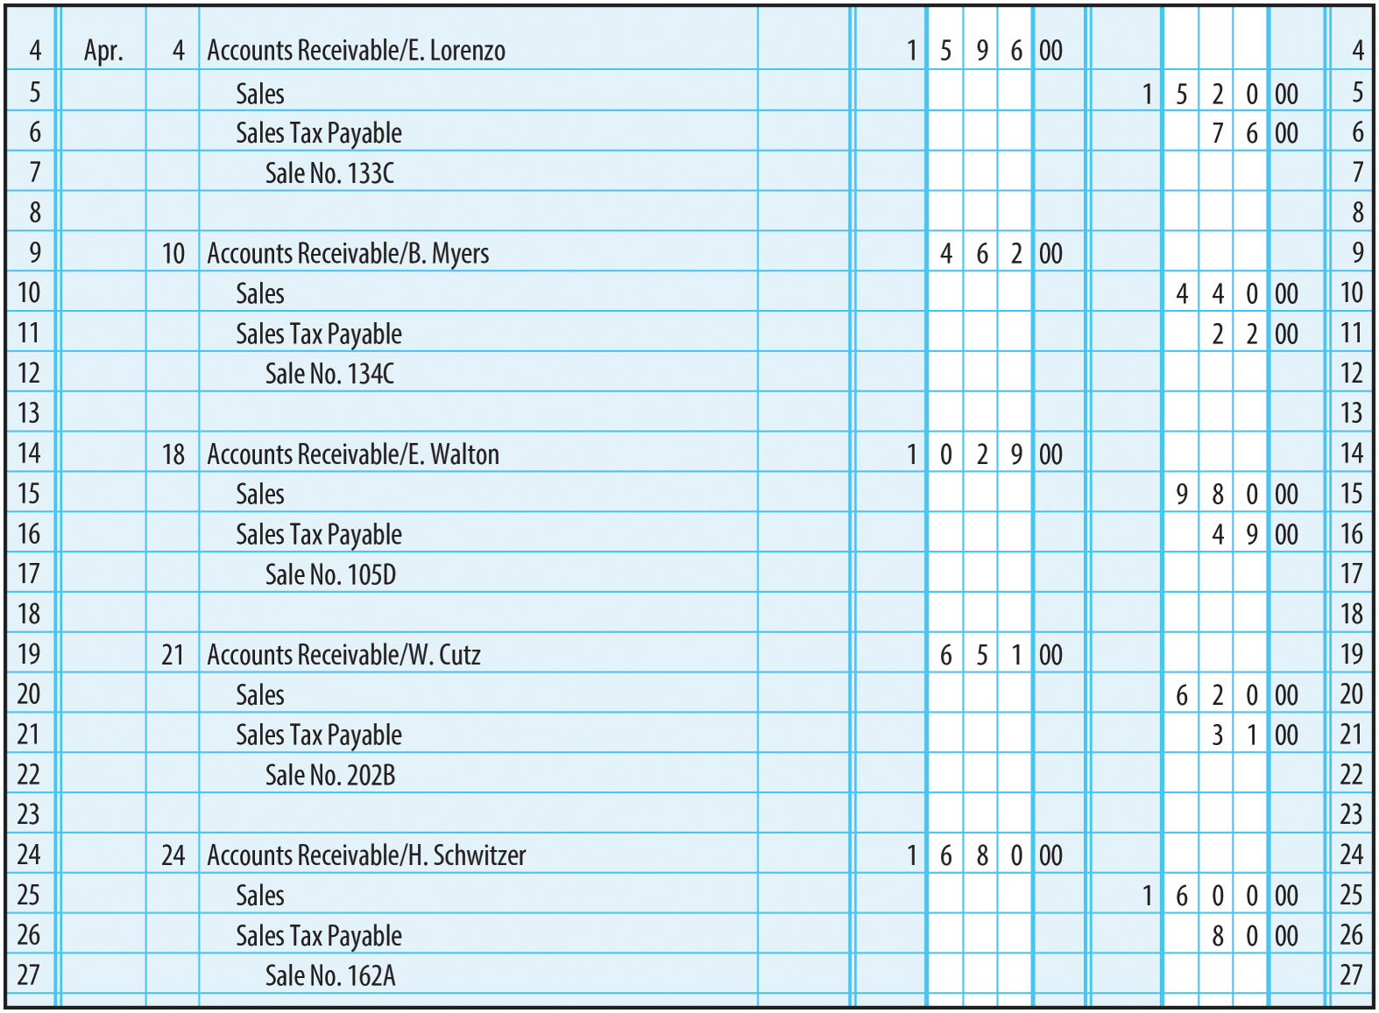
Sales Entered in General Journal (Figure 12-2)

Slide 8
Sales Journal
These transactions can be recorded more efficiently by using a sales journal
Sales Journal - Used to record only sales of merchandise on account
A sale is recorded in the sales journal by entering the following information:
  Date
  Sale number
  Customer (to whom sold)
  Dollar amounts

Slide 9
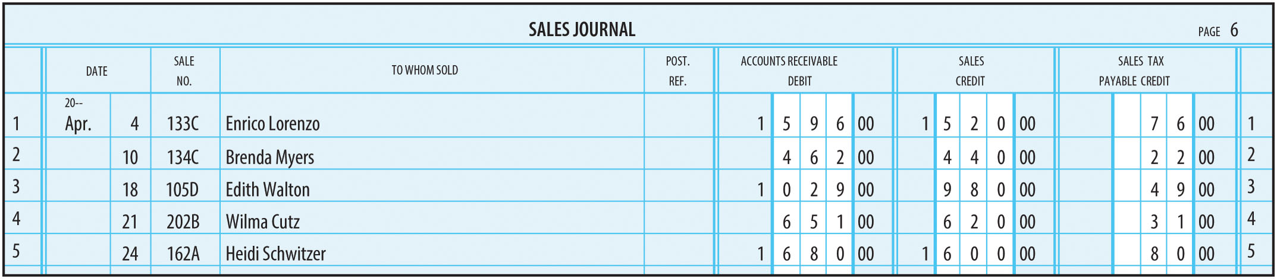
Sales Journal (Figure 12-3)
There is no need to enter any general ledger account titles, since they appear in the column headings

Slide 10
Posting The Sales Journal
In the sales journal:
  Step 1: Total the amount columns, verify that the total of the debit column equals the total of the credit columns, and rule the columns
In the ledger account:
  Step 2: Enter the date of the transaction in the Date column
  Step 3: Enter the amount of the debit or credit in the Debit or Credit column
  Step 4: Enter the new balance in the Balance column under Debit or Credit
  Step 5: Enter the initial “S” and the journal page number in the Posting Reference column
In the sales journal:
  Step 6: Enter the ledger account number immediately below the column totals for each account that is posted

Slide 11
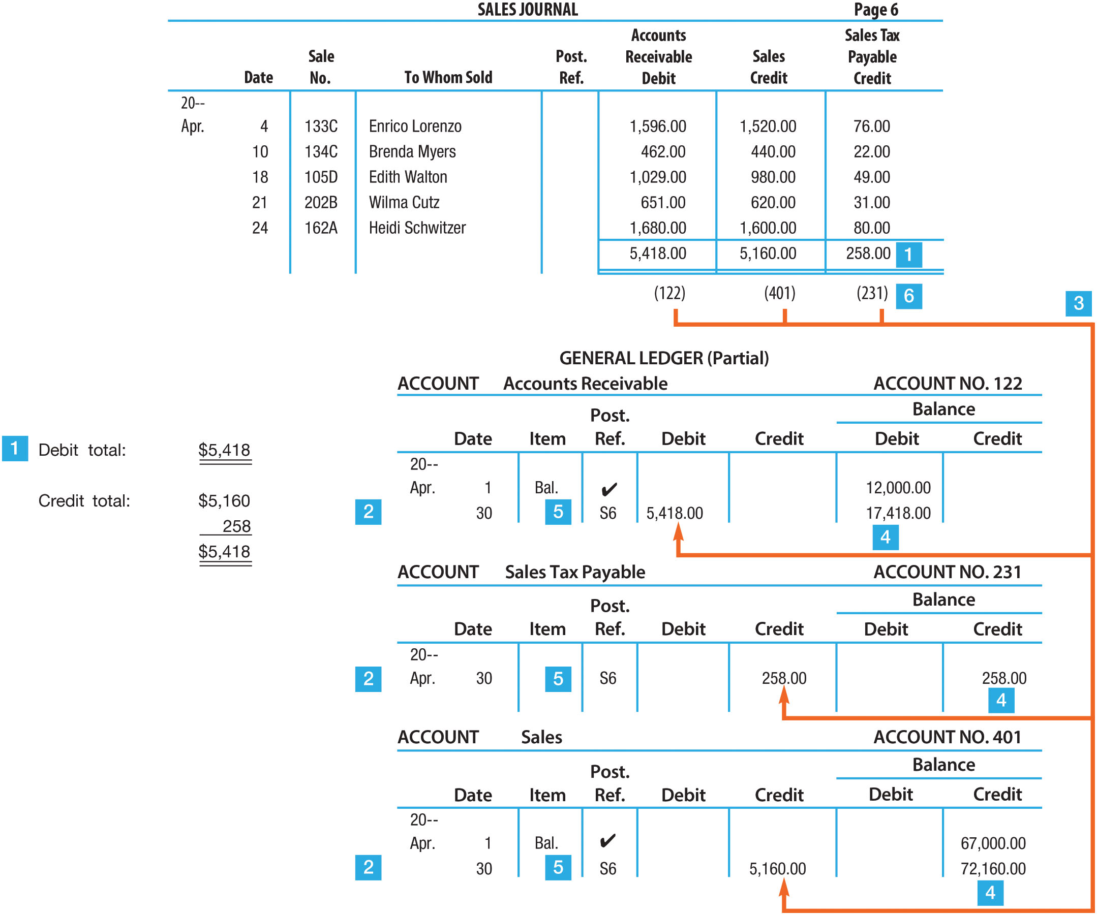
Posting The Sales Journal to the General Ledger (Figure 12-5)

Slide 12
Posting from the Sales Journal to the Accounts Receivable Ledger
Accounts receivable ledger is posted daily so that current information is available for each customer at all times
  In the accounts receivable ledger account:
    Step 1: Enter the date of the transaction in the Date column
    Step 2: Enter the amount of the debit or credit in the Debit or Credit column
    Step 3: Enter the new balance in the Balance column
    Step 4: Enter the initial “S” and the journal page number in the Posting Reference column
  In the sales journal:
    Step 5: Enter a check mark (✓) in the Posting Reference column of the journal for each transaction that is posted

Slide 13
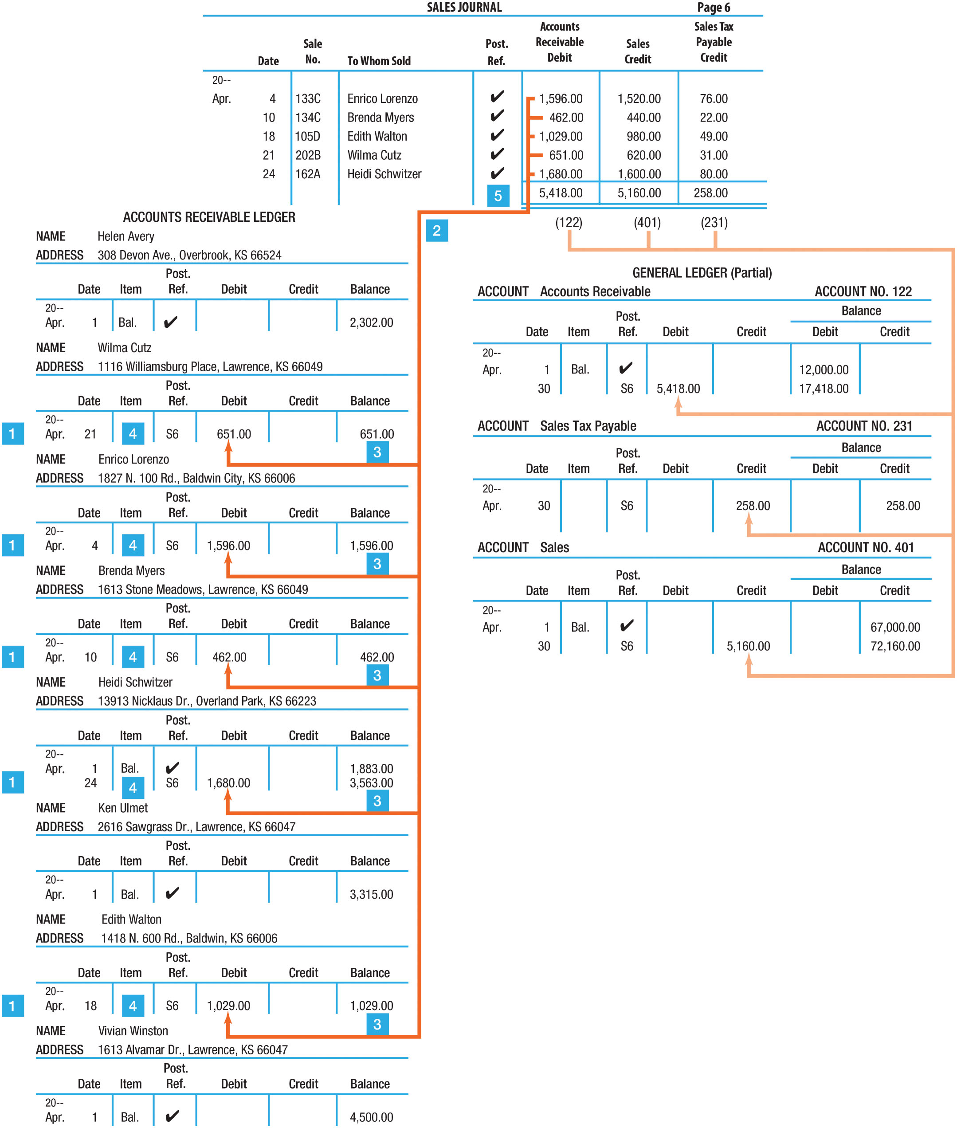
Posting from the Sales Journal to the Accounts Receivable Ledger (Figure 12-6)

Slide 14
Learning Objective 3
Describe and use the cash receipts journal

Slide 15
Cash Receipts Journal (1 of 2)
Used to record only cash receipt transactions
Includes separate columns for frequently used accounts, such as:
  Accounts Receivable Credit
  Sales Credit
  Sales Tax Payable Credit
  General Credit
  Bank Credit Card Expense Debit
  Cash Debit

Slide 16
Cash Receipts Journal (2 of 2)
Cash Receipts were as follows:
  April 14 Received cash on account from Enrico Lorenzo for Sale No. 133C, $1,596
  April 20 Received cash on account from Brenda Myers for Sale No. 134C, $462
  April 28 Received cash on account from Edith Walton for Sale No. 105D, $1,029
  April 30 Made cash sales for the month of $3,600 plus tax of $180
  April 30 Made bank credit card sales for the month of $22,500 plus tax of $1,125 – Bank credit card expenses on these sales are $900
  April 30 Received cash for rent revenue, $600
  April 30 Borrowed cash from the bank by signing a note, $3,000

Slide 17
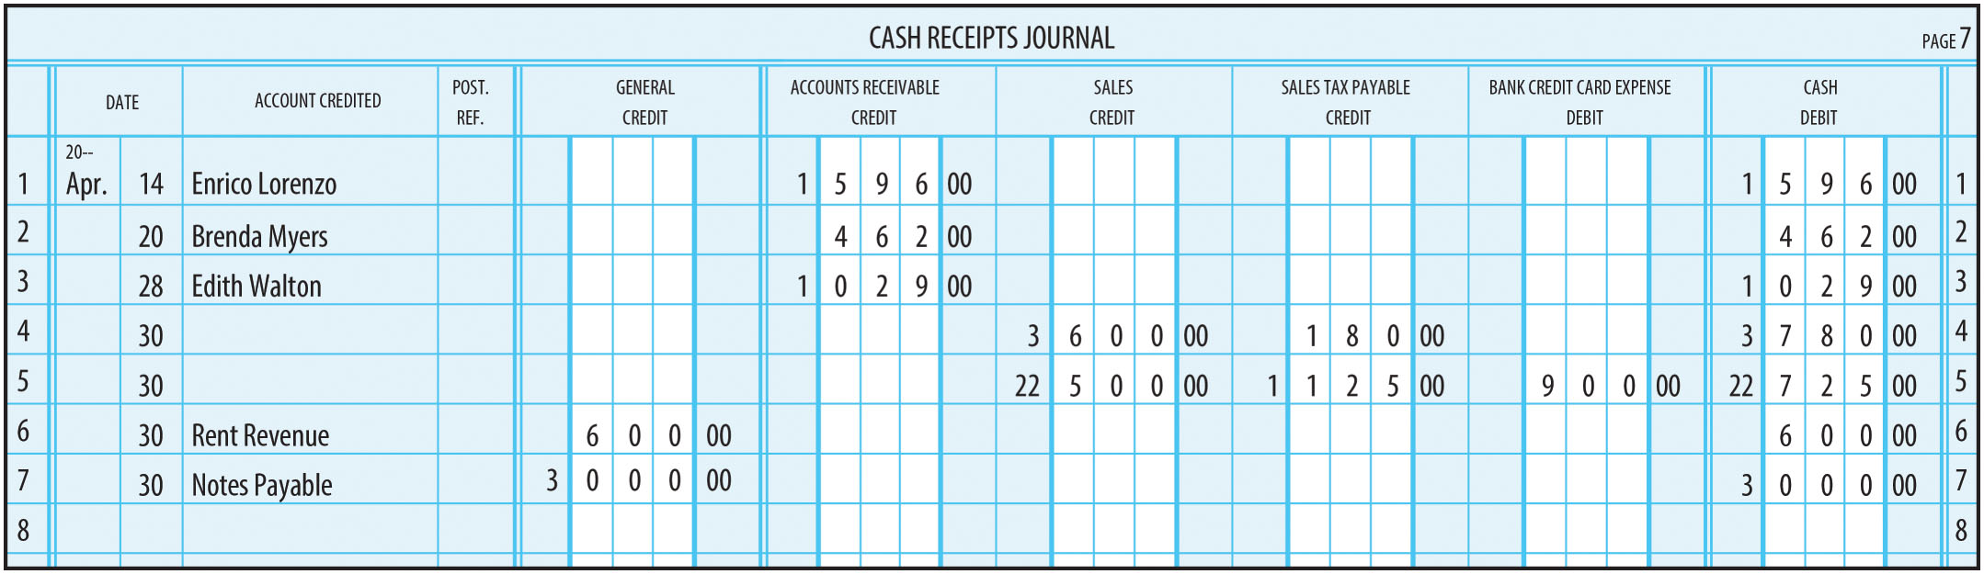
Cash Receipts Journal (Figure 12-7)
The Account Credited column is
  Used to identify the customer name for any collection on account
  Used to enter the appropriate account name whenever the General Credit column is used
  Left blank if the entry is for cash sales or bank credit card sales

Slide 18
Cash Receipts Journal Posting
On a daily basis, the amounts in the General Credit column are posted
At the end of the month, the other columns are totaled
Each column total (except the General Credit column) is posted at the end of the month
Postings to the subsidiary accounts receivable ledger are made daily

Slide 19
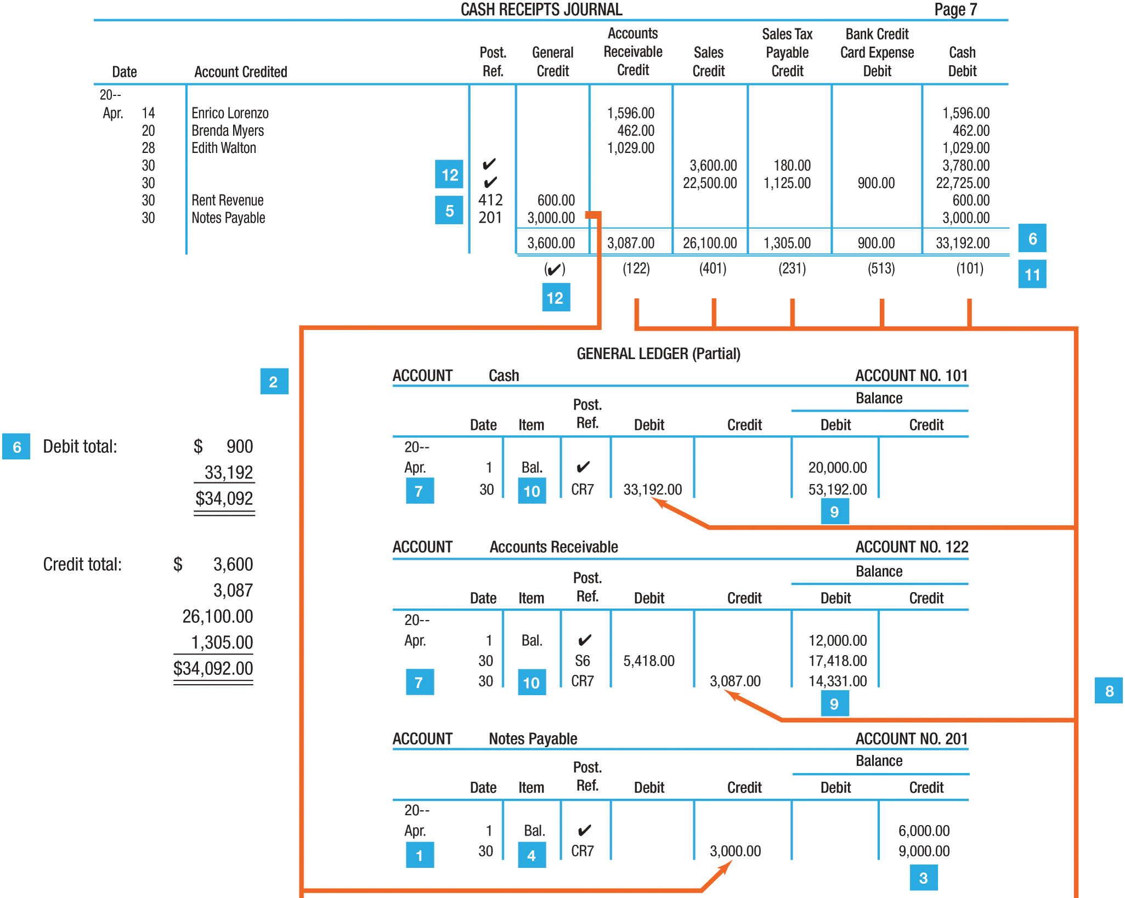
Posting from the Cash Receipts Journal to the General Ledger (Figure 12-9)

Slide 20
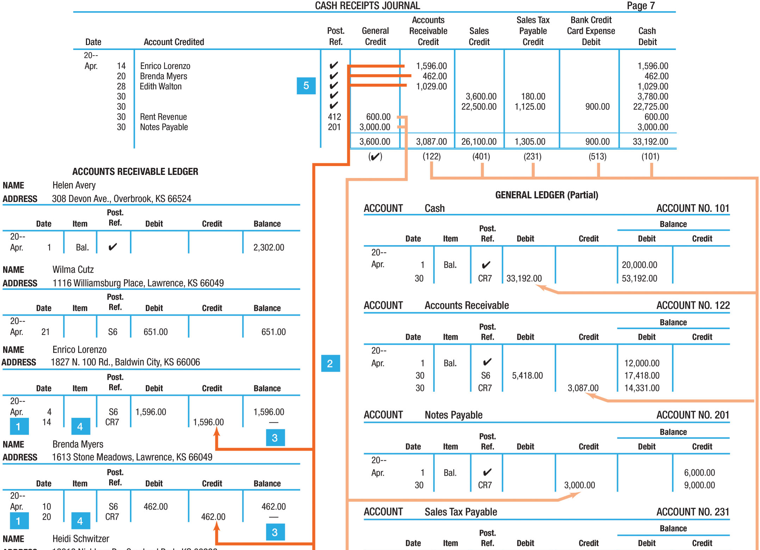
Posting from the Cash Receipts Journal to the Accounts Receivable Ledger
(Figure 12-10)

Slide 21
Learning Objective 4
Describe and use the purchases journal

Slide 22
Purchases Journal
Used to record only purchases of merchandise on account
  Cash purchases would be recorded in the cash payments journal
There are two types of formats:
  Single-column
    Purchases Debit/Accounts Payable Credit
  Three-column
    Purchases Debit
    Freight-In Debit
    Accounts Payable Credit

Slide 23
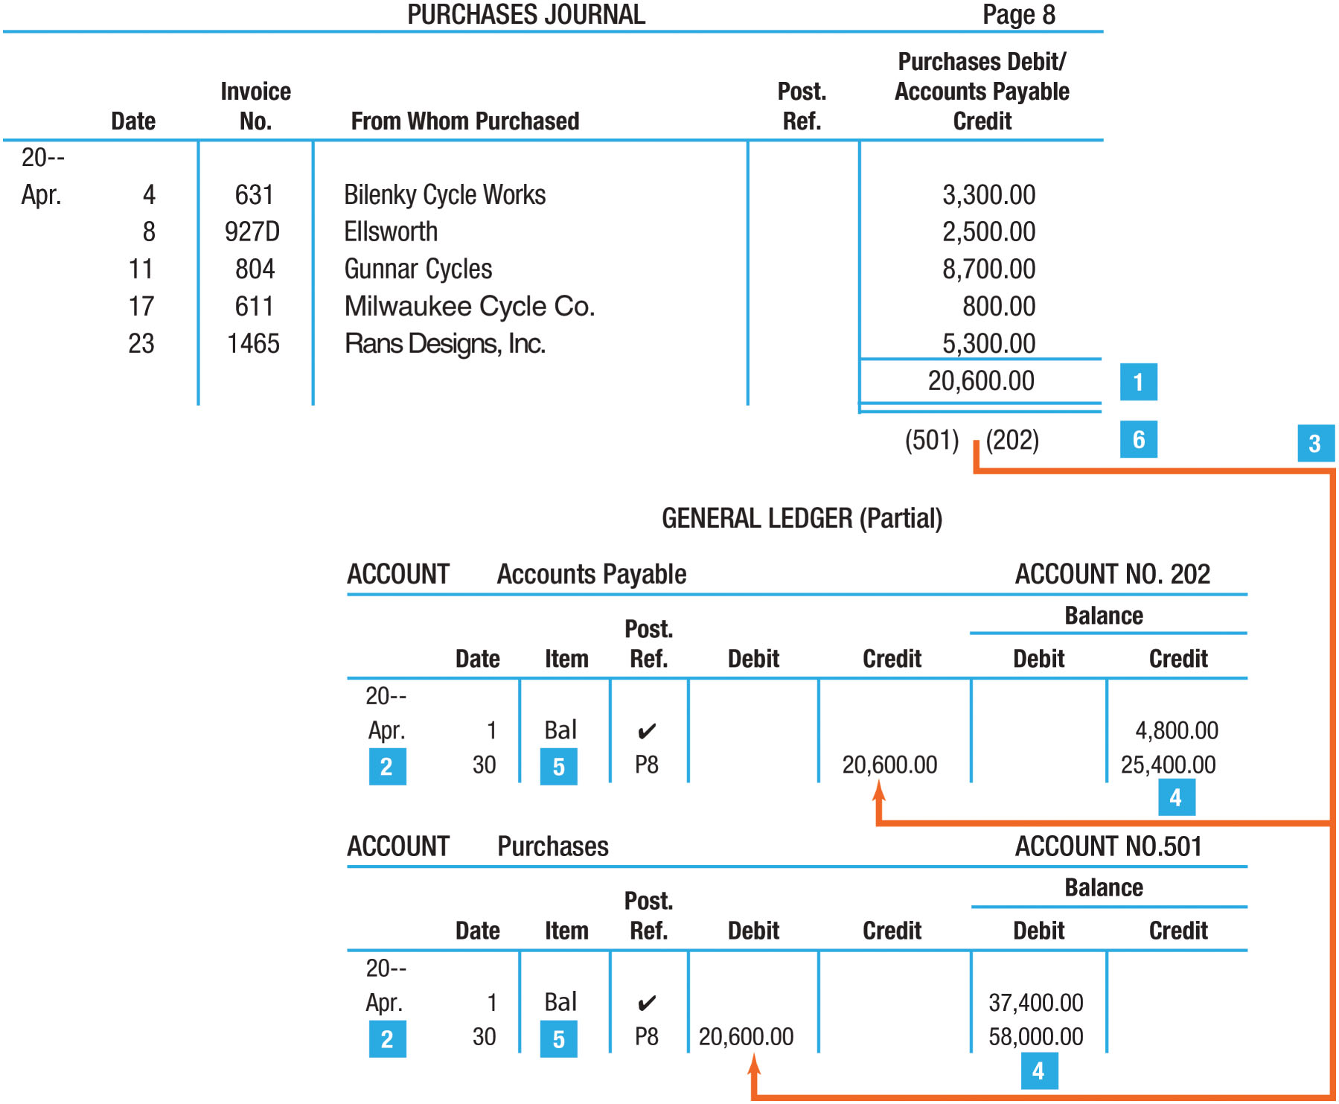
Figure 12-14 Posting From the Purchases Journal to the General Ledger

Slide 24
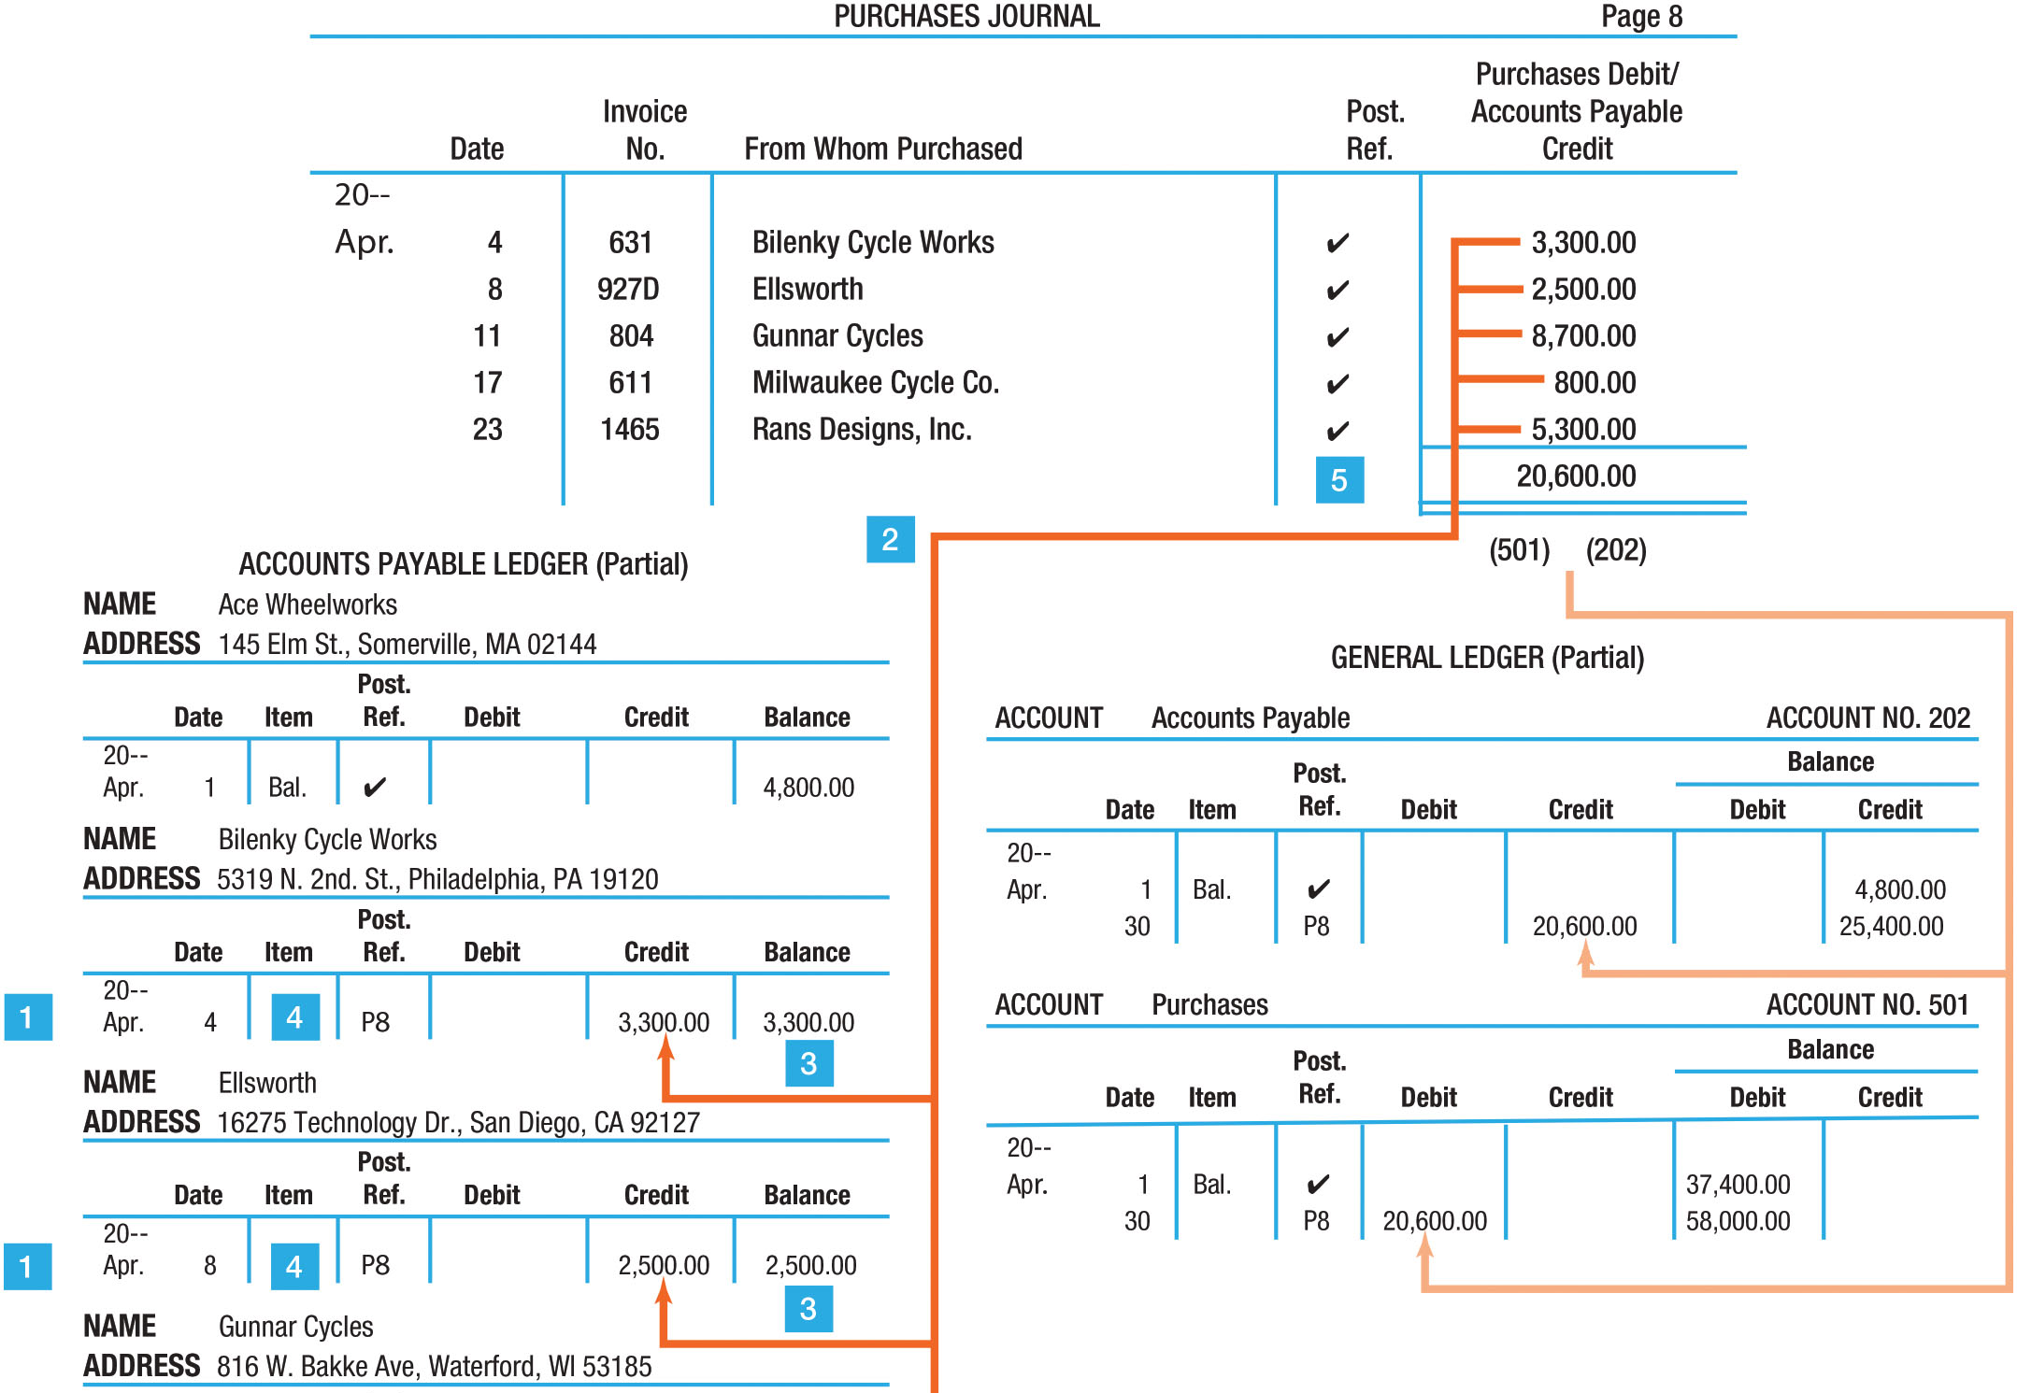
Figure 12-15 Posting From the Purchases Journal to the Accounts Payable Ledger

Slide 25
Learning Objective 5
Describe and use the cash payments journal

Slide 26
Cash Payments Journal (1 of 2)
Used to record only cash payments transactions
Every transaction in the journal will involve a credit to the cash account
Columns are set up in the journal for those accounts most frequently affected by cash payments transactions

Slide 27
Cash Payments Journal (2 of 2)
Five types of cash payments transactions are as follows:
  Payment of an expense (April 2)
  Cash purchase (April 4)
  Payment of an account payable (April 10 and 24)
  Payment of a note payable (April 14)
  Withdrawal by the owner (April 22)
These have been recorded in the Cash Payments Journal (shown on next slide)

Slide 28
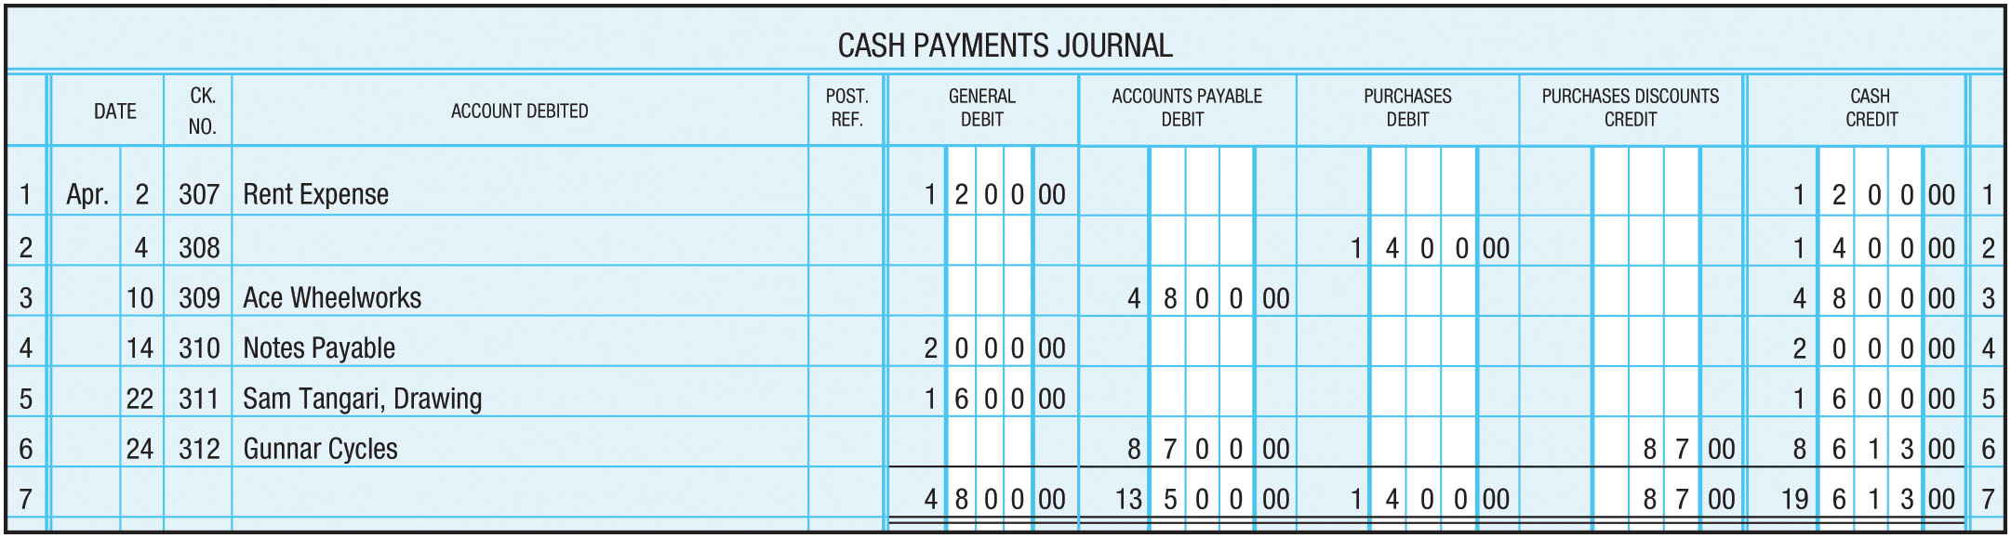
Cash Payments Journal (Figure 12-16)
General Debit column is provided for debits to any other accounts affected by cash payments transactions
For good internal control over cash payments, all payments (except out of petty cash) should be made by check; therefore, the cash payments journal also includes a Check Number column

Slide 29
Cash Payments Journal Posting
On a daily basis, the amounts in the General Debit column are posted
At the end of the month, the columns are totaled, the equality of debits and credits is verified, and the totals are posted to the general ledger

Slide 30
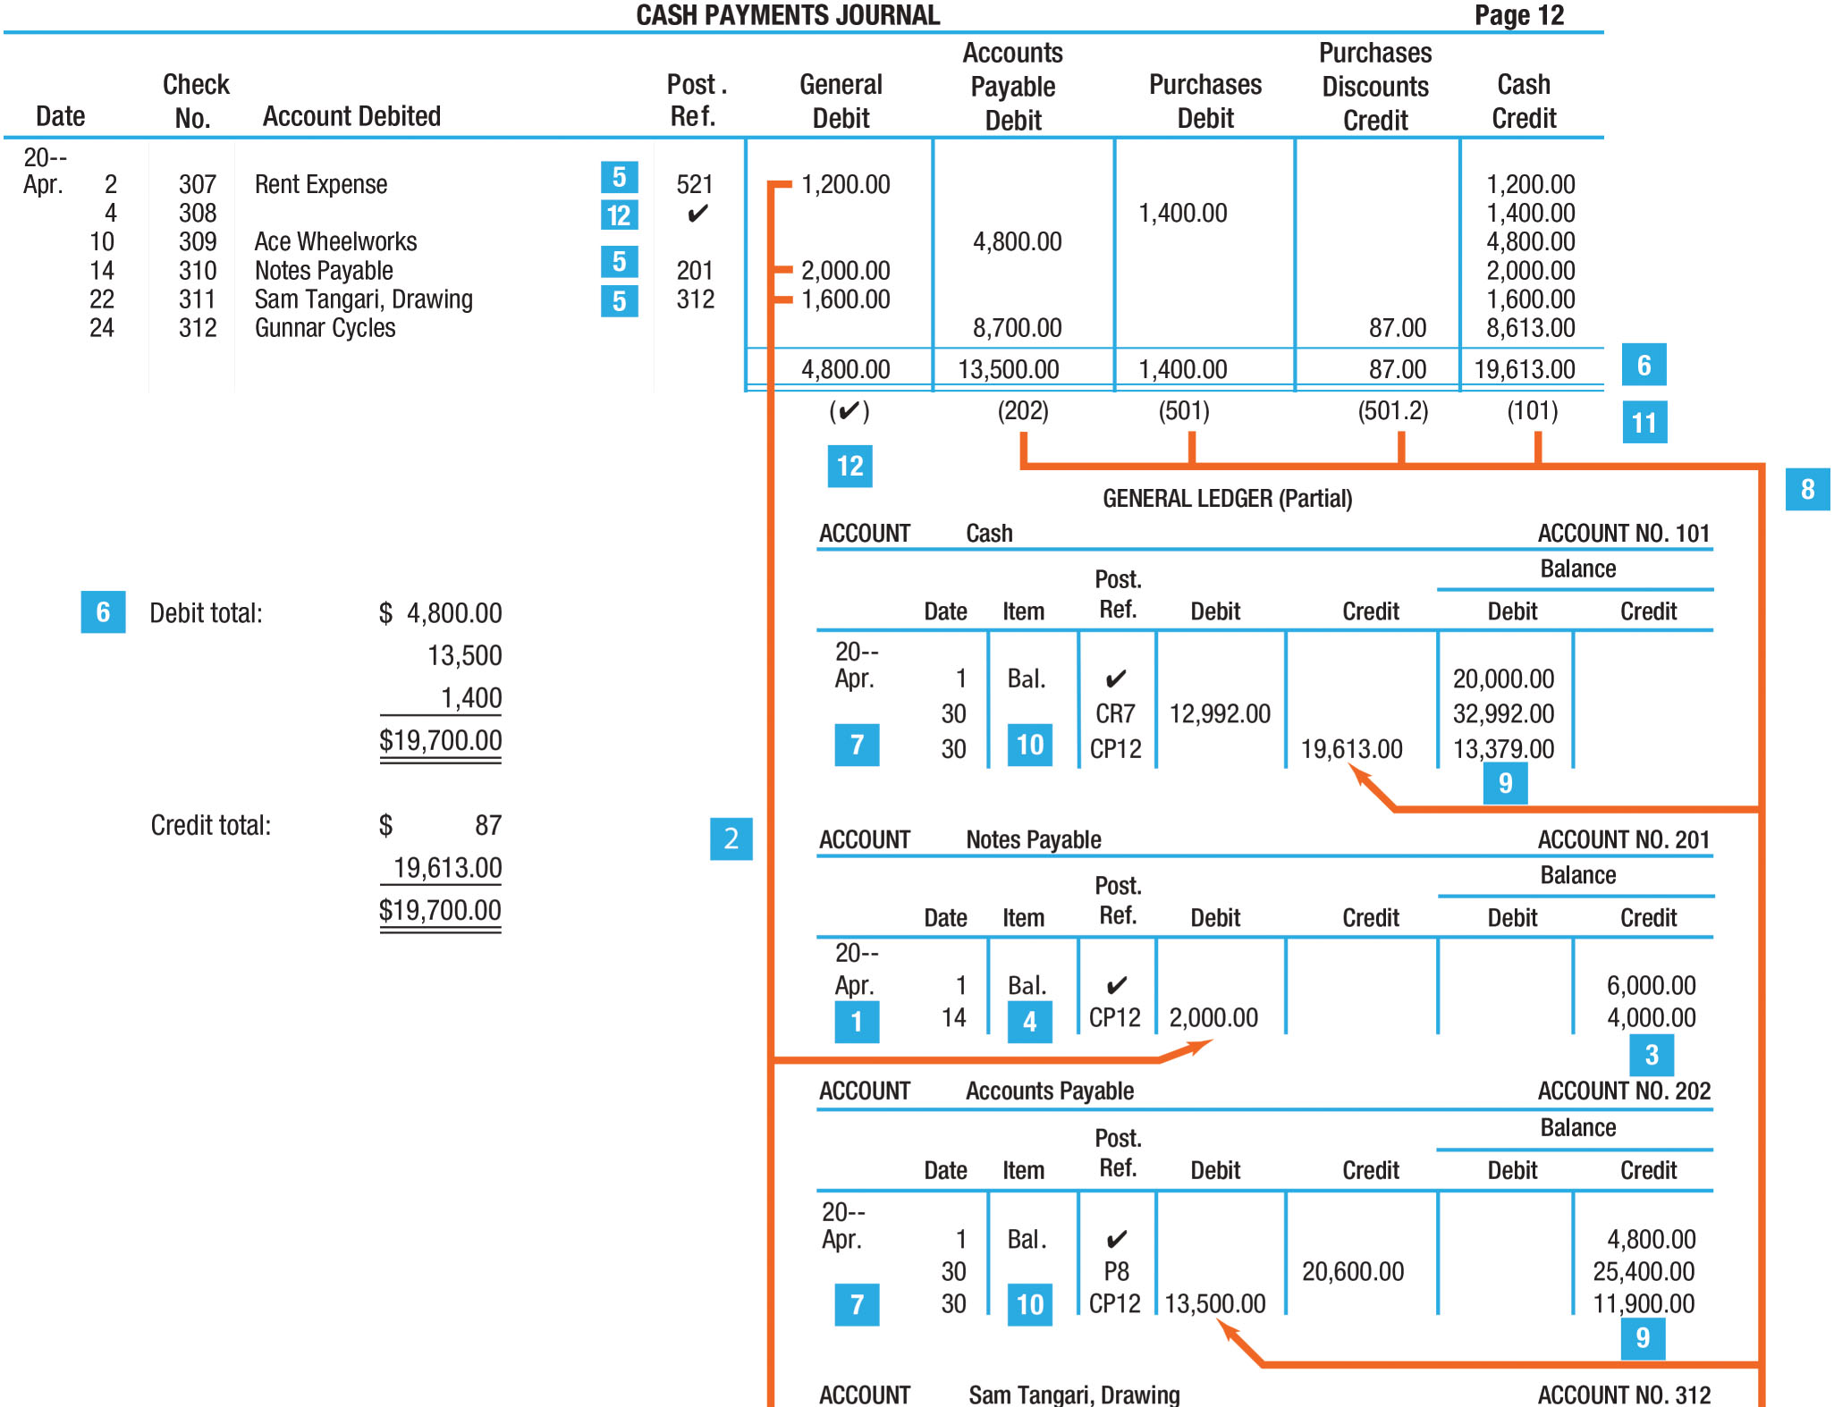
Posting from the Cash Payments Journal to the General Ledger
(Figure 12-17)

Slide 31
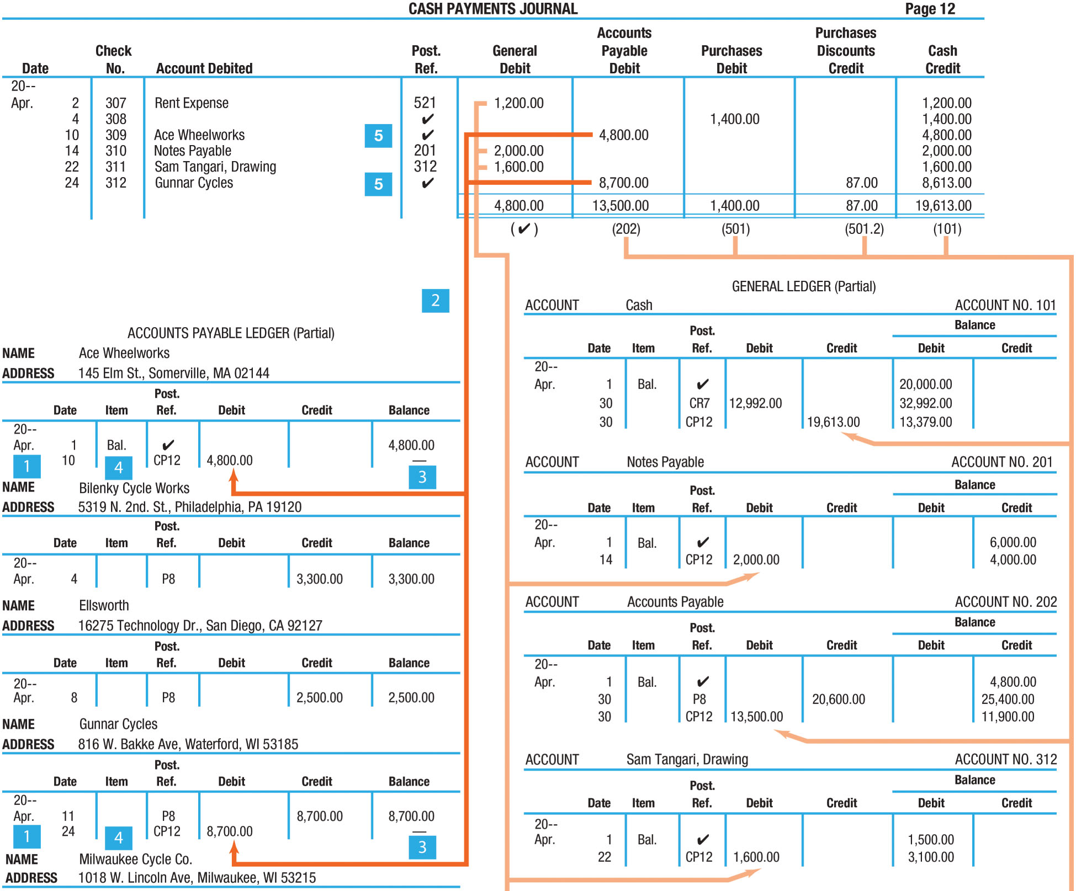
Posting from the Cash Payments Journal to the Accounts Payable Ledger (Figure 12-18)

