Slide 1
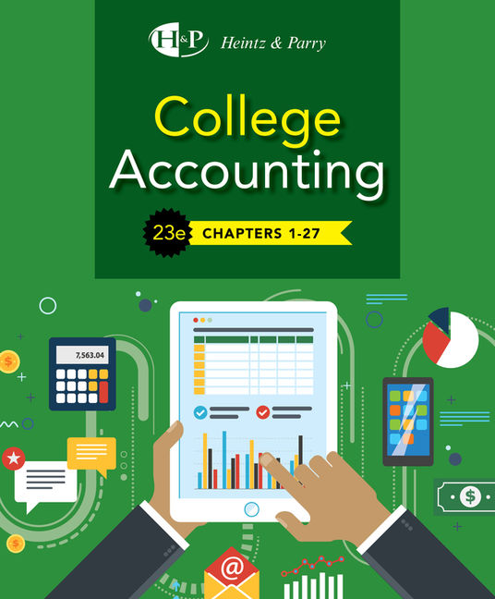
Introduction To Accounting
Chapter 1

Slide 2
Learning Objective 1
Describe the purpose of accounting

Slide 3
The Purpose of Accounting
To provide financial information about the current operations and financial condition of a business to individuals, agencies, and organizations

Slide 4
Who Are the Users of Accounting Information?
User | Information Needed | Decisions Made By Users
Owners—Present and future | Company’s profitability and current financial condition | If business is good, owners may consider making additional investments for growth. If business is poor, they may want to talk to management to find out why and may consider closing the business.
Managers—May or may not own business | Detailed measures of business performance | Managers need to make operating decisions. How much and what kinds of inventory should be carried? Is business strong enough to support higher wages for employees?
Creditors—Present and future | Company’s profitability, debt outstanding, and assets that could be used to secure debt | Should a loan be granted to this business? If so, what amount of debt can the business support, and what Interest rate should be charged?
Government Agencies—National, state, and local | Company’s profitability, cash flows, and overall financial condition | The IRS enforces U.S. tax laws to determine how much income tax the business must pay. Local governments may be willing to adjust property taxes paid by the business to encourage it to stay in town.

Slide 5
Learning Objective 2
Describe the accounting process

Slide 6
The Accounting Process
Accounting is a system of:
Gathering financial information about a business and
Reporting this information to users

Slide 7
Steps of the Accounting Process
ANALYZING
Looking at events that have taken place and thinking about how they affect the business
RECORDING
Entering financial information about events into the accounting system
CLASSIFYING
Sorting and grouping similar items together rather than merely keeping a simple, diary-like record of numerous events
SUMMARIZING
Aggregation of many similar events to provide information that is easy to understand
REPORTING
Telling the results
Using tables of numbers is common
INTERPRETING
Deciding the meaning and importance of the information in various reports

Slide 8
Learning Objective 3
Define GAAP and describe the process used by FASB to develop these principles

Slide 9
GAAP
Generally Accepted Accounting Principles (GAAP)
Rules to follow when preparing financial statements
Developed by the Financial Accounting Standards Board (FASB)
Procedures and guidelines to be followed in the accounting and reporting process

Slide 10
Process Used by FASB to Develop GAAP
Identify an accounting issue
Place the issue on the FASB’s agenda
Research the issue
Issue a Preliminary Views document to identify pros and cons of treatments
Hold public hearings
Issue an exposure draft
Consider feedback on the exposure draft
Issue a final Accounting Standards Update which amends the FASB Accounting Standards Codification

Slide 11
Learning Objective 4
Define three types of business ownership structures

Slide 12
Three Types of Ownership Structures
Sole proprietorship
Partnership
Corporation

Slide 13
Sole Proprietorship
One owner
Owner assumes all risk
Owner makes all decisions

Slide 14
Partnership
Two or more owners (partners)
Partners share risks
Partners may disagree on how to run the business

Slide 15
Corporation
Owned by stockholders
Stockholders have limited risk
Stockholders may have little influence on business decisions

Slide 16
Learning Objective 5
Classify different types of businesses by activities

Slide 17
Types of Businesses
Service business
Merchandising business
Manufacturing business

Slide 18
Service Business
A business that provides a service
Travel Agency
Computer Consultant
Physician

Slide 19
Merchandising Business
A business that buys a product from another business to sell to customers
Department Store
Pharmacy
Grocery Store

Slide 20
Manufacturing Business
A business that makes a product to sell
Automobile Manufacturer
Furniture Maker
Toy Factory

Slide 21
Learning Objective 6
Identify career opportunities in accounting

Slide 22
Career Opportunities (1 of 2)
Accounting Clerks
Record, sort, and file accounting information
Often in one area such as cash, payroll, accounts receivable, accounts payable, inventory, or purchases
Involved with only a small portion of the total accounting responsibilities for the firm

Slide 23
Career Opportunities
Bookkeepers
Supervise the work of accounting clerks
Assist with daily accounting work
Summarize accounting information
One to two years of accounting education and experience as an accounting clerk
Para-Accountants
Provide many accounting, auditing, or tax services
Under the direct supervision of an accountant
Two-year degree or significant accounting and bookkeeping experience

Slide 24
Accountants
Design the accounting information system
Focus on analyzing and interpreting information
Look for important trends in the data
Study the impact of alternative decisions
Enter the field with a college degree in accounting

Slide 25
Accounting Careers
Public Accounting
Private Accounting
Governmental and Not-for-Profit Accounting

Slide 26
Public Accounting
Offer services to the public
Auditing
Taxation
Management Advisory Services
Forensic Accounting
Certifications for public accountants
CPA (Certified Public Accountant)
CFE (Certified Fraud Examiner)

Slide 27
Private (Managerial) Accounting
Employees of private businesses
Provide a variety of services:
Accounting Information Systems
Financial, Cost, and Tax Accounting
Budgeting
Internal Auditing
Controller—principal accounting officer of the company
Certifications:
CMA (Certified Managerial Accountant)
CIA (Certified Internal Auditor)

Slide 28
Governmental and Not-for-Profit Accounting
Work in all levels of government
Also employed by schools, churches, hospitals, etc.
Gather and report financial information, but rules are somewhat different

Slide 29
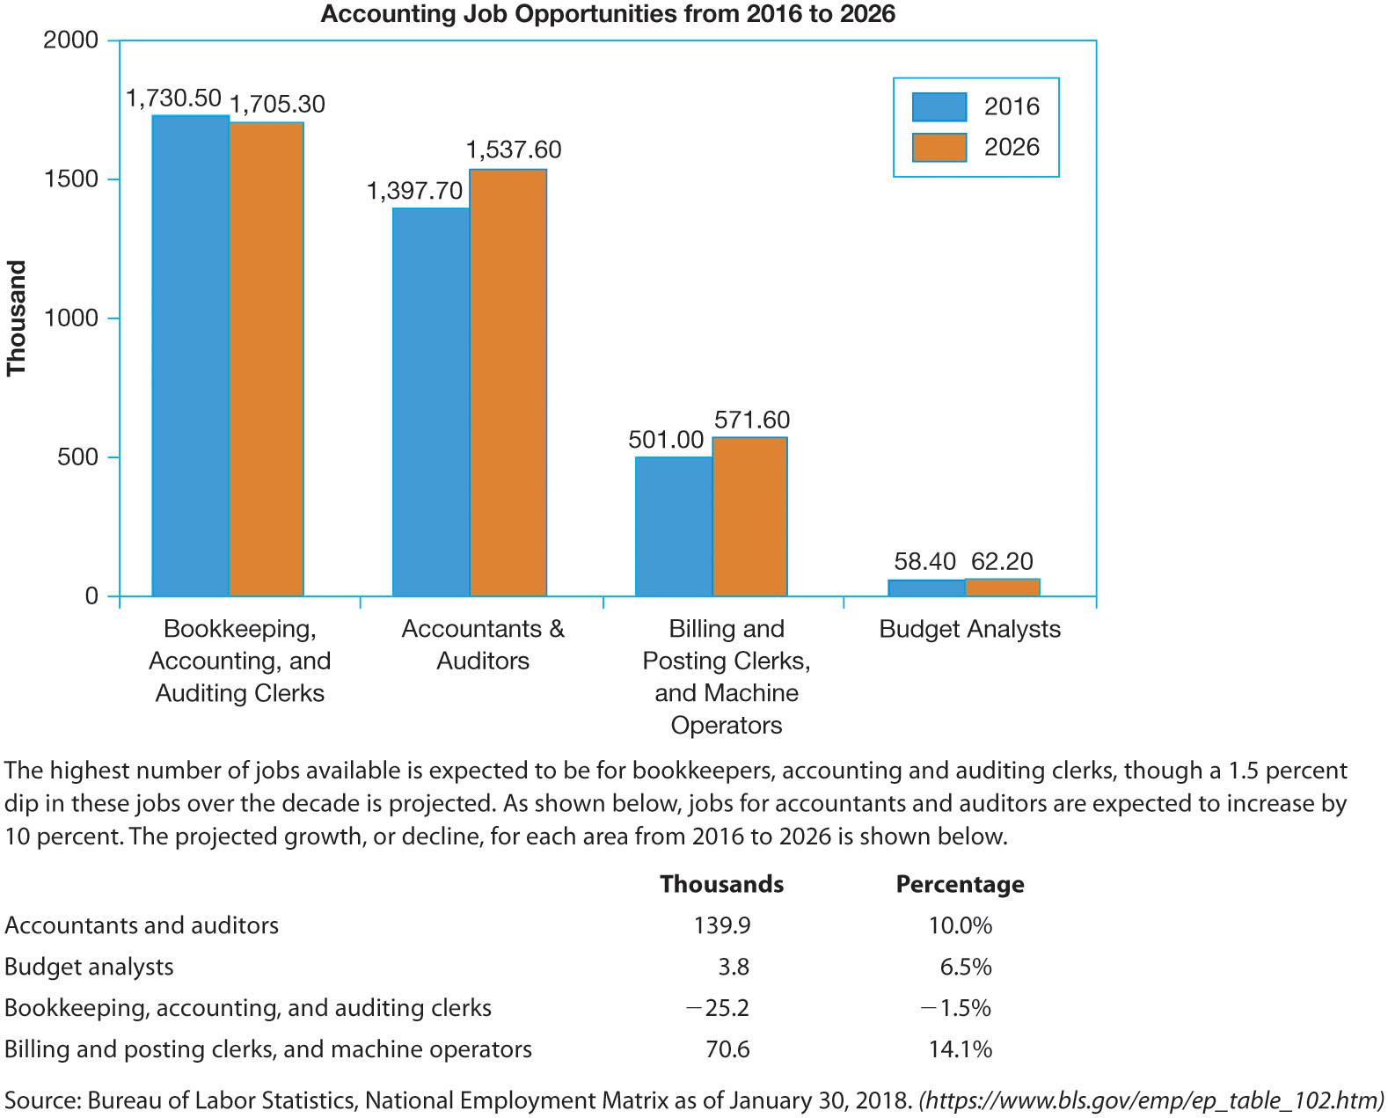
Accounting Jobs Expected Demand
FIGURE 1-7 Expected Demand

Slide 30
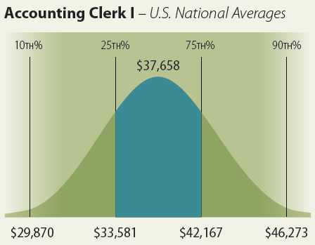
Job Descriptions in the Accounting Profession (1 of 6)
ACCOUNTING CLERK I Performs routine accounting activities such as maintenance of the general ledger, preparation of various accounting statements, and financial reports. Posts journal entries and verifies billings, invoices, and checks. Assists in completing moderately complex calculations. Reconciles accounts and bank statements. Has a basic understanding of bookkeeping and accounting principles. Is proficient with spreadsheets and other software tools. Typically requires a high school diploma. Typically reports to a supervisor or manager. Possesses a moderate understanding of general aspects of the job. Works under the close direction of senior personnel in the functional area. May require 0-1 year of general work experience.

Slide 31
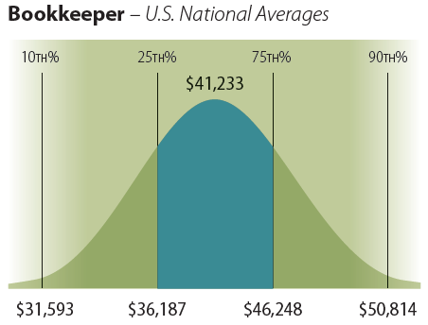
Job Descriptions in the Accounting Profession (2 of 6)
BOOKKEEPER Maintains and records a complete and systematic set of business transactions. Balances ledgers, reconciles accounts, and prepares reports to show receipts, expenditures, accounts receivable, and payable. Follows bookkeeping procedures established by the organization. May require an associate's degree or its equivalent. Typically reports to a supervisor or a manager. Gaining or has attained full proficiency in a specific area of discipline. Works under moderate supervision. Typically requires 1-3 years of related experience.

Slide 32
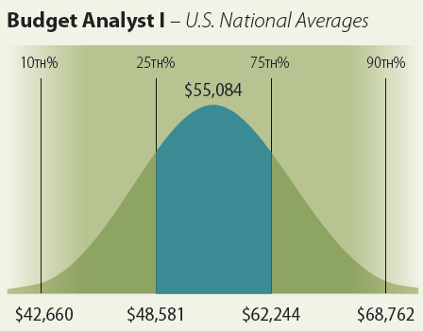
Job Descriptions in the Accounting Profession (3 of 6)
BUDGET ANALYST I Analyzes an organization's accounting records to determine financial resources required. Plans, analyzes, and prepares the organization's budget activities according to previous budget figures and estimated revenue. Makes recommendations for budget allocations to ensure conformance to budgetary limits. Keeps track of expenses, inventories, and budget balances. Prepares financial reports. Requires a bachelor's degree. Typically reports to a supervisor or manager. Works on projects/matters of limited complexity in a support role. Work is closely managed. Typically requires 0-2 years of related experience.

Slide 33
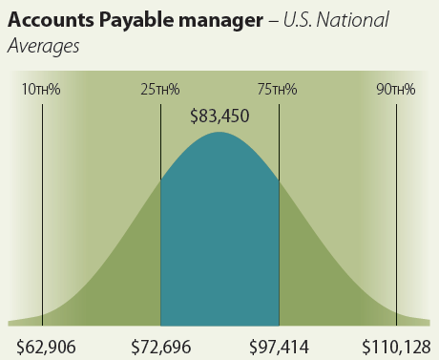
Job Descriptions in the Accounting Profession (4 of 6)
ACCOUNTS PAYABLE MANAGER Manages all activities in the accounts payable function. Ensures timely payments of vendor invoices and expense vouchers and maintains accurate records and control reports. Reviews applicable accounting reports and accounts payable register to ensure accuracy. Typically requires a bachelor's degree. Typically reports to a head of a unit/department. Manages subordinate staff in the day-to-day performance of their jobs. True first-level manager. Ensures that project/department milestones/goals are met and adhering to approved budgets. Has full authority for personnel actions. Extensive knowledge of department processes. Typically requires 5 years experience in the related area as an individual contributor. 1 to 3 years supervisory experience may be required.

Slide 34
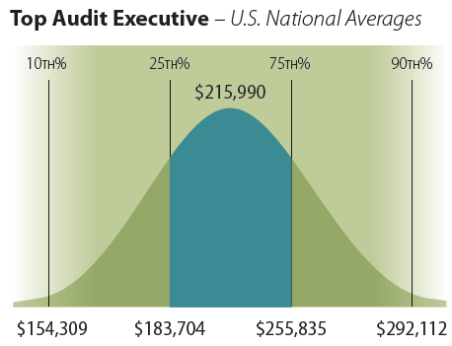
Job Descriptions in the Accounting Profession (5 of 6)
TOP AUDIT EXECUTIVE Oversees all aspects of an organization's auditing function. Plans and directs all accounting and financial data. Designs internal auditing procedures and ensures they are followed. Monitors procedures for effectiveness and provides recommendations for improvement. Requires a bachelor's degree. Typically reports to top management. Manages a business unit, division, or corporate function with major organizational impact. Establishes overall direction and strategic initiatives for the given major function or line of business. Has acquired the business acumen and leadership experience to become a top function or division head.

Slide 35
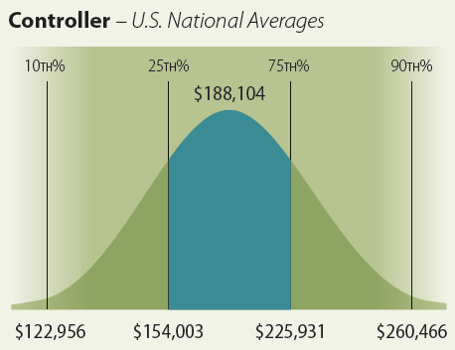
Job Descriptions in the Accounting Profession (6 of 6)
CONTROLLER Leads and directs an organization's accounting functions. Establishes and maintains the organization's overall accounting systems, procedures, and policies. Directs all analysis and reporting of financial information including budgets, planning, and required filings and reports. Presents findings and recommendations to management. Requires a bachelor's degree of accounting or finance. Typically reports to Chief Financial Officer (CFO). Typically requires CPA. Manages a departmental function within a broader corporate function. Develops major goals to support broad functional objectives. Approves policies developed within various sub-functions and departments. Comprehensive knowledge of the overall departmental function. Typically requires 8+ years of managerial experience.

