Slide 1

Analyzing Transactions: The Accounting Equation
Chapter 2

Slide 2
Learning Objective 1
Define the accounting elements

Slide 3
Business Entity
An individual, association, or organization that engages in economic activities and controls specific economic resources
The business entity’s finances are kept separate from the owner’s nonbusiness assets and liabilities (business entity concept)

Slide 4
Business Entity Concept
The owner of a business may have business assets and liabilities as well as nonbusiness assets and liabilities
Nonbusiness assets and liabilities are not included in the business entity’s accounting records
If the owner invests money or other assets in the business, the investment is now reclassified as a business asset

Slide 5
Assets
Items owned by a business that will provide future benefits
  Must be owned, not rented
  Do not have to be paid off – might still be making payments
Examples:
  Cash
  Merchandise
  Furniture
  Fixtures
  Machinery
  Buildings
  Land
  Accounts Receivable

Slide 6
Accounts Receivable
The amount of money owed to the business by its customers as a result of making sales “on account” or “on credit”
Simply put, the customers have promised to pay sometime in the future

Slide 7
Liabilities
Something owed to another business entity
A probable future outflow of assets as the result of a past transaction or event
  Debts or obligations of the business that can be paid with cash, goods, or services
Examples:
  Accounts payable
  Notes payable

Slide 8
Accounts Payable
An unwritten promise to pay a supplier for assets purchased or services received
Referred to as making a purchase “on account” or “on credit”
  Be careful! Don’t confuse accounts receivable and accounts payable. Ask yourself: Are we waiting to receive? Or waiting to pay?

Slide 9
Notes Payable
Formal written promises to pay suppliers or lenders specified sums of money at definite future times

Slide 10
Owner’s Equity
Amount by which the business assets exceed the business liabilities
  Also called:
    Net Worth
    Capital

Slide 11
A Broader View
Assets and the Cost of Products We Buy
Next time you buy something, think of all the assets a company needs to produce that product. If the product comes from a capital-intensive industry, one that requires heavy investments in assets, the company must price the product high enough to cover the cost of using the assets and replacing them when they wear out. For example, AT&T recently reported that the cost of property, plant, and equipment used for operating purposes came to over $319 billion.

Slide 12
Learning Objective 2
Construct the accounting equation

Slide 13
The Accounting Equation
Assets = Liabilities + Owner’s Equity
Assets: The left side shows the assets
Liabilities + Owner’s Equity: The right side shows where the money came from to buy the assets

Slide 14
Example
If a business has total assets of $60,400 and total liabilities of $5,400, what is the owner’s equity?
  Once the debts are paid, the remaining assets belong to the owner (owner’s equity).
  ASSETS - LIABILITIES = OWNER’S EQUITY
    Extrapolated from the basic accounting equation: Assets = Liabilities + Owner’s Equity
    $60,400 - $5,400 = $55,000
    Note: The accounting equation must always remain in balance!

Slide 15
Learning Objective 3
Analyze business transactions

Slide 16
Business Transaction
An economic event that has a direct impact on the business
Usually requires an exchange with an outside entity
Must be able to measure this exchange in dollars
All business transactions affect the accounting equation through specific accounts

Slide 17
Account
A separate record used to summarize changes in each asset, liability, and owner's equity of a business

Slide 18
Analyzing Business Transactions
Three Questions:
  What happened?
    Make certain you understand the event that has taken place
  Which accounts are affected?
    Identify the accounts that are affected
    Classify these accounts as assets, liabilities, or owner’s equity
  How is the accounting equation affected?
    Determine which accounts have increased or decreased
    Make certain that the accounting equation remains in balance after the transaction has been entered

Slide 19
Learning Objective 4
Show the effects of business transactions on the accounting equation

Slide 20
Mitchell’s Campus Delivery
Let’s analyze the effect of transactions on the accounting equation

Slide 21
Transaction (a): Investment by owner (1 of 2)
Mitchell Williams, the owner, invested $5,000 in the business
What happened?
  Mitch took $5,000 from his personal bank account and deposited it in a new account in the business’s name.
Identify the accounts that are affected
  Cash
  Mitchell Williams, Capital

Slide 22
Transaction (a): Investment by owner (2 of 2)
Classify these accounts as assets, liabilities, or owner’s equity
    Cash - Asset
    M. W. Capital – Owner’s Equity
Determine which accounts have increased or decreased
    Cash – Increased
    M. W. Capital – Increased
Does the accounting equation balance?
    ASSETS = LIABILITIES + OWNER’S EQUITY
    Assets of $5,000 = Liabilities of $0 + Owner’s Equity of $5,000

Slide 23
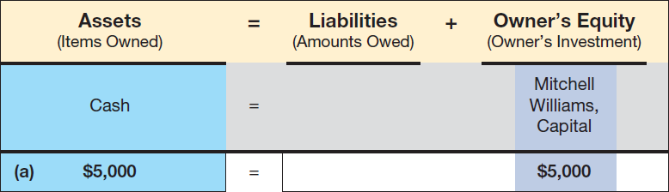
Transaction (a): Accounting Equation

Slide 24
Transaction (b): Purchase of an Asset for Cash
(1 of 2)
What happened?
    Mitch bought delivery equipment for $2,000 cash
Identify the accounts that are affected
    Cash
    Delivery Equipment
Classify these accounts as assets, liabilities, or owner’s equity
    Cash — Asset
    Delivery Equipment — Asset

Slide 25
Transaction (b): Purchase of an Asset for Cash
(2 of 2)
Determine which accounts have increased or decreased
    Cash – Decreased
    Delivery Equipment – Increased
Does the accounting equation balance?
    ASSETS = LIABILITIES + OWNER’S EQUITY
    Assets of $5,000 = Liabilities of $0 + Owner’s Equity of $5,000
ASSETS = LIABILITIES + OWNER’S EQUITY
  Traded one asset for another
    Cash for Delivery Equipment
  One asset increased, another decreased – Total assets unchanged
  LIAB. + O. E.: The right hand side of the equation is not affected.

Slide 26
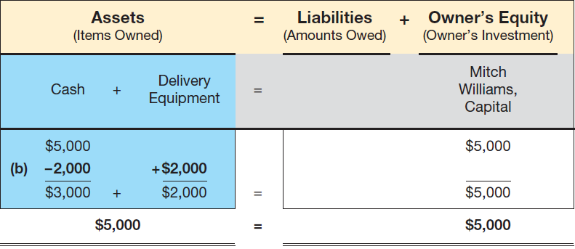
Transaction (b): Accounting Equation

Slide 27
Transaction (c): Purchase of an Asset on Account
(1 of 2)
What happened?
    Mitch bought delivery equipment for $1,800 “on account”
    Payments will be made over the next three months
    No cash was exchanged today
Identify the accounts that are affected
    Delivery Equipment
    Accounts Payable
Classify these accounts as assets, liabilities, or owner’s equity
    Delivery Equipment – Asset
    Accounts Payable – Liability

Slide 28
Transaction (c): Purchase of an Asset on Account
(2 of 2)
Determine which accounts have increased or decreased
    Delivery Equipment – Increased
    Accounts Payable – Increased
Does the accounting equation balance?
    ASSETS = LIABILITIES + OWNER’S EQUITY
    Assets of $6,800 = Liabilities of $1,800 + Owner’s Equity of $5,000
  Asset acquired for promise to pay “in the future”
  Assets increased, but so do Liabilities (promise to pay)
  Assets increased by $1,800 – Liabilities increased by $1,800

Slide 29
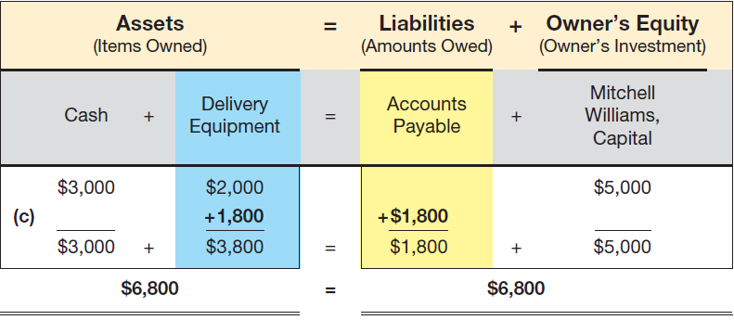
Transaction (c): Accounting Equation

Slide 30
Transaction (d): Payment on a loan
(1 of 2)
What happened?
    Mitch paid the first installment on the scooter of $600
Identify the accounts that are affected
    Cash
    Accounts Payable
Classify these accounts as assets, liabilities, or owner’s equity
    Cash – Asset
    Accounts Payable – Liability

Slide 31
Transaction (d): Payment on a loan
(2 of 2)
Determine which accounts have increased or decreased
    Cash – Decreased
    Accounts Payable – Decreased
Does the accounting equation balance?
    ASSETS = LIABILITIES + OWNER’S EQUITY
    Assets of $6,200 = Liabilities of $1,200 + Owner’s Equity of $5,000
  Cash (asset) decreased by $600
  Accounts Payable (liability) decreased by $600
  Owner’s Equity was unchanged

Slide 32
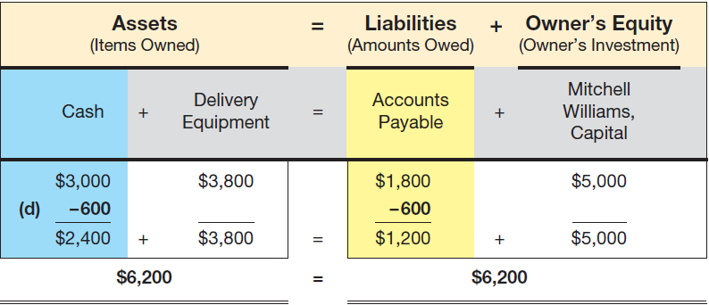
Transaction (d): Accounting Equation

Slide 33
Revenues
The amount a business charges customers for products sold or services performed
Recognized when earned (even if cash has not yet been received)
Increases both assets (cash or accounts receivable) and owner’s equity
Examples
  Delivery Fees
  Consulting Fees
  Rent Revenue (renting space to others)
  Interest Revenue (interest received on bank deposits)
  Sales (selling merchandise)

Slide 34
Expenses
Represent the decrease in assets (or increase in liabilities) as a result of efforts made to produce revenues
Separate accounts are maintained for each type of expense
Either decreases assets or increases liabilities, but ALWAYS decreases owner’s equity
Examples
  Rent
  Salaries
  Supplies consumed
  Taxes

Slide 35
Accounting Period Concept
The concept that income determination can be made on a periodic basis (month, quarter, year, etc.)
Any accounting period of 12 months is called a fiscal year

Slide 36
Net Income vs. Net Loss
Net income – Total revenues are greater than total expenses for the period
Net loss – Expenses are greater than total revenue for the period
Net Income
Revenues | $9,000
Expenses | 5,000
Net Income | $4,000
Net Loss
Revenues | $3,000
Expenses | 5,000
Net Loss | $2,000

Slide 37
Withdrawals
The owner taking (withdrawing) cash or other assets from the business for personal use
Reduces owner’s equity and assets
Also referred to as drawing

Slide 38
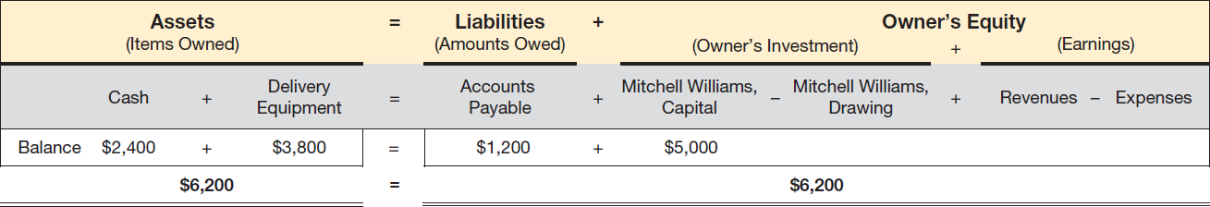
Expanded Accounting Equation
The accounting equation is expanded to include revenues, expenses, and withdrawals
Note that revenues increase owner’s equity, while expenses and drawing decrease owner’s equity

Slide 39
Transaction (e): Delivery Revenues Earned in Cash
What happened?
    Mitch received $2,100 cash from clients for delivery services
Identify the accounts that are affected
    Cash (Asset) – Increase
    Delivery Fees (Revenue) – Increase
      Note: Revenue increases Owner’s Equity
Does the accounting equation balance?
    ASSETS = LIABILITIES + OWNER’S EQUITY
  Cash (asset) increased by $2,100
  Delivery Fees (Revenue) increased by $2,100
  Liabilities were unchanged

Slide 40
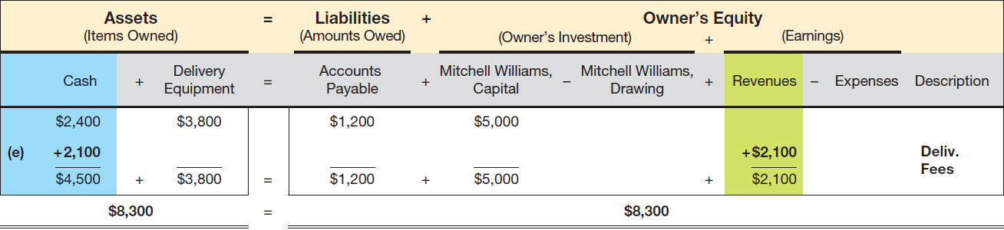
Transaction (e): Accounting Equation

Slide 41
Transaction (f): Paid Rent for Month
What happened?
    Mitch paid $1,000 for June office rent
Identify the accounts that are affected
    Cash (Asset) – Decrease
    Rent Expense – Increase
      Note: Expenses decrease Owner’s Equity
Does the accounting equation balance?
    ASSETS = LIABILITIES + OWNER’S EQUITY
  Cash (asset) decreased by $1,000
  Owner’s Equity decreased by $1,000 (increase in Rent Expense)
  Liabilities were unchanged

Slide 42
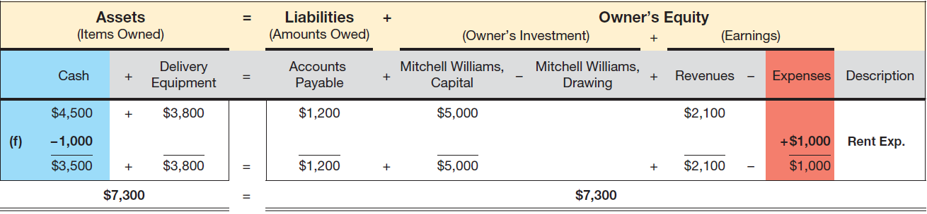
Transaction (f): Accounting Equation

Slide 43
Transaction (g): Paid Phone Bill
What happened?
    Mitch paid $100 cash for phone service
Identify the accounts that are affected
    Cash (Asset) – Decrease
    Phone Expense – Increase
      Note: Expenses decrease Owner’s Equity
Does the accounting equation balance?
    ASSETS = LIABILITIES + OWNER’S EQUITY
  Cash (asset) decreased by $100
  Owner’s Equity decreased by $100 (increase in Phone Expense)
  Liabilities were unchanged

Slide 44
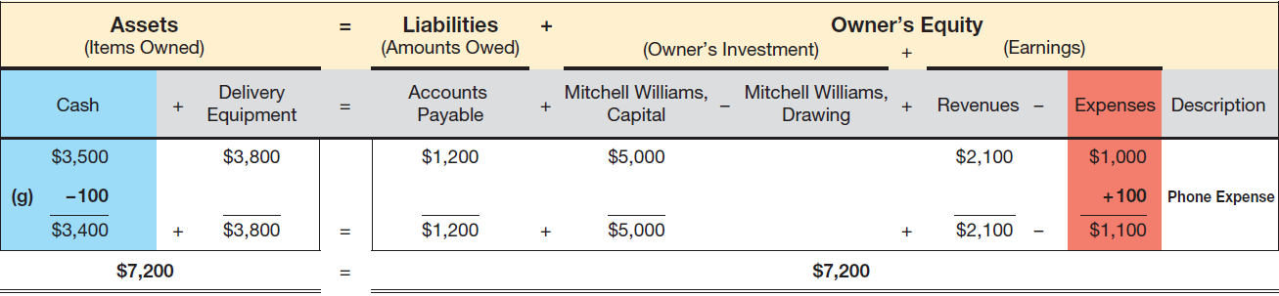
Transaction (g): Accounting Equation

Slide 45
Transaction (h): Delivery Revenues Earned on Account
What happened?
    Mitch performed delivery services in the amount of $2,400
    Cash is not received at this time
    Accounts Receivable is increased for the amount owed to Mitch
Identify the accounts that are affected
    Account Receivable (Asset) – Increase
    Delivery Fees (Revenue) – Increase
      Note: Revenues increase Owner’s Equity
Does the accounting equation balance?
    ASSETS = LIABILITIES + OWNER’S EQUITY
  Accounts Receivable (asset) increased by $2,400
  Owner’s Equity increased by $2,400 (increase in Delivery Fees)
  Liabilities were unchanged

Slide 46
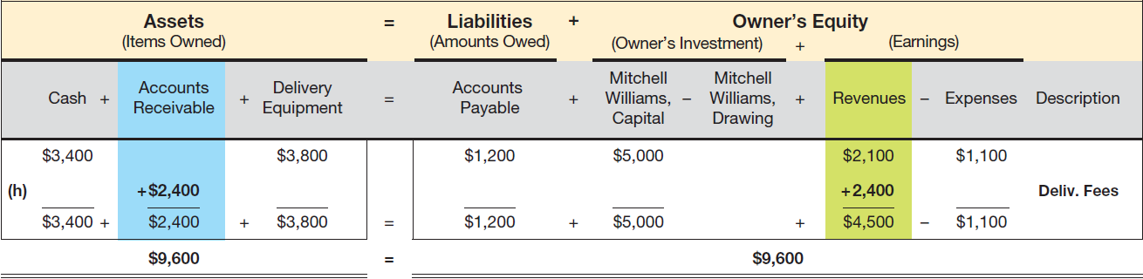
Transaction (h): Accounting Equation
Note: Revenue is recognized when it is earned even though cash is not received

Slide 47
Transaction (i): Purchase of Supplies
What happened?
    Mitch purchased supplies for $80 cash
    Supplies should last for several months
    Supplies should be recorded as an asset since they provide future benefits
Identify the accounts that are affected
    Supplies (Asset) – Increase
    Cash (Asset) – Decrease
Does the accounting equation balance?
    ASSETS = LIABILITIES + OWNER’S EQUITY
  Supplies (Asset) increased by $80
  Cash (Asset) decrease by $80
  Liabilities and Owner’s Equity were unchanged

Slide 48
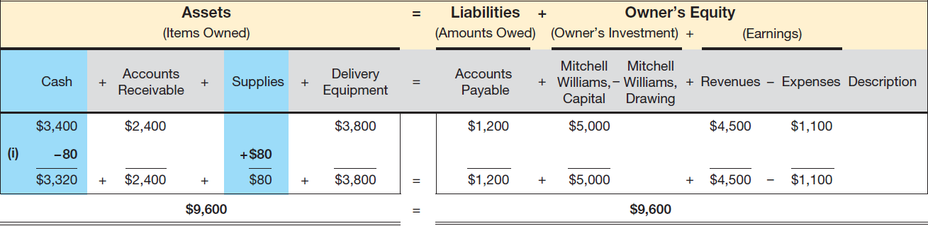
Transaction (i): Accounting Equation
Note: Supplies is a Prepaid Expense account since the supplies will be charged off to expenses when they are consumed

Slide 49
Transaction (j): Cash Receipts From Prior Sales on Account
What happened?
    Mitch received $1,900 in cash for delivery services performed for customers earlier in the month.
    Owner’s Equity is NOT affected by this transaction (revenue was recognized when earned)
Identify the accounts that are affected
    Accounts Receivable (Asset) – Decrease
    Cash (Asset) – Increase
Does the accounting equation balance?
    ASSETS = LIABILITIES + OWNER’S EQUITY
  Accounts Receivable (Asset) decreased by $1,900
  Cash (Asset) increased by $1,900
  Liabilities and Owner’s Equity were unchanged

Slide 50
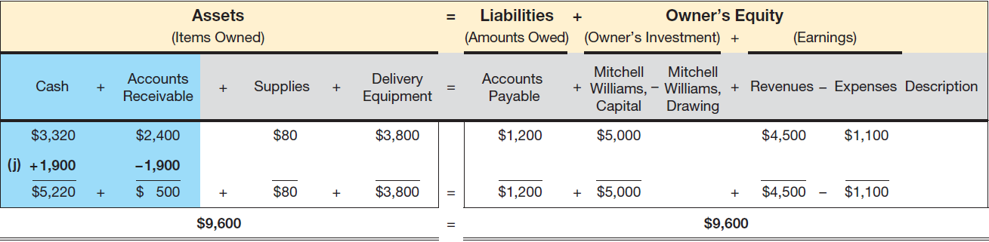
Transaction (j): Accounting Equation
Note: Revenue is recognized when EARNED, not when cash is received

Slide 51
Transaction (k): Purchase of an Asset on Account (Making a Partial Payment)
What happened?
    Mitch bought a scooter for $1,000 paying $300 cash and agreeing to pay the rest over four months
    Note: Transaction affects three accounts
Identify the accounts that are affected
    Delivery Equipment (Asset) – Increase
    Cash (Asset) – Decrease
    Accounts Payable (Liability) – Increase
Does the accounting equation balance?
    ASSETS = LIABILITIES + OWNER’S EQUITY
  Cash (Asset) decreased by $300
  Delivery Equipment (Asset) increased by $1,000
  Accounts Payable (Liability) increased by $700
  Owner’s Equity is unchanged

Slide 52
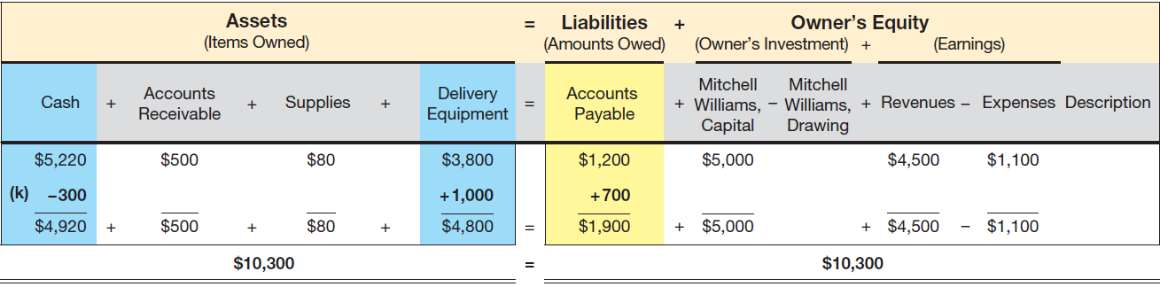
Transaction (k): Accounting Equation

Slide 53
Transaction (l): Payment of Insurance Premium
What happened?
    Mitch paid $700 for an insurance policy that lasts 7 months
    Note: Since the policy provides future benefits, should be recorded as an asset
Identify the accounts that are affected
    Prepaid Insurance (Asset) – Increase
    Cash (Asset) – Decrease
Does the accounting equation balance?
    ASSETS = LIABILITIES + OWNER’S EQUITY
  Cash (Asset) decreased by $700
  Prepaid Insurance (Asset) increased by $700
  Liabilities and Owner’s Equity are unchanged

Slide 54
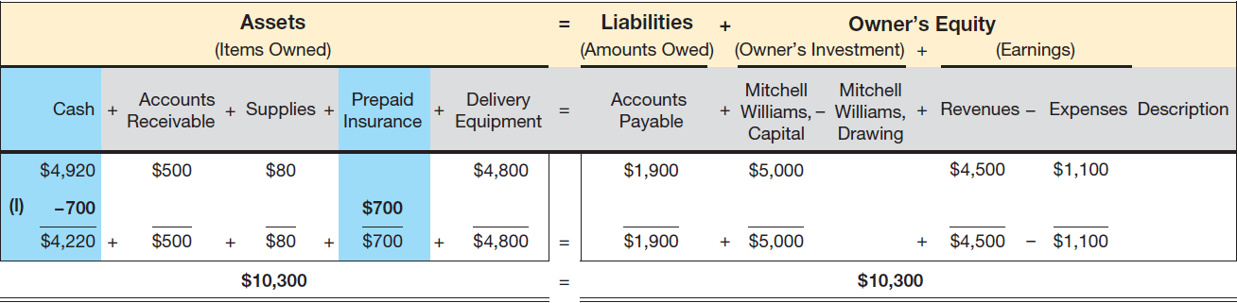
Transaction (l): Accounting Equation
Note: Both supplies and insurance are recorded as assets because they will provide benefits for several months

Slide 55
Transaction (m): Payment of Wages
What happened?
    Mitch paid $1,650 in wages to his employees
Identify the accounts that are affected
    Cash (Asset) – Decrease
    Wages Expense (Expense) – Increase
      Note: Expenses decrease Owner’s Equity
Does the accounting equation balance?
    ASSETS = LIABILITIES + OWNER’S EQUITY
  Cash (Asset) decreased by $1,650
  Wages Expense (Expense) increased by $1,650 (which decreases Owner’s Equity)
  Liabilities are unchanged

Slide 56
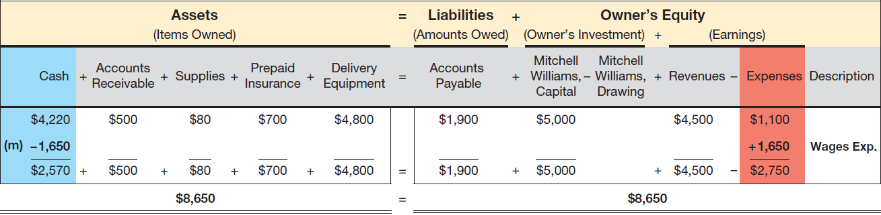
Transaction (m): Accounting Equation
Note: As with other expenses, cash is reduced and owner’s
equity is reduced by increasing an expense

Slide 57
Transaction (n): Deliveries Made For Cash and on Account
What happened?
    Deliveries of $3,500 were made: $900 in cash, $2,600 on account
Identify the accounts that are affected
    Cash (Asset) – Increase
    Accounts Receivable (Asset) – Increase
    Delivery Fees (Revenues) – Increase
      Note: Revenues increase Owner’s Equity
Does the accounting equation balance?
    ASSETS = LIABILITIES + OWNER’S EQUITY
  Cash (Asset) increases by $900
  Accounts Receivable (Asset) increases by $2,600
  Delivery Fees (Revenue) increased by $3,500 (which increased Owner’s Equity)
  Liabilities are unchanged

Slide 58
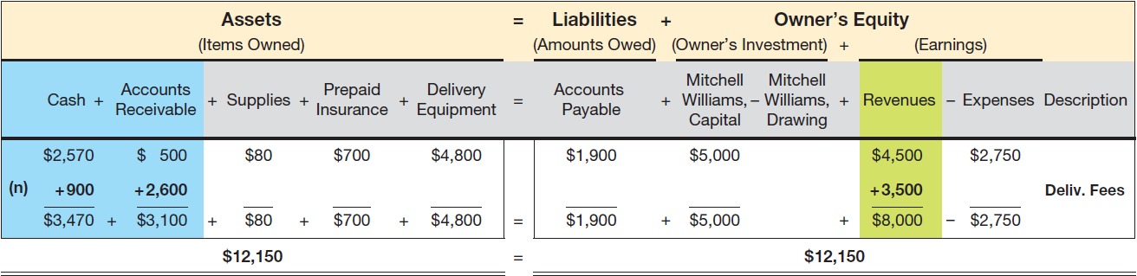
Transaction (n): Accounting Equation
Note: Recording these revenues impacts three accounts while the equation remains in balance

Slide 59
Transaction (o): Withdrawal of Cash From Business
What happened?
    Mitch took $3,000 out of the business for personal expenses
Identify the accounts that are affected
    Cash (Asset) – Decrease
    Drawing Account (Owner’s Equity) – Increase
      Note: Withdrawals decrease Owner’s Equity
Does the accounting equation balance?
    ASSETS = LIABILITIES + OWNER’S EQUITY
  Cash (Asset) decreases by $3,000
  Drawing Account (Owner’s Equity) increases by $3,000
  Liabilities are unchanged

Slide 60
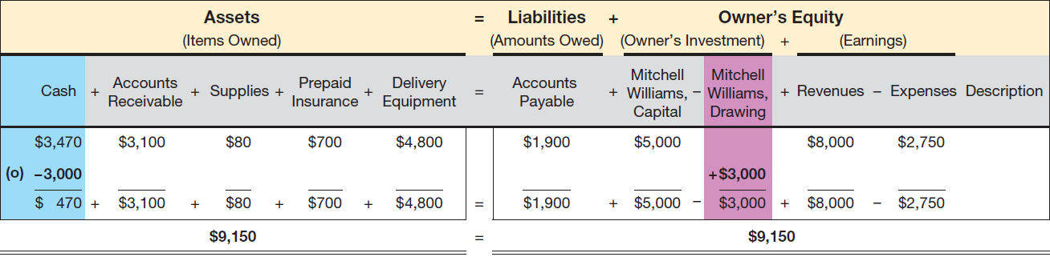
Transaction (o): Accounting Equation
Withdrawals by the owner are reported in the drawing account
Withdrawals are the opposite of investments by the owner
Just like expenses, the drawing account will increase in this situation, but it does cause a decrease in owner’s equity

Slide 61
Learning Objective 5
Prepare and describe the purposes of a simple income statement, statement of owner’s equity, and balance sheet

Slide 62
Financial Statements
Three commonly prepared financial statements:
  Income statement
  Statement of owner’s equity
  Balance sheet

Slide 63
Financial Statement Headings
The name of the company
The title of the statement
The time period covered or the date of the statement
Example
  Mitchell's Campus Delivery
  Income Statement
  For Month Ended June 30, 2025

Slide 64
Guidelines For Preparing Financial Statements
Financial statements are prepared primarily for users not associated with the company following a standard format
Single rules (underlines) indicate that the numbers above the line have been added or subtracted
Double rules (double underlines) indicate a total
Dollar signs are used at the top of columns and for the first amount entered in a column beneath a ruling
On the income statement, some companies list expenses from highest to lowest dollar amount, with miscellaneous expense listed last
On the balance sheet, assets are listed from most liquid to least liquid.
  Liquidity measures the ease with which the asset will be converted to cash
Liabilities are listed from most current to least current

Slide 65
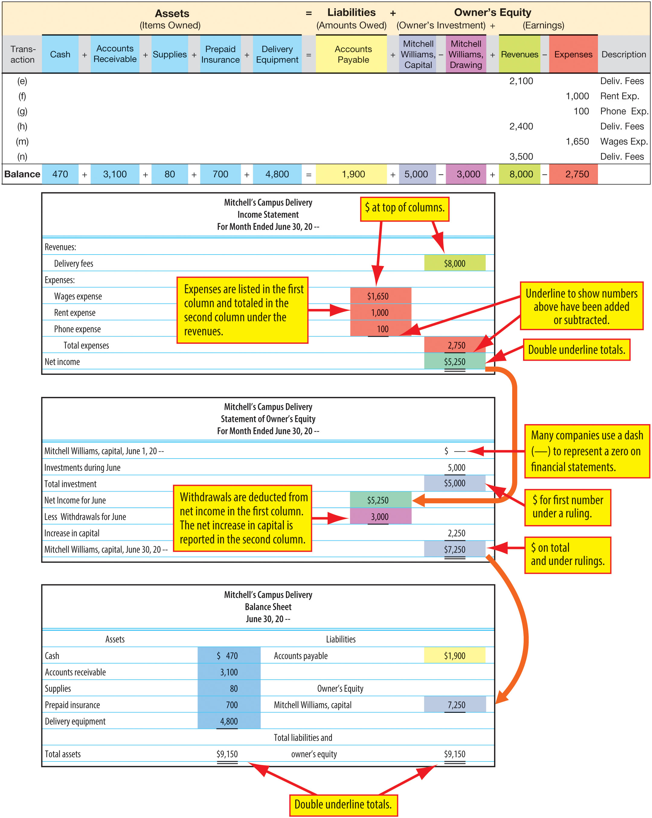
Income Statement
Reports the profitability of business operations for a specific period of time
Expenses are subtracted from revenues to determine net income (loss)
Also called the profit and loss statement or operating statement

Slide 66
The Statement Of Owner’s Equity
Reports the activities that affected owner’s equity for a specific period of time
Uses Net Income from the income statement

Slide 67
The Balance Sheet
Reports a firm’s assets, liabilities, and owner’s equity on a specific date
Confirms that the accounting equation has remained in balance
Also referred to as a statement of financial position or statement of financial condition

Slide 68
Learning Objective 6
Define the three basic phases of the accounting process

Slide 69
Accounting Process – Three Basic Phases
Input
  Business transactions provide the necessary input
Processing
  Recognizing the effect of these transactions on the assets, liabilities, owner’s equity, revenues, and expenses of a business is the processing function
Output
  The financial statements are the output

