Slide 1

The Double-Entry Framework
Chapter 3

Slide 2
Learning Objective 1
Define the parts of a T account

Slide 3
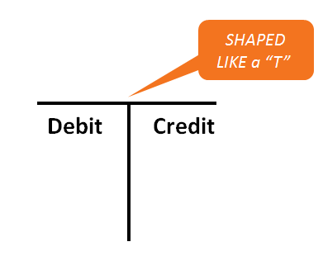
The T Account (1 of 5)

Slide 4
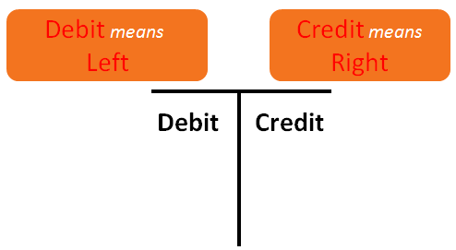
The T Account (2 of 5)

Slide 5
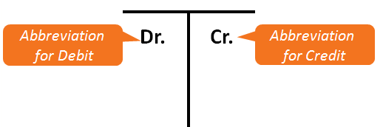
The T Account (3 of 5)

Slide 6
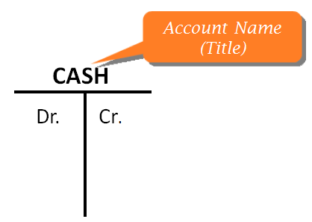
The T Account (4 of 5)

Slide 7
The T Account (5 of 5)
Every T account has an increase side and a decrease side
Some accounts increase on the debit side, and some accounts increase on the credit side
The debit side is always on the left, and the credit side is always on the right

Slide 8
Learning Objective 2
Foot and balance a T account

Slide 9
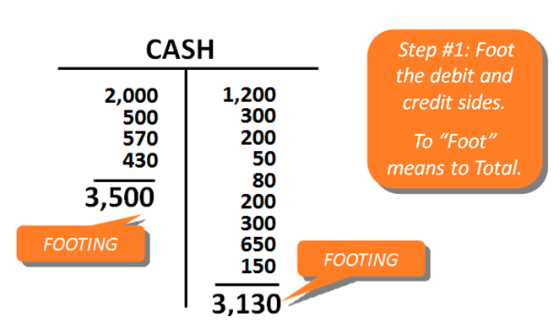
Balancing a T Account (1 of 3)

Slide 10
Balancing a T Account (2 of 3)
Step #2: Find the balance by finding the difference between the debit and credit totals (footings)
$3,500 debit footing - $3,130 credit footing = $370 balance

Slide 11
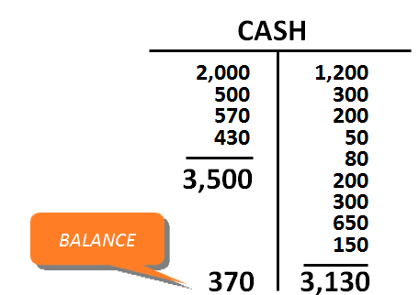
Balancing a T Account (3 of 3)
The balance is written on the side with the larger total

Slide 12
Learning Objective 3
Describe the effects of debits and credits on specific types of accounts

Slide 13
Debits and Credits
To debit an account means to enter an amount on the left or debit side of the account
To credit an account means to enter an amount on the right or credit side of the account
Debits may increase or decrease the balances of specific accounts
  This is also true for credits

Slide 14
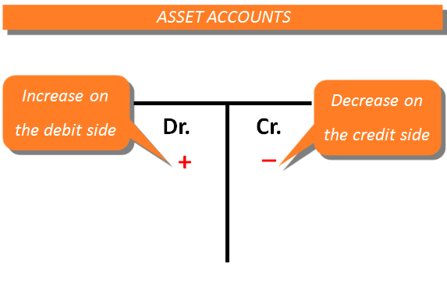
Assets

Slide 15
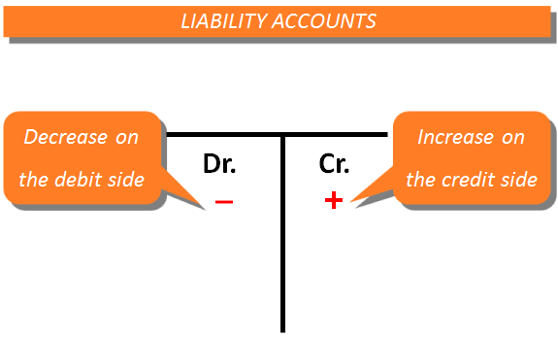
Liabilities

Slide 16
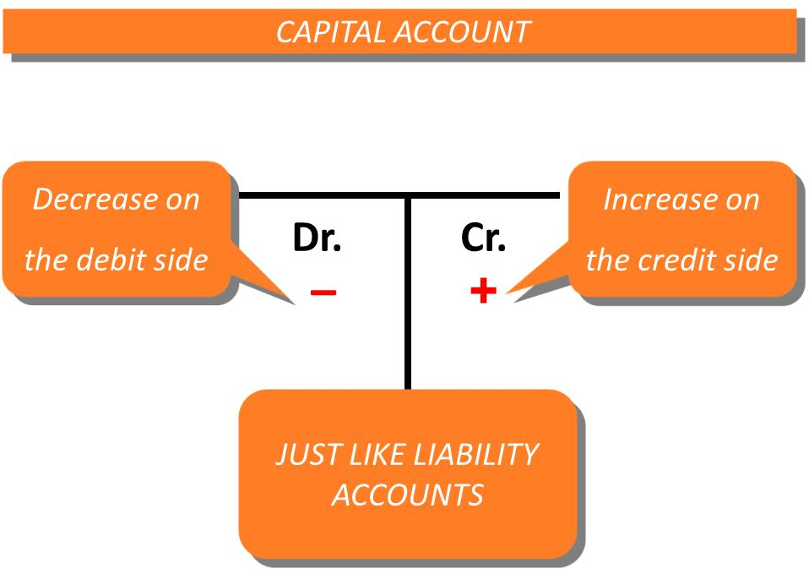
Owner’s Capital

Slide 17
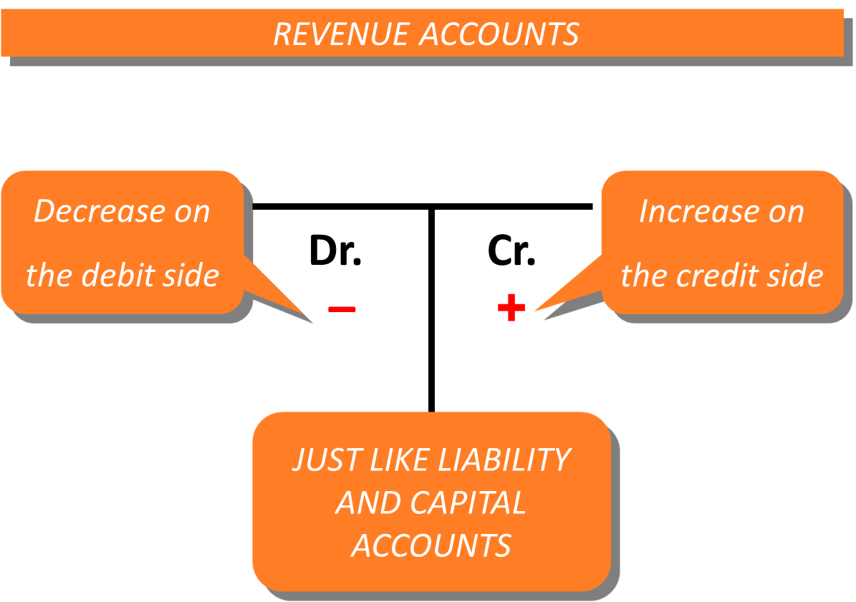
Revenues

Slide 18
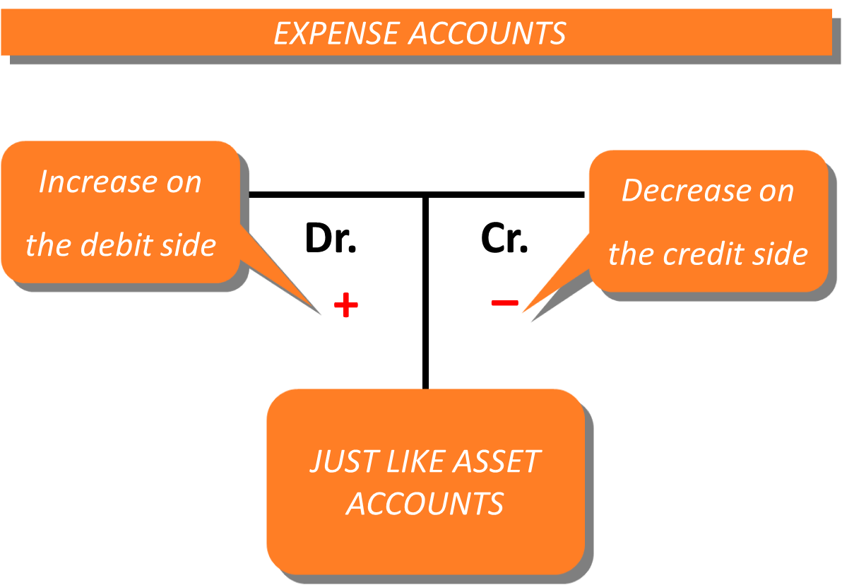
Expenses

Slide 19
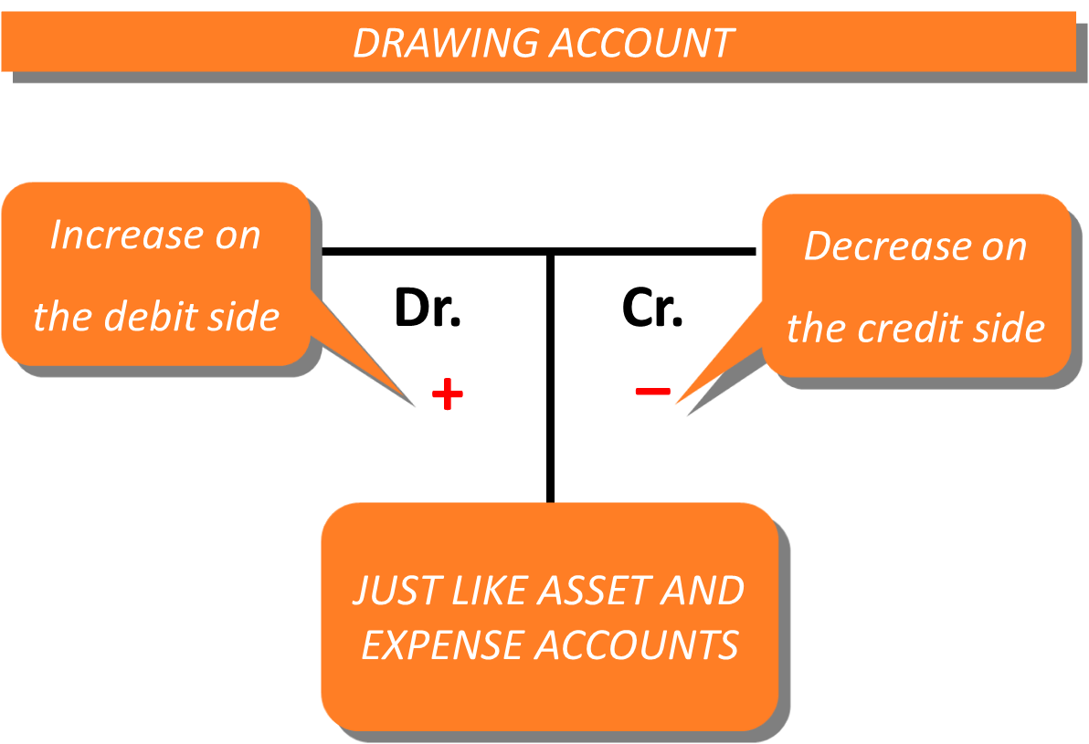
Drawing

Slide 20
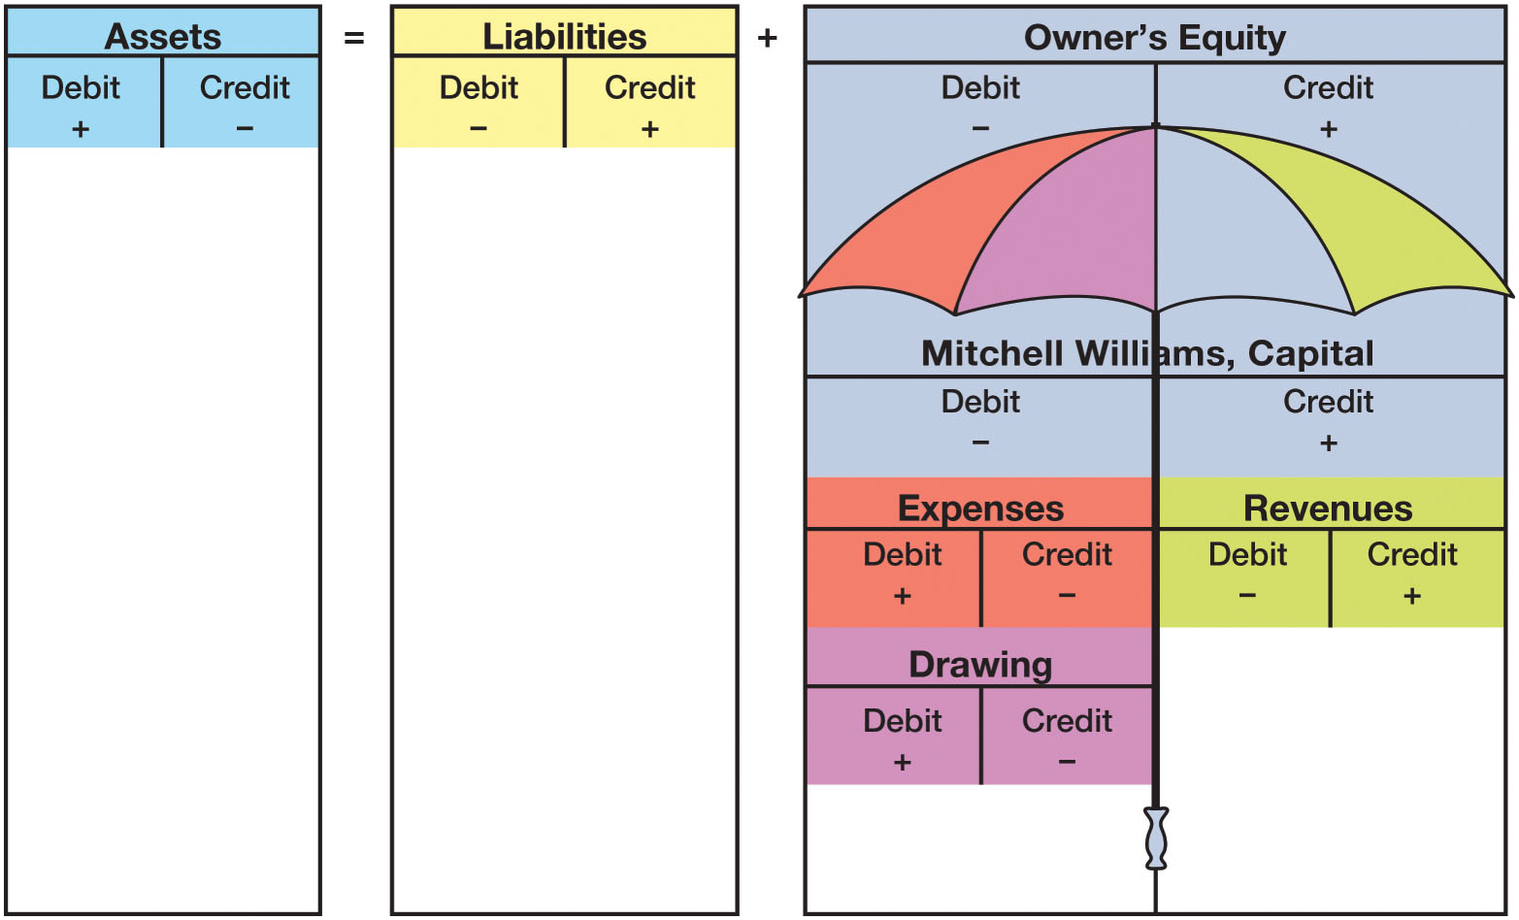
The Accounting Equation and the Owner’s Equity Umbrella
FIGURE 3-2 The Accounting Equation and the Owner’s Equity Umbrella

Slide 21
Normal Balances
ACCOUNT | INCREASE | DECREASE | NORMAL BALANCE
Assets | Debit | Credit | Debit
Liabilities | Credit | Debit | Credit
Owner’s Capital | Credit | Debit | Credit
Revenues | Credit | Debit | Credit
Expenses | Debit | Credit | Debit
Drawing | Debit | Credit | Debit

Slide 22
Learning Objective 4
Use T accounts to analyze transactions

Slide 23
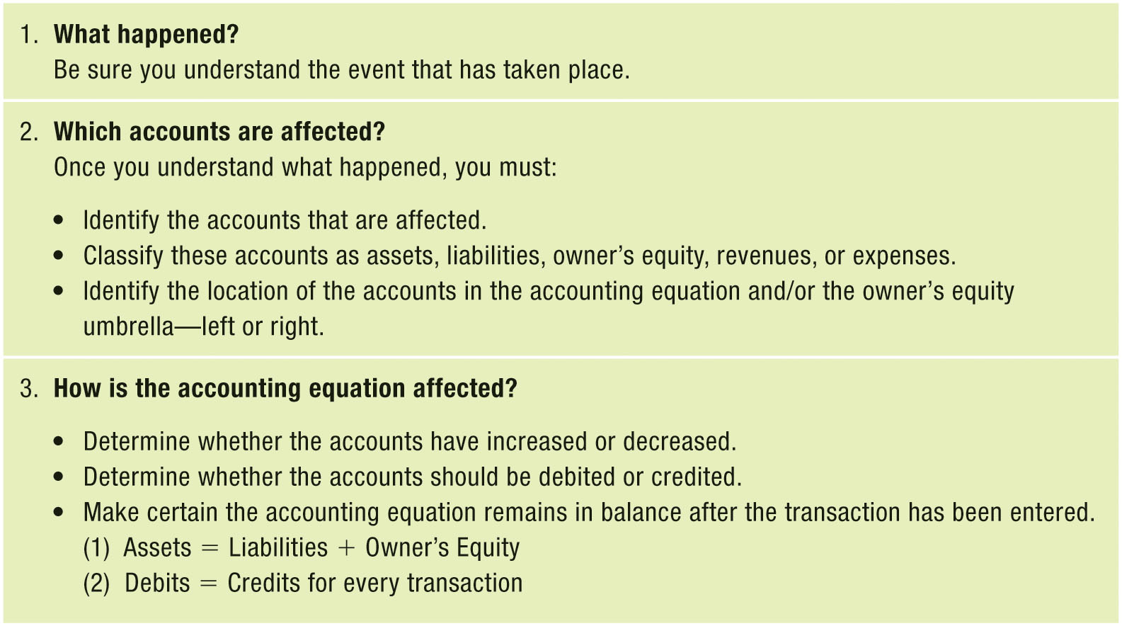
Steps in Transaction Analysis
FIGURE 3-4 Steps in Transaction Analysis

Slide 24
Transaction (a): Investment by Owner (1 of 2)
Mitchell Williams, the owner, invested $5,000 in the business
Identify the accounts that are affected
  Cash
  M. Williams, Capital
Classify these accounts as assets, liabilities, owner’s equity, revenues, or expenses
  Cash – Asset
  M. Williams, Capital – Owner’s equity
The transaction is entered as an increase in an asset and an increase in owner’s equity
Debit Cash and credit Mitchell Williams, Capital for $5,000

Slide 25
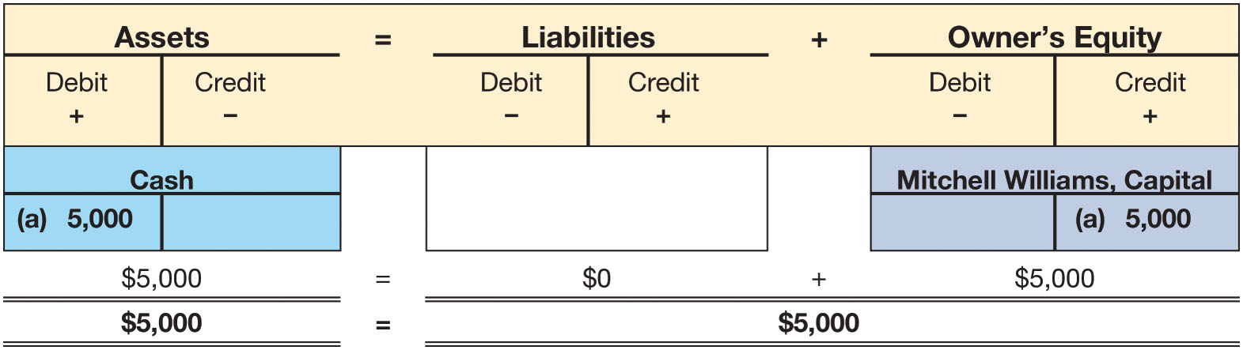
Transaction (a): Investment by Owner (2 of 2)
FIGURE 3-5 Transaction (a): Investment by Owner

Slide 26
Transaction (b): Purchase of an Asset for Cash (1 of 2)
Mitch bought a motor scooter (delivery equipment) for $2,000 cash
Identify the accounts that are affected
  Cash
  Delivery Equipment
Classify these accounts as assets, liabilities, owner’s equity, revenues, or expenses
  Cash – Asset
  Delivery Equipment – Asset
Mitch exchanged one asset (Cash) for another (Delivery Equipment)
Debit Delivery Equipment and credit Cash for $2,000
Notice that the total assets are still $5,000

Slide 27
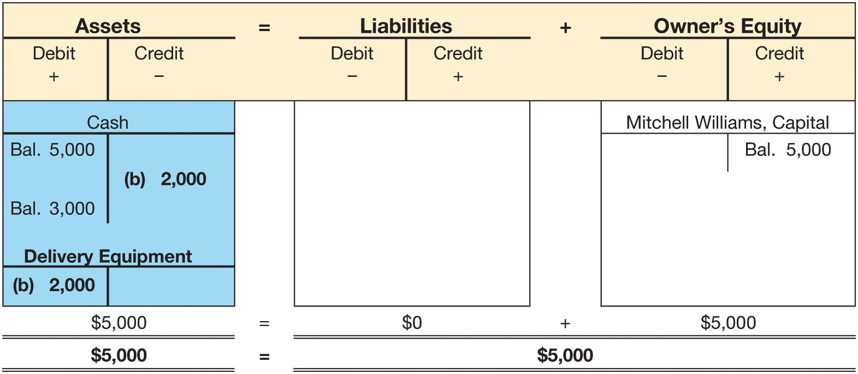
Transaction (b): Purchase of an Asset for Cash
(2 of 2)
FIGURE 3-6 Transaction (b): Purchase of an Asset for Cash

Slide 28
Transaction (c): Purchase of an Asset on Account (1 of 2)
Mitch bought a second motor scooter on account for $1,800
Identify the accounts that are affected
  Delivery Equipment
  Accounts Payable
Classify these accounts as assets, liabilities, owner’s equity, revenues, or expenses
  Delivery Equipment – Asset
  Accounts Payable - Liability
“On account” means Mitch will pay for the asset later
Debit Delivery Equipment and credit Accounts Payable for $1,800

Slide 29
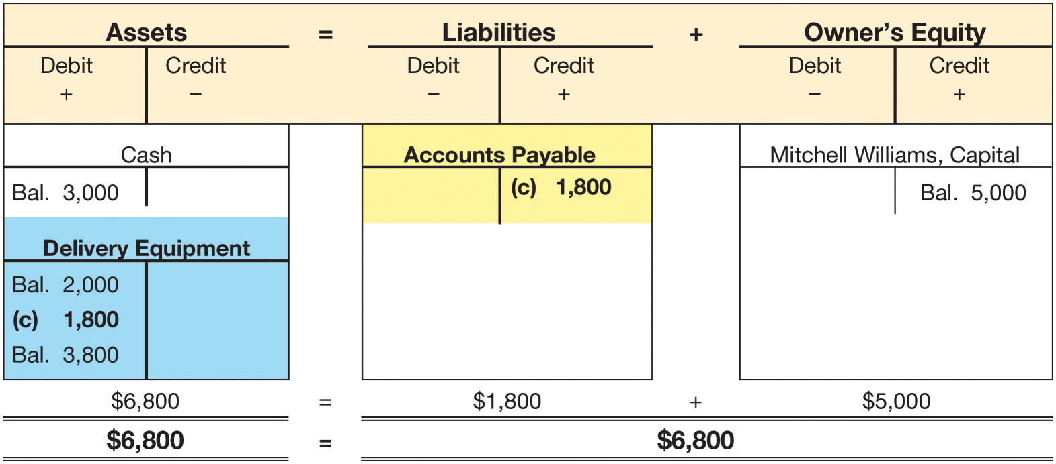
Transaction (c): Purchase of an Asset on Account (2 of 2)
FIGURE 3-7 Transaction (c): Purchase of an Asset on Account

Slide 30
Transaction (d): Payment on Account (1 of 2)
Mitch made the first $600 payment on the scooter
Identify the accounts that are affected
  Cash
  Accounts Payable
Classify these accounts as assets, liabilities, owner’s equity, revenues, or expenses
  Cash – Asset
  Accounts Payable - Liability
This payment decreases the asset (Cash) and decreases the liability (Accounts Payable)
Credit Cash and debit Accounts Payable for $600

Slide 31
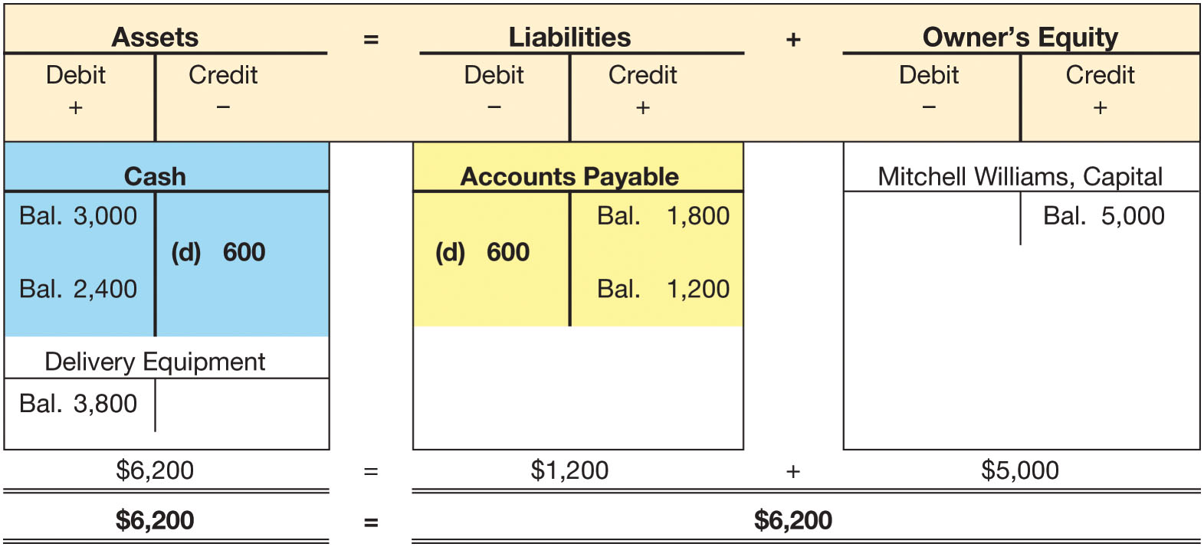
Transaction (d): Payment on Account (2 of 2)
FIGURE 3-8 Transaction (d): Payment on Account

Slide 32
Transaction (e): Delivery Revenues Earned in Cash (1 of 2)
Mitch made deliveries and received $2,100 cash from clients
Identify the accounts that are affected
  Cash
  Delivery Fees
Classify these accounts as assets, liabilities, owner’s equity, revenues, or expenses
  Cash – Asset
  Delivery Fees - Revenue
Increase the asset (Cash) and increase revenues (Delivery Fees)
Debit Cash and credit Delivery Fees for $2,100

Slide 33
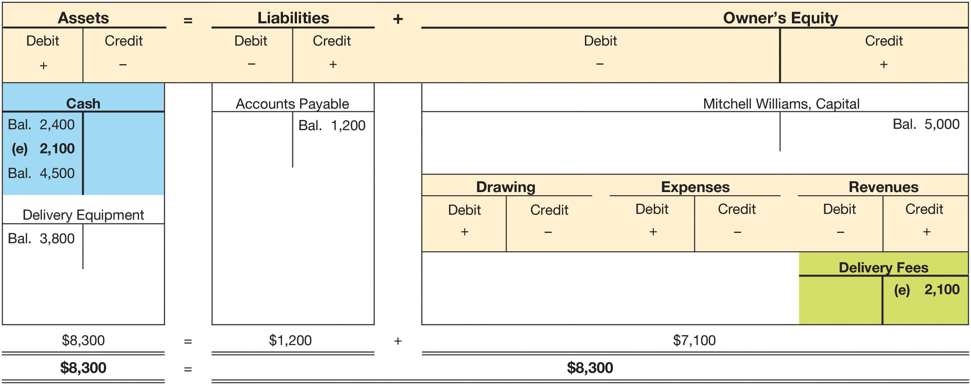
Transaction (e): Delivery Revenues Earned in Cash (2 of 2)
FIGURE 3-10 Transaction (e): Delivery Revenues Earned in Cash

Slide 34
Transaction (f): Paid rent for month (1 of 2)
Mitch paid $1,000 for office rent for June
Identify the accounts that are affected
  Cash
  Rent Expense
Classify these accounts as assets, liabilities, owner’s equity, revenues, or expenses
  Cash – Asset
  Rent Expense - Expense
Decrease the asset (Cash) and increase expense (Rent Expense)
Credit Cash and debit Rent Expense for $1,000

Slide 35
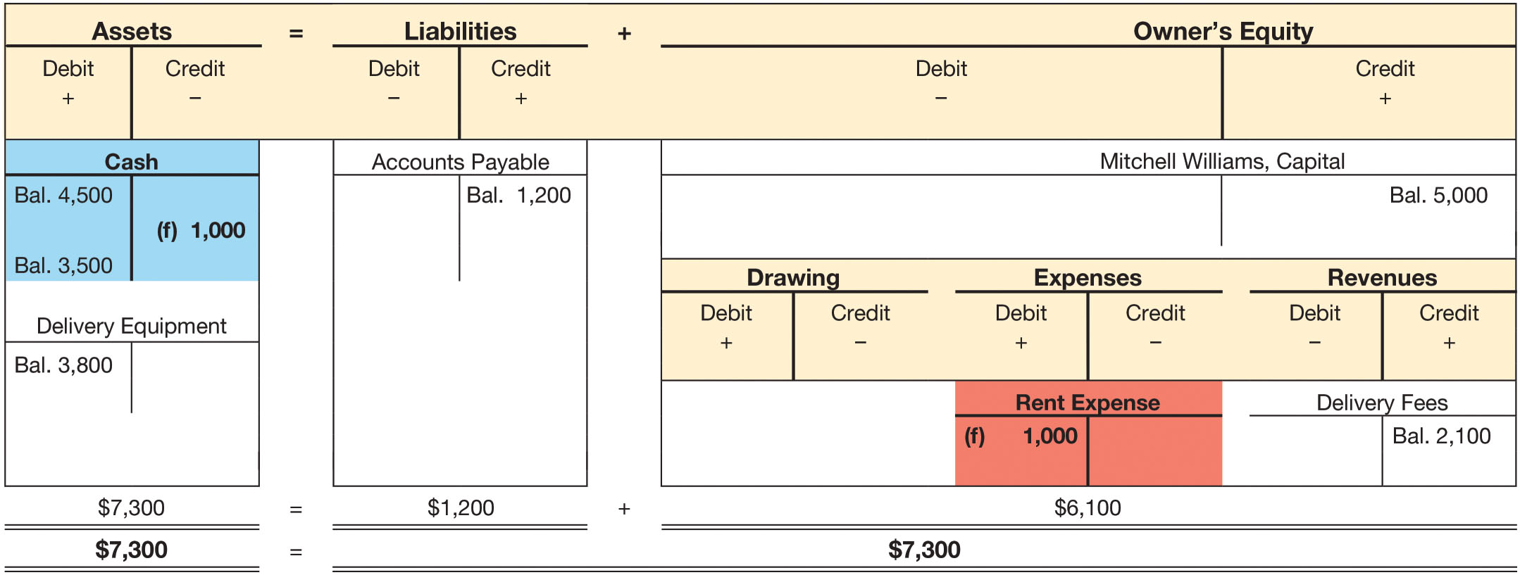
Transaction (f): Paid rent for month (2 of 2)
FIGURE 3-11 Transaction (f ): Paid Rent for Month

Slide 36
Transaction (g): Paid phone bill (1 of 2)
Mitch paid for phone service, $100
Identify the accounts that are affected
  Cash
  Phone Expense
Classify these accounts as assets, liabilities, owner’s equity, revenues, or expenses
  Cash – Asset
  Phone Expense - Expense
Decrease the asset (Cash) and increase expense (Phone Expense)
Credit Cash and debit Phone Expense for $100

Slide 37
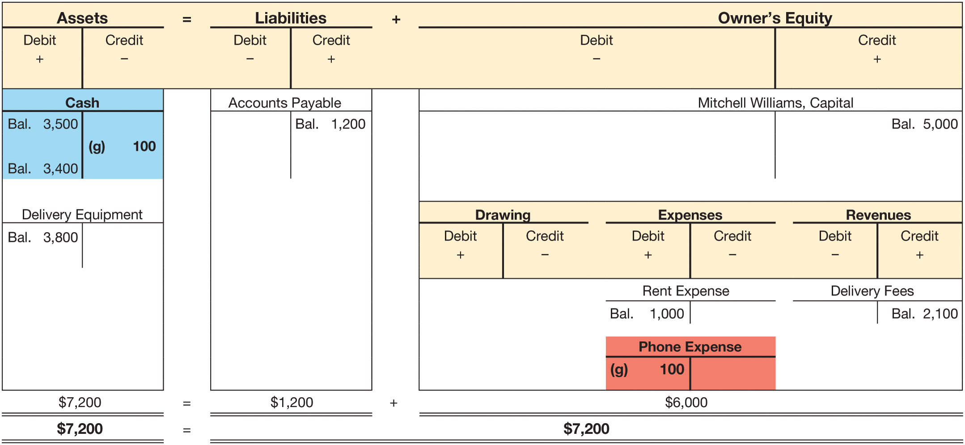
Transaction (g): Paid phone bill (2 of 2)
FIGURE 3-12 Transaction (g): Paid Phone Bill

Slide 38
Transaction (h): Delivery revenues earned on account (1 of 2)
Mitch made deliveries on account for $2,400
Identify the accounts that are affected
  Accounts Receivable
  Delivery Fees
Classify these accounts as assets, liabilities, owner’s equity, revenues, or expenses
  Accounts Receivable – Asset
  Delivery Fees - Revenue
Mitch receives a promise that his customers will pay cash in the future. Therefore, the asset, Accounts Receivable, increases
Since revenues are recognized when earned, the revenue account, Delivery Fees, also increases
Debit Accounts Receivable and credit Delivery Fees for $2,400

Slide 39
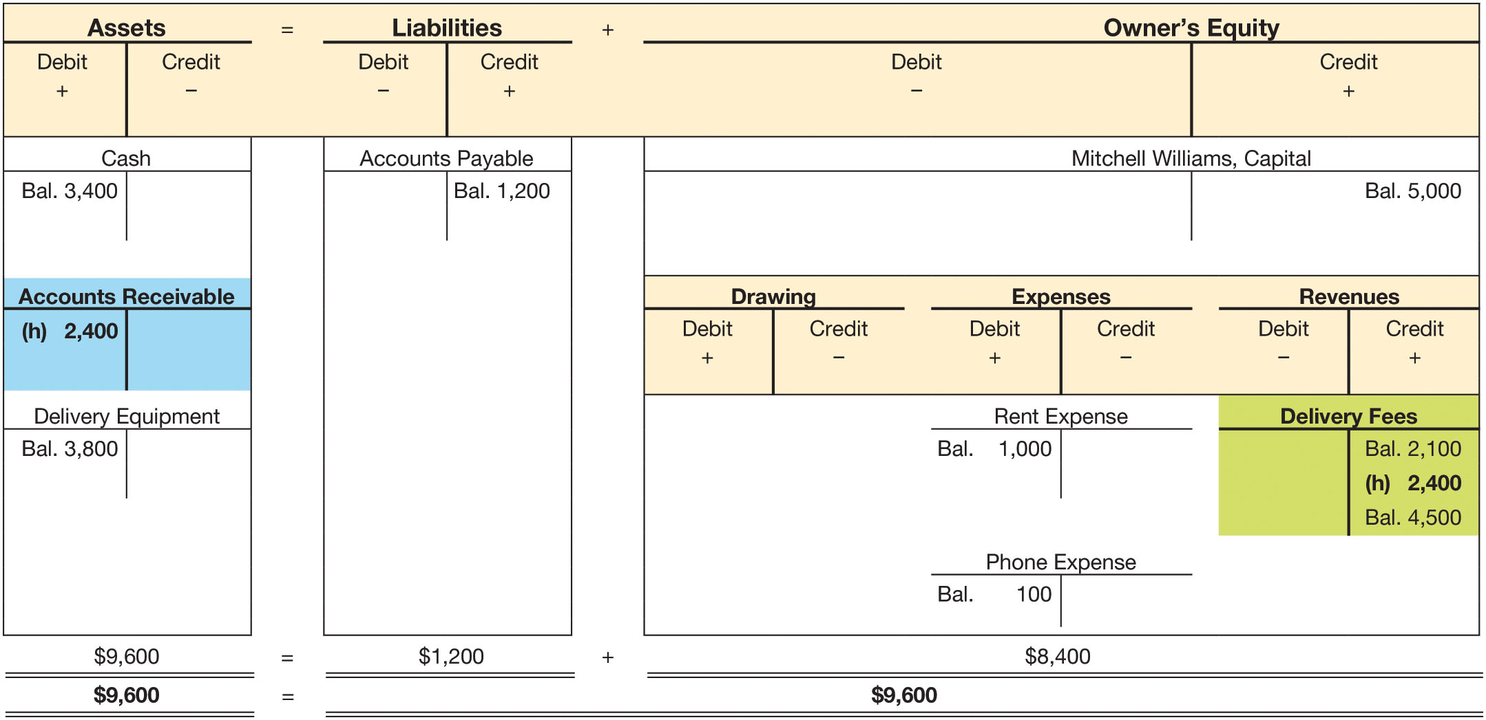
Transaction (h): Delivery revenues earned on account (2 of 2)
FIGURE 3-13 Transaction (h): Delivery Revenues Earned on Account

Slide 40
Transaction (i): Purchase of Supplies (1 of 2)
Mitch bought pens, paper, delivery envelopes, and other supplies for $80 cash
  These supplies will last for several months
  Since they will generate future benefits, the supplies should be recorded as an asset
Identify the accounts that are affected
  Cash
  Supplies
Classify these accounts as assets, liabilities, owner’s equity, revenues, or expenses
  Cash – Asset
  Supplies - Revenue
Debit Supplies and credit Cash for $80

Slide 41
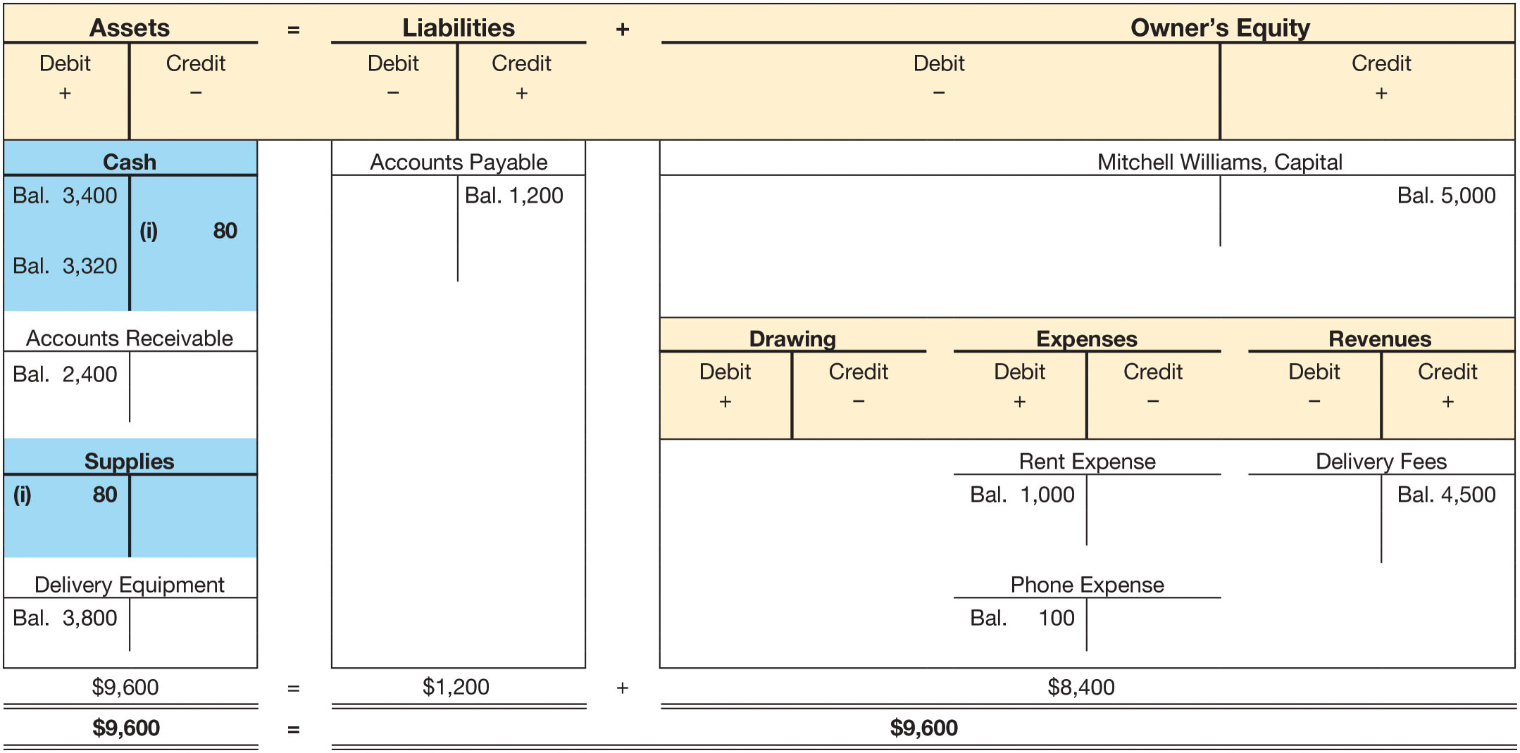
Transaction (i): Purchase of Supplies (2 of 2)
FIGURE 3-14 Transaction (i): Purchase of Supplies

Slide 42
Transaction (j): Cash receipts from prior sales on account (1 of 2)
Mitch received $1,900 in cash for delivery services performed for customers earlier in the month
  Mitch received cash, but this transaction did not affect revenue since the revenue was previously recorded when earned
Identify the accounts that are affected
  Cash
  Accounts Receivable
Classify these accounts as assets, liabilities, owner’s equity, revenues, or expenses
  Cash – Asset
  Accounts Receivable – Asset
This transaction increases Cash and reduces the amount due from customers reported in Accounts Receivable
Debit Cash and credit Accounts Receivable for $1,900

Slide 43
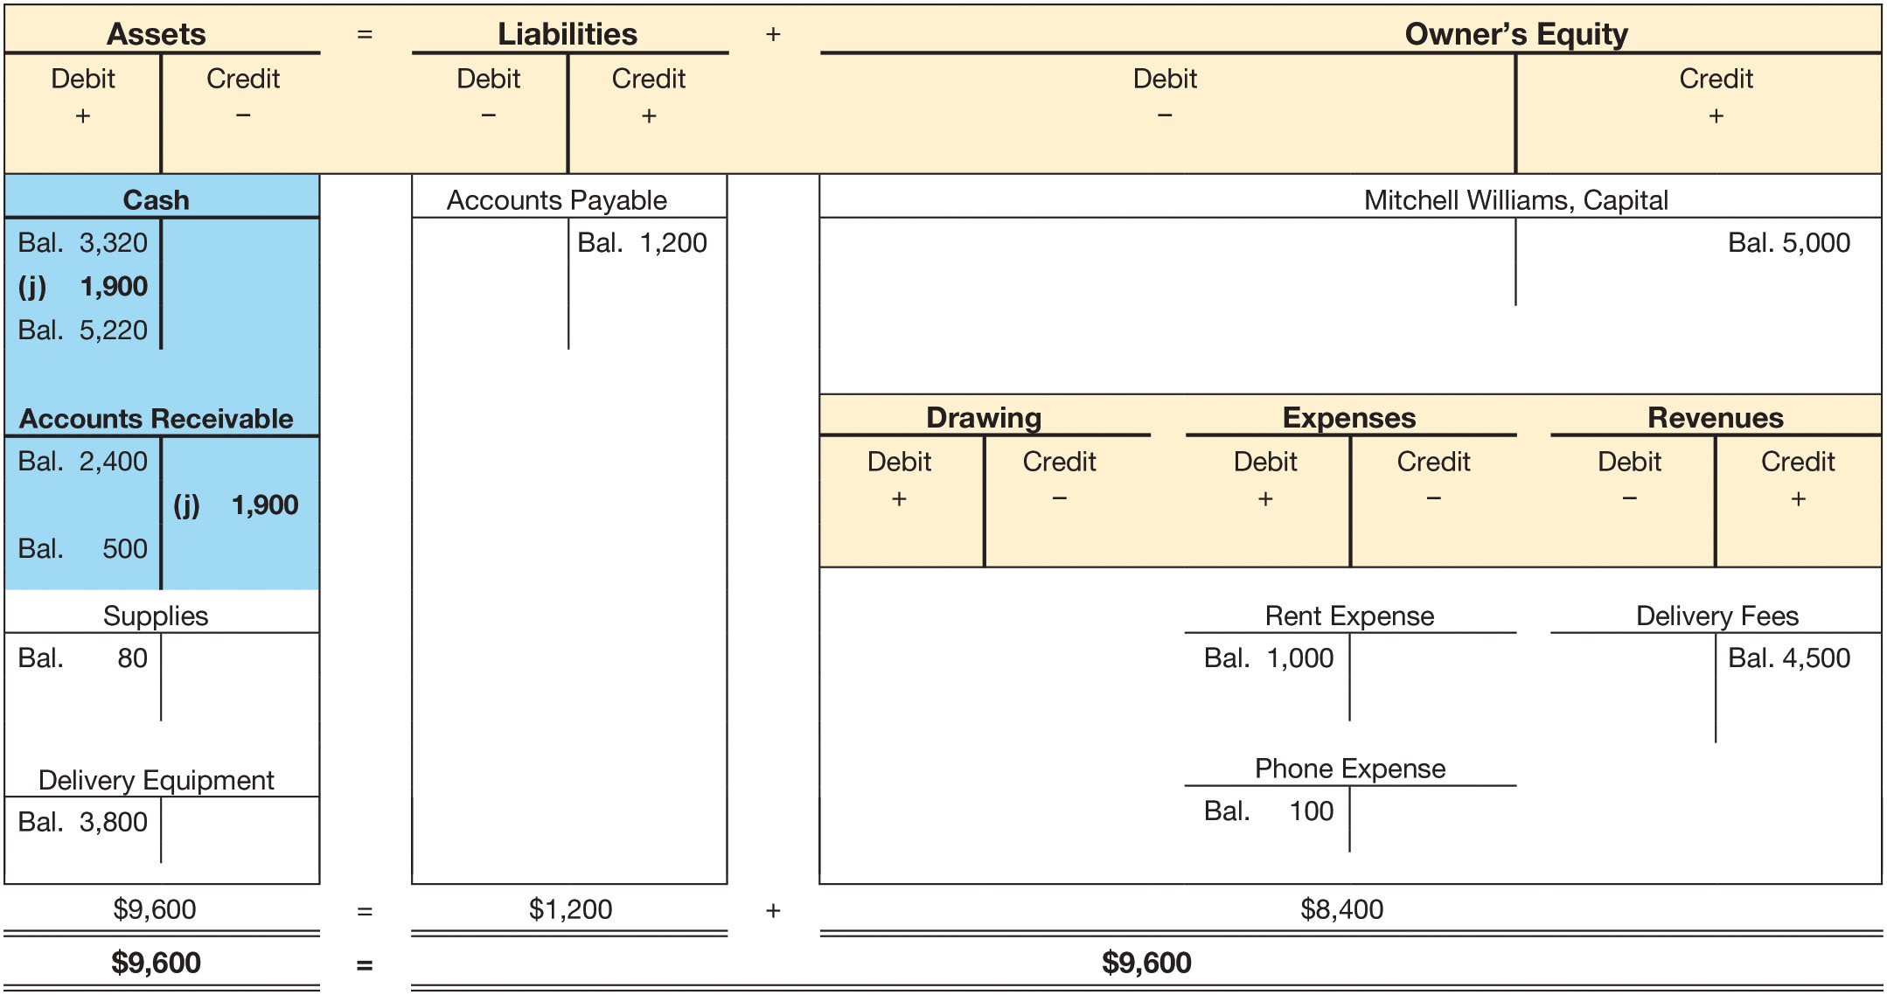
Transaction (j): Cash receipts from prior sales on account (2 of 2)
FIGURE 3-15 Transaction (j): Cash Receipts from Prior Sales on Account

Slide 44
Transaction (k): Purchase of an asset on credit making a partial payment (1 of 2)
Mitch bought a third motor scooter for $1,000. Mitch made a down payment of $300 and spread the remaining payments over the next four months
Identify the accounts that are affected
  Delivery Equipment - Asset
  Cash - Asset
  Accounts Payable - Liability
Delivery Equipment increases by $1,000, Cash decreases by $300, and Accounts Payable increases by $700
  Debit Delivery Equipment for $1000
  Credit Cash for $300
  Credit Accounts Payable for $700

Slide 45
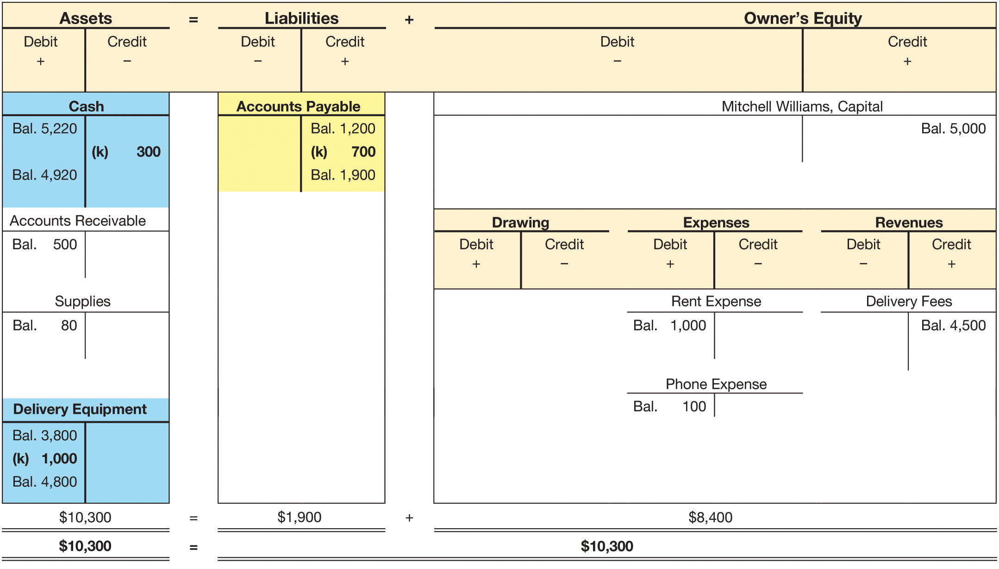
Transaction (k): Purchase of an asset on credit making a partial payment (2 of 2)
FIGURE 3-16 Transaction (k): Purchase of an Asset on Credit Making a Partial Payment

Slide 46
Transaction (l): Payment of insurance premium (1 of 2)
Mitch paid $700 for an eight-month liability insurance policy
  Since insurance is paid in advance and will provide future benefits, it is treated as an asset
Identify the accounts that are affected
  Prepaid Insurance - Asset
  Cash - Asset
Prepaid Insurance increases by $700 and Cash decreases by $700
Debit Prepaid Insurance for $700
Credit Cash for $700

Slide 47
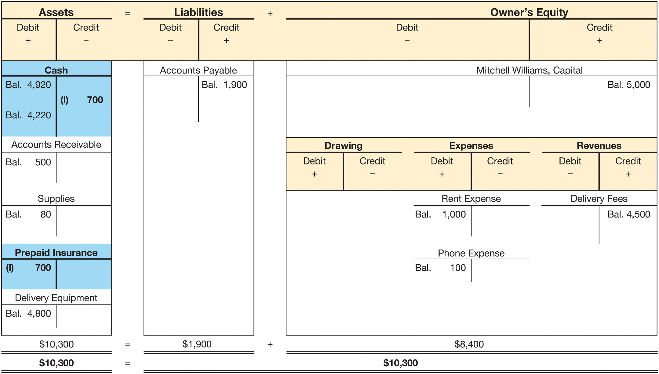
Transaction (l): Payment of insurance premium (2 of 2)
FIGURE 3-17 Transaction (l): Payment of Insurance Premium

Slide 48
Transaction (m): Payment of Wages (1 of 2)
Mitch paid his part-time employees $1,650 in wages
  This is an additional business expense
Identify the accounts that are affected
  Wages Expense - Expense
  Cash - Asset
Wages Expense increases by $1,650 and Cash decreases by $1,650
Debit Wages Expense for $1,650
Credit Cash for $1,650

Slide 49
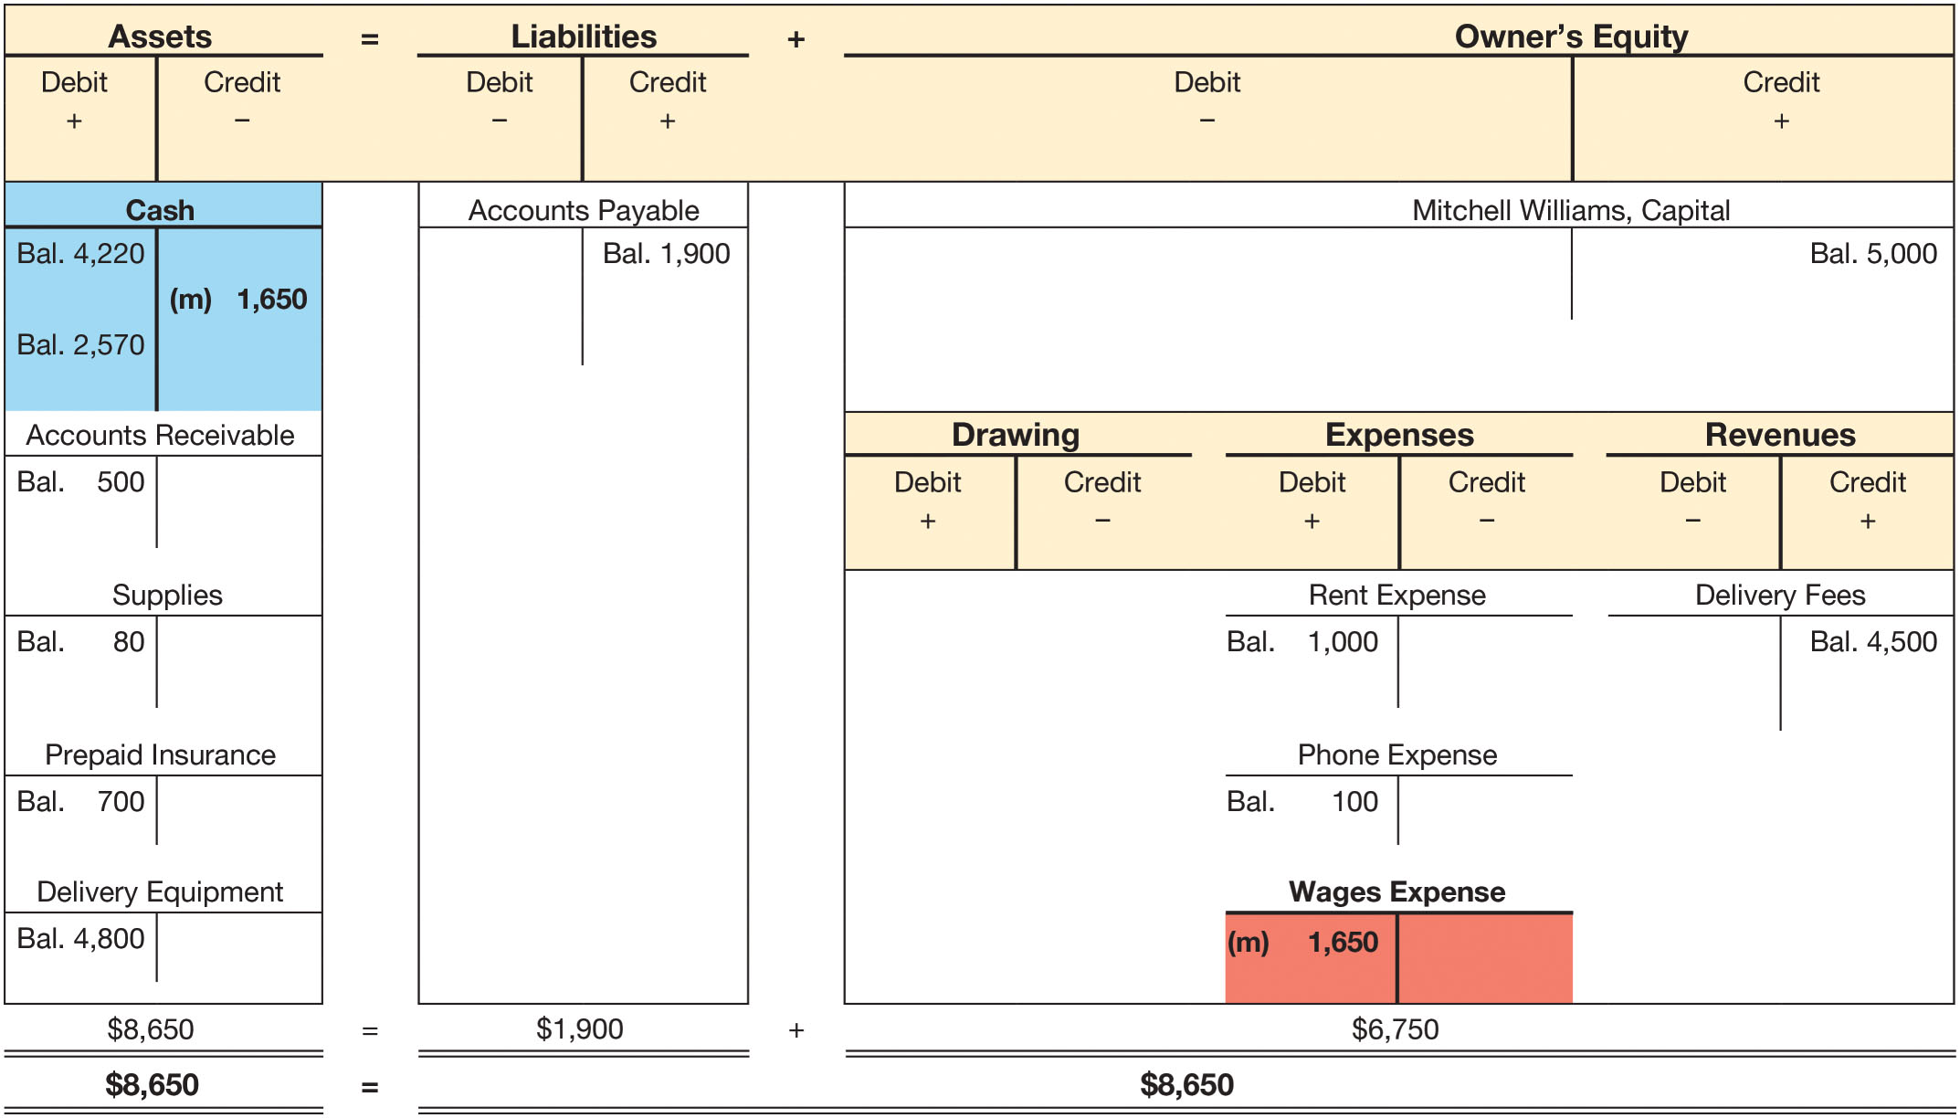
Transaction (m): Payment of Wages (2 of 2)
FIGURE 3-18 Transaction (m): Payment of Wages

Slide 50
Transaction (n): Deliveries made for cash and credit (1 of 2)
Total delivery fees for the remainder of the month amounted to $3,500: $900 in cash and $2,600 on account
  Since the delivery fees have been earned, the revenue account increases $3,500 even though not all the cash has been received
Identify the accounts that are affected
  Delivery Fees - Revenue
  Cash – Asset
  Accounts Receivable - Asset
Delivery Fees increases by $3,500, Cash increases by $900, and Accounts Receivable increases by $2,600
  Credit Delivery Fees for $3,500
  Debit Cash for $900
  Debit Accounts Receivable for $2,600

Slide 51
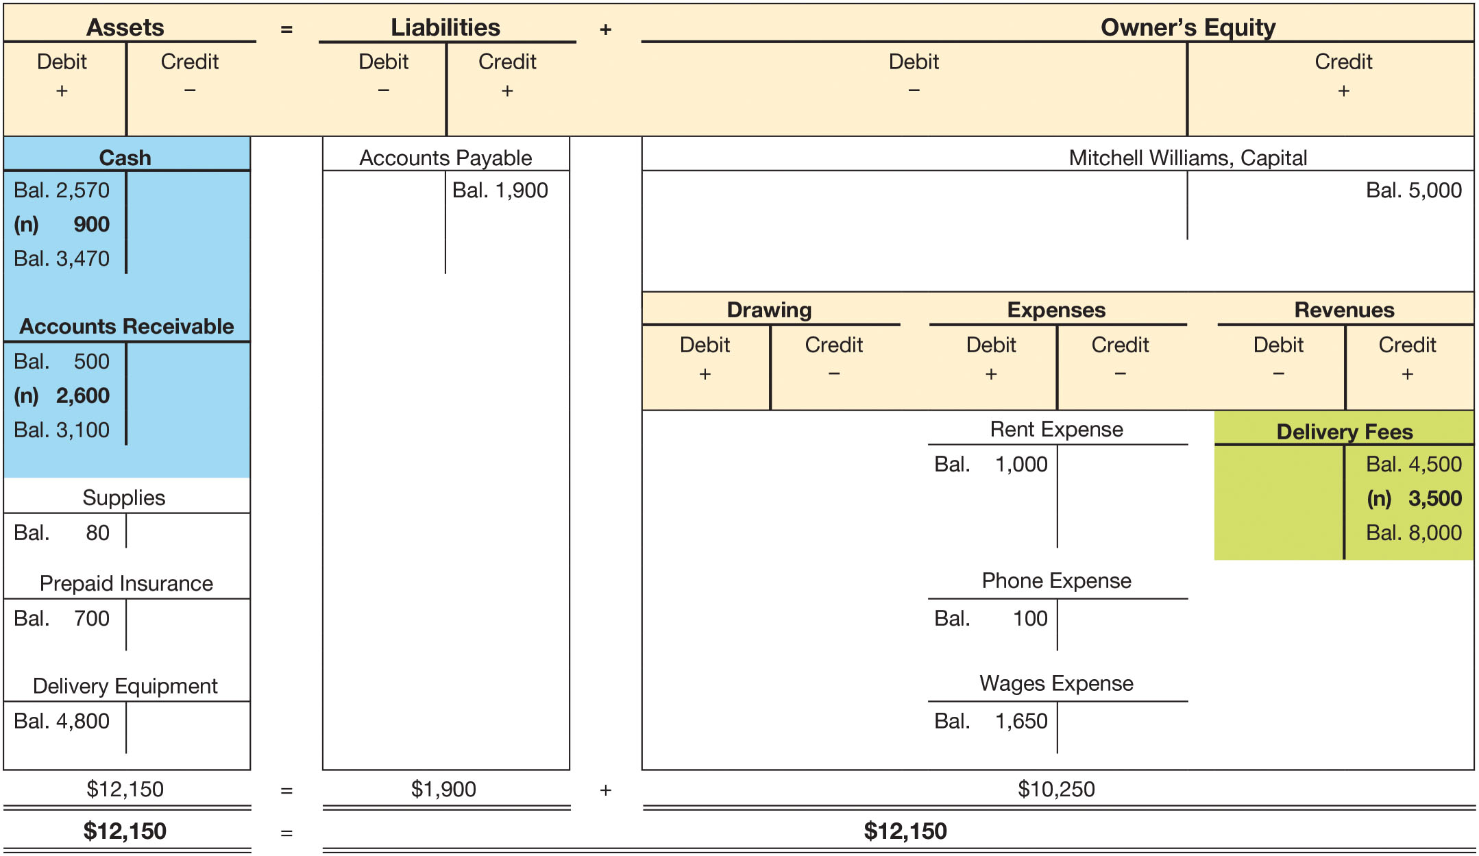
Transaction (n): Deliveries made for cash and credit (2 of 2)
FIGURE 3-19 Transaction (n): Deliveries Made for Cash and Credit

Slide 52
Transaction (o): Withdrawal of cash from business (1 of 2)
Mitch withdrew $3,000 in cash from the business to pay for textbooks, extra class fees, and living expenses
  Cash withdrawals decrease owner’s equity and decrease cash
  Withdrawals are reported in the drawing account
Identify the accounts that are affected
  Cash – Asset
  Mitchell Williams, Drawing – Owner’s Equity
Cash decreases by $3,000 and Mitchell Williams, Drawing increases by $3,000
  Credit Cash for $3,000
  Debit Mitchell Williams, Drawing for $3,000

Slide 53
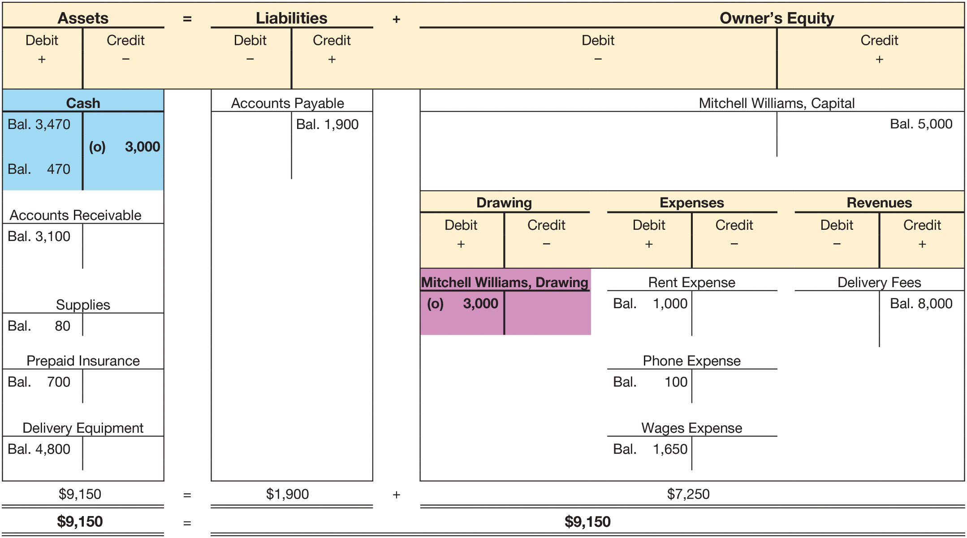
Transaction (o): Withdrawal of cash from business (2 of 2)
FIGURE 3-20 Transaction (o): Withdrawal of Cash from Business

Slide 54
Learning Objective 5
Prepare a trial balance and explain its purposes and linkages with the financial statements

Slide 55
Important Double-Entry Accounting Rules
The sum of the debits must equal the sum of the credits
  At least two accounts are affected by each transaction
The accounting equation must remain in balance

Slide 56
The Trial Balance (1 of 2)
Prepared periodically to determine debits equal credits
List of all accounts and their balances
By totaling of debits and credits, equality can be tested
  Proves the accounting equation has remained in balance
A trial balance is not a formal statement or report
  Normally, only the accountant sees it
Used as an aid in preparing financial statements

Slide 57
The Trial Balance (2 of 2)
Accounts are listed in a specific order
  Assets
  Liabilities
  Owner’s Equity
  Revenues
  Expenses
Debits and credits are totaled proving that they are in balance

Slide 58
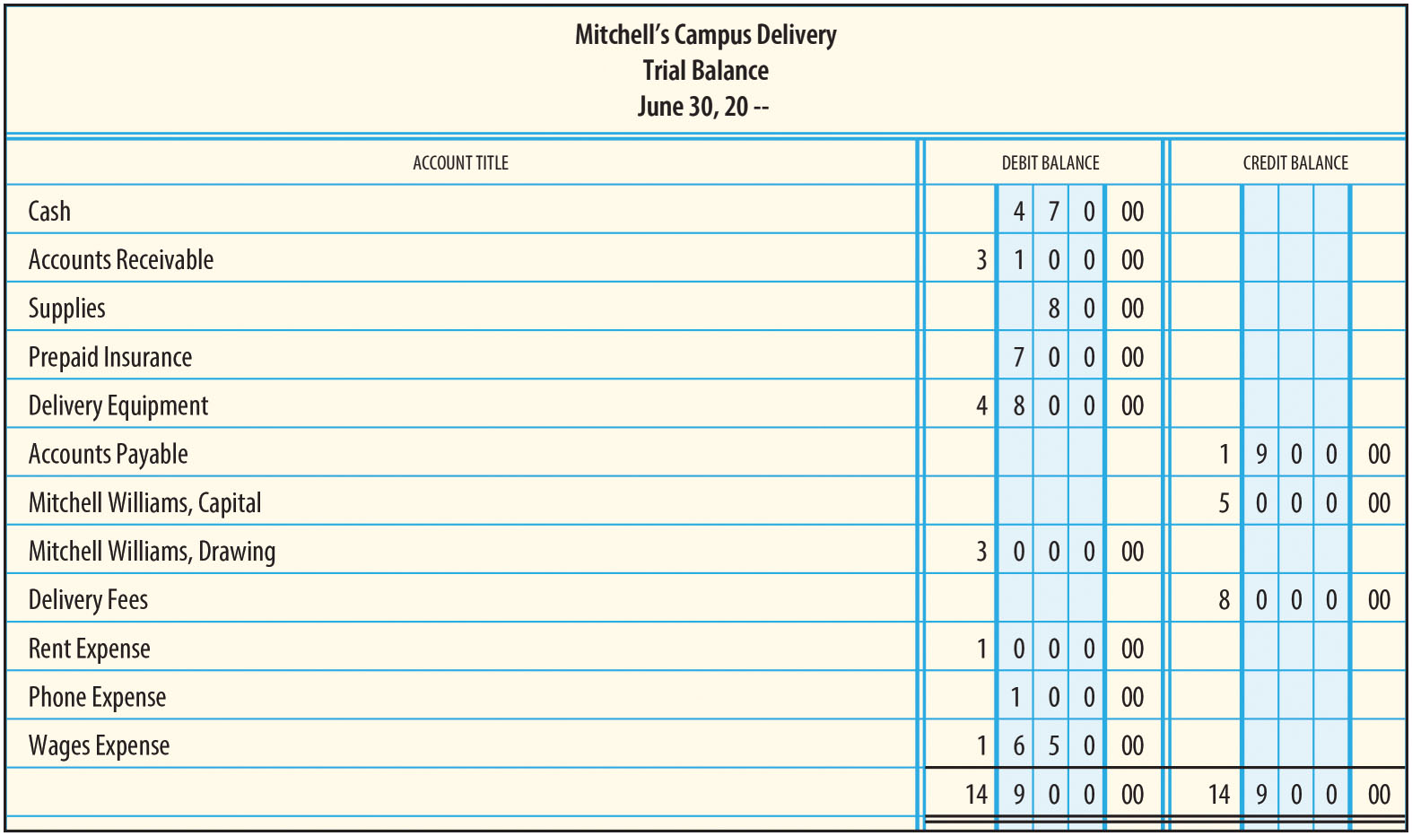
Trial Balance Example
FIGURE 3-22 Trial Balance

Slide 59
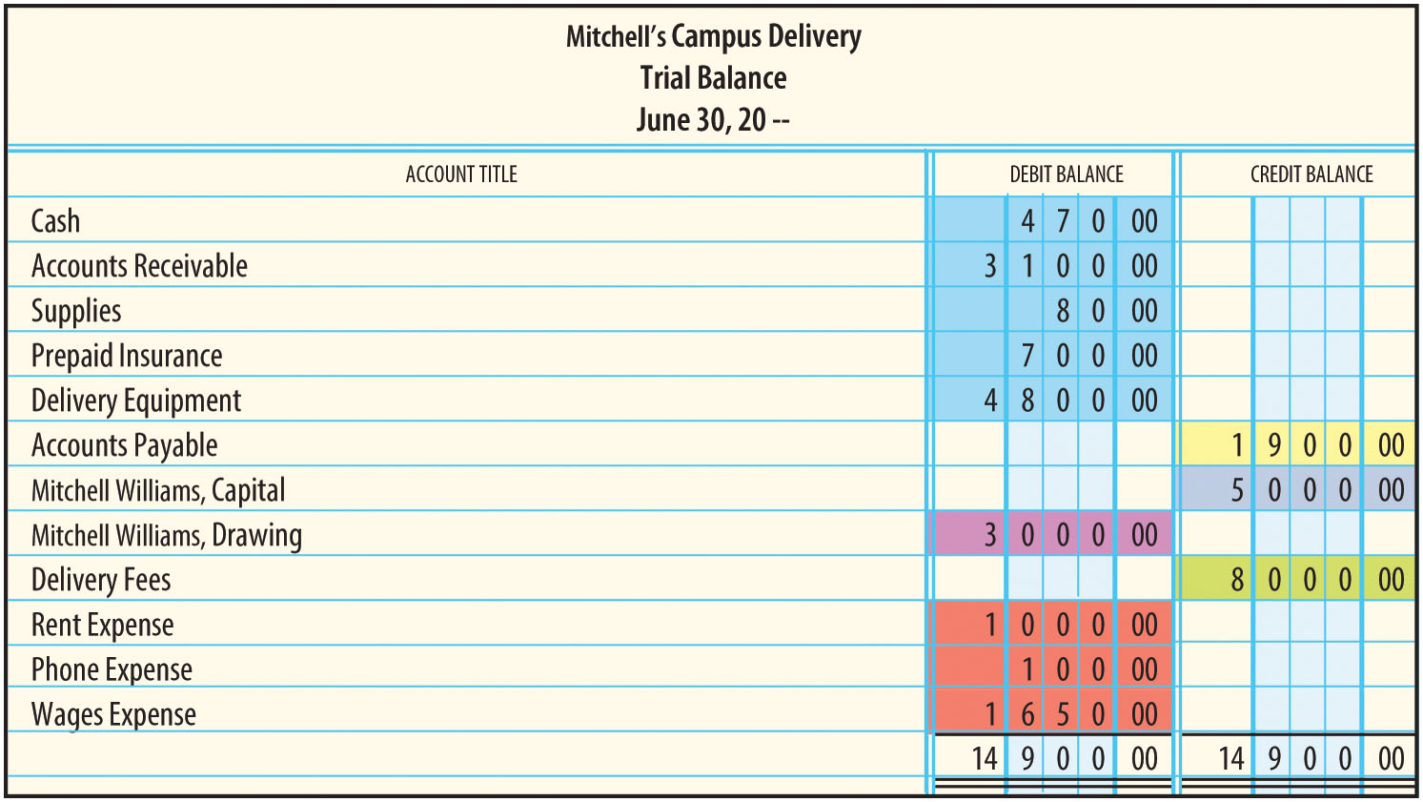
Linkages Between Trial Balance and Financial Statements (1 of 2)
FIGURE 3-23 Linkages Between the Trial Balance and Financial Statements

Slide 60
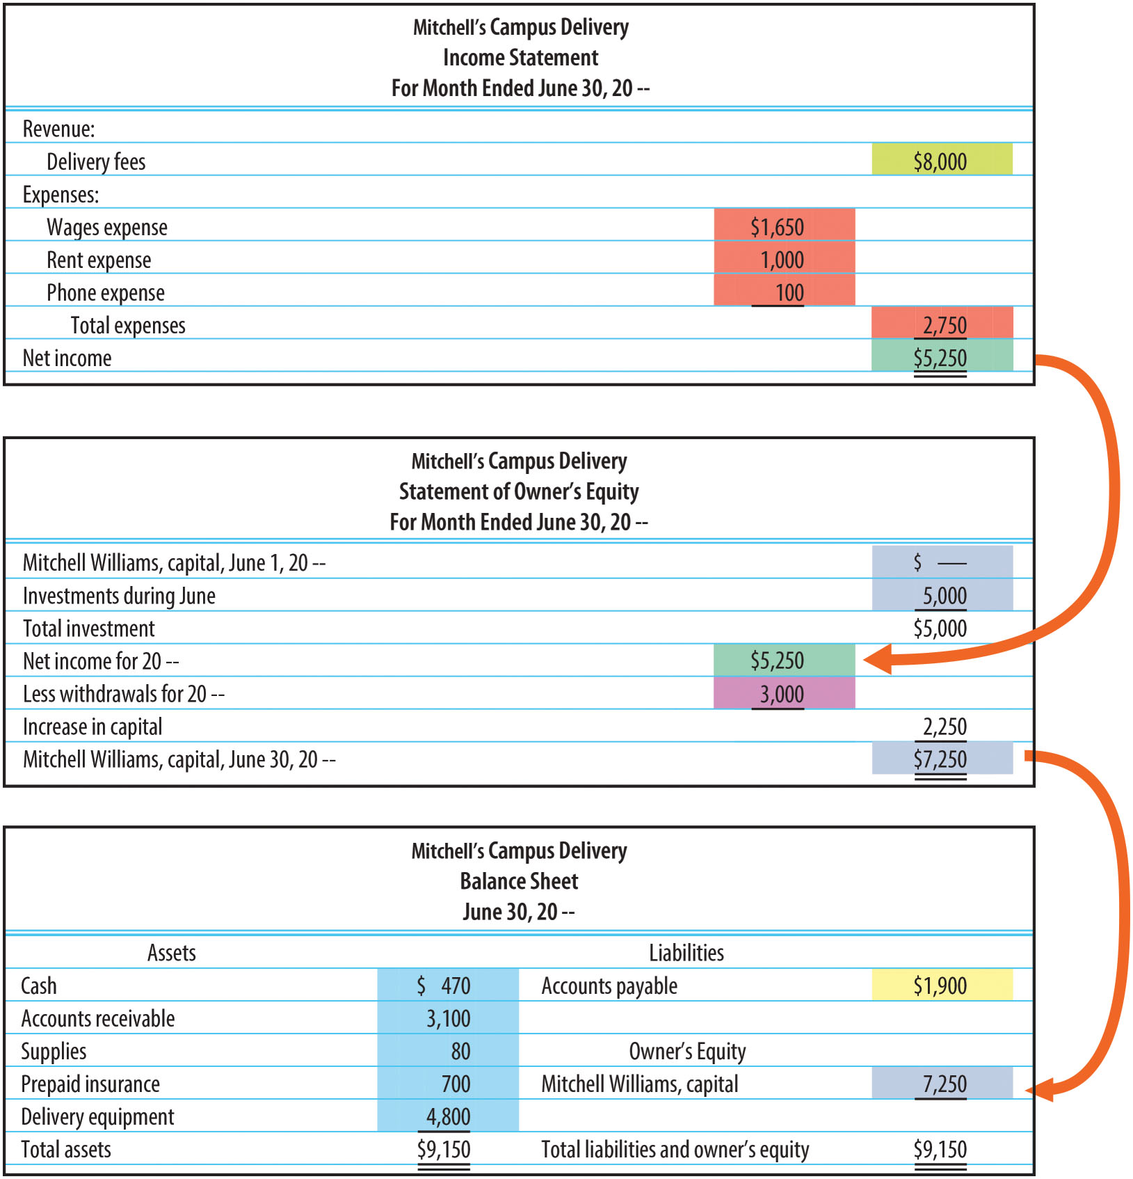
Linkages Between Trial Balance and Financial Statements (2 of 2)
FIGURE 3-23 Linkages Between the Trial Balance and
Financial Statements (concluded)

