Slide 1

Journalizing and Posting
Transactions
Chapter 4

Slide 2
Learning Objective 1
Describe the flow of data from source documents to the trial balance

Slide 3
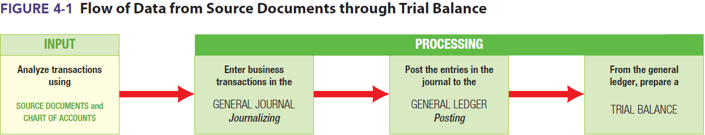
Steps in the Flow of Financial Data
Analyze what happened by using information from source documents and the firm’s chart of accounts
Enter business transactions in the general journal in the form of journal entries
Post these journal entries to the accounts in the general ledger
Prepare a trial balance

Slide 4
Learning Objective 2
Describe and explain the purpose of source documents

Slide 5
Source Documents (1 of 2)
Almost any document that provides information about a business transaction can be called a source document
Trigger the analysis of what happened
Begin the process of entering transactions in the accounting system
Serve as objective evidence of business transactions
Filed for possible future reference
  Having objective, verifiable evidence that a transaction occurred is an important accounting concept

Slide 6
Source Documents (2 of 2)
Examples of source documents include:
  Check stubs or copies of checks
    Cash payments
  Receipt stubs, copies of receipts, cash register tapes, or memos of cash register totals
    Cash receipts
  Copies of sales tickets or sales invoices issued to customers or clients
    Sales of goods or services
  Purchase invoices received from suppliers
    Purchase of goods or services

Slide 7
Learning Objective 3
Describe the chart of accounts as a means of classifying financial information

Slide 8
The Chart of Accounts
A list of all accounts used by a business
In numeric order
  Numbering should follow a consistent pattern
Used to determine which accounts are affected by a given transaction

Slide 9
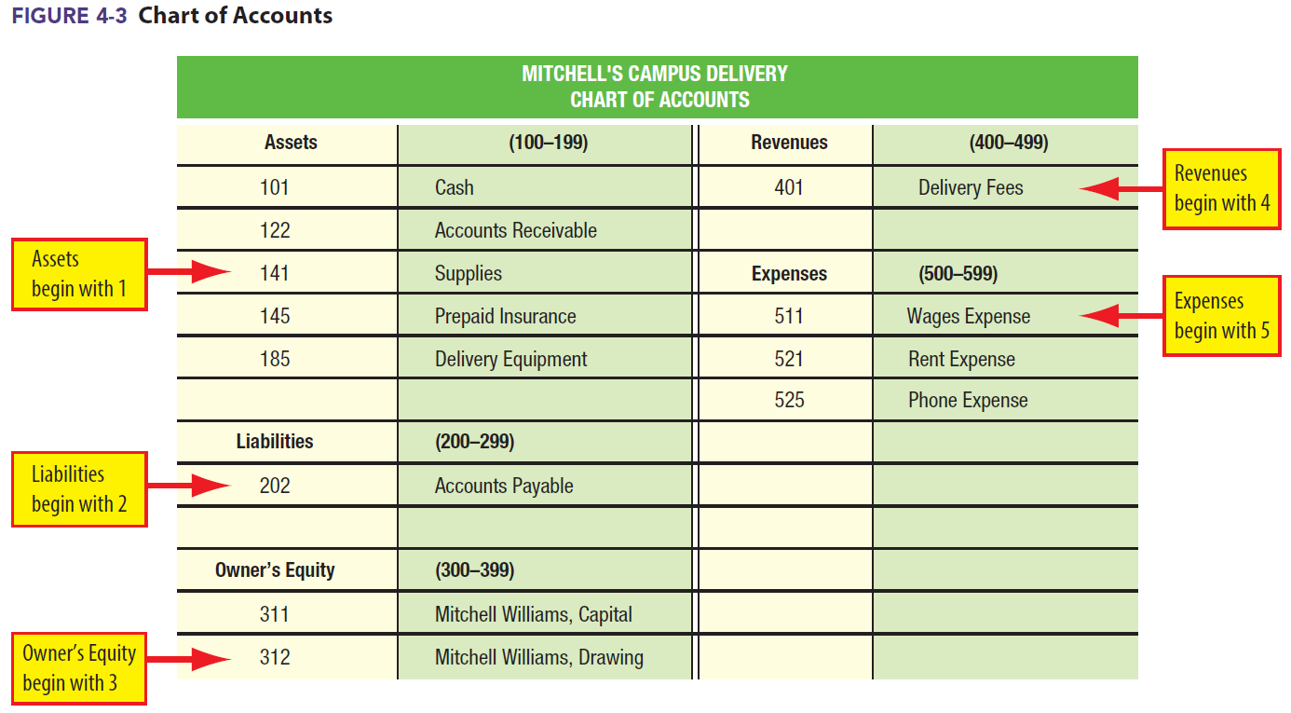
Mitchell’s Campus Delivery Chart of Accounts

Slide 10
Learning Objective 4
Journalize transactions

Slide 11
Journal
Journal: A day-by-day listing of transactions
Purpose: To provide a record of all transactions completed by the business
Commonly referred to as a book of original entry
The simplest journal form is a two-column general journal
  Two columns – one for debits, one for credits
  Any kind of transaction may be entered into a general journal
The act of entering transactions in a journal is called journalizing
For every transaction, the entry should include:
  Date
  Title of each account affected
  Amounts
  Brief description

Slide 12
Journalizing Example: Transaction (a)
June 1 Mitchell Williams opened a bank account with a deposit of $5,000 for his business
  Notice: transactions now have dates associated with them

Slide 13
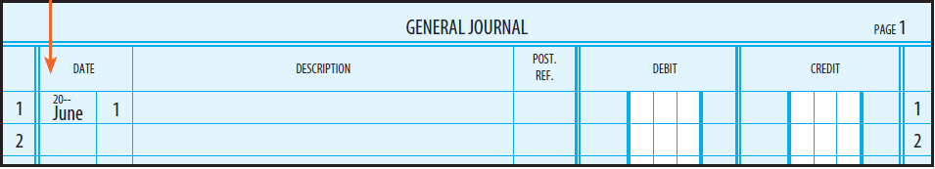
Journalizing Step 1
Enter the date
  The year is only written on the first line of each page

Slide 14
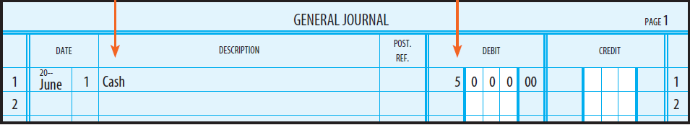
Journalizing Step 2
Cash is entered on the first line at the extreme left of the Description column
The amount of the debit, $5,000, is entered on the same line in the Debit column

Slide 15
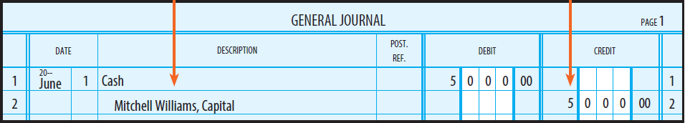
Journalizing Step 3
The title of the account to be credited, Mitchell Williams, Capital, is entered on the second line
  Indented one-half inch from the left side of the Description column
The amount of the credit, $5,000, is entered on the same line in the Credit column

Slide 16
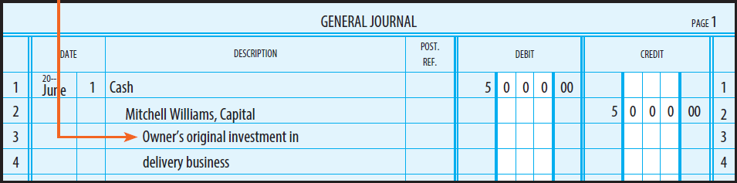
Journalizing Step 4
The explanation of the entry is entered on the next line
  Indented an additional one-half inch
Leave a blank line between transactions

Slide 17
Compound Entry
An entry requiring more than one debit and/or more than one credit
All debits come before any credits

Slide 18
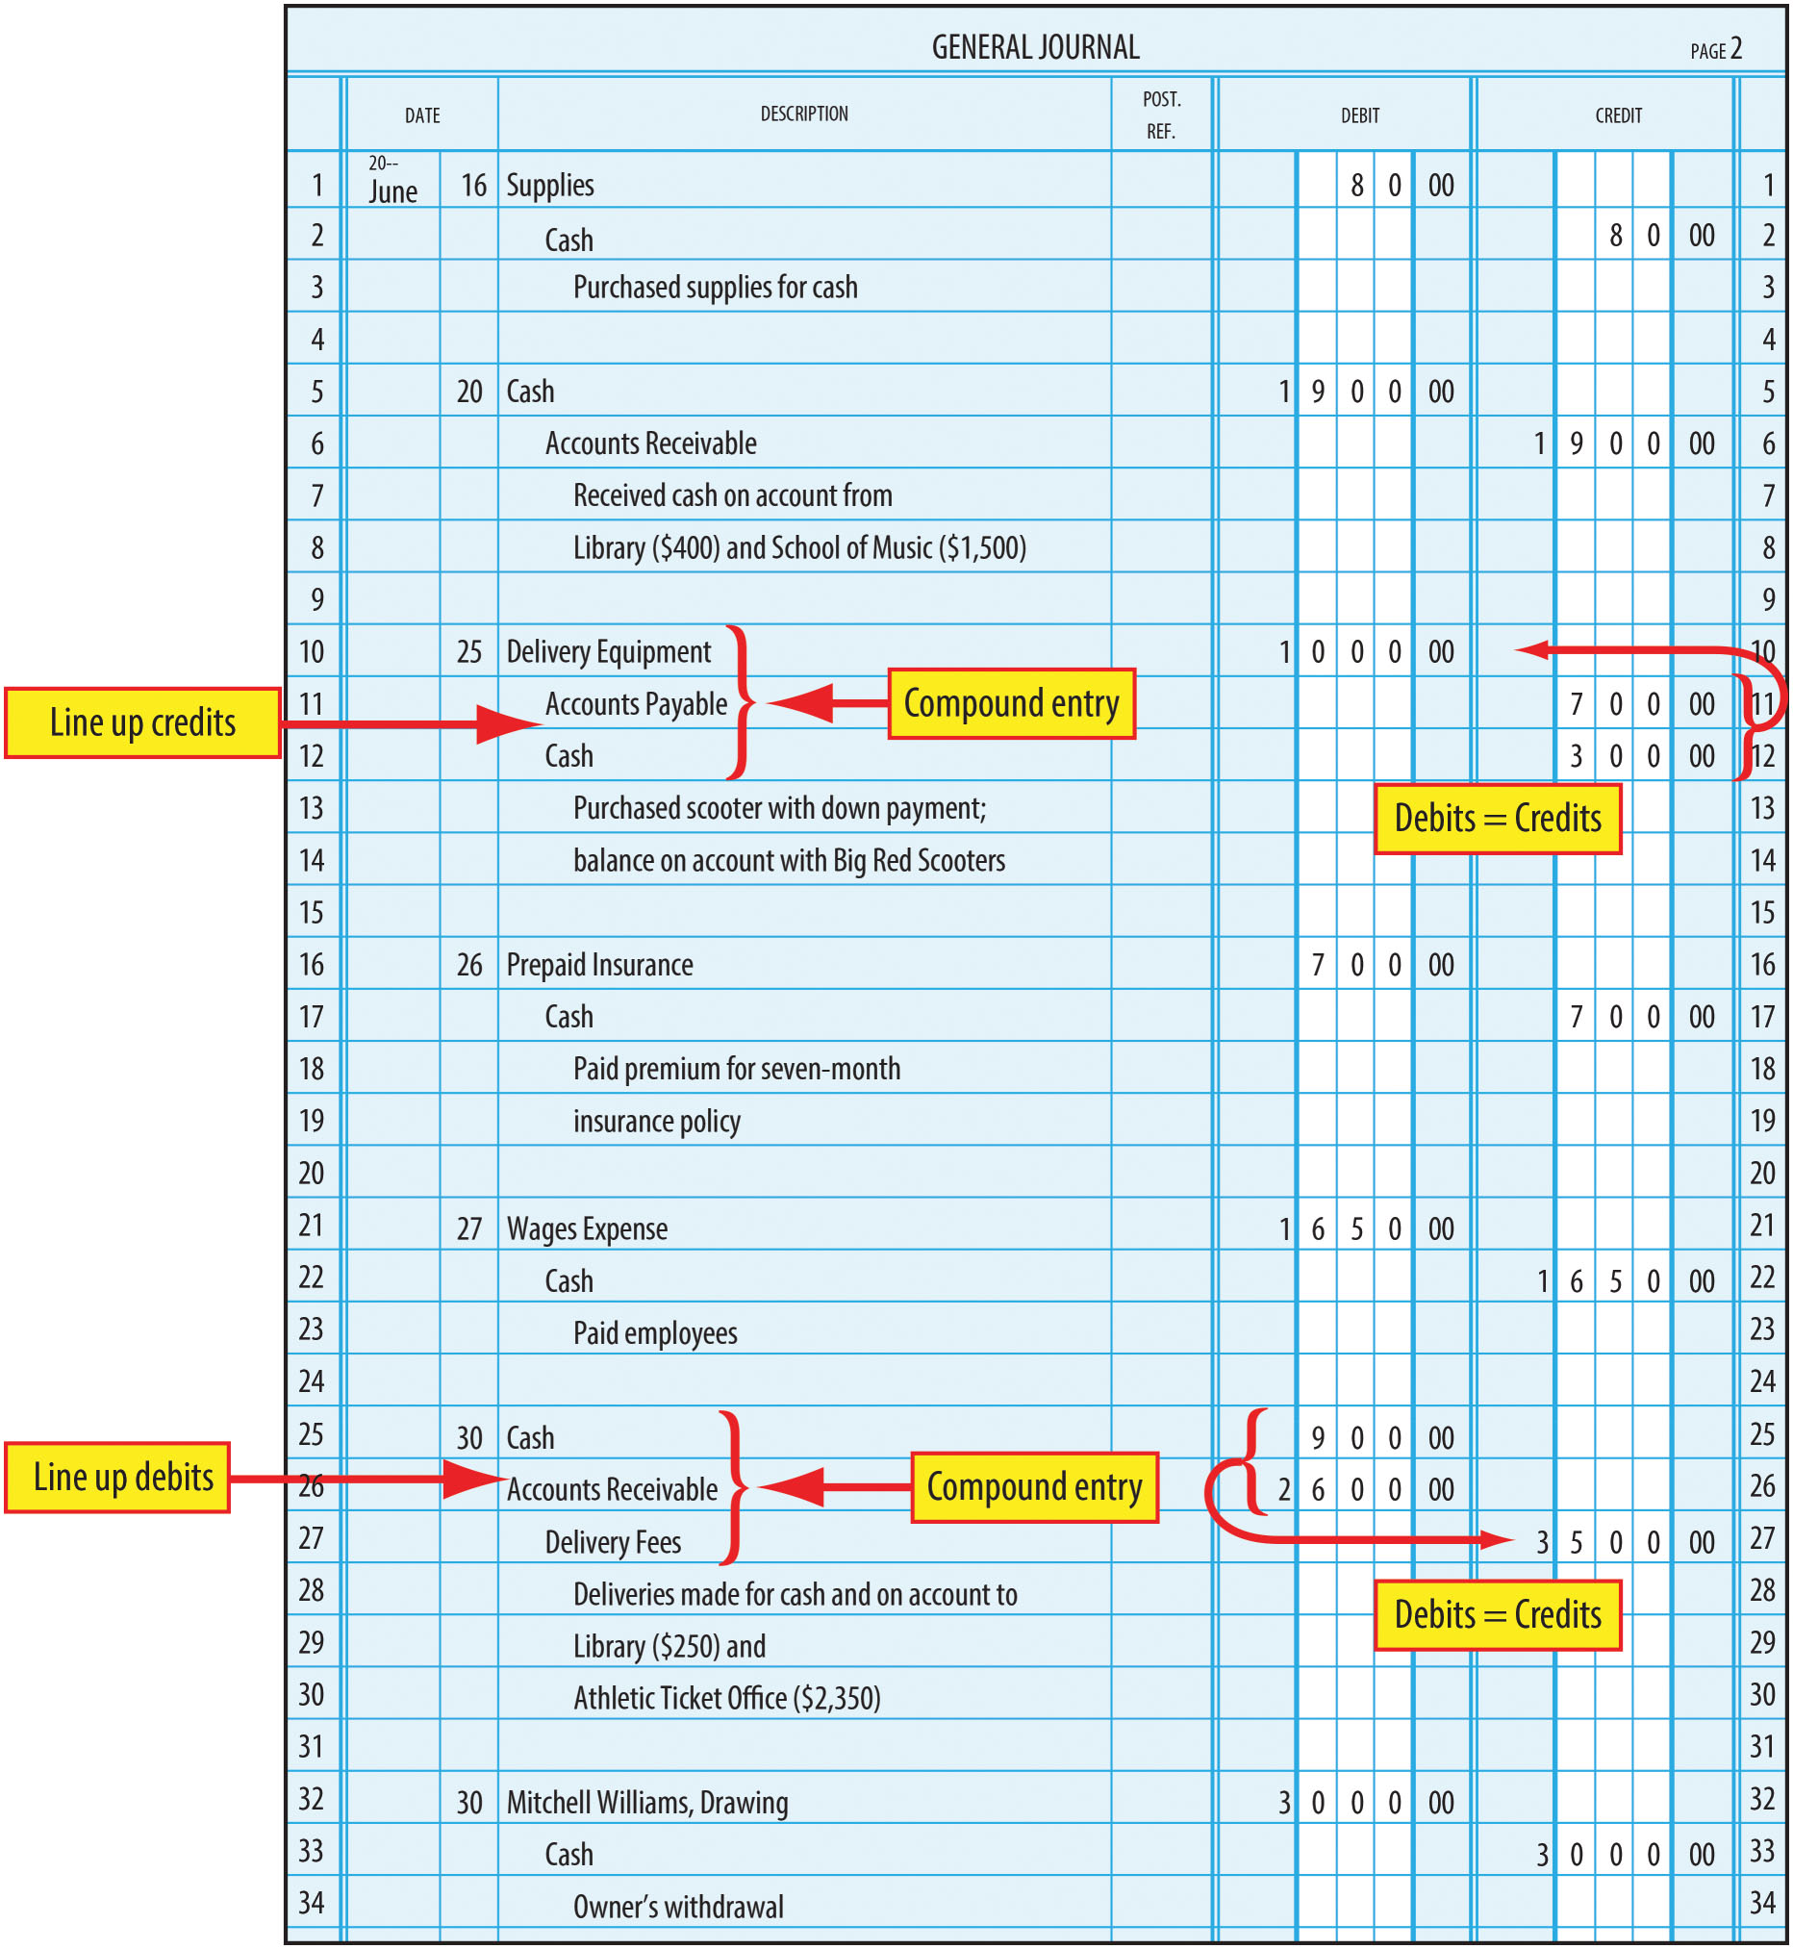
Compound Entry In General Journal
FIGURE 4-7 General Journal Entries (concluded)

Slide 19
Learning Objective 5
Post to the general ledger and prepare a trial balance

Slide 20
General Ledger
A complete set of all accounts used by a business
  Similar to T accounts
Used to keep a complete record of the debits and credits made to each account as a result of entries made in the journal
Numbered and arranged in the same order as the chart of accounts
T accounts were introduced previously. However, businesses are more likely to use a version of the account called the general ledger account
  Keeps a running balance

Slide 21
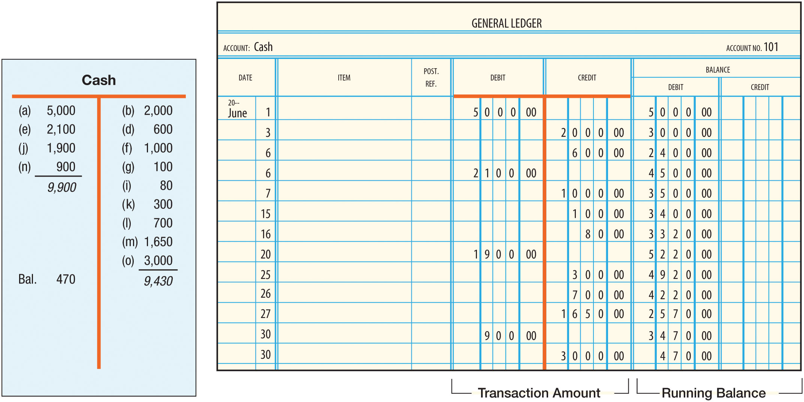
T Account vs. General Ledger Account
FIGURE 4-8 Comparison of T Account and General Ledger Account

Slide 22
Posting to the General Ledger (1 of 2)
The process of copying debits and credits from the journal to the ledger accounts
Done daily or at frequent intervals
Five-step process to post each debit or credit
  Step 1: Enter the date of the transaction in the Date column
  Step 2: Enter the debit (or credit)
  Step 3: Enter the balance of the account
    If the balance of the account is zero, draw a line through the Debit and Credit columns)
  Step 4: Enter the journal page in the Posting Reference column
  Step 5: Enter the ledger account number in the Posting Reference column

Slide 23
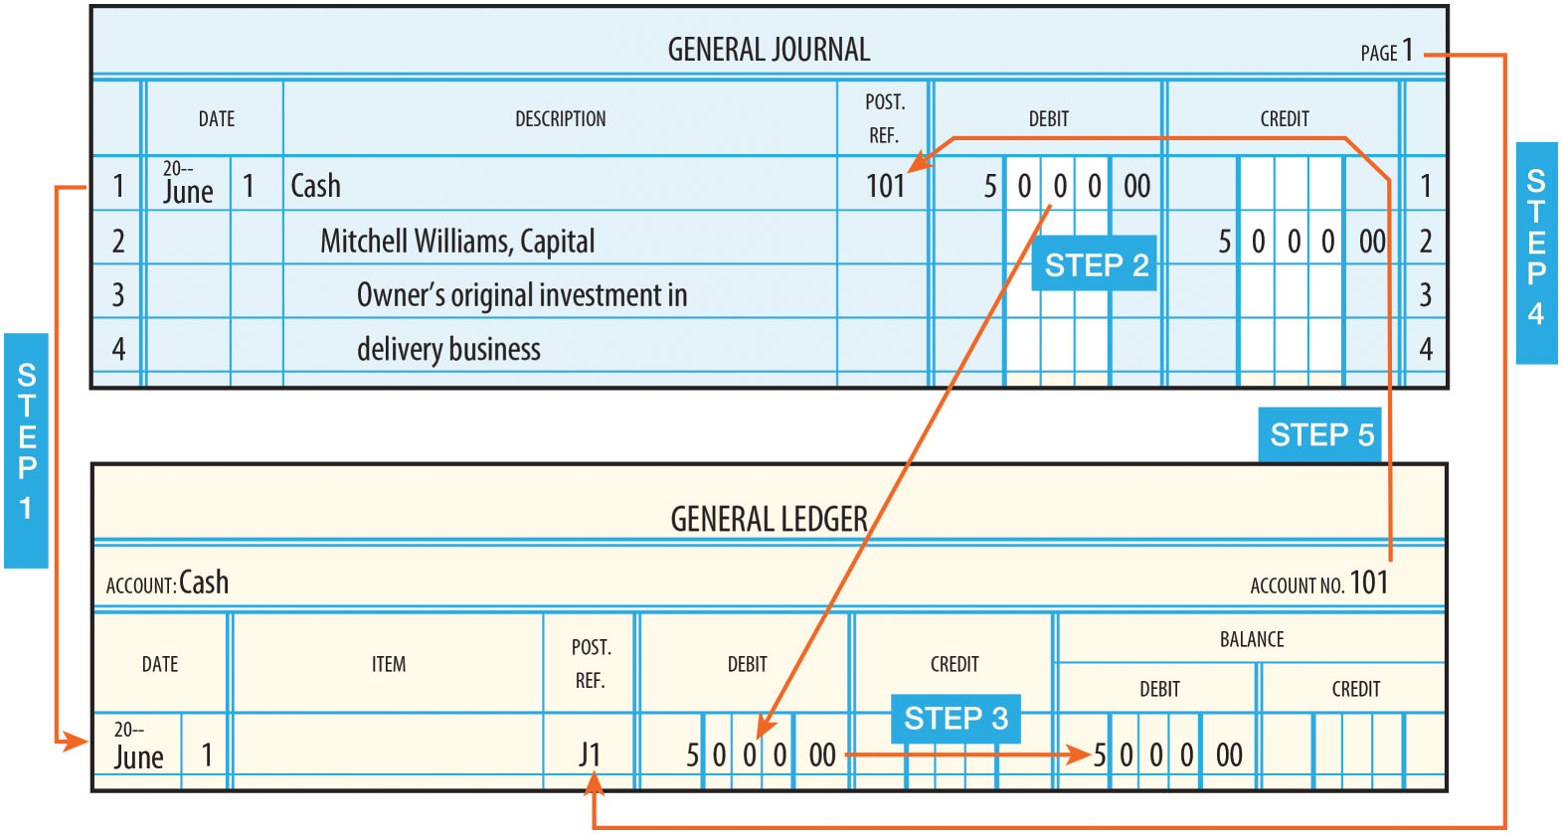
Posting to the General Ledger (2 of 2)
FIGURE 4-9 Posting a Debit

Slide 24
The Trial Balance (1 of 2)
Used to prove the equality of the debits and credits in the ledger accounts
Can be prepared daily, weekly, monthly, or whenever desired
Prepared after all transactions have been journalized and posted

Slide 25
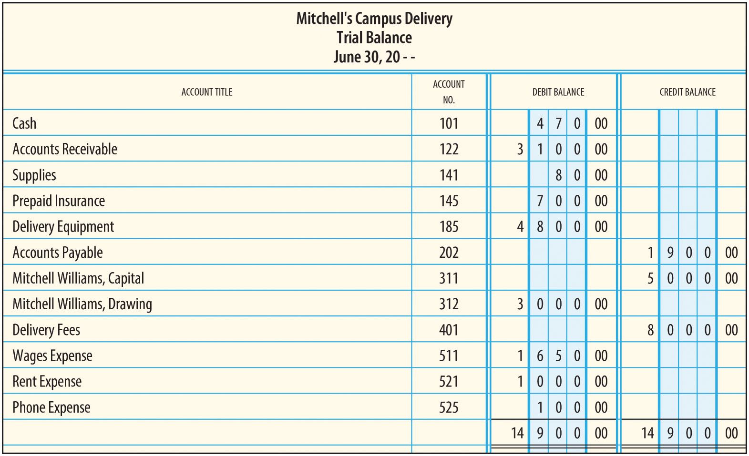
The Trial Balance (2 of 2)
FIGURE 4-13 Trial Balance

Slide 26
Learning Objective 6
Explain how to find and correct errors

Slide 27
But It Balances…
Even though the trial balance indicates that the ledger is in balance, the ledger can still contain errors if
  A journal entry was made debiting or crediting the wrong accounts
  An item was posted to the wrong account
It is important, therefore, to be very careful in preparing the journal entries and in posting them to the ledger accounts

Slide 28
Tips for Finding Errors (1 of 2)
Double-check your addition
  Review balances
  See if any balances are too large or small, relative to other accounts
    See if any balances are entered in the wrong column
Find the difference between the debits and the credits
  Is the difference the amount of a specific transaction?
  Do you forget to post the debit or credit part of that transaction?
Divide the difference by 2
  Is this number the amount of a specific transaction?
    Did you post the debit or credit twice?
    Did you post the debit as a credit (or vice versa)?

Slide 29
Tips for Finding Errors (2 of 2)
Divide the difference by 9
  If the difference is evenly divisible by 9, you could have a slide error or a transposition error
Slide errors - Occur when the decimal point “slid” a digit or two to the right or left
  For example if the amount was $250, but recorded as $25
    The difference is $225 ($250 – $25)
    The difference is evenly divisible by 9 ($225 ÷ 9 = 25)
Transposition errors - Occur when two digits are reversed
  For example if the amount was $250, but recorded as $520
    The difference is $270 ($520 – $250)
    The difference is evenly divisible by 9 ($270 ÷ 9 = 30)

Slide 30
If The Tips Don’t Work…
You must retrace your steps through the accounting process
  Double-check your addition for the ledger accounts
  Trace all postings

Slide 31
Correcting Errors
Erasing is NOT acceptable
  It may suggest that you are trying to hide something
Make the correction in a manner that is easy for others to observe and understand
Make a correcting entry
  A new entry must be made to correct the accounts

Slide 32
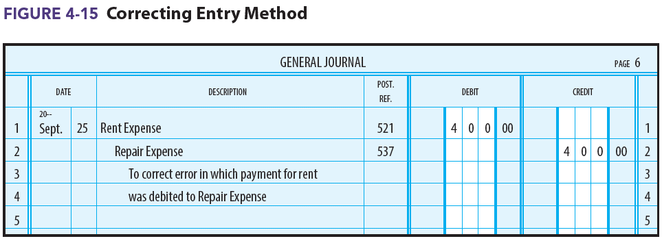
Correcting Entry Method Example
Assume that a $400 payment for Rent Expense was incorrectly debited to Repair Expense but correctly credited to Cash
You need to get $400 out of Repair Expense and into Rent Expense

