Slide 1
Managing and Enhancing Performance: The Big Picture

Slide 2
Learning Outcomes
Describe the relationships among performance measured at different levels within an organization and discuss how training, development, and job redesign can help improve performance
Discuss the role of alternate work arrangements in motivating and enhancing performance
Describe the role of incentive pay and identify different programs for individual-based and team-based incentive plans

Slide 3
Learning Outcomes (Continued)
Discuss the best ways to deliver performance feedback and the issues involved with feedback and describe the basic operation of the ProMES system
Discuss how organizations evaluate performance-enhancement programs
Discuss how recent world events have affected the role of HR

Slide 4
Enhancing Performance at Different Levels
LO 1
Performance exists at multiple levels
  Basic level performance is that of an individual employee
Firm-level performance: Indication of a firm’s chances of long-term survival
  Generates profits
  Determines company’s stock price
  Requires a strong HR system

Slide 5
Training and Development
LO 1
Basic form of performance-enhancement intervention
Begin with needs assessment
  Provides information on gaps between present and desired performance
  Gives a roadmap of changes that are required to improve performance
Models can be adapted to individuals or groups

Slide 6
Job Redesign
LO 1
Job rotation
  Involves systematically moving employees from one job to another
Job enlargement
  Increases the total number of tasks workers perform assuming that doing the same basic task repeatedly is the primary cause of worker dissatisfaction
Job enrichment
  Tries to increase the number of tasks a worker does and the control the worker has over the job

Slide 7
Job Redesign (Continued 1)
LO 1
Disadvantages of job enlargement
  Increased training costs
  Union demand for increased pay to perform more tasks
  Job remains boring and monotonous
Successful job enrichment requires managers to:
  Remove some controls from the job
  Delegate more authority to workers
  Structure work in complete and natural units

Slide 8
Job Redesign (Continued 2)
LO 1
Job characteristics approach
  Alternative to job specialization that takes into account the work system and employee preferences
Work team
  Arrangement in which a group is given responsibility for designing the work system to be used in performing an interrelated set of jobs

Slide 9
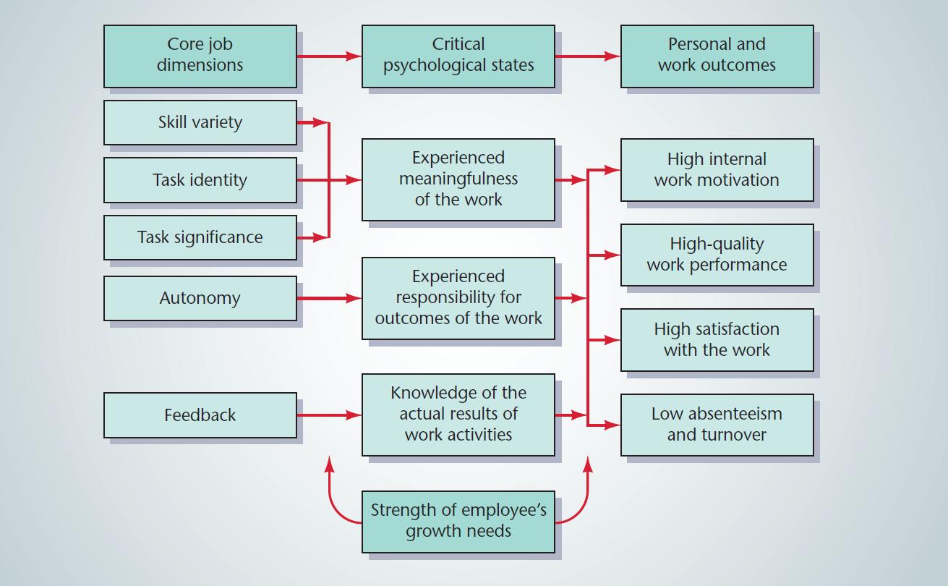
14.1 The Job Characteristics Model of Job Design
LO 1
Source: Reprinted from Organizational Behavior and Human Performance, Vol. 16, J. R. Hackman and G. R. Oldham, “Motivation Through the Design of Work: Test of a Theory,” pp. 250–279, 1976, with permission from Elsevier.

Slide 10
Alternative Work Schedules
LO 2
Flexible work hour plans: Employees must work 40 hours per week and five days a week
  Employees have control over the starting and ending times for work on each day
Compressed workweeks: Employees work the required number of hours per week, but do so in fewer than five days

Slide 11
Alternative Work Sites
LO 2
Home work programs
  Include arrangements referred to as cottage industries or an electronic cottage
Telecommuting
  Logical extension of electronic cottage
  Employees do most of their work at home and receive assignments electronically
  Increases job satisfaction and productivity

Slide 12
Incentives and Performance-Based Rewards
LO 3
Merit pay: Awarded to employees on the basis of the relative value of their contributions to the organization
  Merit-pay plans: Compensation plans that formally base at least some meaningful portion of compensation on merit
Skill- and knowledge-based pay
  Employees are rewarded for acquisition of skills and knowledge that may help the organization in the future

Slide 13
Individual Incentive Pay Plans
LO 3
Reward individual performance on a real-time basis
  No effect on base salary
  Most common form is sales commission
  Practical only when performance can be measured easily and objectively

Slide 14
Team and Group Incentive Plans
LO 3
Gainsharing: Shares cost savings from productivity improvements with employees
  Scanlon plans: Teams or groups are encouraged to suggest strategies for reducing costs
    Gains are distributed across the organization
Profit sharing: Portion of company profits is paid into a profit-sharing pool and distributed to all employees at the end of the year

Slide 15
Team and Group Incentive Plans (Continued)
LO 3
Stock-option plans
  Give senior managers the option to buy company stock in the future at a predetermined fixed price
Stock-purchase plans
  Employees are entitled to company stock only if they remain with the company for a specified period of time
Employee stock ownership plans (ESOPs)
  Employees are gradually given a major stake in the ownership of a corporation

Slide 16
Performance-Management Techniques
LO 4
Behavior modification
  Systematic and simultaneous application of positive reinforcement or punishment
  Helps eliminate undesirable behaviors in an employee
Goal theory
  Employees exert great effort when they have specific and difficult goals to achieve
Performance feedback
  Helps employees improve performance

Slide 17
Productivity Measurement and Evaluation System (ProMES)
LO 4
Program developed to improve group or firm-level productivity
  Incorporates ideas from goal setting to feedback
  Includes incentives for improvement
  Based on a model of motivation similar to expectancy theory

Slide 18
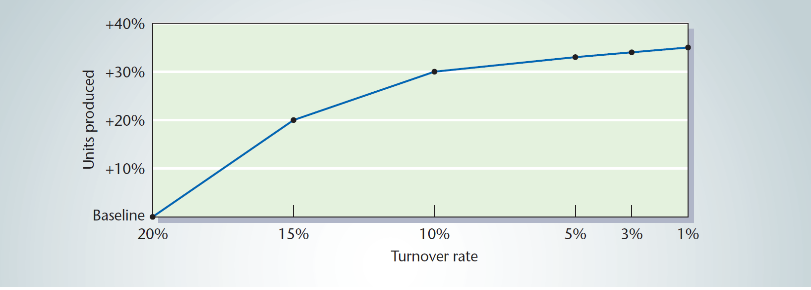
14.3 A Sample ProMES Curve
LO 4

Slide 19
Evaluating Performance-Enhancement Programs
LO 5
Programs need to contribute to achieving the goals of an organization
General indexes of firm-level performance
  Human resource indicators
  Measures of profitability, productivity, and controllable costs
  Financial and accounting indicators such as stock price and market share

Slide 20
Human Resources in the Headlines
LO 6
HR and Islam
  Islam is the fastest growing religion in the world
  Some practices may have to be adapted to consider Muslim culture
Privacy and cybersecurity in the 21st century
  Employees need to be trained on handling confidential information
    Posting information on social media websites must be prohibited

Slide 21
Human Resources in Faith-Based Businesses
LO 6
Employee recruitment advantages
  Faith-related holidays
  Reasonable compensation and benefits
  Fellow believers are drawn in
Employee recruitment disadvantages
  Faith-related holidays limit sales and elicit fewer working hours
  Religious contributions may restrict business
  Individuals with different beliefs may not want to work there

Slide 22
The #MeToo Movement
LO 6
Increase in the number of complaints pertaining to sexual harassment
  HR departments need to be proactive in dealing with such complaints
  Eliminating sexual harassment requires a cultural change
Allegations of sexual harassment can cause significant damage to an organization’s reputation

Slide 23
Key Terms
Base salary
Compressed
workweeks
Employee stock
ownership plans
(ESOPs)
Firm-level performance
Flexible work hour plans
Gainsharing
Individual incentive plans
Job characteristics approach
Job enlargement
Job enrichment
Job rotation
Merit pay
Merit-pay plans

Slide 24
Key Terms (Continued)
Productivity measurement and evaluation system (ProMES)
Profit sharing
Sales commission
Scanlon plan
Stock-option plan
Stock-purchase plan
Work team

Slide 25
Summary
Firms must create a strong HR system to enable employees to view the effects of behavior on firm performance
Performance can be enhanced by providing:
  Flexibility in working arrangements
  Incentive and performance-based rewards
  Performance feedback
General indexes of firm-level performance are useful in determining firm performance

