Slide 1
Intermediate Accounting
Third Edition
Wahlen, Intermediate Accounting, Third Edition. © 2020 Cengage. All Rights Reserved. May not be scanned, copied or duplicated, or posted to a publicly accessible website, in whole or in part.

Slide 2
Current Liabilities and Contingent Obligations
Chapter 9

Slide 3
Learning Objectives
Explain the characteristics of a liability.
Describe the nature, classification, and valuation of current liabilities.
Identify, measure, and record current liabilities based on a contractual amount.
Understand and record current liabilities whose amounts are determined by operating activities.
Identify and account for contingent gains and losses, including warranties and premiums.
Describe the presentation and disclosure of current liabilities and contingencies.

Slide 4
What Are Liabilities? Part 1
Learning Objective #1
Liabilities are the probable future sacrifices of economic benefits arising from present obligations of a company to transfer assets or provide services in the future as a result of past transactions or events. Three characteristics of a liability include:
    a present obligation that will be settled by a probable future sacrifice involving the transfer of assets, provision of services, or other use of assets at a specified or determinable date.
    the company has little or no discretion to avoid the future sacrifice of economic benefits.
    the transaction, event, or arrangement obligating the company has already happened.

Slide 5
What Are Liabilities? Part 2
Liabilities include the following obligations:
  Legal liabilities are obligations incurred in transactions that are contractual to pay cash or to provide goods or services to other entities in the future.
    Examples include accounts payable, notes payable, taxes payable, and wages payable.
  Equitable and constructive liabilities are obligations that a company accepts by paying them in the normal course of business even though there is no legal requirement to do so.
    Examples include vacation pay or year-end bonuses.

Slide 6
What Is a Current Liability?
Learning Objective #2
Current liabilities are obligations that are satisfied with current assets or by the creation of current liabilities.
For most companies, the operating cycle—from cash to inventory to receivables and back to cash—is less than one year, and, therefore, the usual classification criterion is one year.
When an organization’s operating cycle is greater than a year, it determines the classification of the liability.

Slide 7
Liquidity, Financial Flexibility, and
Current Liabilities, Part 1
Liquidity refers to how quickly a company can convert its assets to cash in order to cover operating costs and pay its liabilities when they become due.
  Financial statement users predict future cash inflows from liquid assets relative to future cash outflows needed to meet liabilities coming due.
Financial flexibility refers to a company’s ability to use its financial resources to adapt to change and to take advantage of opportunities.
  A more liquid company generally has greater financial flexibility.

Slide 8
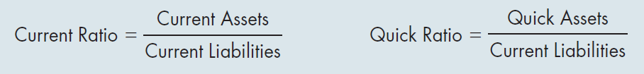
Liquidity, Financial Flexibility, and
Current Liabilities, Part 2
Two useful ratios for assessing a company’s liquidity are the current ratio and the quick ratio.
These ratios are computed as follows:

Slide 9
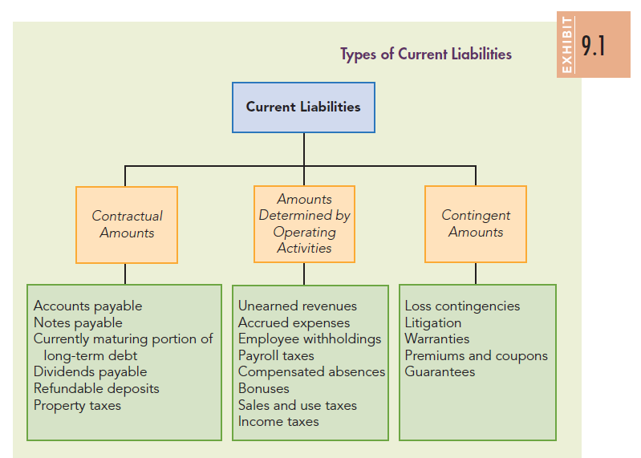
Types of Current Liabilities

Slide 10
How Are Current Liabilities Valued?
Conceptually, a company should record and report its current liabilities at the present value of the required future payments.
In practice, however, most current liabilities are measured, recorded, and reported at their maturity or face amount.
The difference between the maturity amount and the present value of the maturity amount is usually not material because of the short time period involved—usually one year or less.

Slide 11
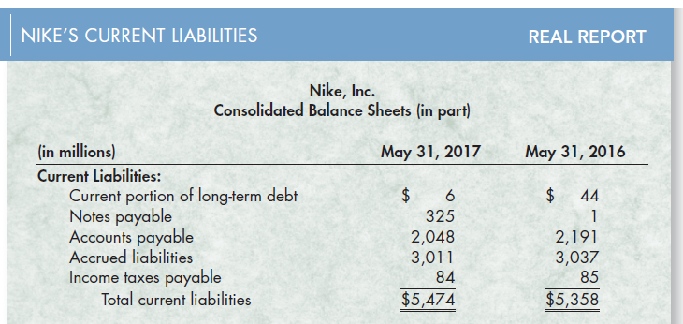
Real Report: Nike’s Current Liabilities,
Part 1 (Slide 1 of 2)

Slide 12
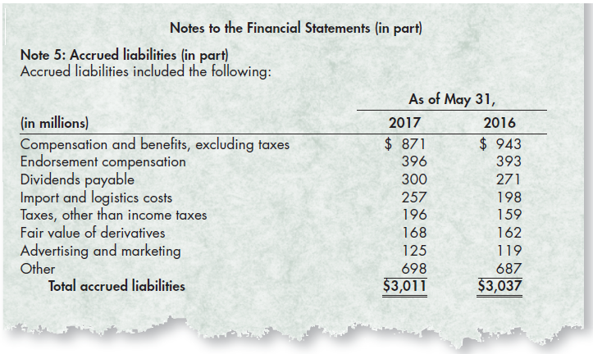
Real Report: Nike’s Current Liabilities,
Part 1 (Slide 2 of 2)

Slide 13
Real Report: Nike’s Current Liabilities, Part 2
Questions:
  Describe Nike’s largest current liabilities. What do they represent?
    Nike’s largest current liabilities are accounts payable and accrued liabilities. Accounts payable represent obligations to suppliers arising from purchasing inventory, supplies, and services on credit. The accrued liabilities represent obligations that have been incurred but not yet paid. The largest of the accrued liabilities include costs relating to compensation such as salaries and wages, as well as endorsement compensation.

Slide 14
Real Report: Nike’s Current Liabilities, Part 3
Classify each of Nike’s current liability accounts using the classification given in Exhibit 9.1.
  Nike’s liabilities fit into two of the three classifications given in Exhibit 9.1. For example, accounts payable and dividends payable are based on contractual amounts. Accrued compensation and benefits and accrued taxes payable are amounts determined by operating activities. Nike reports no amounts for contingent obligations.

Slide 15
How Do You Account for Current Liabilities Based on a Contractual Amount?
Learning Objective #3
When current liabilities are based on a contractual amount, the liability and its maturity amount are known with reasonable certainty.

Slide 16
Trade Accounts Payable
Accounts payable (or trade accounts payable) are obligations to suppliers arising from purchasing inventory, supplies, or services on credit.
All accounts payable must be recorded in the proper accounting period.
  Issues arise when a company purchases inventory near the end of its accounting period and the goods are in transit at year-end. Ownership of goods in transit is determined by terms (FOB shipping point vs. FOB destination).
  The amount of the trade accounts payable usually is determined by reviewing the invoice, which specifies the exact amount owed and the date payment is due.
  When cash discounts (e.g., 2/10, n/30) are offered, a company has the option to record the purchase (inventory) and the associated liability (accounts payable) using the gross price method or the net price method.

Slide 17
Notes Payable
A note payable is a promissory note that requires the borrower to repay a sum of money on a specific date and may be classified as short term or long term.
  Notes payable normally result from purchasing goods or services on credit or borrowing money.
  The ability to obtain short-term financing with notes payable is often a key component of a company’s working capital strategy.
While the promissory note is the source document used to determine and record the initial amount of the liability, interest also plays a key valuation role.

Slide 18
Classification of Notes Payable
Interest-bearing note—The principal amount equals the face value of the note, and the interest rate is stated explicitly on the note.
Non-interest-bearing note—The note is stated at its maturity value that includes both the principal and interest to maturity. The borrower receives less than the face value, and, therefore, the interest is implied as the difference between the face value of the note and the cash received.

Slide 19
Interest-Bearing Note
For an interest-bearing note, the face value of the note is its present value.
Therefore, the liability is recorded at an amount equal to the face value of the note.
Interest expense is accrued over the life of the note by applying the stated interest rate to the face value.

Slide 20
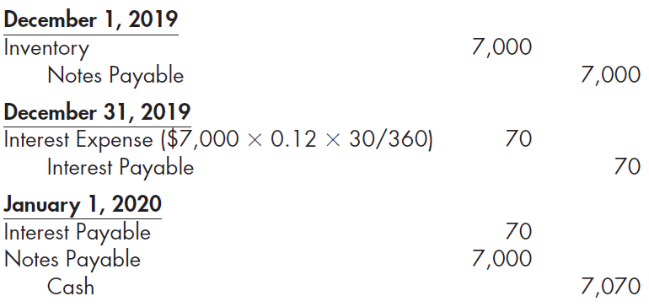
Example: Interest-Bearing Note
Titan Corporation uses a perpetual inventory system and purchases merchandise for $7,000 on December 1, 2019, by issuing a $7,000, 12%, 30-day note to the supplier. Titan records the issuance of the note, the accrual of interest, and the payment of the principal and interest (assuming for simplicity, a 360-day business year), respectively, as follows:

Slide 21
Non-Interest-Bearing Note
Non-interest-bearing notes do not include an explicitly stated interest component; however, interest is implicit in the face value of the note.
This implicit interest, called a discount on notes payable, is deducted from the face amount to determine the cash received by the borrower.
Interest expense is then recorded over the life of the note as an adjustment of this discounted amount.

Slide 22

Example: Non-Interest-Bearing Note, Part 1
On April 1, 2019, Trollingwood Corporation borrows money at First National Bank by issuing a $10,000, 3 month, non-interest-bearing note. The note is discounted on a 12% basis. Therefore, Trollingwood receives $9,700
It makes the following journal entry to record the issuance of the note payable:
Observe that $10,000 is the maturity value of the note, but the company records the liability at its present value—the face amount of the note minus the discount. The discount represents the interest expense applicable to the entire term of the note and is shown on Trollingwood’s balance sheet as a contra account to Notes Payable.

Slide 23

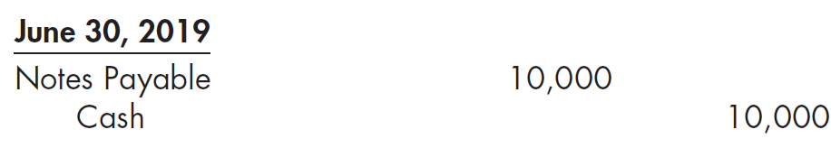
Example: Non-Interest-Bearing Note, Part 2
At maturity, Trollingwood would make the following entry to recognize interest expense:
Observe that the reduction in the Discount on Notes Payable account increases the current liability amount shown on the company’s balance sheet.

Slide 24

Example: Non-Interest-Bearing Note, Part 3
The effective interest rate for 3 months (one-fourth of a year) can be determined as follows:
The effective annual interest rate can be determined as follows:

Slide 25
Credit Lines
A line of credit is an agreement that allows a corporation to borrow up to a prearranged limit.
  A noncommitted line means the corporation does not have to follow any formal loan procedures or complete the normal paperwork.
  A committed line of credit is a more formal process that normally requires a corporation to pay a commitment fee to have access to the funds, providing it with flexibility to borrow when needed.

Slide 26
Commercial Paper
Commercial paper is an unsecured note payable that is commonly used to finance accounts receivable and inventories, as well as to meet other short-term obligations.
Commercial paper generally has a maturity ranging from 30 to 270 days.
A major benefit of commercial paper is that it does not have to be registered with the SEC as long as it matures before 270 days, making it a very cost-effective way to obtain financing.

Slide 27
Currently Maturing Portion of Long-Term Debt, Part 1
Generally, a company classifies the currently maturing portion of long-term debt (such as bonds or installment loans) as a current liability to show the effect on its liquidity.
Any long-term debt will become a current liability immediately before the year of retirement.
Example Browne Company issued 20-year bonds that mature on July 1, 2020. Browne reports the bonds as a long-term liability in its December 31, 2018 (and prior) balance sheets. However, because the amount is due within one year of December 31, 2019, the bonds would be reported as a current liability on its December 31, 2019, balance sheet.

Slide 28
Currently Maturing Portion of Long-Term Debt, Part 2
The second situation involves the issuance of installment debt instruments—such as bonds that retire in periodic installments or mortgages requiring monthly or annual installment payments.
Example Assume that on July 1, 2018, Rexlow Corporation issues 9% serial bonds with a face value of $1 million. These bonds are to be retired in installments of $100,000, beginning on July 1, 2020, and for each year thereafter until all bonds are retired. Rexlow’s December 31, 2019, balance sheet would show the currently maturing installment of $100,000 as a current liability and the $900,000 (the installments due after December 31, 2020) as a long-term liability.

Slide 29
Short-Term Debt Expected to Be Refinanced
Short-term debt that is expected to be refinanced on a long-term basis may be excluded from the current liability classification if the company has both:
  intent to refinance the obligation on a long-term basis AND
  the ability to refinance the obligation on a long-term basis
The ability to refinance on a long-term basis means that the company has done one of the following:
  refinanced the obligations by issuing long-term obligations or equity securities after the date of its balance sheet but before the balance sheet is issued
  entered into a long-term financing agreement before it issues its balance sheet that clearly permits the company to refinance the short-term obligations on a long-term basis

Slide 30
Repayment and Replacement
If a company repays a short-term debt after the balance sheet date and then later issues long-term debt (or common stock) before the balance sheet actually is published, GAAP requires that such short-term debt be included in current liabilities at the balance sheet date.

Slide 31
Obligations Callable by the Creditor
If a company violates a long-term debt agreement and the liability becomes callable by the creditor, the company reports the entire amount of the long-term obligation as a current liability. An exception to this requirement exists if the obligation that meets one of the following conditions:
  The creditor has waived the right to request repayment for more than one year (or operating cycle, if longer) from the balance sheet date.
  It is probable that the company will resolve the violation of a debt agreement for a long-term obligation within a specified grace period, thus preventing it from becoming callable (the violation is reported in the footnotes).

Slide 32

Dividends Payable (Slide 1 of 2)
When a company’s board of directors declares a dividend, it reduces retained earnings and recognizes a current liability if it expects to distribute the dividend within the following year. The entry to record the declaration of a $50,000 cash dividend is as follows:

Slide 33
Dividends Payable (Slide 2 of 2)
There are two exceptions to the recording of dividends as current liabilities:
  A company does not report the amount owed for a stock dividend—a dividend payable in shares of stock—as a current liability, instead it reports the declaration of a stock dividend as an element of shareholders’ equity.
  A company does not report undeclared dividends in arrears on cumulative preferred stock as liabilities. Instead, dividends on preferred stock do not become a liability until they are formally declared by the company’s board of directors. However, the company discloses dividends in arrears in the notes to the financial statements because of their potential affect on the company’s liquidity.

Slide 34
Advances and Refundable Deposits (Slide 1 of 2)
Many utility and other companies require customers and employees to make deposits which are recorded as liabilities to the customers.
Example Calloway, Inc. supplies restaurants with beverages in reusable containers. During 2019, Calloway delivered 10,000 containers and charged customers a refundable deposit of $20 per container. Deposits are forfeited if not returned within one year. Sixty percent of the containers were returned by the end of the year.

Slide 35
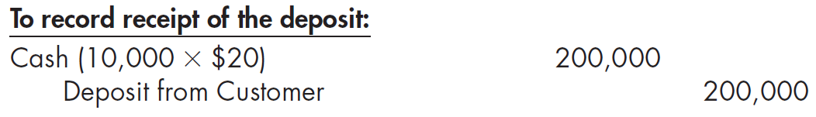
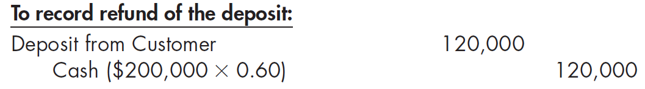
Advances and Refundable Deposits (Slide 2 of 2)
Summary journal entries to record the receipt of the deposit and subsequent refund are as follows:

Slide 36
Property Taxes, Part 1
Property taxes are assessed by municipal, county, and some state governments based on the value of certain property that a company owns. They become a legal liability, or lien, against the property at a date specified by law.
Example Ezell Company operates in Lee County which has a fiscal year-end of September 30. Property taxes become a lien against the property on October 1 of each year, and the estimated property taxes for the period October 1, 2019, to September 30, 2020, are $7,200. Ezell received a tax bill for $7,290 which it pays on January 15, 2020. Ezell’s entries to record the monthly accruals and payments relating to property tax are as presented on the next slide.

Slide 37
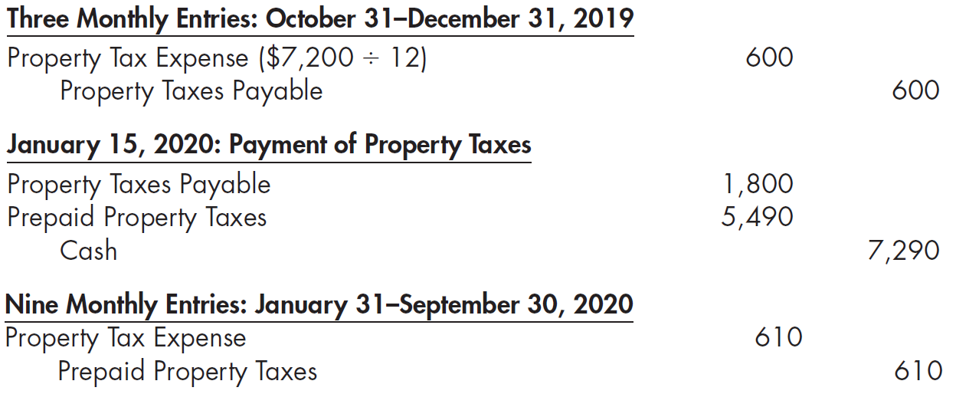
Property Taxes, Part 2
Note that the $610 amount in the last journal entry is the result of allocating the $90 difference ($7,290 − $7,200) between the actual and estimated property taxes to the remaining 9-month period ending September 30, 2020.

Slide 38
How Do We Account for Current Liabilities with Amounts Determined by Operating Activities?
Learning Objective #4
Current liabilities determined by operating activities include:
  Unearned revenue
  Wages payable and payroll taxes
  Bonuses
  Compensated balances
  Sales and use taxes
  Income taxes
  Others

Slide 39
Unearned (Deferred) Revenues
A company’s unearned revenues (deferred revenues) include amounts that it has collected from customers but for which the company has not yet satisfied its performance obligations and, therefore, cannot be recorded as revenues until the company provides the product or service to the customer. Unearned revenues are reported as either current liabilities or long-term liabilities, depending upon the length of time it will take the company to satisfy its performance obligations.
Common examples of unearned revenues are amounts collected from customers in advance, such as rent, magazine subscriptions, tickets, gift certificates, airfares, memberships, insurance premiums, and service contracts.

Slide 40
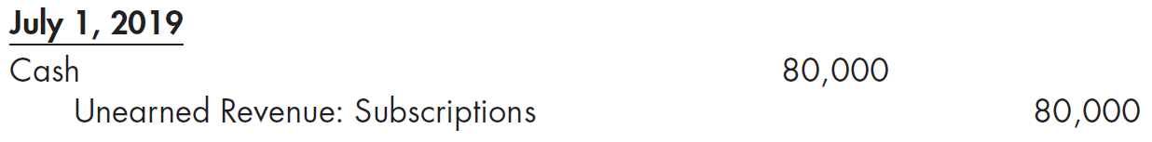
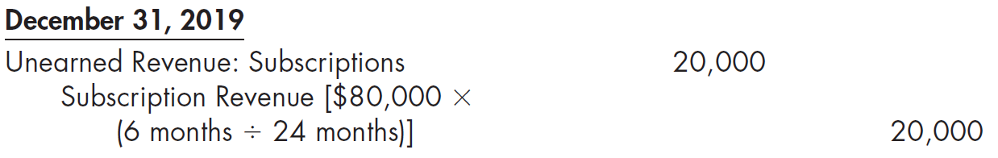
Example: Unearned (Deferred) Revenues
On July 1, 2019, Cook Publishing Company sells $80,000 of two-year magazine subscriptions in advance. Cook makes the following entry when it receives the cash:
At the end of the year, Cook makes the following adjusting entry:
As of December 31, 2019, Cook will report the $40,000 that will be earned in 2020 as a current liability and the remaining $20,000 that will be earned in 2021 as a long-term liability.

Slide 41
Accrued Liabilities Related to Compensation
Accrued liabilities are expenses that have been incurred but not yet paid.
  These liabilities are usually recorded as in adjusting entries at the end of the accounting period.
Liabilities Related to Compensation
  All companies incur liabilities related to compensating their employees. These liabilities include amounts owed to employees for salaries, required withholdings from employees’ pay, voluntary deductions from employees’ pay, payroll taxes, and other compensation-related liabilities, such as compensated absences and bonuses. In most cases these are reported as current liabilities.

Slide 42
Employee Withholdings and Payroll Taxes
The federal income tax law and many state and local governments require employers to withhold from the pay of each employee a legal amount for the anticipated income taxes payable by the employee to the respective governmental units.
The employer must pay withheld amounts to the respective governmental unit at specified times and through specified channels.
Employers determine the amount by using applicable legal rates or by referring to withholding tax tables.

Slide 43
FICA Taxes
Federal Insurance Contribution Act (FICA) taxes are withheld from the wages of each employee under certain conditions, and employers must pay their own share (in addition to the amounts withheld from employees’ wages).
Employers must remit the sum of both taxes to the Internal Revenue Service along with the income taxes withheld.
FICA taxes serve to pay:
  Old-age, Survivor, and Disability Insurance (OASDI) benefits
  Medicare or federal hospital insurance benefits
Together, these taxes are referred to as social security taxes.

Slide 44
FUTA Taxes and Voluntary Payroll Deductions
Unemployment insurance taxes are another type of social security tax.
The Federal Unemployment Tax Act (FUTA) requires a tax with a maximum rate of 6.0% to be levied on employers of one or more persons, but the rate applies to only the first $7,000 paid to each employee.
  The law provides that 5.4% of the 6.0% is payable to the state, assuming that the state levies an approved unemployment insurance tax. Thus, in these cases, the net effective federal unemployment tax rate is 0.6%.
Contractual arrangements between individual employees and employers result in voluntary payroll deductions for things like group health insurance, accident insurance, life insurance, union dues, and tax-sheltered retirement savings.

Slide 45
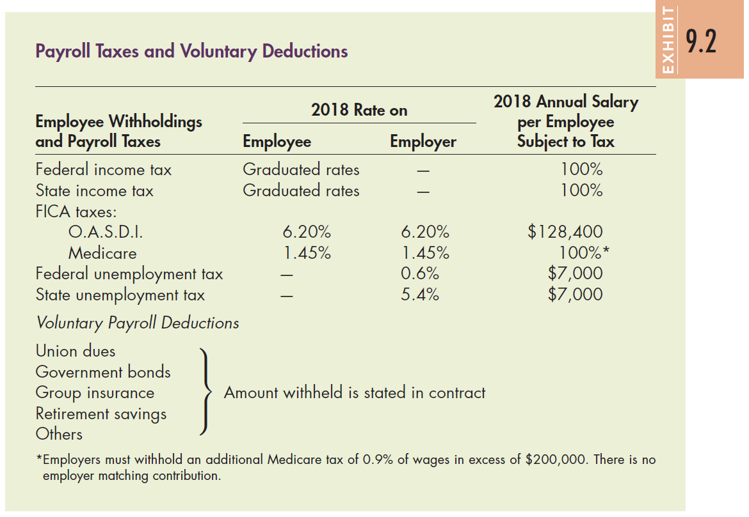
Payroll Taxes and Voluntary Deductions

Slide 46
Example: Accounting for Withholdings,
Payroll Taxes, and Deductions (Slide 1 of 2)
Wager Corporation has a weekly payroll of $28,000, all of which is subject to FICA tax (8% on employee, 8% on employer), federal unemployment tax (0.6%), and state unemployment tax (5.4%). In addition, federal and state income tax withholdings were $1,980 and $1,000, respectively. Finally, a voluntary payroll deduction of $360 was made for union dues.

Slide 47
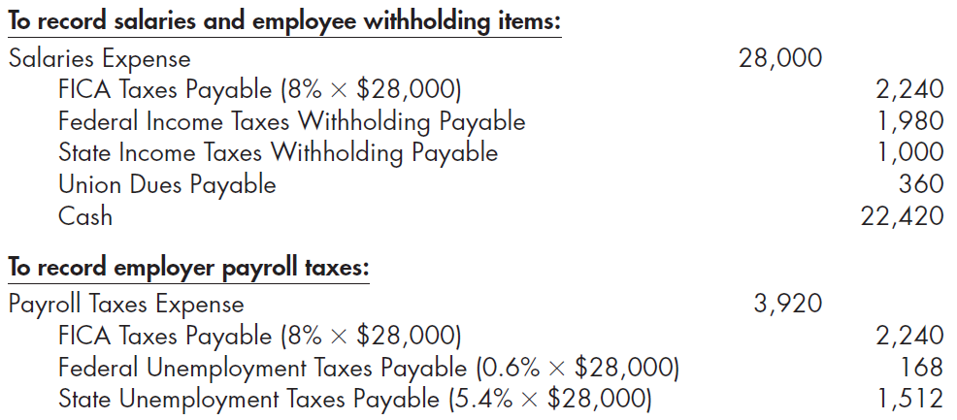
Example: Accounting for Withholdings,
Payroll Taxes, and Deductions (Slide 2 of 2)
Wager makes the following two entries each period to record the payment of the payroll and payroll taxes:

Slide 48
Compensated Absences, Part 1
Compensated absences include vacation, holiday, illness, or other personal activities for which a company pays its employees. They do not include items such as severance pay, stock options, or long-term fringe benefits.
A company recognizes an expense and accrues a liability for employees’ compensation for future absences if all the following conditions are met:
  The company’s obligation is based on the employee’s services already rendered.
  The obligation relates to rights that vest (the employee will be paid even if employment is terminated) or accumulate (unused benefits can be carried forward to a period subsequent to when they were earned).
  Payment of the compensation is probable.
  The amount can be reasonably estimated.

Slide 49
Compensated Absences, Part 2
If the company meets the first three conditions but does not accrue a liability because the last condition is not met, it discloses the known facts about these compensated absences in the notes to its financial statements.
Vacation pay is earned as a result of past employment. Therefore, the company must recognize an expense and accrue a current liability.
If sick pay benefits vest and are not used by the end of the period, then the employer must recognize an expense and accrue a current liability. However, if sick pay benefits accumulate but do not vest, recognition and accrual is optional.

Slide 50
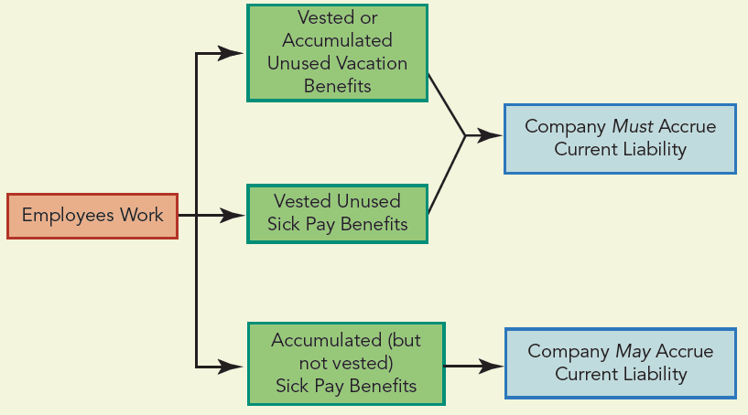
Accounting for Compensated Absences

Slide 51
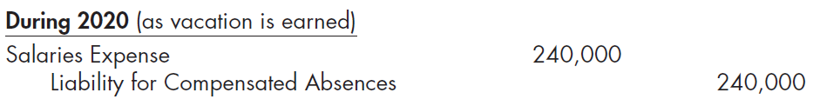
Example: Compensated Absence—Vacation Benefits, Part 1
Milton Company has 100 employees who are each paid an average of $200 per day. The company has a policy (which meets the conditions set by GAAP) of allowing each employee 12 days of paid vacation per year. The total annual cost of the paid vacations is $240,000 (100 employees × 12 days × $200 per day). Assuming no vacation days were taken in 2020, Milton makes the following entry at the end of the year:
This journal entry recognizes salaries expense in the period during which the employees work and earn the vacation time, thus adhering to the matching principle.
The liability for compensated absences will be satisfied when the employees take their vacations.

Slide 52
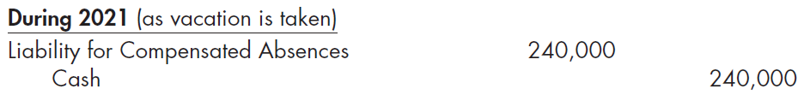
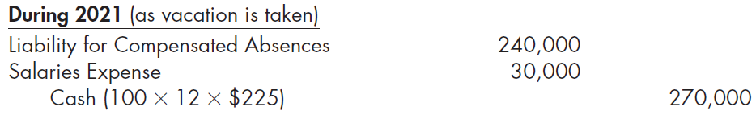
Example: Compensated Absence—Vacation Benefits, Part 2
Assuming all of vacation benefits were taken in 2021, Milton would record the payment of vacation pay as follows:
If the employees received a raise in 2021 so that their average pay rate was $225 per day, the company would treat this increase in pay rate as a change in estimate and revalue the liability.

Slide 53
Bonus Obligations (Slide 1 of 2)
Companies establish earnings-based bonus agreements as an incentive to certain employees, particularly executives and managers, to increase company earnings.
The bonus is an additional compensation and is an operating expense of the company, therefore deducted when computing the company’s taxable income.
The bonus is typically paid shortly after the end of the year, thus it is reported as a current liability in the year it has been earned by the employees.

Slide 54
Bonus Obligations (Slide 2 of 2)
Bonus agreements may be structured in various ways, such as:
  Income before income taxes and before deducting the bonus
  Income before income taxes and after deducting the bonus
  Income after deducting taxes but before deducting the bonus
  Income after deducting both the bonus and the income taxes

Slide 55
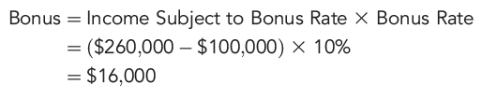
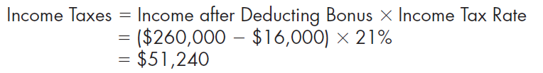
Example: Bonus Computation, Part 1
Bonex Corporation reported income for the current year of $260,000 before deducting income taxes and before a bonus to the chief executive officer. Bonex’s effective tax rate is 21% and the bonus rate is 10%. The bonus applies to any income, before deducting income taxes and the bonus, above $100,000. The bonus is calculated as:
Because the bonus is a tax deductible expense (if paid within a certain period of time), income taxes are computed as follows:

Slide 56
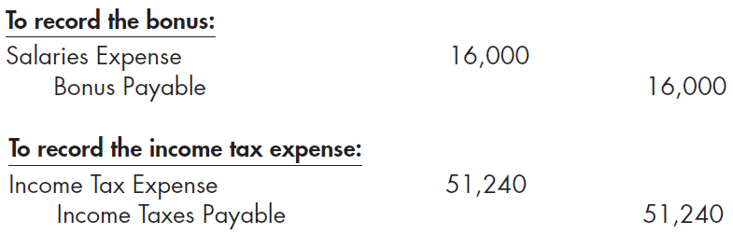
Example: Bonus Computation, Part 2
Bonex records the bonus and income taxes as follows:
Bonex reports both the Bonus Payable and Income Taxes Payable as current liabilities on its balance sheet.

Slide 57
Sales and Use Taxes
A sales tax is levied by a governmental authority (such as a state or local government) on the transfer of certain goods and services.
  A seller must collect sales tax from the customer and pay the amount to the proper governmental authority
A use tax is levied by a state or local governmental unit on goods bought from a vendor from a non-sales-tax area or sector.
  It is levied on the buyer of merchandise purchased for the buyer’s own use or consumption.

Slide 58
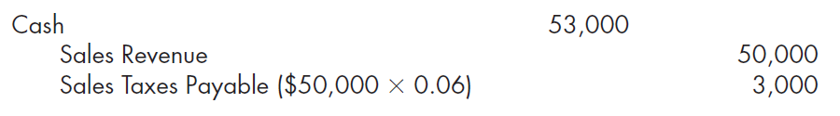
Example: Sales Tax Separate from Sales
Selleroy Company sells merchandise for cash with a retail sales price of $50,000 on which a sales tax of 6% is levied. The company collects $53,000 from its customers and records the collection as follows:
Selleroy owes the $3,000 sales taxes it collected to the state or local government levying the tax. Therefore, the amount is not part of revenues but is recorded as a current liability.

Slide 59

Example: Sales Tax Included in Sales
Smally Company collects sales taxes but includes the amount of the sales taxes in the price it charges for the merchandise. Therefore, it records the combined amount of both the sales and the sales taxes in the Sales Revenue account. At the end of January, Sales Revenue shows a credit balance of $169,600. Assuming a 6% sales tax on all goods, Smally computes the amount of sales for the month by dividing the Sales Revenue amount by 1 plus the sales tax rate. Thus, Sales Revenue is $160,000 ($169,600 ÷ 1.06). At the end of January, Smally records the following entry to reduce Sales Revenue to the proper amount and create the current liability for sales taxes:

Slide 60
Income Taxes
The income of corporations is subject to a federal income tax separate from that of individuals. In addition, corporations may be subject to state, local, and foreign income taxes, depending on where the company generates income.
  The passage of the Tax Cut and Jobs Act in December 2017 imposed a flat 21% federal corporate income tax rate starting in 2018.
  When a corporation accrues its estimated income taxes for financial statement purposes, it increases both Income Tax Expense and a current liability, Income Taxes Payable. Later, when the corporation pays its actual income taxes, it eliminates the current liability.

Slide 61
How Do We Account for Contingent
Gains and Losses? Learning Objective #5
In the normal operations of a company, transactions, events, and commercial arrangements sometimes give rise to uncertainty regarding whether the company will experience a future gain or loss, become obligated to make payments, or become entitled to receive payments.
This uncertainty will ultimately be resolved at some future date. These situations are commonly referred to as “contingencies.”
GAAP defines a contingency for a company as an existing condition, situation, or set of circumstances involving uncertainty as to a possible gain (a “gain contingency”) or loss (a “loss contingency”) that will be resolved when a future event occurs or fails to occur.
Because the degree of uncertainty can vary greatly and the resolution of this uncertainty can significantly impact a company’s cash flows, it is important that financial statement users carefully analyze a company’s contingencies.

Slide 62
Gain Contingencies
A gain contingency is an existing situation in which there is a potential increase in assets or a potential decrease in liabilities, dependent on the occurrence of some future event.
Examples of gain contingencies include:
  Lawsuits in which the company is the plaintiff seeking damages
  Favorable resolutions of tax disputes (for example, audits)
  Insurance claims in which the amount to be received from the insurance company for damaged property is expected to exceed the book value of the property
GAAP takes a conservative approach to gain contingencies, thus they are not accrued, as this would cause income to be recognized prior to its realization.
Gain contingencies may be disclosed in the notes to the financial statements, but care should be taken to avoid misleading users to the likelihood of realization of the possible gain.

Slide 63
Loss Contingencies, Part 1
A loss contingency is an existing situation in which there is a potential decrease in assets or a potential increase in liabilities, dependent on the occurrence of some future event.
GAAP requires a company to categorize the likelihood of occurrence of a future event that will confirm the loss as:
  Probable—The future event is likely to occur.
  Reasonably possible—The chance of the future event occurring is more than remote but less than likely.
  Remote—The chance of the future event occurring is slight.
In addition, the company must assess whether or not it can provide a reasonable estimate of the dollar amount of the contingent loss.

Slide 64
Loss Contingencies, Part 2
A company accrues an estimated loss from a loss contingency, together with a corresponding liability (or asset impairment), if both of the following conditions are met:
  The company has information prior to issuing its financial statements that indicates it is probable that a liability has been incurred (or an asset impaired) at the date of the financial statements.
  The company can reasonably estimate the amount of the loss. In certain situations, a company’s reasonable estimate of the loss may be a range of amounts.

Slide 65
Reporting a Loss Contingency (Slide 1 of 2)
If either of the preceding two conditions are not met, but there is at least a reasonable possibility that a loss may have been incurred, the company discloses the loss contingency in the notes to its financial statements.
  The disclosure should indicate the nature of the contingency and give an estimate of the possible loss or range of loss, or state that such an estimate cannot be made. In some cases, remote loss contingencies must be disclosed.

Slide 66
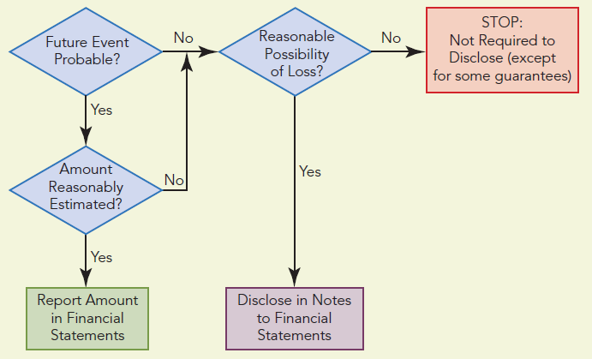
Reporting a Loss Contingency (Slide 2 of 2)

Slide 67
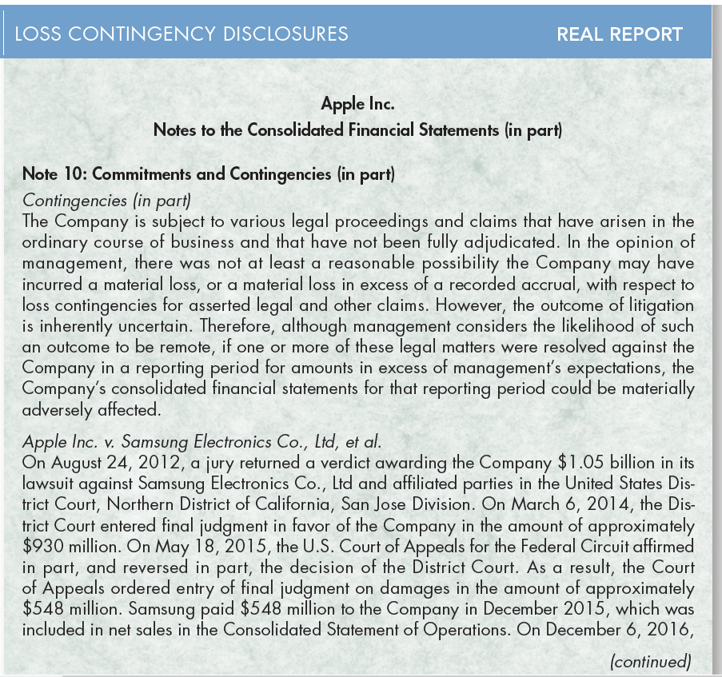
Real Report: Loss Contingency Disclosures,
Part 1 (Slide 1 of 3)

Slide 68
Real Report: Loss Contingency Disclosures,
Part 1 (Slide 2 of 3)

Slide 69
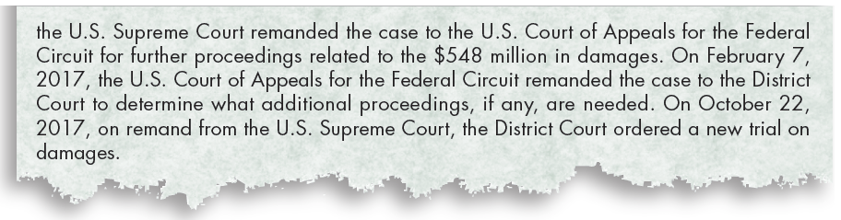
Real Report: Loss Contingency Disclosures,
Part 1 (Slide 3 of 3)

Slide 70
Real Report: Loss Contingency Disclosures,
Part 2 (Slide 1 of 2)
Questions:
Is Apple involved in litigation that could result in a loss? If so, what is Apple’s justification for not accruing a loss and a related liability?
  Apple is involved in various legal proceedings that could result in loss. However, Apple feels that the likelihood of an outcome that would result in a material loss is remote and, therefore, no accrual of a liability is necessary.

Slide 71
Real Report: Loss Contingency Disclosures,
Part 2 (Slide 2 of 2)
Questions:
2. Has Apple recorded a gain resulting from the jury award of $1.05 billion in its lawsuit against Samsung Electronics?
  Even though Apple has received a $1.05 billion judgment against Samsung Electronics, it did not record a gain at that time as the case was being appealed. However, Apple did record a gain of $548 million in December 2015 when Samsung paid the final judgment. Note that if Apple had recognized the gain contingency at the time of the original judgment, it would have overstated income before taxes by approximately $500 million. For this reason, gain contingencies are not recognized until they have been realized.

Slide 72
Warranty Obligations
To help promote sales, manufacturers and retailers commonly provide customers a warranty in connection with the sale of a good or service. These warranties can be classified as either:
Assurance-type warranties—a warranty in which the seller promises the customer that the good or service will function as specified in the contract. If it does not function as specified, an assurance-type warranty generally requires the seller, over a specified time after the sale, to correct any defect in the quality of the merchandise sold, to replace the item, or to refund the selling price.
Service-type warranties—a warranty in which the seller provides a service to a customer in addition to the assurance that the delivered good or service will function as specified in the contract. A service-type warranty represents a distinct service and is a separate performance obligation relative to the related good or service.

Slide 73
Assurance-Type Warranties
GAAP requires a company to recognize any warranty costs associated with an assurance-type warranty as an expense in the period during which it makes the sale.
The company must recognize an accrual for the estimated warranty expense over the life of the warranty and a liability for future performance.
The company classifies the estimated portion of the warranty liability as either a current liability and/or a long-term liability, depending on when it expects to incur the warranty costs.
When the company uses its resources to fulfill the warranty agreement, it decreases both the liability and the asset it used to satisfy the warranty.

Slide 74
Example: Assurance-Type Warranty (Slide 1 of 2)
Anglee Machinery Corporation begins production on a new machine in April 2019 and sells 200 machines at $6,000 each by December 31, 2019. Each machine carries a one-year warranty. Experience from the sale of similar machinery in the past has shown that the warranty costs will average $150 per unit. Anglee spent $5,000 in 2019 and $25,150 in 2020 to fulfill the warranty agreements for the machines sold in 2019.

Slide 75
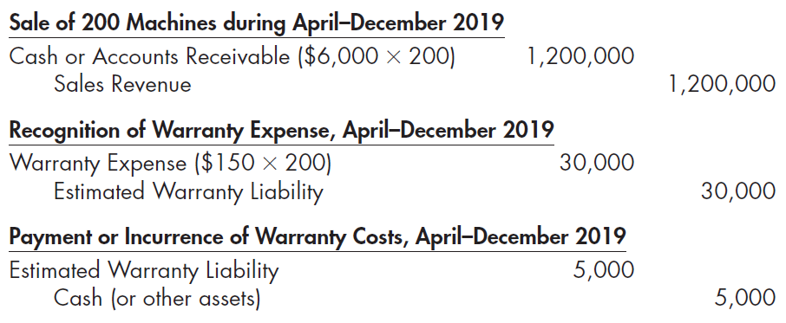
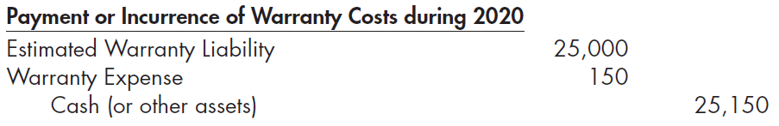
Example: Assurance-Type Warranty (Slide 2 of 2)
The company records this information for the year 2019 as follows:

Slide 76
Modified Cash Basis Method
Under the modified cash basis method, a company records assurance-type warranty costs as an expense during the period in which it makes the repairs to merchandise under warranty.
The modified cash basis is justified for financial reporting under one of three conditions:
  when the warranty period is relatively short, making the cost of estimating the warranty liability greater than the benefits obtained
  when it is not possible for the company to make a reliable estimate of the warranty obligation amount at the time of sale
  when its results are not materially different from the accrual method
The modified cash basis method is the only method accepted for federal income tax purposes.

Slide 77
Service-Type Warranties
Warranties are often priced and sold separately from the product itself. Therefore, the sale of the warranty represents a separate sales transaction and distinct performance obligation.
Under this method, a company defers revenue from the sale of the warranty contract and generally recognizes it as the performance obligation is satisfied (generally on a straight-line basis over the life of the contract).
Any costs necessary to satisfy the warranty are generally expensed as incurred.

Slide 78
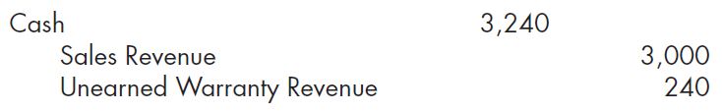
Example: Service-Type Warranty, Part 1
Waggoner Electronics offers its customers a three-year extended warranty that protects the customer from defects beginning after the manufacturer’s one-year warranty expires. On January 2, 2019, Waggoner sells a high-definition television to Matt O’Malley for $3,000. Matt also purchases an extended warranty for $240.
Because the extended warranty begins in 2020 after the regular warranty expires, the company reports the $240 balance in Unearned Warranty Revenue as a long-term liability on its December 31, 2019, balance sheet.

Slide 79

Example: Service-Type Warranty, Part 2
If Matt returns the television for warranty service that costs $200 on June 30, 2020, Waggoner would make the following entry:
Waggoner then makes the following entry in 2020, 2021, and 2022 to recognize warranty revenue:
At the end of 2020, Waggoner would report the $160 balance in Unearned Warranty Revenue as an $80 current liability and an $80 long-term liability.

Slide 80
Premium, Coupon, and Cash Rebate Obligations
Many companies offer premiums such as toys, dishes, CDs, and small appliances in exchange for labels, coupons, box tops, or wrappers from their products.
Other companies offer coupons printed in newspapers and magazines that can be used to reduce the purchase price of their products.
Still others offer a cash rebate when customers return a cash register receipt for the purchase of their products. Many of these offers expire after a specified time, but some do not have an expiration date.
While all of these offers are intended to increase a company’s sales, the accounting for premiums differs from that for coupons and cash rebates. Generally, premiums result in the recognition of an expense, while coupons and cash rebates result in a reduction of revenue.

Slide 81
Example: Premium Offered to Customers, Part 1
On October 1, 2019, American Spaghetti Corporation began offering customers a spaghetti serving fork in return for 30 spaghetti can labels. The offer expires April 1, 2020. The cost of each spaghetti fork is $2. Based on past experience, the company estimates that only 60% of the labels will be redeemed. During 2019, the company purchased 6,000 spaghetti forks. In 2019, it sold 300,000 cans of spaghetti at $1.80 per can. From these sales, 105,000 labels were returned for redemption in 2019. The company records the following series of journal entries in 2019 to recognize expenses and to record its current liabilities:

Slide 82
Example: Premium Offered to Customers, Part 2 (Slide 1 of 2)
The company reports the Premium Expense as a selling expense on its 2019 income statement. The company reports the Inventory of Premiums as a current asset and the Estimated Premium Liability as a current liability on its December 31, 2019, balance sheet because the offer expires in less than a year.

Slide 83
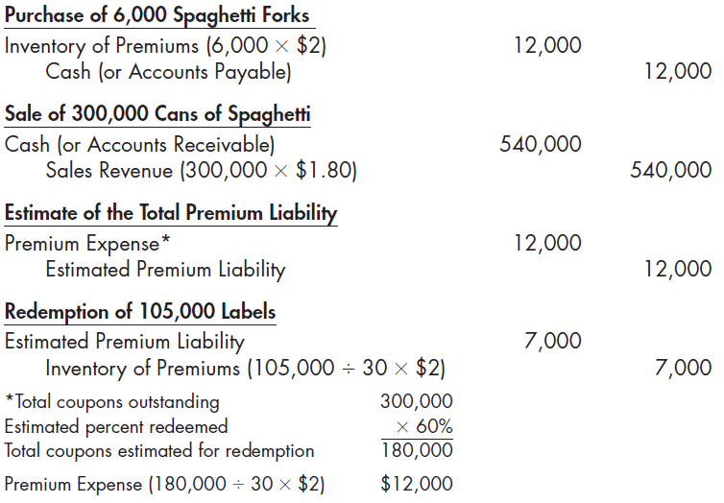
Example: Premium Offered to Customers, Part 2 (Slide 2 of 2)

Slide 84
Example: Coupons and Cash Rebates, Part 1
On January 1, 2020, Eat Well Cereal Company began offering a cash rebate of $2 to customers who return five coupons contained within cereal boxes. The offer expires on December 31, 2020. Based on historical experience, the company estimates that 30% of the coupons will be redeemed. During 2020, the company sold 1,000,000 boxes of cereal at $4 per box. From these sales, 250,000 coupons were redeemed in 2020 and 50,000 coupons were unredeemed at the end of the year.

Slide 85
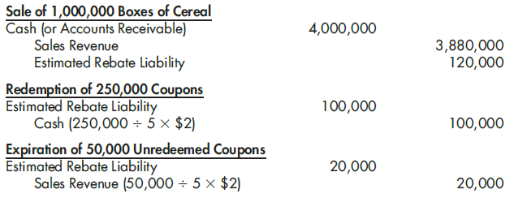
Example: Coupons and Cash Rebates, Part 2
The company records the following series of journal entries in 2020 to account for the cash rebate:

Slide 86
How Are Current Liabilities and Contingencies Presented in the Financial Statements? Part 1 Learning Objective #6
Conceptually, a company should report its three main balance sheet elements—assets, liabilities, and equity—in homogeneous classes.
The FASB has suggested broad guidelines as follows:
  Assets and liabilities with different implications for the financial flexibility of the company should be reported as separate items.
  Assets and liabilities with different general liquidity characteristics should be reported as separate items.
  Assets and liabilities that differ regarding the measurement attribute should be reported in separate categories.
Most companies list items within the current liability section (1) in the order of their average length of maturity, (2) according to amount (largest to smallest), or (3) in the order of liquidation preference—that is, in the order of their legal claims against assets.

Slide 87
How Are Current Liabilities and Contingencies Presented in the Financial Statements? Part 2
A popular way of presenting these items is as follows:
  accounts payable
  notes payable
  accrued liability items
  unearned (deferred) revenue items
  other current liabilities
These current liabilities are usually recorded and reported at their maturity values.
A company discloses any major issues affecting its current liabilities in a note to its financial statements.
Current liabilities are not offset against the assets that the company plans to use for their liquidation, and currently maturing long-term debt is classified as a current liability (unless refinanced).

Slide 88
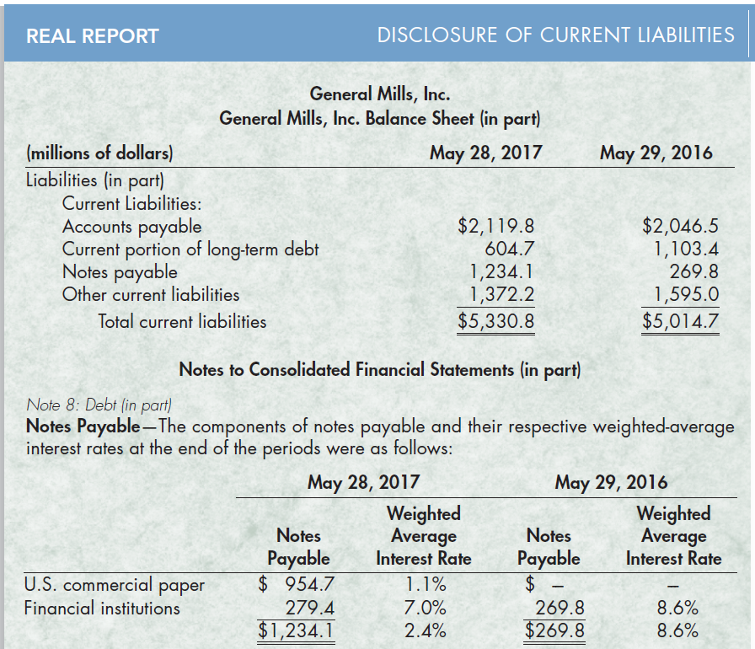
Real Report: Disclosure of Current Liabilities,
Part 1

Slide 89
Real Report: Disclosure of Current Liabilities,
Part 2
Questions:
1. What is the composition of General Mills’ short-term notes payable? Are these notes payable properly classified as current liabilities?
General Mills’ notes payable are primarily composed of commercial paper and other short-term borrowings from financial institutions. Commercial paper is a form of short-term note payable that typically has a maturity ranging from 30 days to 270 days. Therefore, General Mills properly classified these notes payable as a current liability.
2. General Mills reported current assets of $4,061.4 million on May 28, 2017. Compute its current ratio and provide any relevant comments.
The current ratio for General Mills at May 28, 2017, is 0.76 ($4,061 million ÷ $5,330.8 million). A ratio less than one could signal liquidity problems because current liabilities exceed current assets. For this reason, General Mills maintains lines of credit sufficient to cover its short-term borrowings. This should alleviate any short-term liquidity concerns.

Slide 90
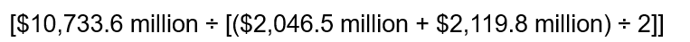
Real Report: Disclosure of Current Liabilities,
Part 3
3. General Mills reported cost of goods sold of $10,733.6 million for 2017. Compute its payables turnover.
The 2017 payables turnover for General Mills is 5.15.
Dividing this ratio into 365 days, it appears that General Mills is paying its suppliers, on average, every 71 days.

