Slide 1
Intermediate Accounting
Third Edition
Wahlen, Intermediate Accounting, Third Edition. © 2020 Cengage. All Rights Reserved. May not be scanned, copied or duplicated, or posted to a publicly accessible website, in whole or in part.

Slide 2
Depreciation, Depletion, Impairment, and Disposal
Chapter 11

Slide 3
Learning Objectives
Identify the factors involved in depreciation.
Calculate depreciation expense using various time-based and activity-based methods.
Explain the issues involved in selecting depreciation methods.
Understand group and composite depreciation methods.
Understand the disclosure of depreciable assets.
Understand additional depreciation issues, including partial period depreciation, changes and corrections of depreciation, and depreciation and accretion of asset retirement obligations.
Test for and account for the impairment of property, plant, and equipment.
Explain how to account for the disposal of property, plant, and equipment.
Understand and record depletion of natural resources.
(Appendix 11.1) Understand depreciation for income tax purposes and how it differs from depreciation for financial reporting purposes.

Slide 4
What Are Depreciation, Depletion, and Amortization?
Depreciation is the allocation of the cost of tangible assets, such as property, plant, and equipment.
Depletion is the allocation of the cost of natural resources, such as oil, gas, minerals, and timber.
Amortization is the allocation of intangible assets, such as patents and copyrights. It is also used as general term to describe the periodic allocation of costs.

Slide 5
What Are the Factors Involved in Depreciation?
Learning Objective #1 (Slide 1 of 2)
Asset costs all costs necessary to acquire and prepare the asset for use in order to obtain the benefits from the asset.
Service life (or useful life) is the amount of service or use that a company expects from the asset before its disposal, which can be affected by:
  Physical causes: these factors include wear and tear because of operational use, deterioration, an decay that is a function of time, and damage and destruction.
  Functional causes: these factors limit the service life of the asset through obsolescence and inadequacy, even though the physical life is not exhausted.

Slide 6
What Are the Factors Involved in Depreciation?
Learning Objective #1 (Slide 2 of 2)
Residual value (or salvage value) is the net amount that a company expects to obtain from disposing of an asset at the end of its service life.
Accounting principles require that a company use a method of cost allocation that is:
  Systematic: the calculation should follow a formula and not be determined in an arbitrary manner.
  Rational: the amount of the depreciation expense each period should relate to the decline in the asset’s service potential each period.

Slide 7
What Are the Methods of Cost Allocation?
Learning Objective #2
The depreciation base (depreciable cost) is computed as:
Time-based methods
  Straight-line
  Accelerated
    Sum-of-the-years’-digits
    Declining-balance
Activity (or use) methods
  Appropriate when the service life of the asset is affected primarily by the amount the asset is used and not by the passage of time
Group or Composite methods

Slide 8

Straight-Line Depreciation Method
The straight-line method is appropriate when a company estimates that the service potential of the asset will decline by an approximately constant amount each period of its useful life.
The straight-line method is the most widely used depreciation method.

Slide 9
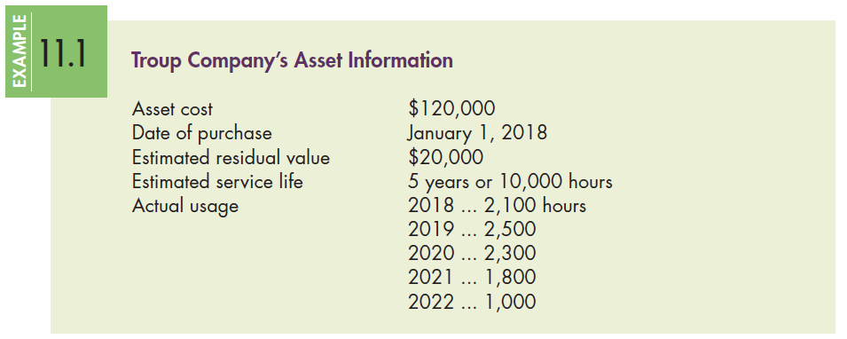
Example: Depreciation
To illustrate the most common depreciation methods, consider the data for Troup Company:

Slide 10
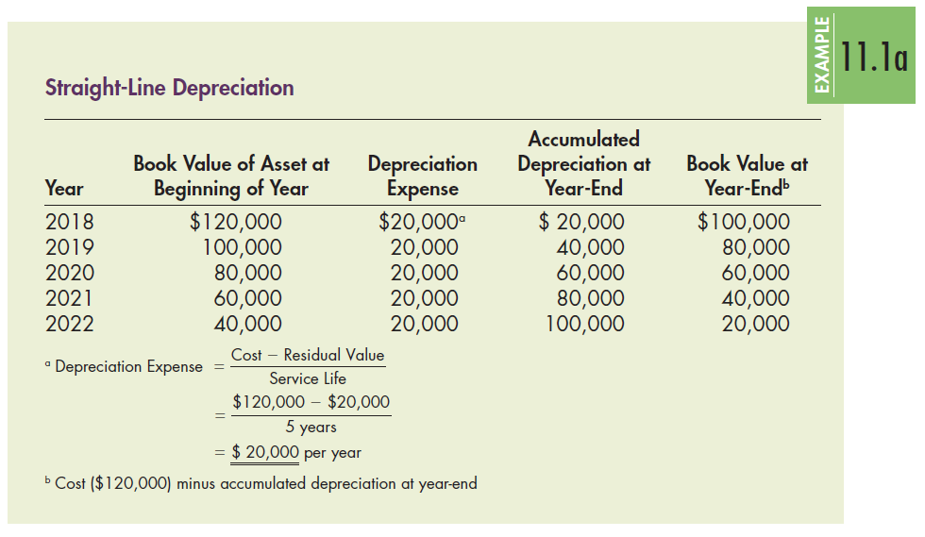
Example: Straight-Line Depreciation (Slide 1 of 2)

Slide 11
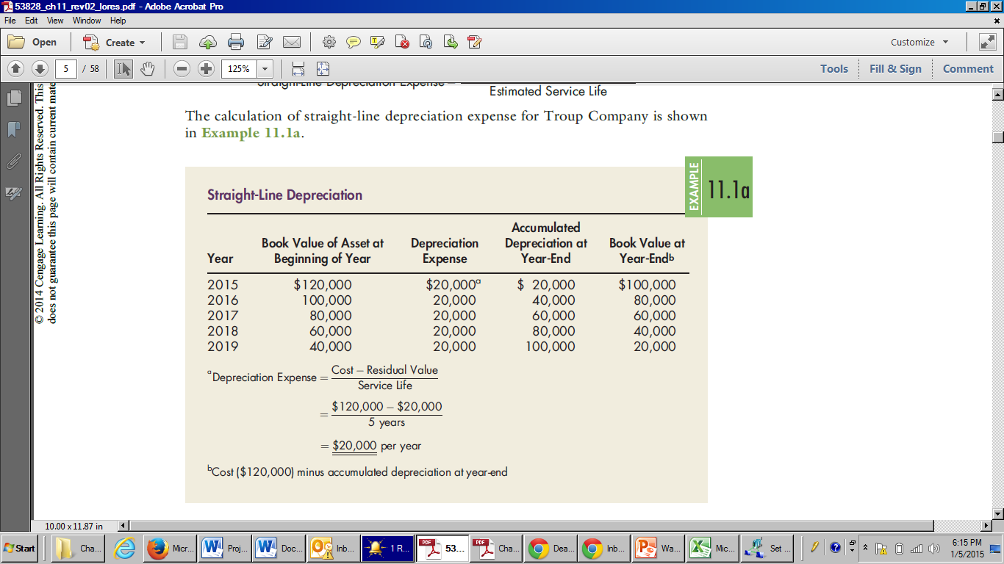
Example: Straight-Line Depreciation (Slide 2 of 2)

Slide 12
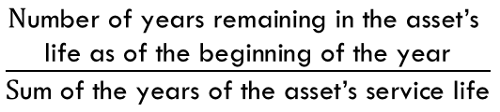
Accelerated Depreciation Methods (Slide 1 of 2)
Appropriate when a company estimates that the service potential of the asset will decline more quickly in the early periods of the asset’s useful life than in the later periods.
  Sum-of-the-years’-digits method: recognizes a declining depreciation expense each period by applying a decreasing fraction each year to the depreciable base of the asset.

Slide 13
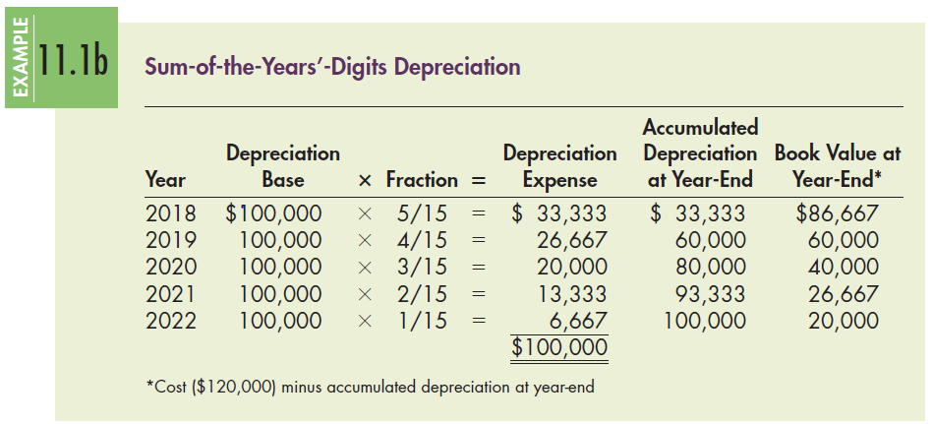
Example: Sum-of-the-Year’s-Digits Depreciation

Slide 14
Accelerated Depreciation Methods (Slide 2 of 2)
Declining-balance methods: accelerated depreciation methods that recognize a declining depreciation expense amount each period by applying a constant rate to the book value of the asset (not the depreciable basis) at the beginning of each period.
The declining-balance depreciation rate is some multiple (m) of the straight-line rate:
Declining-Balance Depreciation Rate = (m) × Straight-Line Rate
The multiple (m) is often 2, in which case the declining-balance method is called the double-declining-balance method.
An alternative multiple (m) could be chosen, such as a 1.5, which is referred to as a 150% declining rate.

Slide 15
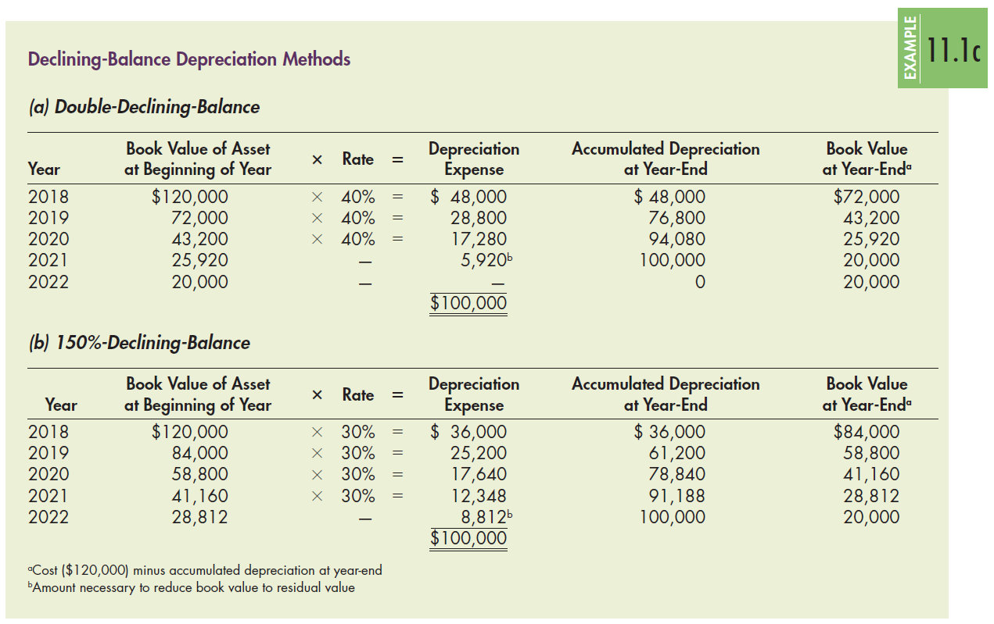
Example: Declining-Balance Depreciation

Slide 16
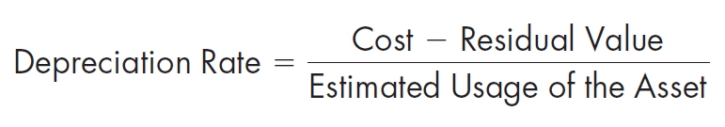
Activity Depreciation Methods
When the service life of the asset is affected primarily by the amount the asset is used and not by the passage of time, depreciation expense should be recognized using an activity method (also called the units-of-production method).
Activity, or usage, is usually measured in terms of an input measure such as the number of hours worked or an output measure such as miles driven or units produced.

Slide 17
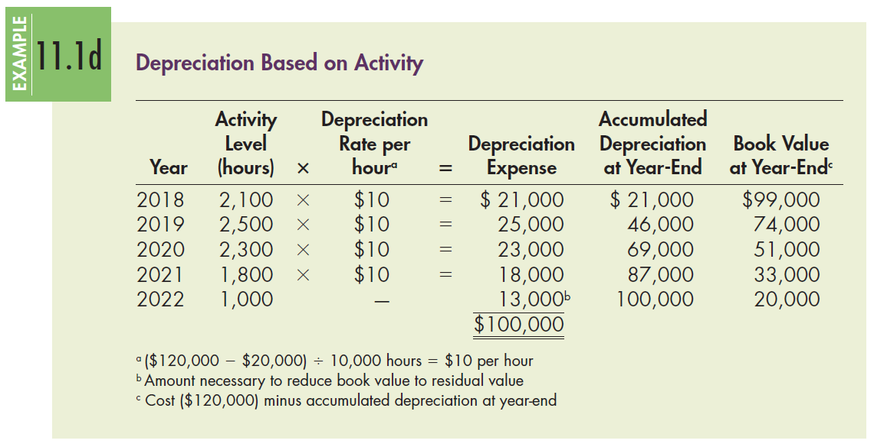
Example: Depreciation Based on Activity

Slide 18

Recording and Reporting Depreciation
(Slide 1 of 2)
Regardless of the depreciation method used, the amount of depreciation expense is generally recorded each period of the asset’s service life by making the journal entry shown below. The credit entry to record depreciation is to a contra-asset account usually called Accumulated Depreciation, or Allowance for Depreciation.
The credit entry to record depreciation is to a contra-asset account usually called Accumulated Depreciation, or Allowance for Depreciation.

Slide 19
Recording and Reporting Depreciation
(Slide 2 of 2)
While depreciation is normally reported as a current-period expense, a manufacturing company may not expense all its depreciation cost in the period but instead include it as part of manufacturing overhead.
A manufacturing company includes depreciation on manufacturing assets as a cost of inventory by allocating depreciation to each unit of production during the year by increasing the Work-in-Process Inventory account.

Slide 20
What Should Be Considered When Selecting Depreciation Methods? Learning Objective #3
Depreciation (as well as depletion and amortization) is a process of cost allocation, not asset valuation.
The purpose of depreciation is to allocate the cost of an asset to expense in a systematic and rational manner.
The asset’s book value should represent fair value both at the time the asset is acquired (acquisition cost should reflect fair value) and at the end of the asset’s life, when residual value represents the disposal value
While the majority of companies use the straight-line depreciation method because of its simplicity, several other issues should be considered in selecting a depreciation method.

Slide 21
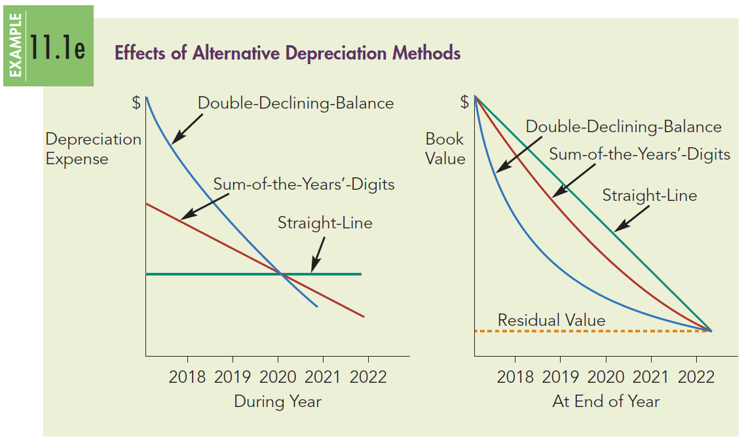
Depreciation Comparison

Slide 22
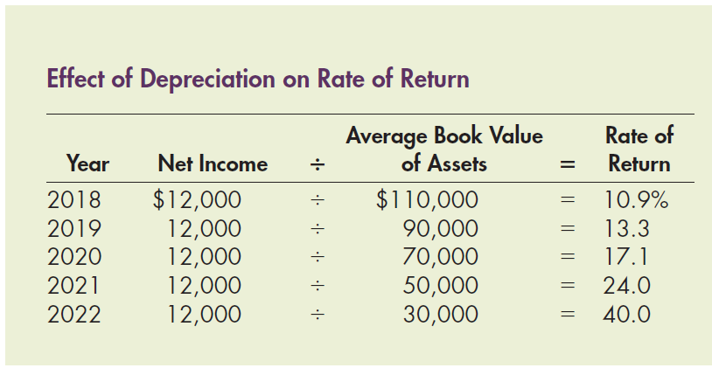
Depreciation and Rate of Return
The depreciation of property, plant, and equipment may lead to distortions in the rate of return analysis.

Slide 23
Depreciation and Maintenance Costs (Slide 1 of 2)
Two additional factors that are often considered when a company selects a depreciation method are:
  repair and maintenance costs
  the risk associated with the cash flows from the asset

Slide 24
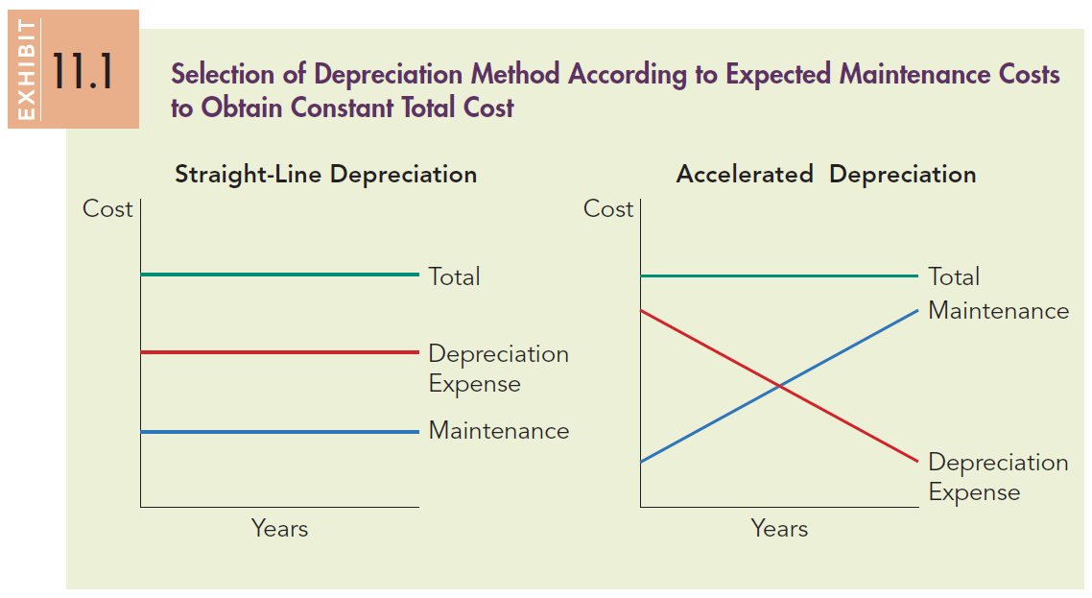
Depreciation and Maintenance Costs (Slide 2 of 2)

Slide 25
What Additional Depreciation Methods Exist?
Learning Objective #4
Group depreciation: Applied to homogeneous assets that are expected to have similar service lives and residual values (e.g., laptop computers).
Composite depreciation: Applied to heterogeneous assets that are related but have differing service lives and residual values (all the different items of equipment in a company’s office).

Slide 26
Group Depreciation
A company uses group depreciation when it owns a group of homogeneous assets with similar ages, useful lives, and residual values. Under this method, the company:
  capitalizes the total cost of the assets into one account which is treated as one ‘‘asset’’ for purposes of depreciation
  bases the group depreciation rate on the average life of the assets in the group
  calculates the depreciation expense each period by multiplying this rate by the balance in the asset account
  accumulates the depreciation expense in a single contra-asset account

Slide 27
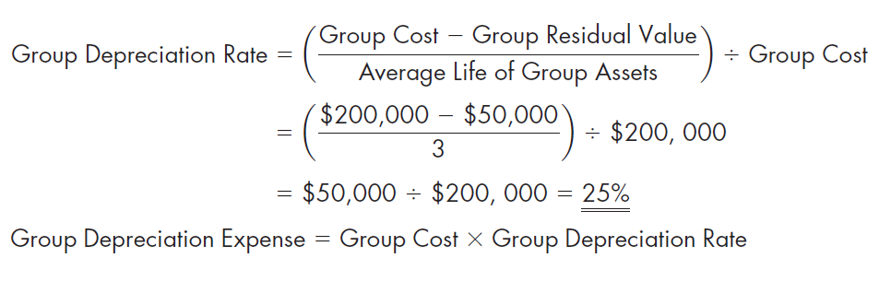
Example: Group Depreciation
(Slide 1 of 3)
Minneola Company purchases 10 cars for $20,000 each, and the average expected service life is 3 years with a residual value of $5,000 each. Of those cars, three are sold after 2 years for $8,000 each, five after 3 years for $6,000 each, and two after 4 years for $4,800 each. Minneola computes the depreciation rate as follows:

Slide 28
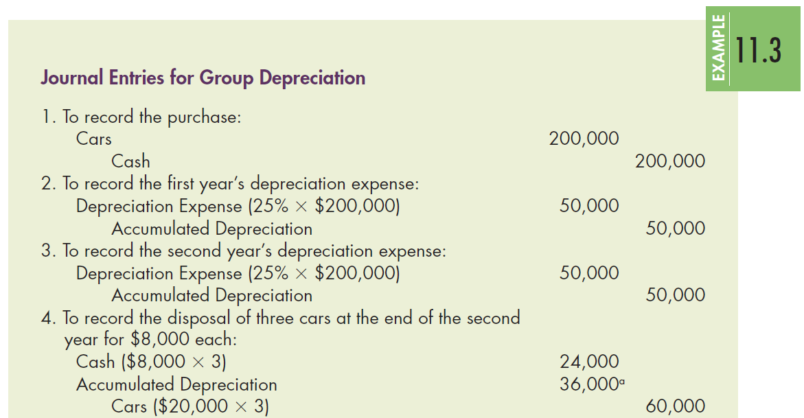
Example: Group Depreciation
(Slide 2 of 3)

Slide 29
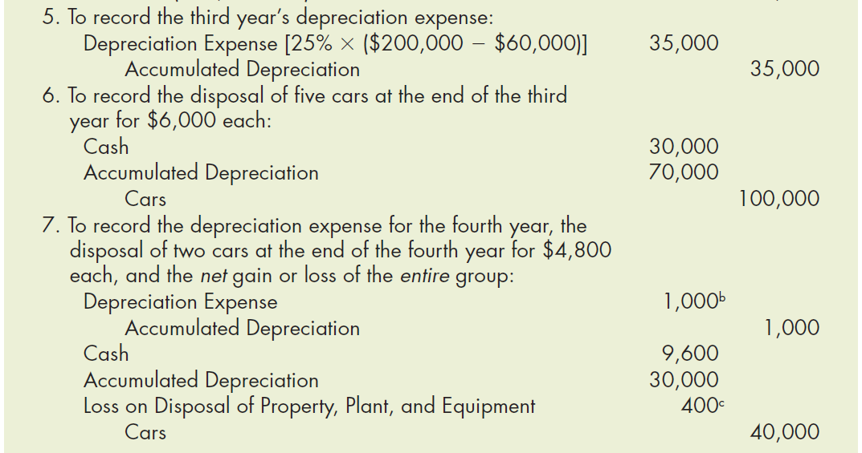
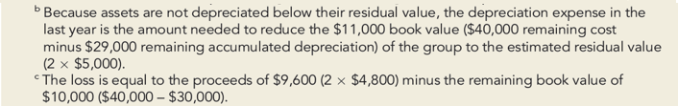
Example: Group Depreciation
(Slide 3 of 3)

Slide 30
Composite Depreciation
A company may apply composite depreciation to heterogeneous (dissimilar) assets that are related but have different service lives or residual values. It uses similar procedures to group depreciation, as follows:
  The company combines the assets in one asset account and depreciates them accordingly.
  The company uses one accumulated depreciation account.
  The company does not recognize a gain or loss on each item retired.
  The company recognizes a net gain or loss when it retires the final asset.

Slide 31
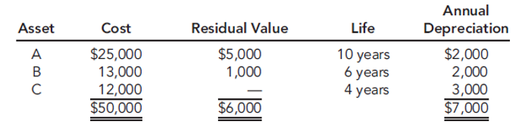
Example: Composite Depreciation (Slide 1 of 2)
Granville Company purchases three assets with the following characteristics:
Asset | Cost | Residual Value | Life | Annual Depreciation
A | $25,000 | $5,000 | 10 years | $2,000
B | 13,000 | 1,000 | 6 years | 2,000
C | 12,000 | Empty Cell | 4 years | 3,000
Total | $50,000 | $6,000 | Empty Cell | $7,000

Slide 32
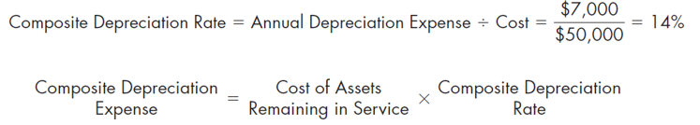
Example: Composite Depreciation (Slide 2 of 2)
Assuming that Granville uses straight-line depreciation, it computes the composite depreciation rate as follows:
Depreciation expense is $7,000 ($50,000 × 0.14). It would continue this process until the book value equals the estimated residual value of $6,000. If the Granville purchases another asset, it may include the asset in the group by adding the cost to the asset account. It then calculates a new composite depreciation rate.

Slide 33
Component Depreciation
When an operating asset is made up of individual components that are significant with respect to the total cost of the item, IFRS require that the initial cost of the operating asset be allocated to the significant components and each component be depreciated separately. This is called component depreciation.

Slide 34
How Are Depreciable Assets Disclosed?
Learning Objective #5
GAAP requires the following disclosures for depreciation:
  Depreciation expense for the period
  Balances of major classes of depreciable assets, by nature or function, at the balance sheet date
  Accumulated depreciation, either by major classes of depreciable assets or in total, at the balance sheet date
  A general description of the method or methods used in computing depreciation with respect to major classes of depreciable assets

Slide 35
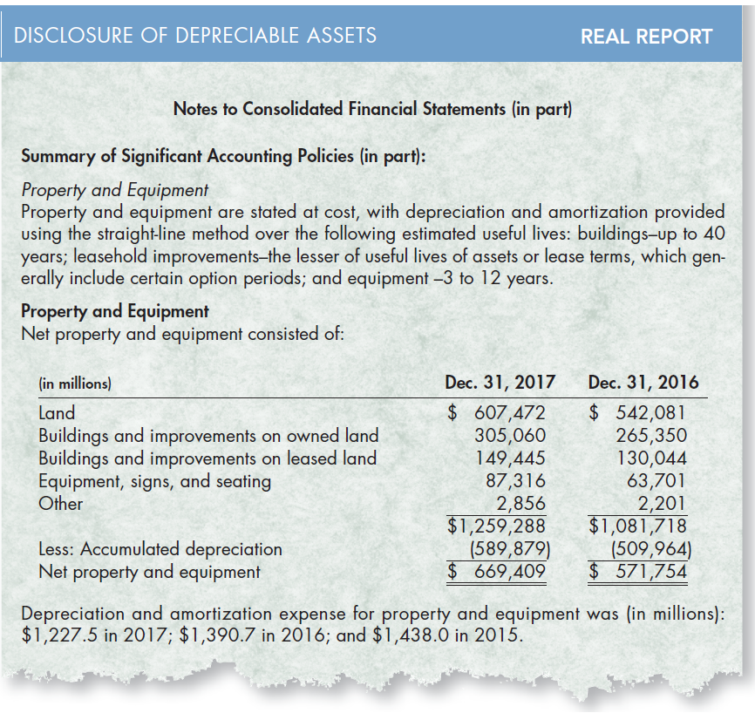
Real Report: Disclosure of Depreciable Assets
(Slide 1 of 3)
McDonald’s

Slide 36
Real Report: Disclosure of Depreciable Assets
(Slide 2 of 3)
1. Why do you think McDonald’s selected the straight-line depreciation method?
Straight-line depreciation is the most widely used and easily understood of all the depreciation methods. The straight-line method tends to produce higher income and shareholders’ equity amounts compared with the accelerated methods. Furthermore, many of McDonald’s fixed assets (leasehold improvements, machinery and equipment, furniture and fixtures, computer hardware and software, and smallwares) may provide benefits evenly over time, which is consistent with the results of the straight-line method. Also, any benefit derived from using an alternative depreciation method may not exceed the increased costs associated with that method.

Slide 37
Real Report: Disclosure of Depreciable Assets
(Slide 3 of 3)
2. Why does McDonald’s disclose information about the estimates (e.g., useful lives) used in its depreciation calculations?
The depreciation calculation uses varying estimates of service lives and residual values. The disclosure of these items allows users to gain insights into a company’s fixed assets. Such analysis may yield insights into the company’s competitive position, capital replacement policy, and profitability.

Slide 38
What Are Some Additional Issues Related to Depreciation? Learning Objective #6
There are several special issues related to depreciation:
  Depreciation for partial periods
  Changes and corrections of depreciation
  Depreciation and accretion of asset retirement obligations

Slide 39
Depreciation for Partial Periods
While our previous discussion assumed that assets were purchased on the first day of the fiscal year and disposed of on the last day, this seldom occurs in practice.
When acquisition and disposal of assets occur throughout the year, a company should record depreciation only for the portion of the year that the asset was used in the operation of the business.
While depreciation could be computed to the nearest day, such precision is unnecessary given the use of estimates in the calculation of depreciation. Therefore, three common alternative policies, or conventions, are used to compute depreciation for partial periods
  Nearest whole month convention
  Nearest whole year convention
  One-half year convention

Slide 40
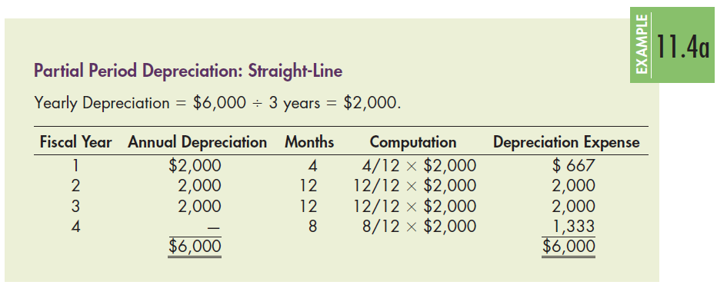
Example: Partial Period Depreciation
Nearest Whole Month Convention (Slide 1 of 3)
Vann Company purchases a $6,000 asset with a 3-year life and no residual value on August 18. If Vann uses the nearest whole month convention, it should record 4 months (September through December) of depreciation expense in the first year, 12 months of depreciation in the second and third years, and 8 months (January through August) of depreciation in the fourth year.
Fiscal Year | Annual Depreciation | Months | Computation | Depreciation Expense
1 | $2,000 | 4 | Four twelfths times $2,000 | $667
2 | 2,000 | 12 | Twelve twelfths times $2,000 | 2,000
3 | 2,000 | 12 | Twelve twelfths times $2,000 | 2,000
4 | Empty Cell | 8 | Eight twelfths times $2,000 | 1,333 (underline)
Total | $6,000 (double underline) | Empty Cell | Empty Cell | $6,000 (double underline)

Slide 41
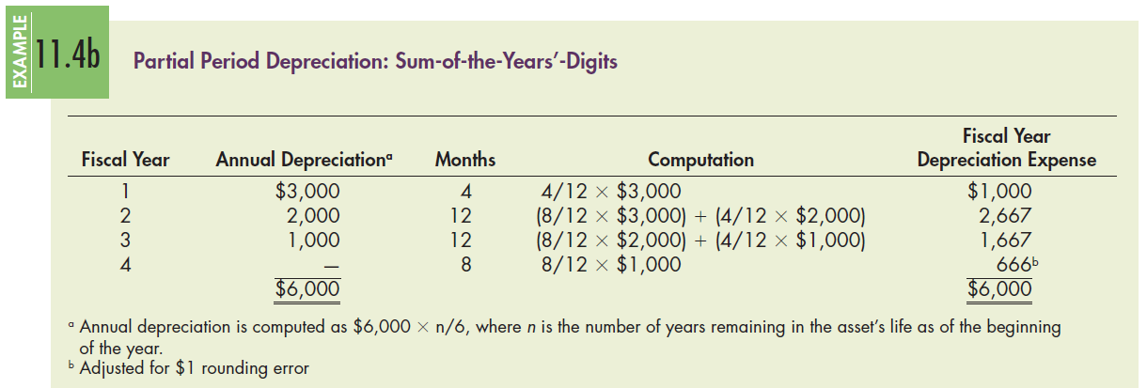
Example: Partial Period Depreciation
Nearest Whole Month Convention (Slide 2 of 3)
Vann Company purchase a $6,000 asset with a 3-year life and no residual value on August 18. If Vann uses the nearest whole month convention to calculate depreciation, it should record 4 months of depreciation in the first year, 12 months of depreciation in the second and third years, and 8 months of depreciation in the fourth year.
Fiscal Year | Annual Depreciation (Footnote A) | Months | Computation | Depreciation Expense
1 | $3,000 | 4 | Four twelfths times $3,000 | $1,000
2 | 2,000 | 12 | Left parenthesis, Eight twelfths times $3,000, right parenthesis, plus left parenthesis four twelfths times $2,000 right parenthesis. | 2,667
3 | 1,000 | 12 | Left parenthesis, Eight twelfths times $2,000, right parenthesis, plus left parenthesis four twelfths times $1,000 right parenthesis. | 1,667
4 | Empty Cell | 8 | Eight twelfths times $1,000 | 666 (Footnote B)
Total | $6,000 | Empty Cell | Empty Cell | $6,000

Slide 42
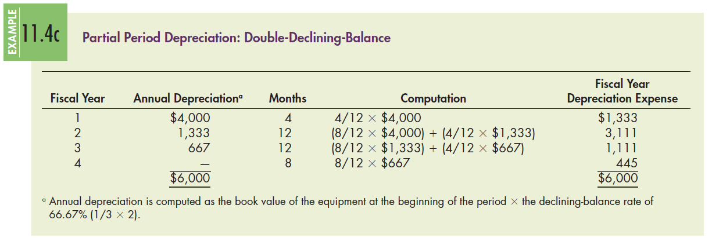
Example: Partial Period Depreciation
Nearest Whole Month Convention (Slide 3 of 3)
Vann Company purchase a $6,000 asset with a 3-year life and no residual value on August 18. If Vann uses the nearest whole month to calculate depreciation, it should record 4 months of depreciation in the first year, 12 months of depreciation in the second and third years, and 8 months of depreciation in the fourth year.
Fiscal Year | Annual Depreciation (Footnote A) | Months | Computation | Depreciation Expense
1 | $4,000 | 4 | Four twelfths times $4,000 | $1,333
2 | 1,000 | 12 | Left parenthesis, Eight twelfths times $4,000, right parenthesis, plus left parenthesis four twelfths times $1,333 right parenthesis. | 3,111
3 | 667 | 12 | Left parenthesis, Eight twelfths times $1,333, right parenthesis, plus left parenthesis four twelfths times $667 right parenthesis. | 1,111
4 | Empty Cell | 8 | Eight twelfths times $667 | 445 (Footnote B)
Total | $6,000 | Empty Cell | Empty Cell | $6,000

Slide 43
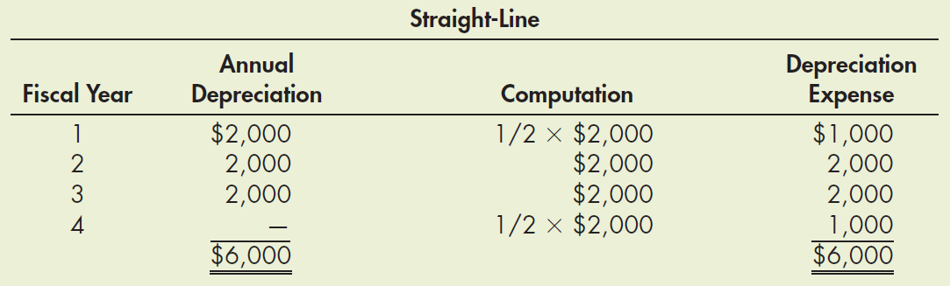
Example: Partial Period Depreciation
One-Half Year Convention (Slide 1 of 3)
Vann Company purchase a $6,000 asset with a 3-year life and no residual value on August 18. If Vann uses the nearest whole month to calculate depreciation, it should record 4 months of depreciation in the first year, 12 months of depreciation in the second and third years, and 8 months of depreciation in the fourth year.

Slide 44
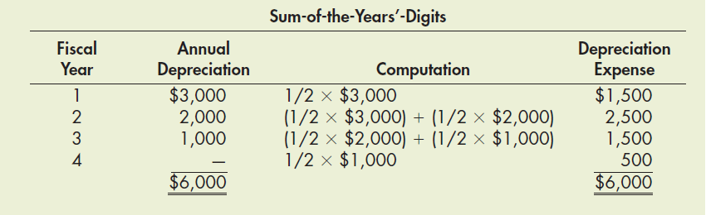
Example: Partial Period Depreciation
One-Half Year Convention (Slide 2 of 3)
Vann Company purchase a $6,000 asset with a 3-year life and no residual value on August 18. If Vann uses the nearest whole month to calculate depreciation, it should record 4 months of depreciation in the first year, 12 months of depreciation in the second and third years, and 8 months of depreciation in the fourth year.
Fiscal Year | Annual Depreciation | Computation | Depreciation Expense
1 | $3,000 | One half times $3,000 | $1,500
2 | 2,000 | Left parenthesis, One half times $3,000, right parenthesis, plus left parenthesis one half times $2,000 right parenthesis. | 2,500
3 | 1,000 | Left parenthesis, One half times $2,000, right parenthesis, plus left parenthesis one half times $1,000 right parenthesis. | 1,500
4 | Empty Cell | One half times $1,000 | 500 (underline)
Total | $6,000 (double underline) | Empty Cell | $6,000 (double underline)

Slide 45
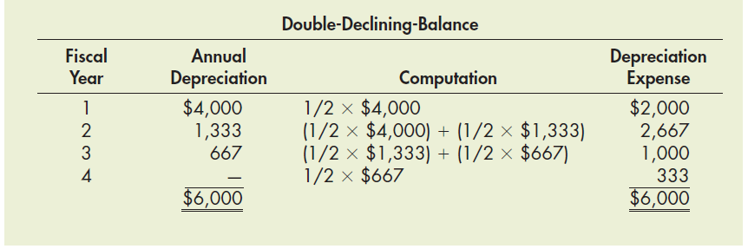
Example: Partial Period Depreciation
One-Half Year Convention (Slide 3 of 3)
Vann Company purchase a $6,000 asset with a 3-year life and no residual value on August 18. If Vann uses the nearest whole month to calculate depreciation, it should record 4 months of depreciation in the first year, 12 months of depreciation in the second and third years, and 8 months of depreciation in the fourth year.
Fiscal Year | Annual Depreciation | Computation | Depreciation Expense
1 | $4,000 | One half times $4,000 | $2,000
2 | 1,333 | Left parenthesis, One half times $4,000, right parenthesis, plus left parenthesis one half times $1,333 right parenthesis. | 2,667
3 | 667 | Left parenthesis, One half times $1,333, right parenthesis, plus left parenthesis one half times $667 right parenthesis. | 1,000
4 | Empty Cell | One half times $667 | 333 (underline)
Total | $6,000 (double underline) | Empty Cell | $6,000 (double underline)

Slide 46
Change in Depreciation Estimate
Depreciation expense is based on estimates of service life and residual value.
As new or additional information becomes available, a company may find it necessary to revise its estimates of service life, residual value, or both.
The change of these estimates will result in a recalculation of depreciation expense, which is accounted for prospectively.
A company allocates the remaining book value of the asset at the beginning of the year of the change over the new remaining life, considering the new residual value.

Slide 47

Example: Change in Depreciation Estimate
Example In 2014, Kellman Company bought a machine for $200,000. At that time, Kellman estimated the machine would have a useful life of 10 years and a residual value of $20,000. Kellman uses the straight-line method of depreciation and depreciates the machine at a rate of $18,000 per year. On January 1, 2019, when the machine had a book value of $110,000, Kellman determined that the machine would have a remaining useful life of 4 years and a residual value of $10,000. For 2019 through 2022, Kellman would record depreciation expense of:

Slide 48
Change in Depreciation Method
A change in the depreciation method for currently owned assets is also accounted for prospectively. However, this change requires a justification as to why the new method is preferable.
For example, a company may change its depreciation method because of a change in the estimated future benefits expected from the asset.
When a company changes its depreciation method, the company allocates the book value of the asset at the beginning of the year of the change over the remaining life (considering the residual value) using the new depreciation method.
This change is called a change in accounting estimate that is effected by a change in accounting principle.

Slide 49
Correction of a Depreciation Error
A correction of an error in depreciation is accounted for as a prior period adjustment.
The effect on the current period’s financial statements involves a correction to the amount in the accumulated depreciation account and an adjustment to retained earnings (net of income taxes) for the amount of the error in previously reported net income.
The company’s previous financial statements are also corrected (restated).

Slide 50
Depreciation and Accretion Related to Asset
Retirement Obligations (Slide 1 of 2)
The acquisition and use of operating assets may create an asset retirement obligation (ARO), which is a legal obligation related to the retirement of an asset.
  The fair value of this obligation is initially recognized as a liability with an offsetting increase in the carrying value of the related asset.
  In subsequent periods, the asset is depreciated over its service life.

Slide 51
Depreciation and Accretion Related to Asset
Retirement Obligations (Slide 2 of 2)
In addition, the company recognizes accretion expense and increases the asset retirement obligation each year it uses the asset.
  Accretion expense is classified as an operating expense and results from the increase in the carrying value of the liability associated with the asset retirement obligation.
  It is computed by multiplying the book value of the liability by the discount rate used to compute the original present value of the asset retirement obligation.

Slide 52

Example: Depreciation and Accretion of Asset Retirement Obligations (Slide 1 of 2)
Example On January 1, Reed Company spent $100,000 in the interior redesign of a retail store which it had acquired through a 10-year lease. Reed recognized a $12,000 asset retirement obligation related to this leasehold improvement. Reed depreciates this asset over 10 years using the straight-line method with no residual value. Reed would make the following entry at the end of the year to record depreciation:

Slide 53

Example: Depreciation and Accretion of Asset Retirement Obligations (Slide 2 of 2)
In addition to this entry, Reed must recognize the increase in the present value of the asset retirement obligation due to the passage of time. This increase is called accretion expense. Assuming a discount rate of 10%, Reed would make the following entry to recognize the accretion of the liability:

Slide 54
How Do We Account for the Impairment of Property, Plant, and Equipment? Learning Objective #7
Property, plant, and equipment is generally reported on the balance sheet at its historical cost minus accumulated depreciation.
Because depreciation is a cost allocation process and does not attempt to measure fair value, situations may occur in which the future economic benefit or service potential of an asset decreases below its book value, which is called an impairment of an asset.
To faithfully represent these assets’ values would suggest that a company should write down these assets and recognize a loss.

Slide 55
How Do We Account for the Impairment of Property, Plant, and Equipment?
GAAP requires that a company review its property, plant, and equipment for impairment whenever events or changes in circumstances indicate that the book value of the property, plant, and equipment may not be recoverable.
Examples of such events or changes in circumstances include:
  significant decrease in the fair value of the asset
  significant change in the way the asset is used
  significant change in the business or regulatory environment
  costs of constructing the asset that exceed the planned amount
  current-period operating loss
  negative cash flow from operating activities
  expectation that the asset will more likely than not (i.e., more than 50% chance) be sold or otherwise disposed of before the end of its useful life

Slide 56
Impairment of Assets to Be Held and Used
(Slide 1 of 3)
After the company identifies events or circumstances exist that indicate that an asset to be held and used may be impaired, a company will apply the following 2-step procedure to measure and recognize the impairment loss:
Step 1. Recoverability Test.
  To test for impairment, a company first groups the assets at the lowest level at which identifiable cash flows are largely independent of the cash flows of other groups of assets. (We will use the singular term ‘‘asset’’ to describe the group of assets identified by a company.)
  Next, a company estimates the future net cash flows expected to result from the use of the asset and its eventual sale.

Slide 57
Impairment of Assets to Be Held and Used
(Slide 2 of 3)
Step 1. Recoverability Test. (cont.)
  If the total undiscounted expected cash flows are less than the book value of the asset, the book value is not recoverable and the company must recognize an impairment loss.
  If the total undiscounted expected cash flows are greater than or equal to the book value of the asset, the company recognizes no impairment loss.
Step 2. Measurement of the Loss.
  If the recoverability test indicates an impairment has occurred, the company measures the impairment loss for an asset that it intends to hold and use as the difference between the asset’s book value and its fair value.

Slide 58
Impairment of Assets to Be Held and Used
(Slide 3 of 3)
Step 2. Measurement of the Loss. (cont.)
  The fair value is the amount at which the asset could be sold in a orderly transaction between market participants.
  If quoted market prices are not available, fair value may be measured as the present value of the expected future cash flows.
  If a company uses the present value to estimate fair value, the discount rate should be the rate of return that the company would require for a similar investment with similar risks.
When a company recognizes an impairment loss, it writes down the asset to reduce its book value to fair value.

Slide 59
Example: Impairment Loss
(Slide 1 of 3)
Example Impairment Loss
On January 1, 2016, Hall Company purchased machinery for $3 million. The machinery is held for use and not for sale. Hall is depreciating the machinery over 10 years by the straight-line method to a zero residual value. Late in 2019, because of technological changes in the industry and reduced selling prices for its products, Hall believes that the machinery may be impaired and will have a remaining useful life of 5 years. To test for impairment, Hall estimates that the machinery will produce net cash flows of $300,000 each year for the next 5 years. In addition, Hall uses a discount rate of 16% to evaluate capital budgeting projects of similar risk. Hall tests for impairment and measures the loss as shown in Example 11.6.

Slide 60
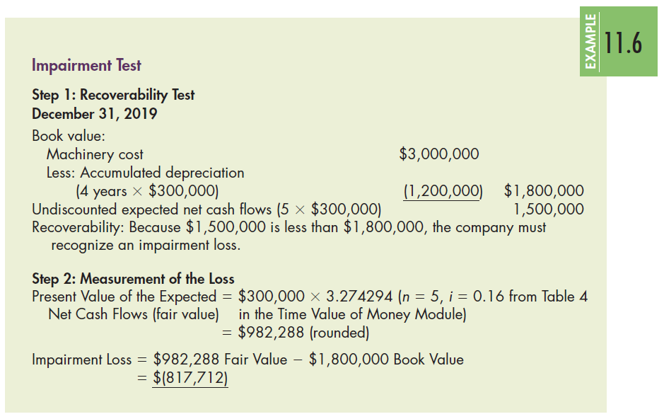
Example: Impairment Loss
(Slide 2 of 3)

Slide 61
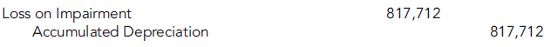
Example: Impairment Loss
(Slide 3 of 3)
Although GAAP does not specify how to record the write-down, it does indicated that the reduced book value of the asset is to be accounted for as the new depreciable base. Therefore, we will record the impairment loss as an increase to accumulated depreciation. Hall records the loss as follows:
Hall reports the $817,712 loss in income from the continuing operation on its 2019 income statement, and the property, plant, and equipment at its fair value of $982,288 ($3,000,000 cost minus $2,017,712 accumulated depreciation) on its 2019 ending balance sheet. Hall will depreciate the machinery over its remaining useful life of 5 years.

Slide 62
Disclosures of Impairment Loss
A company must disclose the following information in the year of the write-down and the next 2 years:
  Description of the impaired asset and the circumstances leading to the impairment
  How the asset’s fair value was determined
  Amount of the loss
  Income statement caption which includes the loss
  Operating segment affected (if applicable)

Slide 63
Impairment of Assets Held for Sale
Property, plant, and equipment that a company intends to sell is reported at the lower of its book value or net realizable value (fair value minus the costs to sell).
The use of net realizable value provides a more faithful representation of the cash flows that the company expects to receive from the sale of the assets.
The impairment loss is recognized for the amount of the write-down from book value to the net realizable value.
Restoration of the impairment loss is permitted if the net realizable value increases. In this case, a company would recognize a gain to the extent of any previously recognized losses.
Under no circumstances may the asset be revalued above the original carrying value.

Slide 64
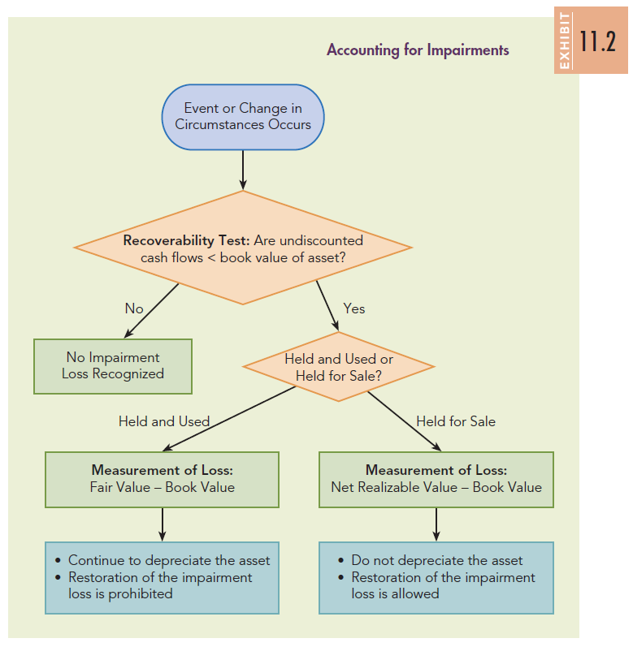
Impairment Test

Slide 65
Conceptual Evaluation of Asset Impairment
(Slide 1 of 2)
The recognition of an impairment loss is intended to enhance the usefulness of a company’s financial statements by recording the loss in the period it is incurred and reporting the fair value of productive assets.
Thus, the information is expected to be more relevant and help users assess the return on investment, operating capability, and risk of the company.
The information should also improve comparability across companies.

Slide 66
Conceptual Evaluation of Asset Impairment
(Slide 2 of 2)
Four major concerns arise regarding the accounting for impairments:
  Some question whether the fair value of property, plant, and equipment is relevant for assets that will be held and used in normal operations because the asset is not going to be sold in the near term.
  Assuming fair value is relevant (and most believe it is), the cash flows expected by a company from using a specific asset are not necessarily the same as those used to determine the market value of the asset because the company may use the asset differently from other companies. Therefore, the specific cash flows may not result in a faithful representation of fair value.
  The use of undiscounted cash flows for the recoverability test ignores the time value of money.
  The impairment test may differ for identical assets simply because of the depreciation method or service life selected by a company.

Slide 67
How Do We Account for the Disposal of Property, Plant, and Equipment? Learning Objective #8 (Slide 1 of 2)
A company may dispose of property, plant, and equipment by sale, involuntary conversion, abandonment, or exchange.
When a disposal occurs, a company recognizes a gain or a loss on the disposal for the difference between the book value of the asset (cost minus accumulated depreciation) and the consideration received.
A gain or loss arises because depreciation is a cost allocation process, and its application does not result in the asset being reported at its market value.

Slide 68
How Do We Account for the Disposal of Property, Plant, and Equipment? Learning Objective #8 (Slide 2 of 2)
Therefore, the gain or loss may be considered a correction of the income that has been recorded in the years the asset has been owned.
The gain or loss on disposal is normally reported in income from continuing operations in the ‘‘Other Income and Expense’’ category.
However, it could be reported as a disposal of a component of a business if it meets the appropriate criteria.
To account for the disposal of property, plant, and equipment, the company first records the depreciation up to the date of the disposal. It then removes the cost of the asset and the related amount of accumulated depreciation from the respective accounts.

Slide 69
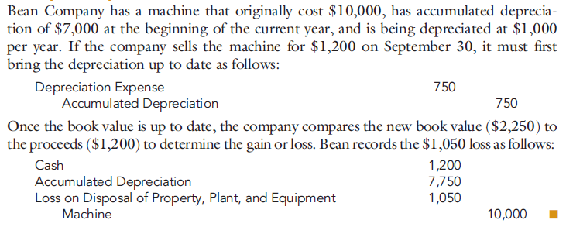
Example:
Disposal of Property, Plant, and Equipment
Bean Company has a machine that originally cost $10,000, has accumulated depreciation of $7,000 at the beginning of the current year, and is being depreciated at $1,000 per year. If the company sells the machine for $1,200 on September 30, it must first bring the depreciation up to date as follows:
Once the book value is up to date, the company compares the new book value ($2,250) to the proceeds ($1,200) to determine the gain or loss. Bean records the $1,050 loss as follows:

Slide 70
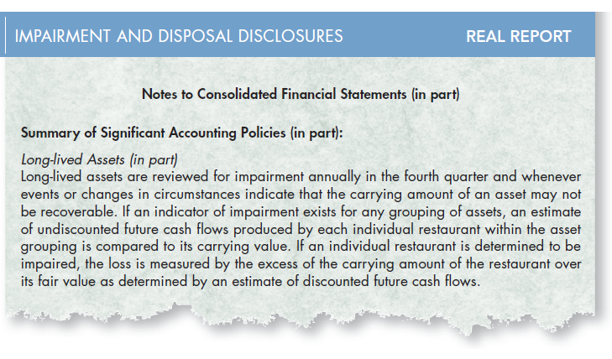
Real Report: Disclosure of
Impairment and Disposal (Slide 1 of 2)
McDonald’s

Slide 71
Real Report: Disclosure of
Impairment and Disposal (Slide 2 of 2)
1. How often does McDonald’s review its long-lived assets for impairment?
McDonald’s reviews its long-lived assets for impairment annually in the fourth quarter or when circumstances indicate that an impairment may have occurred. An indicator of impairment that it uses is negative operating cash flow for the most recent trailing 24-month period.
2. With regard to impairments, how does McDonald’s measure fair value, and how would this measurement be classified in the fair value hierarchy (Level 1, 2, or 3)?
McDonald’s measures fair value using a discounted cash flow model. In the fair value hierarchy, this would be classified as a Level 3 input. From Chapter 4, Level 3 inputs are unobservable inputs that reflect the company’s assumptions about how market participants would price the asset (or liability).

Slide 72
How Is Depletion Recorded?
Learning Objective #9
Natural resources, such as timber, coal deposits, oil and gas reserves, and mineral deposits make up an important part of the productive assets for many companies.
Similar to other productive assets, the cost of natural resources is allocated as an expense to each period in which the natural resource provides economic benefits to the company.
The allocation of the cost of a natural resource to the periods in which benefits are received is called depletion.

Slide 73
Natural Resources Costs
Any expenditure to obtain the rights to the natural resource and bring it to a condition in which it can be used is capitalized as part of the cost of a natural resource. These costs include:
  Acquisition costs: amounts paid to acquire the rights to a search for an undiscovered natural resource or to use a discovered resource.
  Exploration costs: expenditures, such as drilling a well or excavating a mine, incurred to search for a natural resource.
  Intangible development costs: expenditures incurred after the resource is discovered but before production begins that are necessary for production of the resource. These costs include costs for drilling, tunnels, shafts, and wells.
  Restoration costs (or reclamation costs): costs incurred to restore a natural resource to its natural state. These costs represent an asset retirement obligation and are added to the cost of the natural resource.

Slide 74

Computing Depletion Costs
(Slide 1 of 2)
Because the usefulness of the natural resource is related to the amount of the resource extracted, a company usually records depletion using an activity method.
  The activity measure is the number of units of the resource that the company expects to extract over the life of the asset.
  A unit depletion rate is calculated as follows:

Slide 75
Computing Depletion Costs
(Slide 2 of 2)
  Next, depletion for a period is calculated as follows:
  As the natural resource is recovered, the natural resource is reduced and the amount of depletion is added to an inventory account.
  As the natural resource is sold, the company would recognize an expense, Cost of Goods Sold, related to the asset and reduce the inventory account.
    Thus, Cost of Goods Sold only includes the units of the natural resource that are sold, while ending inventory consists of the units on hand at the end of the period.

Slide 76
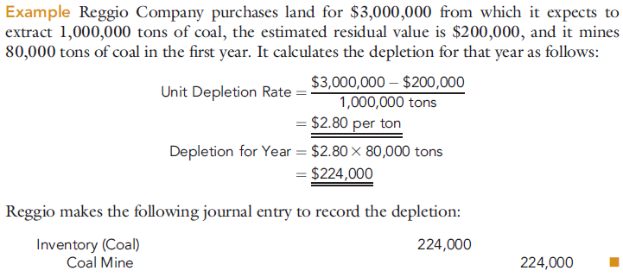
Example: Computing Depletion Costs
(Slide 1 of 3)
Example Reggio Company purchases land for $3,000,000 from which it expects to extract 1,000,000 tons of coal, the estimated residual value is $200,000, and it mines 80,000 tons of coal in the first year. It calculates the depletion for that year as follows:

Slide 77
Example: Computing Depletion Costs
(Slide 2 of 3)
Reggio makes the following journal entry to record the depletion:

Slide 78
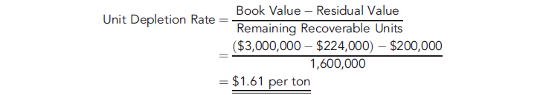
Example: Computing Depletion Costs
(Slide 3 of 3)
Example Continuing the preceding example, suppose that at the beginning of the second year of operation of the coal mine, a new estimate indicates that the mine has a capacity to produce another 1,600,000 tons (for a lifetime production of 1,680,000 tons). Reggio computes a new unit depletion rate as follows:
Reggio uses the new unit depletion rate to compute depletion for the second year.

Slide 79
How Is Depreciation Calculated for Income Tax Purposes? Learning Objective #10 (Slide 1 of 2)
Companies follow different depreciation methods for computing taxable income than for computing income for financial reporting purposes.
The use of different methods is appropriate because the purpose of the depreciation methods required by the income tax laws is to stimulate capital investment through the rapid recovery of capital costs.
However, the purpose of accounting income is to present fairly the activities of the company over a particular period.

Slide 80
How Is Depreciation Calculated for Income Tax Purposes? Learning Objective #10 (Slide 2 of 2)
For assets acquired before 1981, depreciation for income tax purposes is based on use of the straight-line, sum-of-the-years’-digits, and declining-balance methods discussed earlier.
The asset may be depreciated below the estimated residual value, and the Internal Revenue Service (IRS) publishes tables that give a range of the estimated lives to use. For assets purchased in 1981 through 1986, the Accelerated Cost Recovery System (ACRS) is used.
For assets purchased in 1987 and later, ACRS was modified and is known as the Modified Accelerated Cost Recovery System (MACRS).

Slide 81
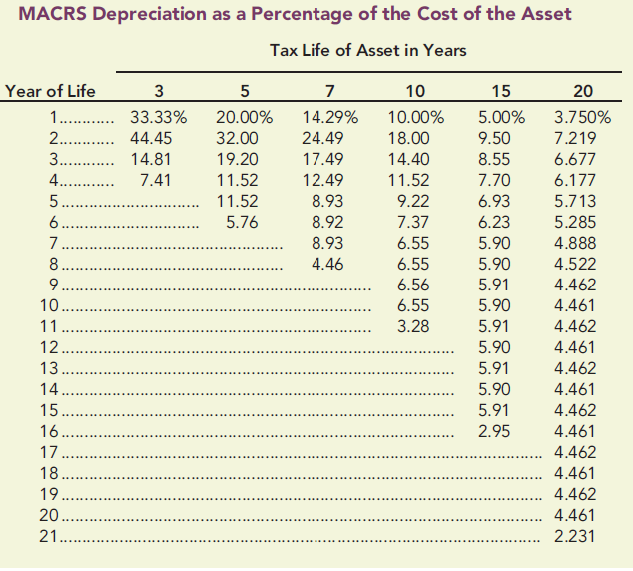
MACRS Depreciation

Slide 82
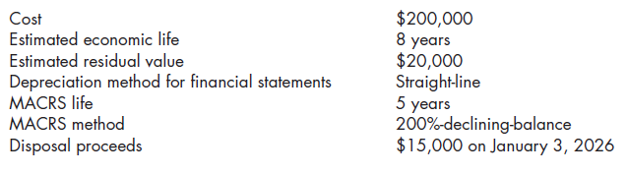
Example: MACRS (Slide 1 of 2)
To show the use of the MACRS system and the differences from the calculation of depreciation expense for financial reporting consider the following facts for an asset purchased by Melville Company on January 1, 2018:

Slide 83
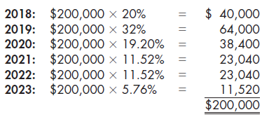
Example: MACRS (Slide 2 of 2)
Melville computes the MACRS depreciation expense as follows:

