Slide 1
Intermediate Accounting
Third Edition
Wahlen, Intermediate Accounting, Third Edition. © 2020 Cengage. All Rights Reserved. May not be scanned, copied or duplicated, or posted to a publicly accessible website, in whole or in part.

Slide 2
The Demand for and Supply of Financial Accounting Information
Chapter 1

Slide 3
Learning Objectives
Understand the forces that drive the demand for financial accounting information in the world economy.
Understand the forces that determine the supply of accounting information, including the role of the Securities and Exchange Commission (SEC).
Explain the role of the Financial Accounting Standards Board (FASB) for establishing U.S. generally accepted accounting principles (U.S. GAAP).
Explain and use the FASB Accounting Standards Codification system, and understand the standard-setting process.
Explain the role of the International Accounting Standards Board (IASB) in establishing International Financial Reporting Standards (IFRS) and the efforts to try to converge accounting standards between the FASB and the IASB.
Understand the output of the financial reporting process and the four primary financial statements, as well as the important information reported with financial statements.
Understand that, because financial accounting information triggers important economic consequences, integrity and the ability to resolve ethical dilemmas are essential to the accounting profession.

Slide 4
The Need for Financial Accounting Information Learning Objective #1
Forces that create demand
Companies compete for a wide variety of resources such as financial capital, physical and natural resources, intellectual property and technology, new product and service ideas, skilled employees and executives, customers, and suppliers.
Strategies
Companies need to develop a business plan with broad strategic objectives and specific tactics.
This business model should guide its strategy and business activities to be different from its rivals, utilizing whatever competitive advantages it might have.

Slide 5
Business Activities
Financing Activities
Raise equity capital by attracting investments from business owners, such as common shareholders
Acquire resources from lenders or by the issuance of bonds
Investing Activities
Acquire productive resources such as property, plant, equipment, technology, intellectual property, legal rights, and operating agreements necessary to operate the business
Operating Activities
Utilize resources in day-to-day activities to produce goods and/or services and sell them to customers

Slide 6
Who Are the Stakeholders?
Stakeholders are parties with an interest in a company
Common equity shareholders
Banks
Creditors
Managers and employees
Suppliers
Labor unions and pension funds
Customers
Governmental authorities
Local communities

Slide 7
What Do Stakeholders Need to Know?
Investors
The business model, strategies, and competitive advantages of the company
Resources the company owns and the debt it owes
The net income or net loss, cash flows, and whether profits and cash flows are growing over time
Creditors
The amount of equity capital in place
Resources the company owns and the debt it owes
Cash flows and the company’s ability to meet interest and principal payments when due

Slide 8
What Drives Stakeholders’ Demand for Accounting Information?
Stakeholders need financial information to make informed resource allocation decisions.
The financial reporting process must communicate financial accounting information to existing and potential investors, creditors, lenders, and other external decision makers.
Information must be relevant and faithfully representative.

Slide 9
The Separation of Ownership and Control
Problems can arise because of the separation of ownership and control.
The investors and creditors (principals) who provided financial capital own the resources but are separate from the executives, managers, and employees (agents) who have day-to-day control of those resources.
The need to solve information asymmetry problems controls the demand for financial accounting information.

Slide 10
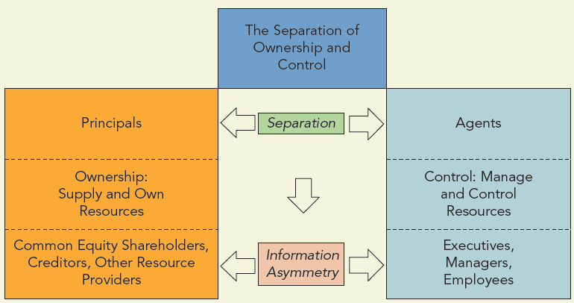
When Ownership is Separate from Control

Slide 11
What Drives the Demand for Accounting Standards and Independent Audits?
A natural demand arises for accounting standards that managers can use to measure and report financial statements that are relevant and representationally faithful.
Professional standards, such as Generally Accepted Accounting Principles (U.S. GAAP) and International Financial Reporting Standards (IFRS) are not sufficient to meet users’ demands.
Accounting standards require many choices, judgments, and estimates
This gives rise to a demand for independent audits
External auditors must be independent experts in accounting who carefully evaluate a company’s accounting records and verify whether the financial statements are fairly presented in accordance with professional standards.

Slide 12
The Supply of Financial Accounting Information Learning Objective #2
The supply of accounting information that companies report is determined primarily by the interactions between two main forces:
Authoritative professional accounting standards, such as U.S. GAAP or IFRS, that govern in the company’s country of incorporation
Choices, methods, estimates, and judgments that the company must make in order to apply those accounting standards to measure and report their financial statements

Slide 13
The Role of the Securities and Exchange Commission (SEC)
The U.S. Congress created the Securities and Exchange Commission (SEC) to administer the Securities Act of 1933 and the Securities Exchange Act of 1934.
The stated mission of the U.S. Securities and Exchange Commission is to “protect investors, maintain fair, orderly, and efficient markets, and facilitate capital formation.”
Under these acts, the SEC has the legal authority to prescribe accounting principles and reporting practices for all corporations issuing publicly traded securities within the U.S. capital markets.

Slide 14
The SEC’s Reporting Requirements
The Securities Act of 1933 requires each company offering securities for sale to the public in the primary and secondary markets to file a registration statement.
Form S-1 – A registration statement
The Securities Exchange Act of 1934 established extensive reporting requirements for listed companies.
Form 10-K – An annual report including financial statements
Form 10-Q – A quarterly report including financial statements
Form 20-F – An annual report from non-U.S. companies
Form 8-K – A report used to describe significant events that may affect the company
Proxy Statement – A report used when management requests the right to vote through proxies at shareholders’ meetings

Slide 15
The SEC’s Authority over Accounting Standards and Financial Reporting
The SEC frequently enforces its regulations on companies, exchanges, and investors.
The SEC delegates its authority to establish accounting standards to the Financial Accounting Standards Board (FASB) and the International Accounting Standards Board (IASB).
The SEC exercises its most direct impact on accounting standards through its input and informal approval (or rejection) of standards that have been proposed but not yet issued.
Instead of deciding what constitutes “generally accepted accounting principles” through edict, the SEC has endorsed the concept of “substantial authoritative support.”

Slide 16
The FASB Learning Objective #3
Timelines
The Committee on Accounting Procedure (CAP)
Formed by the AICPA formed in 1938
Issued Accounting Research Bulletins (ARBs)
Accounting Principles Board (APB)
Formed in 1959 by the AICPA to replace the CAP
Issued Accounting Principle Board Opinions (APBs)
Financial Accounting Standards Board (FASB)
Formed in 1973 to replace the APB
ARBs and APB Opinions remain sources of GAAP unless they have been specifically superseded or amended by the FASB.

Slide 17
The Structure of the FASB (Slide 1 of 2)
There are seven members of the FASB who are full-time employees with no other organizational ties.
Members represent a wide-cross section of interests (auditors, users, academics, financial statement preparers).
Each board member is required to have:
A knowledge of and experience in accounting, finance, business, and accounting education and research
High intelligence, integrity, and discipline
A concern for the public interest regarding investing, financial accounting and reporting

Slide 18
The Structure of the FASB (Slide 2 of 2)

Slide 19
FASB Emerging Issues Task Force (EITF)
The FASB established the Emerging Issues Task Force (EITF) in 1984 as a response to the need for timely guidance on new, specific accounting issues.
The FASB is responsible for identifying financial accounting issues, conducting research to address these issues, and resolving them by issuing new accounting standards.
The primary objectives of the EITF are:
To identify significant emerging accounting issues that it feels the FASB should address.
To develop consensus positions on the implementation issues involving the application of standards. In some cases, these consensus positions may be viewed as the “best available guidance” on GAAP, particularly as they relate to new accounting issues.

Slide 20
FASB Pronouncements
Prior to 2009, the FASB issued several types of pronouncements which had different levels of authority.
Although the FASB no longer issues these types of pronouncements, they are still cited in accounting literature and many companies still refer to them to explain how they applied GAAP.
Because this collection of pronouncements were lengthy, hard to use, sometimes conflicting, and lacked a consistent and logical structure, the FASB conducted a major project that resulted in the FASB Accounting Standards Codification.

Slide 21
Historical Types of FASB Pronouncements
Statements of Financial Accounting Standards. These pronouncements carried the highest authority within GAAP, establishing the methods and procedures required on specific accounting issues.
Interpretations. These pronouncements refined GAAP by clarifying conflicting or unclear issues relating to previously issued standards.
Staff Positions. FASB staff issued pronouncements to provide more timely and consistent application guidance and to make narrow and limited revisions of standards.
Technical Bulletins. FASB staff issued these pronouncements to clarify, explain, or elaborate on accounting and reporting problems related to specific standards.
Statements of Financial Accounting Concepts. These pronouncements establish a theoretical foundation for financial accounting and reporting standards. They are the output of the FASB’s “Conceptual Framework” project (discussed in Chapter 2). They are fundamental principles that guide the development of GAAP.
Other Pronouncements. On a major topic, the FASB staff also may issue a Guide for Implementation, in the form of questions and answers.
Notes:
Exhibit 1.4 on page 1-13: Historical Types of FASB Pronouncements

Slide 22
FASB Accounting Standards Codification Learning Objective #4
The FASB Accounting Standards Codification is an electronic database that integrates and topically organizes U.S. GAAP into one coherent body of literature.
The Codification became effective on July 1, 2009.
The FASB developed the Codification to achieve three goals:
Simplify user access by organizing and categorizing all authoritative U.S. GAAP in one database.
Ensure the codified content accurately represented all U.S. GAAP.
Create a codification research system that is up to date, including the most recently released standards.
The Codification is now the only source of authoritative GAAP for U.S. companies to determine how to record their transactions, events, or circumstances, and how to report the results in their financial statements.
The Codification does not change GAAP.

Slide 23
FASB Accounting Standards Codification Framework
Contains six components or levels, which are increasingly more specific:
Areas – links to nine broad, general accounting subjects
Topics – involve guidance on a particular subject area
Subtopics – are subsets of a Topic and generally distinguished by type or by scope
Sections – characterize the nature of the content in a Subtopic
Subsections – refine and break down Sections into narrower and more specific items
Paragraphs – contain the specific guidance that constitutes GAAP
FASB ASC Reference # Topic, Subtopic, Section, Paragraph (e.g., 330-10-30-1)

Slide 24
The FASB’s Process and Operating Procedures (Slide 1 of 2)
A newly released standard by FASB is referred to as an Accounting Standards Update.
Before issuing a new standard, the FASB completes a multistage process.
On major issues, a Task Force may be appointed to advise and consult with the FASB’s Research and Technical Staff.
Once a Preliminary Views document or Invitation to Comment is published, the FASB holds public hearings similar to those conducted by Congress.
After deliberating on the views expressed and information collected, the FASB issues an Exposure Draft of the proposed update.
After a 30-90 day waiting period for additional comments, the FASB will draft the proposed standard for a final vote.
Accounting Standards Update require a super-majority (at least five votes).
The standard will include a “Basis for Conclusions” which explains the rationale for the new standard or an explanation of Board member dissention.

Slide 25
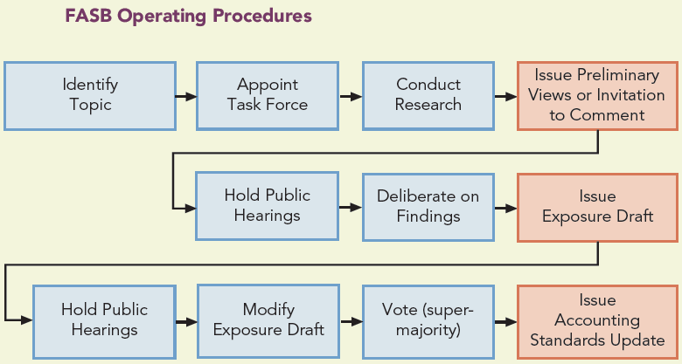
The FASB’s Process and Operating Procedures (Slide 2 of 2)

Slide 26
The IASB and IFRS Learning Objective #5
The IASB is the international accounting standard setter, establishing IFRS which are required or permitted in roughly 130 countries.
As the parent organization of the IASB, the IFRS Foundation consists of a group of Trustees that is responsible for fund-raising, appointing IASB members, and overseeing the effectiveness of the IASB.
The IASB includes 16 members from various countries.
Following a similar process as the FASB, the IASB studies the topic, issues a discussion paper, issues an Exposure Draft, evaluates comments, and drafts the proposed standard.
If approved by 10 of the 16 members, the proposed standard becomes an International Financial Reporting Standard (IFRS).

Slide 27
Convergence of FASB and IASB Accounting Standards
International convergence of accounting standards refers to both a goal and the path chosen to reach it.
The FASB states “the ultimate goal of convergence is a single set of high-quality, international accounting standards that companies worldwide would use for both domestic and cross-border financial reporting. Today, the path toward that goal is the collaborative efforts of the FASB and the IASB to both improve U.S. GAAP and IFRS and eliminate or minimize the differences between them.”
Major projects on the agenda include convergence of accounting standards for:
Consolidated financial statements
Fair value measurement
Financial statement presentation
Revenue recognition

Slide 28
The SEC and International Convergence
In 2007 the SEC decided to allow foreign companies to use IFRS rather than U.S. GAAP and it decided that these companies do not need to reconcile how differences between IFRS and U.S. GAAP affect their reported financial statements
Professional accountants must be fluent in U.S. GAAP and IFRS

Slide 29
Standard Setting in a Political Environment
The FASB and the IASB develop new accounting standards in a thorough, thoughtful, and efficient manner, with due process, and in open public forums.
However, because of the substantial economic consequences, key constituents often disagree about the objectives for new standards.
Compromise is inevitable as the FASB and the IASB respond to the globalization of capital markets.

Slide 30
Primary Financial Statements Learning Objective #6
The financial statements that companies provide to external stakeholders include
Balance sheet
Income statement
Statement of cash flows
Statement of shareholders’ equity
Notes and other items that typically accompany these statements

Slide 31
The Balance Sheet: Measuring Financial Position
The balance sheet is the cornerstone of financial reporting and presents:
A snapshot of the resources of a firm (assets)
The claims on the firm (liabilities and shareholders’ equity)
As of a specific date
Usually the last day of the fiscal quarter or the fiscal year
Also known as the statement of financial position
The balance sheet reports the following equation:
Assets = Liabilities + Shareholders’ Equity
The balance sheet views resources from two perspectives:
Specific resources the of the firm – (e.g., cash, inventory, and equipment)
The claims by persons or entities – (e.g., investors, creditors, lenders, suppliers, employees, and other stakeholders)

Slide 32
Income Statement: Measuring and Reporting Performance
The income statement measures and reports the financial results of a firm’s performance for a period of time such as a quarter or a year.
It provides information about the profits or losses the company has generated during the period by conducting operating, investing, and financing activities.
Revenues measure the inflows of assets and the settlements of obligations from selling goods and providing service to customers.
Expenses measure the outflows of assets that a company consumes and the obligations it incurs in the process of operating the business to generate revenues.
Net Income (or Net Loss) measures the bottom-line profit (or loss) of a company for the period. Another term for net income is earnings.
Net Income = Revenues – Expenses + Gains – Losses
Comprehensive income is the change in equity of a company during a period from transactions, events, and circumstances relating to nonowner sources.

Slide 33
Statement of Cash Flows
The statement of cash flows:
Reports for a period of time the net cash flows (inflows minus outflows) from operating, investing, and financing activities
Provides useful information about how a firm is generating and using cash
Complements the income statement since it demonstrates how cash flows differ from accrual-based income
Useful to creditors and other stakeholders:
To help evaluate the company’s cash-generating ability
Gives information about the likelihood of future cash flows for future payments of obligations

Slide 34
Statement of Shareholders’ Equity
The statement of shareholders’ equity provides information about the common shareholders’ equity claims on the company and how those claims change during the period.
Contributed capital
Amounts initially contributed by shareholders for an interest in a company (e.g., Common Stock, Additional Paid-in Capital, and Other Additional Paid-in Capital)
Earned capital
Cumulative net income in excess of dividends declared – Retained Earnings
Shareholders’ equity effects from the recognition or valuation of certain assets or liabilities – Accumulated Other Comprehensive Income
Cumulative amounts of cash distributed to shareholders to repurchase shares – Treasury Stock

Slide 35
Financial Statement Notes
Companies must provide notes as additional information with the financial statements.
Explain how the accounts and amounts have been determined
Provide important details about the accounting principles, methods, and estimates the company has used to measure assets, liabilities, equity, revenues, expenses, gains, and losses, including fair values of investment securities, pension and postemployment liabilities, income taxes, and intangible assets

Slide 36
Management Discussion and Analysis
Management Discussion and Analysis is an extensive narrative discussion and quantitative analysis from the company’s managers.
Provides managers’ insight into:
Strategies
Evaluation of their performance
Exposure to business risk factors
Expectations about the future of the company

Slide 37
Managers’ and Independent Auditors’ Attestations
The Sarbanes-Oxley Act of 2002 imposed responsibilities:
Management is responsible for financial statements and the underlying accounting and control system that generates the financial statements.
Independent auditors are responsible for assessing a company’s internal control system (referred to as the Assurance Opinion), designing audit tests, and forming an opinion (referred to as the Audit Opinion) about the fairness of the amounts reported in the financial statements.
Why is an auditor’s opinion an essential element of financial reporting?

Slide 38
Ethics and Integrity in the Accounting Profession Learning Objective #7
Accountants serve the greater good of society and owe a responsibility of ethics and fairness to all current and potential stakeholders, whose interests are sometime conflicting.
Accountants face ethical dilemmas, situations in which an accountant must make a decision about what is the “right” (ethical) action to take in given circumstances.
Professional accounting organizations have established codes of ethics for their members.
The AICPA has adopted the Code of Professional Conduct (CPC).
The CPC includes six principles that express the basic tenets of ethical and professional conduct and call for an unswerving commitment to honorable behavior, even at the sacrifice of personal advantage.

Slide 39
Principles of the AICPA Code of Professional Conduct
Responsibilities: In carrying out their responsibilities as professionals, members should exercise sensitive professional and moral judgments in their activities.
The Public Interest: Members should act in a way that will serve the public interest, honor the public trust, and demonstrate commitment to professionalism.
Integrity: To maintain and broaden public confidence, members should perform all professional responsibilities with the highest sense of integrity.
Objectivity and Independence: A member should be objective and free from conflicts of interest in discharging professional responsibilities. A member in public practice should be independent in fact and appearance when providing auditing and other attestation services.
Due Care: A member should observe the profession’s technical and ethical standards, strive continually to improve competence and the quality of services, and discharge professional responsibility to the best of the member’s ability.
Scope and Nature of Services: A member in public practice should observe the Principles of the CPC in determining the scope and nature of services to be provided.
Notes:
Exhibit 1.14 on page 1-35: Principles of the AICPA Code of Professional Conduct

