Slide 1
Intermediate Accounting
Third Edition
Wahlen, Intermediate Accounting, Third Edition. © 2020 Cengage. All Rights Reserved. May not be scanned, copied or duplicated, or posted to a publicly accessible website, in whole or in part.

Slide 2
Financial Reporting: Its Conceptual Framework
Chapter 2

Slide 3
Learning Objectives
Explain the FASB’s Conceptual Framework.
Explain the general and specific objectives of general purpose financial reporting.
Explain the qualitative characteristics of decision-useful information as identified in the FASB and IASB Joint Conceptual Framework project.
Understand and apply the major assumptions of financial reporting and U.S. GAAP.
Describe the financial reporting model in the FASB’s Conceptual Framework.

Slide 4
FASB Conceptual Framework
Learning Objective #1 (Slide 1 of 2)
The intent of FASB’s Conceptual Framework is to establish objectives and fundamental concepts that are the basis for development of financial accounting and reporting guidance.
  The objectives identify the goals and purposes of financial reporting
  The fundamental underlying concepts of financial accounting guide
    the selection of transactions and events to be accounted for,
    their recognition and measurement, and
    the means of summarizing and communicating

Slide 5
FASB Conceptual Framework (Slide 2 of 2)
The Conceptual Framework is intended to:
  Guide the FASB in establishing accounting standards
  Establish objectives and concepts to guide financial statement preparers and auditors to resolve questions and make appropriate judgments in the preparation of financial statements, even in the situations where standards do not exist
  Increase users’ understanding of and confidence in financial reporting
  Enhance financial statement comparability across companies and over time

Slide 6
Accounting Principles
Accounting principles are fundamental theories, truths, and propositions that serve as the practical foundation for financial accounting and financial reporting.
The most fundamental statements of these principles come from FASB’s Statements of Financial Accounting Concepts (Concept Statements).
The Concept Statements and fundamental principles form the basis and the objectives of generally accepted accounting principles (GAAP).

Slide 7
Accounting Concepts
FASB’s Statements of Financial Accounting Concepts are general proclamations that establish:
  Fundamental principles of accounting
  Objectives of financial reporting
  Qualities of useful financial accounting information
  Definitions of basic elements like assets and liabilities
  Types of economic transactions, events, and arrangements to be recognized in financial statements
  Measurement attributes to use to measure and report these transactions, events, and arrangements
  How transactions, events, and arrangements should be presented and classified in financial statements

Slide 8
Accounting Standards
Accounting standards
  Establish the authoritative guidance on how companies should account for and report specific transactions, events, and arrangements in their financial statements.
  Specific accounting standards in GAAP provide guidance on when and how to recognize and measure these elements in financial statements.
Within accounting standards, rules exist, which are specific implementation guidelines through which financial statement preparers apply accounting standards.

Slide 9
How U.S. GAAP Is Established
Accounting Standards Codification
  In the United States, generally accepted accounting principles are established by the Financial Accounting Standards Board (FASB) and organized in the Accounting Standards Codification.
Accounting Standards Updates
  New generally accepted accounting principles are established through accounting standards updates to the codification.

Slide 10
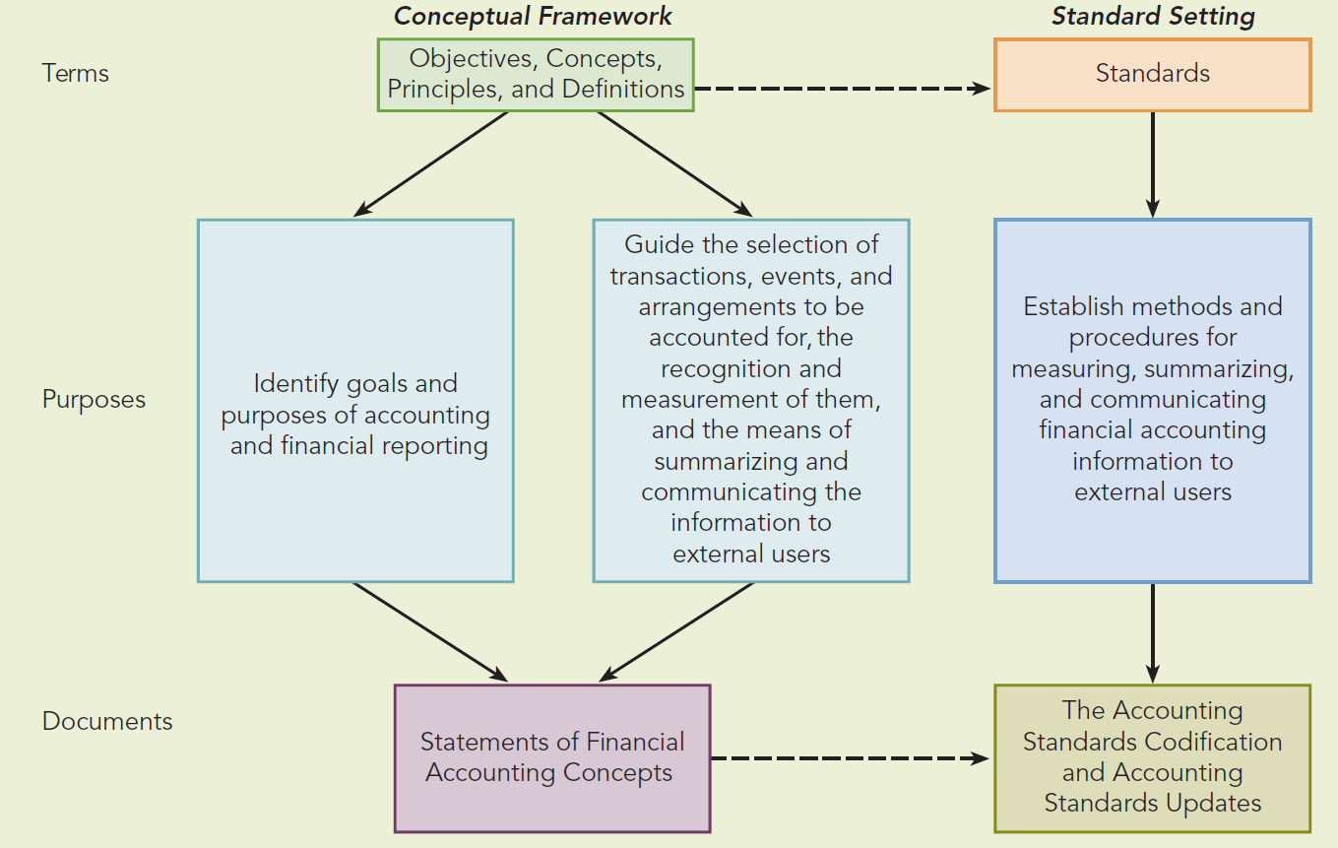
Relationship of Principles, Concepts,
Standards, and Rules

Slide 11
Conceptual Framework: Brief History
Statement of Financial Accounting Concepts No. 1, “Objectives of Financial Reporting by Business Enterprises” (1978)
  Established primary objectives of financial accounting
Statement of Financial Accounting Concepts No. 2, “Qualitative Characteristics of Accounting Information” (1980)
Accounting projects define the accounting elements and identify which elements should be recognized in financial statements, when they should be reported, and how they should be measured.
Reporting projects deal with how elements of financial reports are classified and presented in financial statements, what information should be provided, and where information should be presented.

Slide 12
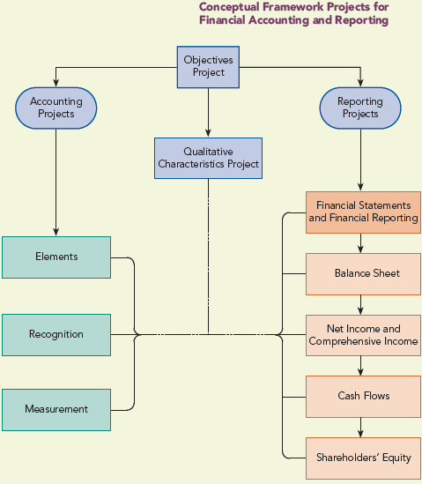
Conceptual Framework Projects

Slide 13
Conceptual Framework: Current Status
FASB and IASB worked closely together on a Joint Conceptual Framework and released Statement of Financial Accounting Concepts No. 8, “ Conceptual Framework for Financial Reporting” (2010)
Chapter 1 (Objectives) and Chapter 3 (Qualitative Characteristics) supersede FASB Concepts Statements No. 1 and No. 2
The FASB and IASB have concluded their joint efforts, and each Board is proceeding independently on further developments to their respective Conceptual Frameworks.

Slide 14
Primary Objective of Financial Reporting
Learning Objective #2
The primary objective of financial reporting is to provide useful information:
Provide financial information about the reporting entity that is useful to existing and potential investors, lenders, and other creditors in making decisions about providing resources to the entity

Slide 15
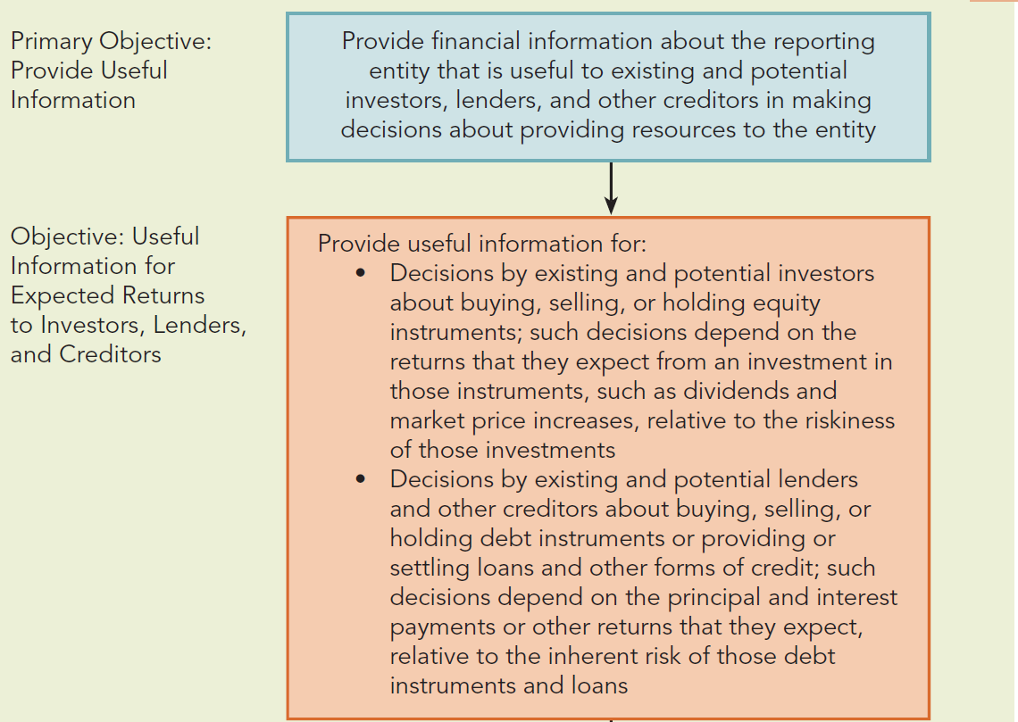
What Are the Objectives of Financial
Reporting? (Slide 1 of 2)

Slide 16
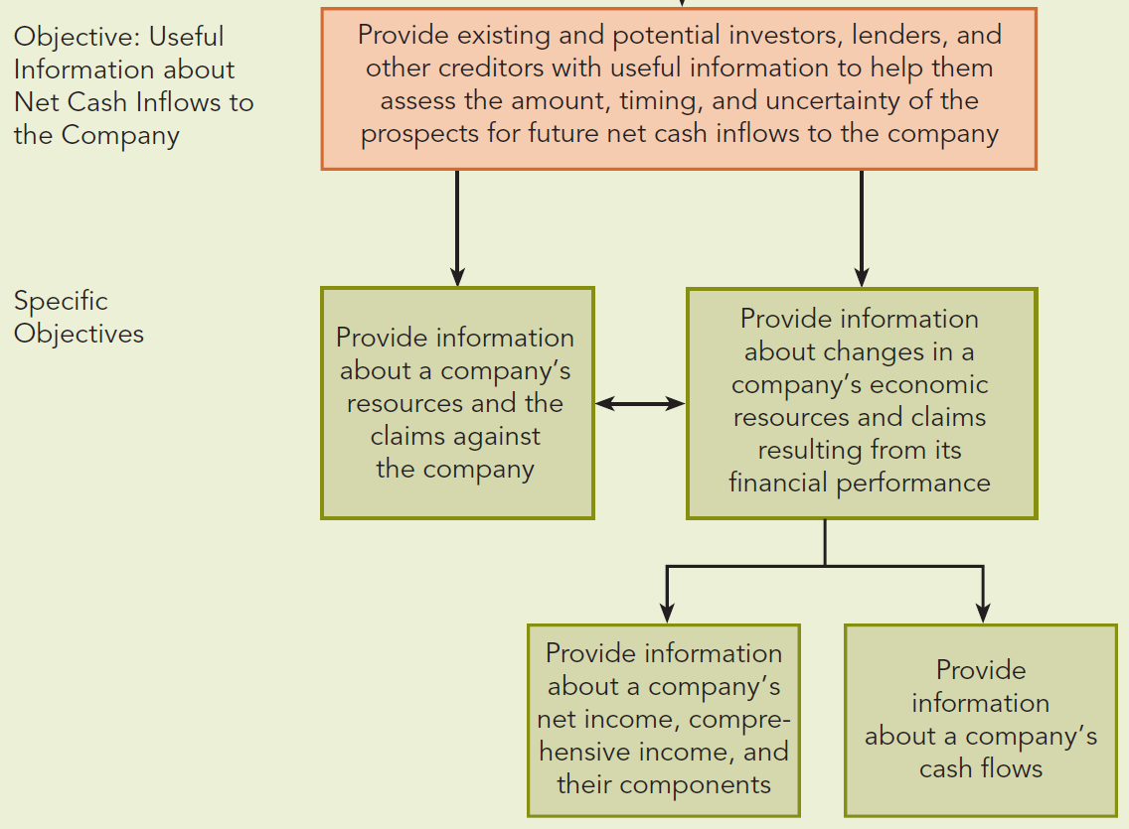
What are the Objectives of Financial
Reporting? (Slide 2 of 2)

Slide 17
Objective 1: Information Useful in Decision Making
Financial reporting should provide useful information about the reporting entity for:
  Existing and potential investors – shareholders, equity fund managers, analysts, and others
  Lenders – banks, lending institutions, bondholders, credit rating agencies
  Other creditors who make decisions about providing resources to the entity – suppliers, customers, employees, and other parties with claims on the firm

Slide 18
Objective 2: Information Useful to External Users in Assessing Expected Returns
Information needs of investors, lenders, and other creditors
  Suppliers of financial capital are primarily interested in the amounts, timing, and uncertainty of the prospective cash flows they will receive.
    Need to assess the expected returns from buying, selling, or holding a company’s equity, debt or other financial instruments
  External users need financial information to form expectations about the timing and amount of prospective cash receipts and assess the risk involved.

Slide 19
Objective 3: Information Useful in Assessing Company Cash Flows
Financial reporting should provide information to help external investors, lenders, and other creditors in assessing the amounts, timing and uncertainty of the prospective net cash inflows to the company.
  Company’s ability to generate net cash inflows determines both its ability to pay dividends and interest and the market prices of its securities.
  These affect the cash flows to investors, lenders, and creditors.

Slide 20
Specific Objectives: Information about Economic Resources and Claims on the Company
Information about a company’s economic resources and the claims on the company is useful to external users for the following reasons:
  To identify the company’s resources, obligations, financial strengths and weaknesses, and to assess its liquidity and solvency
  To specify the types of resources in which the company has invested, as well as the types of the claims on the company
  To indicate the potential future cash flows from the company’s resources and the ability of the resources to satisfy the claims on the company

Slide 21
Specific Objective: Information about Changes in the Company’s Resources and Claims
Financial reporting should provide information about the financial performance which causes the company’s resources and the claims on the company to change during the period.
Information concerning the company’s net income, comprehensive income, and their components is useful to external users in:
  Evaluating management’s performance
  Estimating the company’s “earning power” or other amounts that are representative of persistent long-term income-producing ability
  Predicting future income and net cash flows
  Assessing the risk of investing in or lending to the company

Slide 22
Accrual Accounting, Part 1
Accrual accounting measures and reports the economic effects of a company’s transactions, events, and circumstances on a company’s economic resources and claims in the period in which those effects occur, even if the related cash receipts and payments occur in a different period.
  Provides a better basis for assessing the company’s past and future performance than information solely about cash receipts and payments.

Slide 23
Specific Objective: Information about Cash Flow Changes in the Company’s Resources and Claims
Financial reporting should provide information about how a company’s cash flows cause changes in the company’s resources and claims.
Cash flow information shows how a company obtains and spends cash for its operating, investing, and financing activities.
Investors, lenders, and other creditors use cash flow information about a company to:
  Help understand its operations and its cash-generating ability
  Evaluate its strategic sourcing and use of cash for financing and investing activities
  Assess its liquidity and solvency
  Interpret other information about financial performance

Slide 24
Information about Management and the Governing Board as they Relate to Resources
Financial reporting should provide information about how well the company’s management and governing board have discharged their responsibilities to make efficient and effective use of the company’s resources.
Referred to as management’s stewardship responsibility, management is responsible to the owners for:
  The custody and safekeeping of the resources
  Their efficient and profitable use
  Their protection against unfavorable economic impacts, technological advances, and social changes

Slide 25
Types of Useful Information for Investors, Lenders, and Other Creditors
The following types of information are helpful in assessing the amounts, timing, and uncertainty of expected future cash flows to a company:
  Return on investment – measure of overall company performance for equity shareholders
  Risk – the uncertainty or unpredictability of future profitability of a company
  Financial flexibility – the ability of a company to use its financial resources to adapt to change and to take advantage of opportunities when they arise
  Liquidity – how quickly a company can convert its assets into cash to meet short-term obligations and cover operating costs
  Operating capability – the ability of a company to efficiently produce goods and services for customers

Slide 26
What Qualities Make Accounting Information Useful?
Learning Objective #3
Usefulness in making investment and credit decisions is defined by the joint Conceptual Framework in terms of fundamental qualitative characteristics and enhancing qualitative characteristics
  Qualitative characteristics guide standard setters and financial statement preparers when choosing among accounting alternatives
  Qualities distinguish more-useful from less-useful information

Slide 27
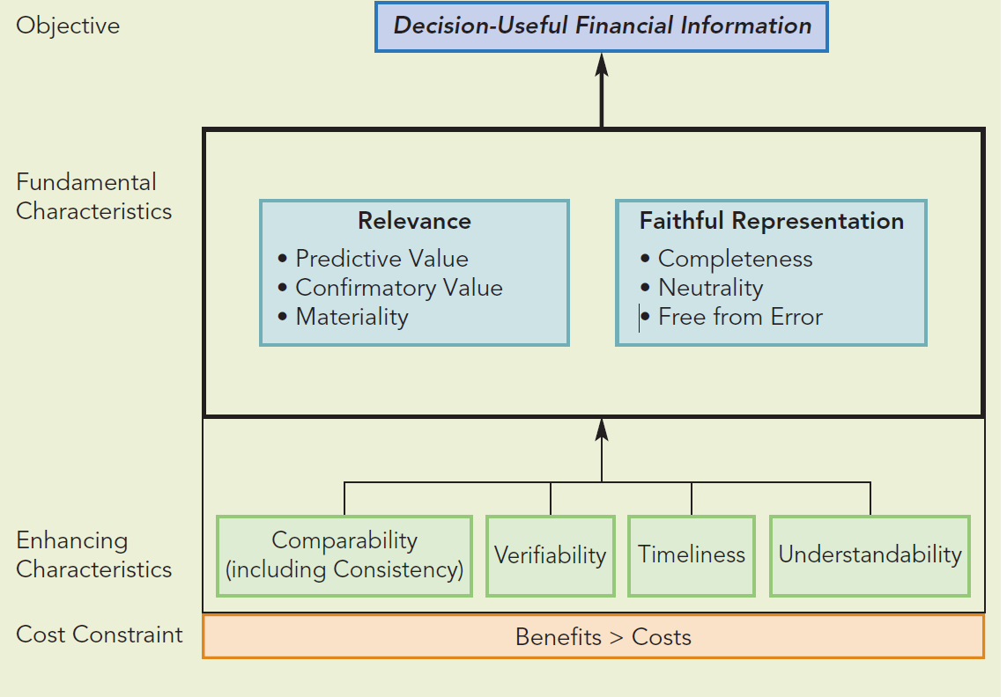
Qualitative Characteristics

Slide 28
Decision Usefulness
Decision usefulness is the ultimate objective of accounting information and can be achieved if the information has a sufficient degree of the fundamental characteristics of
  relevance and
  faithful representation

Slide 29
Relevance
Relevance – information that is capable of making a difference in decisions made by financial statement users
  Predictive Value – information that should help users form expectations about the future
  Confirmatory Value – information that provides feedback to confirm or correct prior predictions and expectations
  Materiality – refers to the nature and magnitude of an omission or misstatement of accounting information that would influence the judgment of a reasonable person relying on that information

Slide 30
Materiality
Materiality depends on entity-specific circumstances and requires judgment to determine whether an item would influence users’ decisions; companies should consider
  The nature of the item
  The relative size rather than absolute size of an item
  Whether a misstated item
    has an effect on trends (particularly in profitability)
    masks a change in earnings and earnings per share
    is currently immaterial but may have a material impact in future periods due to cumulative effect
    changes a net loss into net income (or vice versa)
    misrepresents the company’s compliance with loan agreements
    relates to a segment of the company that is particularly important to the company’s long-run profitability
    increases management’s compensation

Slide 31
Faithful Representation
Faithful representation – when the words and numbers accurately predict the economic substance of what they purport to represent
  Complete representation – provides a user with full disclosure of all information necessary to understand the information being reported, with all necessary facts, descriptions, and explanations
  Neutral representation – not biased, slanted, emphasized or otherwise manipulated to achieve a predetermined result or to influence users’ behavior in a particular direction
  Free from error – the information is measured and described as accurately as possible, using a process that reflects the best available inputs

Slide 32
The Relation between Relevance and
Faithful Representation
Accounting information is most useful when it is both relevant and faithfully represented.
Accounting standards and accounting practitioners must strive to maximize both characteristics to provide users with the most decision useful information possible.

Slide 33
Process of Applying Fundamental Qualitative Characteristics
Step 1 – Identify an economic transaction, event, or arrangement that needs to be recognized in the financial statements.
Step 2 – Identify the type of information that would be most relevant – material and capable of making a difference in decision makers’ predictions of future outcomes and/or confirmations of past predictions.
Step 3 – Determine whether that information can be faithfully represented in a manner that is complete, neutral, and free from error.
Step 4 – Assess whether the benefits of that information are likely to exceed its cost.

Slide 34
Enhancing Characteristics (Slide 1 of 2)
Comparability – enables users of accounting information to identify and explain similarities and differences between two or more sets of economic facts
  Consistency – means that accounting methods and procedures are applied in the same manner from period to period
Verifiability – accounting information is verifiable when different knowledgeable and independent observers can reach consensus that a particular representation is faithful

Slide 35
Enhancing Characteristics (Slide 2 of 2)
Timeliness – accounting information is timely when it is available to decision makers in time to influence their decisions
Understandability – accounting information should be comprehensible to users who have a reasonable knowledge of business and economic activities and who are willing to study the information carefully
What single, pervasive constraint bounds the qualitative characteristics of the financial information disclosed in a company’s financial reports?
Cost Constraint: Benefit > Costs

Slide 36
Accounting Assumptions and Principles
Learning Objective #4
Certain accounting assumptions and principles have had an important impact on the development of accounting and U.S. GAAP:
  Reporting Entity (Economic Entity) Assumption
  Going-Concern (Continuity) Assumption
  Period-of-Time Assumption
  Monetary Unit Assumption
  Mixed Attribute Measurement Model
  Recognition
  Accrual Accounting
  Conservatism

Slide 37
Reporting Entity or Economic Entity Assumption
States that a business enterprise is a legally and economically distinct entity, so that financial statements can be prepared and reported specifically for that entity.
For the purposes of financial accounting, the size of a business is irrelevant.
Assumes that the reporting entity is distinct from its owners.
  May vary from sole proprietorships to multinational corporations with subsidiary companies
What differences may exist between these types of companies when reporting financial information?

Slide 38
Going-Concern (Continuity) Assumption
Assumes that the company will continue to operate in the foreseeable future.
Without substantial evidence to the contrary, the company can be reasonably expected to operate long enough to realize economic benefits from its assets and satisfy its existing obligations.
  Companies that are going bankrupt cannot meet the going-concern assumption and must report their financial statements on a liquidation basis, with all assets and liabilities valued at the amounts estimated to be collected or paid when they are sold or liquidated.

Slide 39
Period-of-Time Assumption
The annual reporting period is often referred to as the accounting period or fiscal year which may or may not be the calendar year.
Some companies choose a fiscal year that more closely approximates their annual business cycle, which is the yearly period from lowest sales through highest sales and back to lowest sales.
In addition to annual reports, publicly traded companies issue financial statements for interim (quarterly) periods.
Reporting on a periodic basis requires the accountant to measure the assets, liabilities, and owners’ equity as of the last day of each period and the financial performance (net income and net cash flows) during each period.

Slide 40
Monetary Unit Assumption
Under the monetary unity assumption, accountants generally use the national currency of the reporting entity as the monetary unit of measure in preparing financial statements.
Accountants traditionally assume that currency is a stable monetary unit over time.
Is the United States dollar considered to be a stable monetary unit for preparing a company’s financial statements? Why or why not?
Although the monetary unit may be stable, the values of the assets and liabilities being measured and reported can change with time.

Slide 41
Mixed Attribute Measurement
Model (Slide 1 of 2)
Seeks to measure assets, liabilities, revenues, expenses, and other elements of the financial statements with the most relevant and faithful measurement available.
The types of measurement attributes used include
  Historical cost (exchange price)
  Allocated historical cost
  Fair value
  Present values of future cash flows
  Net realizable values

Slide 42
Mixed Attribute Measurement
Model (Slide 2 of 2)
At the time of each transaction, the historical cost (exchange price) is the most relevant and faithful representation of the value of the exchange.
  The historical cost provides evidence that independent parties have willingly agreed on the value of the items exchanged at the time of the transaction.
  The qualities of historical cost include relevance, representational faithfulness (neutrality), and verifiability.
Historical cost can lose relevance and other valuation methods may be more relevant to financial statement users.

Slide 43
Recognition
Recognition is the process of formally recording and reporting an item in the financial statements of a company.
A recognized item is shown in both words and numbers, with the amount included in the financial statement totals.
To be recognized, an item must:
  Meet the definition of an element (asset, liability, revenue, expense, etc.)
  Be measurable
  Be relevant
  Be representationally faithful

Slide 44
Accrual Accounting, Part 2
Accrual accounting is the process of measuring and reporting the economic effects of transactions, events, and arrangements in the period when those effects occur, even though cash flows may occur in a different period.
  Accruals – when economic effects are recognized in the current period even though the cash flows will occur in a later period
  Deferrals – when cash flows occur in the current period but economic effects will be recognized in a later period
What are some examples of accruals and deferrals?

Slide 45
Principles of Accrual Accounting
The revenue recognition principle – determines the appropriate period in which a company creates economic benefits, which occurs when a company satisfies its performance obligations, or promises within the contract with a customer.
The expense recognition principle – determines the appropriate period in which a company has consumed economic resources in conducting business operations based on:
  Cause and effect (often termed the matching principle)
  Immediate consumption
  Systematic and rational allocation over time

Slide 46
Conservatism
Conservatism is an approach that accountants use to avoid overstating net assets and net income when these amounts are uncertain and alternative valuations are equally possible.
  Results in the reporting of lower asset values or higher liability values when those values are uncertain
  Also, accountants typically use a lower threshold for the recognition of losses than for gains.
Conservatism is not a principle and is not advocated by the FASB; instead, it is a practical approach accountants take to avoid misleading investors, lenders, and other creditors when valuations are uncertain.
Conservatism is sometimes described as prudence – conservatism is a prudent reaction to uncertainty to ensure, to the extent possible, that the uncertainties and risks inherent in the business situations are adequately considered.

Slide 47
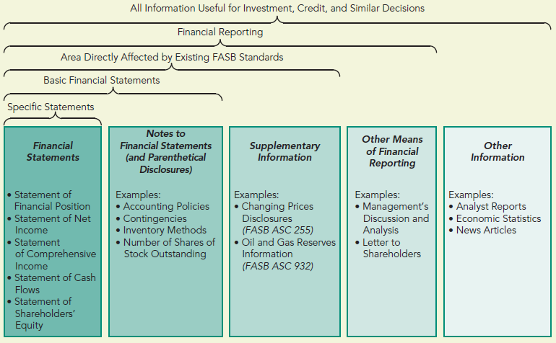
Sources of Information Used in External
Decision Making Learning Objective #5

