Slide 1
Intermediate Accounting
Third Edition
Wahlen, Intermediate Accounting, Third Edition. © 2020 Cengage. All Rights Reserved. May not be scanned, copied or duplicated, or posted to a publicly accessible website, in whole or in part.

Slide 2
Review of a Company’s Accounting System
Chapter 3

Slide 3
Objectives
Understand the components of an accounting system.
Know the five major steps in the accounting cycle.
Record transactions, events, and arrangements using journal entries in the general journal.
Post to the general ledger and prepare a trial balance.
Prepare adjusting entries.
Prepare financial statements.
Prepare closing entries.
Prepare financial statements using a worksheet (spreadsheet).
Prepare reversing entries.
Use subsidiary ledgers and special journals.
(Appendix 3.1) Convert cash-basis financial statements to accrual-basis.

Slide 4
The Accounting System
Learning Objective #1
The primary purpose of a company’s accounting system is to record, organize, summarize and report useful information to external financial statement users and stakeholders, as well as to company managers for making operating, investing, and financing decisions.
Basic components of an accounting system include:
  Accounting equation, which is the framework of the system
  Source documents used to generate accounting information
  Records used to organize and store accounting information
  Outputs – the financial statements

Slide 5
The Accounting Equation
The accounting equation is the foundation of the accounting system:
Assets = Liabilities + Shareholders’ Equity
Assets: the company’s economic resources
Liabilities: obligations owed to creditors
Shareholders’ Equity: shareholders’ residual interest in the company’s assets after the liabilities have been satisfied

Slide 6
Shareholders’ Equity Components
Contributed capital – amount of capital invested by owners
Retained earnings – cumulative amount of net income generated by the company minus the dividends distributed to owners
Ending Balance in Retained Earnings = Beginning Balance in Retained Earnings + Net Income ̶ Dividends
Accumulated other comprehensive income (AOCI) and other comprehensive income (OCI) – these include income items that the FASB has designated to be recognized as a separate component (further discussed in Chapters 4 and 5)

Slide 7
Components of Income
Revenues – measure the inflows of assets and the settlements of obligations from selling goods and providing services to customers
Expenses – measure the outflows of assets that a company consumes and the obligations a company incurs in the process of operating the business
Gains or losses – result from transactions in which the company sells assets or settles liabilities for more or less than their book values

Slide 8
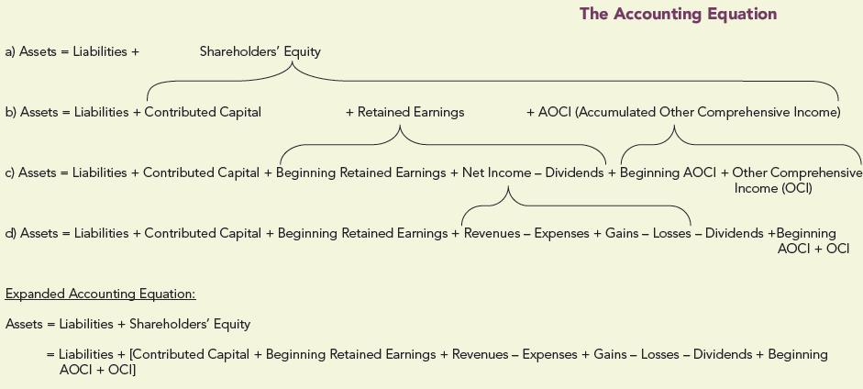
The Expanded Accounting Equation
Notes:
Exhibit 3.1 on page 3-3, The Accounting Equation. The four accounting equations are as follows:
The first equation reads, Assets = Liabilities + Shareholders’ Equity. The second equation reads, Assets = Liabilities + Contributed Capital + Retained Earnings + AOCI (Accumulated Other Comprehensive Income). An upper curly brace groups Contributed Capital, Retained Earnings and AOCI of second equation and points to shareholders’ equity of the first equation. The third equation reads, Assets = Liabilities + Contributed Capital + Beginning Retained Earnings + Net Income minus Dividends + Beginning AOCI + Other Comprehensive Income (OCI). Beginning Retained Earnings, Net Income, and Dividends of the third equation are marked with an upper curly brace and points to Retained Earnings of the second equation and Beginning AOCI, and Other Comprehensive Income (OCI) of the third equation points to AOCI of the second equation. The fourth equation reads, Assets = Liabilities + Contributed Capital + Beginning Retained Earnings + Revenues minus Expenses + Gains minus Losses minus Dividends + Beginning AOCI + OCI. Revenues, Expenses, Gains, and Losses of the fourth equation point to the net income of the third equation.

Slide 9
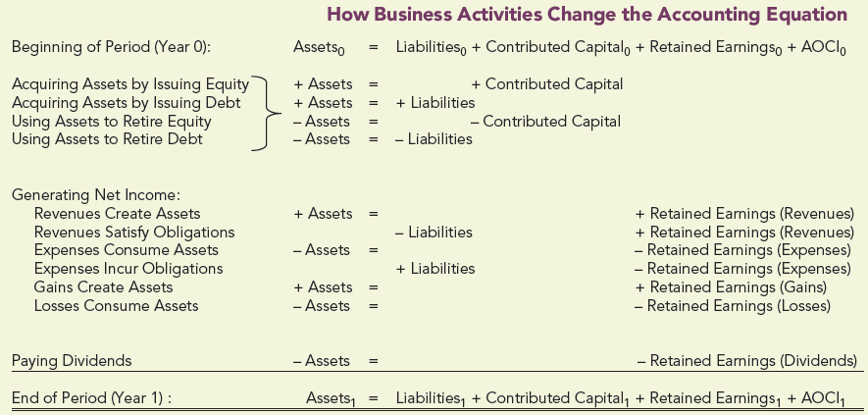
How Business Activities Change the
Accounting Equation
Notes:
Exhibit 3.2 on page 3-4, How Business Activities Change the Accounting Equation. The accounting equations are as follows. The first equation reads, Beginning of Period Assets = Liabilities + Contributed Capital + Retained Earnings + A O C I. The above equation is set in bold. The second equation reads, Acquiring Assets by Issuing Equity + Assets = + Contributed Capital. The third equation reads, Acquiring Assets by Issuing Debt + Assets = + Liability. The fourth equation reads, Using Assets to Retire Equity minus Assets = negative Contributed Capital. The fifth equation reads, Using Assets to Retire Debt minus Assets = negative Liabilities. The equations under the Generating Net Income are as follows: The first equation reads, Revenues Create Assets + Assets = + Retained Earnings (Revenues). The second equation reads Revenues Safety Obligations, No change in assets = negative Liabilities + Retained Earnings (Revenues). The third equation reads Expenses Consume Assets minus Assets = negative Retained Earnings (Expenses). The fourth equation reads, Expenses Incur Obligations, No change in assets = + Liabilities minus Retained Earnings (Expenses). The fifth equation reads, Gains Create assets + Assets = + Retained Earnings (Gains). The sixth equation reads, Losses Consume Assets minus Assets = negative Retained Earnings (Losses). The seventh equation reads, Paying Dividends minus Assets = negative Retained Earnings (Dividends). A single rule appears below the seventh equation. Then the next equation reads, End of Period, Assets = Liabilities + Contributed Capital + Retained Earnings + AOCI. The above equation is set in bold, and a double rule appears below the equation.

Slide 10
Transactions, Events, Arrangements, and Supporting Documents
Transaction – the transfer or exchange of resources between the company and another party
Event – an occurrence that affects the company
Arrangement – an agreement or a promise by the company with another party
Source documents – business documents that record transactions, events, and arrangements within an accounting system

Slide 11
Account Terminology
Accounts – store recorded monetary information from transactions, events, and arrangements
Chart of Accounts – comprehensive list of all accounts and their assigned account numbers
T-Accounts – format used to show debit and credit sides
Debit – left side of a T-account
Credit – right side of a T-account
Double-entry accounting system – for each transaction, event, or arrangement, the total amount of debits must always equal the total amount of credits

Slide 12
Account Classifications
Account classifications
  Permanent accounts – the asset, liability, and shareholders’ equity accounts whose balances at the end of the period are carried forward to the next period.
  Temporary accounts (periodic accounts) – used to determine the changes in retained earnings that occur during a period. Their balances are not carried forward.
Contra account – shows a reduction in a related account.
Balance – difference between the total debits and credits recorded in that account.

Slide 13
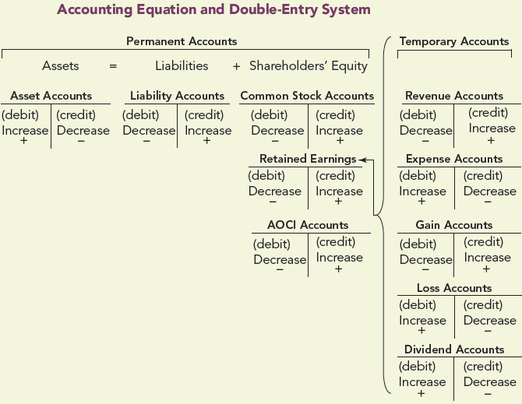
Accounting Equation and Double-Entry System
Notes:
Exhibit 3.3 on page 3-6, Accounting Equation and Double-Entry System. A table shows the Accounting Equation and Double-Entry System. An account name, Permanent Accounts, is centered above the horizontal line. An equation below the line reads Assets = Liabilities + Shareholders’ Equity. A T account is drawn below the assets. The title Asset account is centered above the horizontal line of the T account. A vertical line is drawn perpendicular to the horizontal line. The left side of the T account reads, (debit) Increase +. The right side of the T account reads (credit) Decrease minus. Another T account is drawn below the liabilities. The title Liability Accounts is centered above the horizontal line. A vertical line is drawn perpendicular to the horizontal line. The left side of the T account reads, (debit) Decrease minus. The right side of the T account reads (credit) Increase +. Three T accounts are drawn under Shareholders’ Equity. In the first T account, the title Common Stock Accounts is centered above the horizontal line. A vertical line is drawn perpendicular to the horizontal line. The left side of the T account reads, (debit) Decrease minus. The right side of the T account reads, (credit) Increase +. In the second T account, the title AOCI Accounts is centered above the horizontal line. A vertical line is drawn perpendicular to the horizontal line. The left side of the T account reads, (debit) Decrease minus. The right side of the T account reads, (credit) Increase +. In the third T account, the title Retained Earnings is centered above the horizontal line. A vertical line is drawn perpendicular to the horizontal line. The left side of the T account reads, (debit) Decrease minus. The right side of the T account reads, (credit) Increase +. Five T Accounts arranged vertically are grouped and titled as Temporary Accounts leads to the Retained Earnings. In the first T account, the title Revenue Accounts is centered above the horizontal line. A vertical line is drawn perpendicular to the horizontal line. The left side of the T account reads, (debit) Decrease minus. The right side of the T account reads, (credit) Increase +. In the second T account, the title Expense Accounts is centered above the horizontal line. A vertical line is drawn perpendicular to the horizontal line. The left side of the T account reads, (debit) Increase +. The right side of the T account reads, (credit) Decrease minus. In the third T account, the title Gain Accounts is centered above the horizontal line. A vertical line is drawn perpendicular to the horizontal line. The left side of the T account reads, (debit) Decrease minus. The right side of the T account reads, (credit) Increase +. In the fourth T account, the title Loss Accounts is centered above the horizontal line. A vertical line is drawn perpendicular to the horizontal line. The left side of the T account reads, (debit) Increase +. The right side of the T account reads, (credit) Decrease minus. In the fifth T account, the title Dividend Accounts is centered above the horizontal line. A vertical line is drawn perpendicular to the horizontal line. The left side of the T account reads, (debit) Increase +. The right side of the T account reads, (credit) Decrease minus.

Slide 14
Financial Statements
Annual report
  Contains the financial statements for the fiscal year, supporting schedules and notes, management’s discussion and analysis, and other information.
Interim statements (or quarterly statements)
  Financial statements prepared for shorter time periods.

Slide 15
Accounting Cycle
Learning Objective #2
Step 1 – Record the transactions, events, and arrangements in a journal.
Step 2 – Post the journal entries to the accounts in the ledger.
Step 3 – Prepare and post adjusting entries.
Step 4 – Prepare the financial statements.
Step 5 – Prepare and post closing entries for the temporary accounts: revenues, expenses, gains, losses, and dividends.

Slide 16
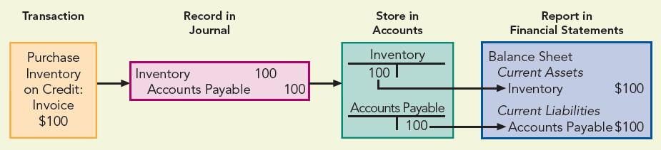
Accounting Information Flows through the Accounting System
Notes:
Exhibit 3.4 on page 3-8, Accounting Information Flows through the Accounting System. An info graph shows an accounting system in four blocks. The header of the blocks from left to the right reads as follows: Transaction; Record in Journal; Store in Accounts; and Report in Financial Statements. Text in the transaction block reads, Purchase Inventory on Credit: Invoice $ 100. Text in the record in journal block reads, Inventory, 100, Accounts Payable, 100. In the Store in Accounts block, two T accounts are shown. In the first T account, the title Inventory is centered above the horizontal line. A vertical line is drawn perpendicular to the horizontal line. To the left of the vertical line, on the debit side of the T account, the amount recorded is 100. In the second T account, the title Accounts Payable is centered above the horizontal line. A vertical line is drawn perpendicular to the horizontal line. To the right of the vertical line, on the debit side of the T account, the amount recorded is 100. Entries on the Report in Financial Statements block read, Balance Sheet followed by Current Assets followed by Inventory, $ 100 followed by Current Liabilities followed by Accounts Payable $ 100. The amount of inventory in store account points to the amount of inventory in the balance sheet of the financial statement. The amount of account payable in store account points to the amount of accounts payable in the balance sheet of the financial statement.

Slide 17
Recording Entries in the General Journal
Learning Objective #3
The general journal consists of a column for:
  The date
  The titles of the accounts affected by each entry
  The account numbers
  Debit(s) amount
  Credit(s) amount
Each transaction is recorded in the general journal with a journal entry.
An explanation is written below each journal entry.

Slide 18
Illustrating the Accounting Cycle
Jaymie Corporation incorporates on January 1, 2019, as a wholesaler. The company uses a perpetual inventory system, in which the inventory account is updated for each purchase or sale.
Accounts used in inventory transactions include:
  Purchase return – inventory returned to receive a refund
  Purchase allowance – company keeps damaged inventory and receives a refund
  Purchase discount – discount offered by supplier to induce prompt payment
During 2019, Jaymie engaged in various transactions.

Slide 19
Preparing Journal Entries, Part 1
Date | Transaction | Analysis
1/1 | Various shareholders invest in Jaymie by purchasing 2,000 shares of no-par stock at $10 per share. | Asset account Cash increased (debited) by $20,000; shareholders’ equity account Common Stock increased (credited) by $20,000.
Date | Account Titles and Explanations | Debit | Credit
2019
Jan. 1 | Cash
 | Common Stock | 20,000
 | Issued 2,000 shares of no-par stock at $10 per share. |  | 20,000
Date | Transaction | Analysis
1/16 | Jaymie purchases 2 acres of land as a building site, paying $1,500 an acre. | Asset account Land increased (debited) by $3,000; Cash decreased (credited) by $3,000.
Date | Account Titles and Explanations | Debit | Credit
16 | Land | 3,000
 | Cash |  | 3,000
 | Purchased 2 acres of land at $1,500 per acre.
Notes:
There are two transactions on the slide. The first one shows a transaction that says various shareholders invest in Jaymie by purchasing 2,000 shares of no-par-stock at $10 per share. Analysis of this transaction shows that the asset account Cash increased (debited) by $20,000, and shareholders’ equity account Common Stock increased (credited) by $20,000. There is a journal entry that shows the date of January 1, 2016, with a debit to Cash for $20,000 and a credit to Common Stock for $20,000. The explanation of the journal entry is stated as “issued 2,000 shares of no-par stock at $10 per share”. The next transaction says that Jaymie purchases 2 acres of land as a building site, paying $1,500 per acre. The analysis says that the asset account Land increased (debited) by $3,000 and the asset account Cash decreased (credited) by $3,000. There is a jounal entry which shows the date of January 16, with a debit to Land for $3,000 and credit to Cash for $3,000. The explanation of the journal entry is stated as “purchased 2 acres of land at $1,500 per acre”.

Slide 20
Preparing Journal Entries, Part 2
Date | Transaction | Analysis
3/30 | Jaymie purchases a building and equipment for $15,320 and $2,120, respectively. Jaymie pays $10,840 and signs a 12% note (interest and principal to be paid after 2 years) for the $6,600 balance. | Asset accounts Building and Equipment increased (debited) by $15,320 and $2,120, respectively; Cash decreased (credited) by $10,840; liability account Notes Payable increased (credited) by $6,600.
Date | Account Titles and Explanations | Debit | Credit
Mar. 30 | Building | 15,320
 | Equipment | 2,120
 | Cash |  | 10,840
 | Notes Payable |  | 6,600
 | Purchased a building and equipment for cash and a note payable.
Date | Transaction | Analysis
3/30 | Jaymie purchases a 1-year comprehensive insurance policy for $360. | Asset account Prepaid Insurance increased (debited) by $360; Cash decreased (credited) by $360.
Date | Account Titles and Explanations | Debit | Credit
30 | Prepaid Insurance | 360
 | Cash |  | 360
 | Purchased a 1-year comprehensive insurance policy.
Notes:
There are two transactions on the slide. The first one shows a transaction that says Jaymie purchases a building and equipment for $15,320 and $2,120 respectively. Jaymie pays $10,480 and signs a 12% note (interest and principal to be paid after 2 years) for the $6,600 balance. Analysis of this transaction shows that the asset account Buildings and Equipment increased (debited) by $15,320 and $2,120 respectively. Cash decreased (credited) by $10,840 and liability account Notes Payable increased (credited) by $6,600. There is a journal entry that shows the date of March 30, 2016, with a debit to Building for $15,320 and a debit to Equipment for $2,120. There are two credits, one to Cash for $10,840 and a credit to Notes Payable for $6,600. The explanation of the journal entry is stated as “purchased a building and equipment for cash and a note payable”. The next transaction says that Jaymie purchases a 1-year comprehensive insurance policy for $360. The analysis says that the asset account Prepaid Insurance increased (debited) by $360 and the asset account Cash decreased (credited) by $369. There is a journal entry which shows the date of March 30, with a debit to Prepaid Insurance for $360 and credit to Cash for $360. The explanation of the journal entry is stated as “purchased a 1-year comprehensive insurance policy”.

Slide 21
Preparing Journal Entries, Part 3
Date | Transaction | Analysis
3/31 | Jaymie purchases $7,300 of inventory on credit from Bark Company. | Asset account Inventory increased (debited) by $7,300; liability account Accounts Payable increased (credited) by $7,300.
Date | Account Titles and Explanations | Debit | Credit
31 | Inventory | 7,300
 | Accounts Payable |  | 7,300
 | Purchased inventory on credit from Bark Company.
Date | Transaction | Analysis
4/2 | Jaymie sells inventory for $8,000 cash. The cost of the inventory was $5,090. | Cash increased (debited) by $8,000; revenue account Sales Revenue increased (credited) by $8,000. Expense account Cost of Goods Sold increased (debited) by $5,090; Inventory decreased (credited) by $5,090.
Date | Account Titles and Explanations | Debit | Credit
April 2 | Cash | 8,000
 | Sales Revenue |  | 8,000
 | To record cash sales.
Notes:
There are two transactions on the slide. The first one shows a transaction that says Jaymie purchases $7,300 of inventory on credit from Bark Company. Analysis of this transaction shows that the asset account Inventory increased (debited) by $7,300 and liability account Accounts Payable increased (credited) by $7,300. There is a journal entry that shows the date of March 31, 2016, with a debit to Inventory for $7,300 and a credit to Accounts Payable for $7,300. The explanation of the journal entry is stated as “purchased inventory on credit from Bark Company”. The next transaction says that Jaymie sells inventory for $8,000 cash and the cost of the inventory was $5,090. The analysis says that the asset account Cash increased (debited) by $8,000 and the revenue account Sales Revenue increased (credited) by $8,000. The expense account Cost of Goods Sold increased (debited) by $5,090, and asset account Inventory decreased (credited) by $5,090. There is a journal entry which shows the date of April 2, with a debit to Cash for $8,000 and a credit to Sales Revenue for $8,000. The rest of the journal entry (for the debit to Cost of Goods Sold for $5,090 and the credit to Inventory for $5,090) is not shown on the slide.

Slide 22
The General Ledger
Learning Objective #4
General ledger - the entire set of accounts for a company
After a company records its transactions, events, and arrangements in a general journal, it updates each account in the general ledger by posting the date and debit amounts and credit amounts from the journal entries. Jaymie Corporation’s Cash T-account follows:
 | Cash
1/1 | 20,000 | 1/16 | 3,000
4/2 | 8,000 | 3/30 | 10,840
12/1 | 450 | 3/30 | 360
12/2 | 2,000 | 4/8 | 7,300
 |  | 7/15 | 3,300
 |  | 10/1 | 1,800
 |  | 12/28 | 428
 |  | 12/29 | 500
Balance | 2,922
Notes:
A T-account is shown for the asset account Cash. There is an illustration of a “T” shape with a title of Cash above the top. The left side shows all the debits that were posted to the Cash account during the year for Jaymie Corporation: 1/1 20,000, 4/2 8,000, 12/1 450, and 12/2 2,000. On the right side, all the credits that were posted to the Cash accounting during the year are listed: 1/16 3,000, 3/30 10,840, 3/30 360, 4/8 7,300, 7/15 3,300, 10/1 1,800, 12/28 428, and 12/29 500. A straight horizontal line is drawn at the bottom of the “T” shape. The account balance of 2,922 is shown on the debit side (left side).

Slide 23
Trial Balance
The trial balance lists all of the general ledger accounts and their balances
The trial balance is used to verify that the total debit balances equal the total credit balances
Column totals must always be equal
If the column totals are not equal, an error has been made
If the debit and credit columns balance, does this ensure that the accounting information is error-free?

Slide 24
Accrual Accounting and Preparing
Adjusting Entries Learning Objective #5
Adjusting entries must be recorded under accrual accounting so that:
  all revenues and expenses are recognized in the appropriate period
  all assets and liabilities have correct ending balances
  always affect both a permanent account and a temporary account
  may be classified into four broad categories
    Deferrals
    Accruals
    Estimates
    Periodic Inventory

Slide 25


Deferrals
Deferrals are transactions, events, or arrangements in which the cash flows occur before the related expenses are incurred or revenues are earned.
  Prepaid Expenses
    Deferred Revenues
Notes:
Exhibit 3.5 on page 3-15: Effects of Adjusting Entries for Prepaid Expenses. Two blocks of data show the entries for prepaid expenses. The first block reads, Decrease Asset leads to the second block reads, Increase Expense. The corresponding text reads, Effect on Accounts.
Exhibit 3.6 on page 3-17: Effects of Adjusting Entries for Deferred Revenues. Two blocks of data show the entries for deferred revenues. The first block reads, Decrease Liability leads to the second block reads, Increase Revenue. The corresponding text reads, Effect on Accounts.

Slide 26
Deferrals – Prepaid Expenses
Prepaid expense – a good or service purchased but not fully used up by the end of the period
  Jaymie Corporation purchased a 1-year insurance policy on March 30, 2019, for $360.
Journal entry:
Prepaid Insurance | 360
Cash |  | 360
    At the end of the year, nine months of insurance coverage has expired. (9/12 × $360)
    Adjusting entry:
Insurance Expense | 270
Prepaid Insurance |  | 270

Slide 27
Deferrals – Deferred Revenues
Deferred revenue (unearned revenue) occurs when customers pay in advance for the future delivery of goods or performance of services.
  On December 1, Jaymie Corporation received $450 for three months’ rent in advance.
Journal entry:
Cash | 450
Uneamed Rent |  | 450
    At the end of the year, one month of rent has been earned. ($450 ÷ 3)
    Adjusting entry:
Uneamed Rent | 150
Rent Income |  | 150

Slide 28


Accruals
Accruals are transactions, events, or arrangements in which the cash flows occur after the related expenses are incurred or revenues earned
  Accrued Expenses
    Accrued Revenues
Notes:
Exhibit 3.7 on page 3-18, Effects of Adjusting Entries for Accrued Expenses. Two blocks of data show the entries for Accrued Expenses. The first block reads, Increase Liability leads to the second block reads, Increase Expense. The corresponding text reads, Effect on Accounts.
Exhibit 3.8 on page 3-19, Effects of Adjusting Entries for Accrued Revenues. Two blocks of data show the entries for Accrued Revenues. The first block reads, Increase Asset leads to the second block reads, Increase Revenue. The corresponding text reads, Effect on Accounts.

Slide 29
Accruals – Accrued Expenses
An accrued expense is an expense that has been incurred but has not yet been paid.
  Jaymie Corporation pays employees’ salaries every six months, making the last $1,800 payment on October 1.
  At the end of December, its employees have earned salaries for three months but have not been paid. ($1,800 × 3/6)
Adjusting entry:
Salaries Expenses | 900
Salaries Payable |  | 900

Slide 30
Accruals – Accrued Revenues
An accrued revenue is a revenue that a company has earned but not yet received.
  On September 1, Jaymie Corporation accepted a $1,320, 15% note as payment when it sold an acre of land.
  Jaymie Corporation is owed interest from September 1 through December 31: ($1,320 × 15% × 4/12)
Adjusting entry:
Interest Receivable | 66
Interest Income |  | 66

Slide 31
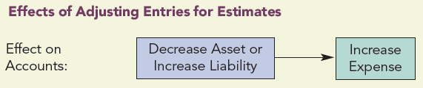
Adjusting Entries - Accounting Estimates
Accounting estimates are certain types of adjusting entries which are based on accounting amounts that are not known with certainty and must be estimated at the end of each period.
Examples include:
    Accumulated Depreciation and Depreciation Expense
    Allowance for Uncollectible Accounts and Bad Debt Expense
Notes:
Exhibit 3.9 on page 3-20, Effects of Adjusting Entries for Estimates. Two blocks of data show the entries for estimates. The first block reads, Decrease Asset or Increase Liability leads to the second block reads, Increase Expense. The corresponding text reads, Effect on Accounts.

Slide 32
Accounting Estimates – Depreciation
Depreciable cost – the difference between the original cost and residual value (salvage value or scrap value)
Depreciation – the allocation of an asset’s depreciable cost as an expense over its useful life
Straight-line depreciation – a depreciation method which allocates a proportionate amount as an expense to each period and is calculated as follows:
    Net book value (carrying value) – historical cost of an asset minus its accumulated depreciation
    An adjusting entry to record depreciation:
Depreciation Expense: Building | 264
Accumulated Depreciation: Building |  | 264

Slide 33
Accounting Estimates – Uncollectible Accounts
Bad debts
  A company makes a sale on credit (accounts receivable) that will not be collected
  Must be estimated in the period of the sale
  The company must reduce its assets so that its accounting records show the amount of accounts receivable that it expects to collect.
  Adjusting entry to record bad debt expense:
Bad Debts Expense | 170
Allowance for Doubtful Accounts |  | 170

Slide 34
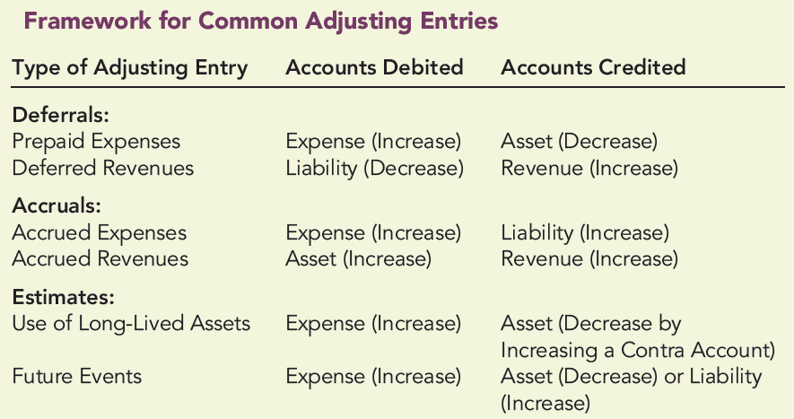
Summary: Adjusting Entries
Notes:
Exhibit 3.10 on page 3-22, Framework for Common Adjusting Entries. This table shows three columns. The three headings at the top are Type of Adjusting Entry, Accounts Debited, and Accounts Credited. In the first section, they list two rows of Deferrals. The first row shows Prepaid Expenses, then accounts debited would be Expense (Increase) and accounts credited would be Asset (Decrease). The second row shows Deferred Revenues, then accounts debited would be Liability (Decrease) and accounts credited would be Revenue (Increase). In the next section, they list two rows of Accruals. The first row in this section shows Accrued Expenses, then accounts debited would be Expense (Increase) and accounts credited would be Liability (Increase). The next row in this section shows Accrued Revenues, then accounts debited would be Asset (Increase) and accounts credited would be Revenue (Increase). The next section lists two rows of Estimates. The first row in this section shows Use of Long-Lived Assets, then accounts debited would be Expense (Increase) and accounts credited would be Asset (Decrease by Increasing a Contra Account). The second row in this section shows Future Events, then accounts debited would be Expense (Increase) and accounts credited Asset (Decrease) or Liability (Increase).

Slide 35
Adjusted Trial Balance
After the adjusting entries are prepared and posted to the general ledger accounts, the financial statements are prepared as follows:
  Step 1: The balance of each account in the general ledger is recomputed if necessary
  Step 2: An adjusted trial balance is prepared, listing all the accounts and their balances after adjustments in either the debit or credit column
  Step 3: The income statement and balance sheet are prepared in sequential order directly from the amounts shown in the adjusted trial balance

Slide 36
Adjusted Trial Balance
Slide (1 of 2)
Jaymie Corporation
Adjusted Trial Balance
December 31, 2019
 | Debit | Credit
Cash | $ 2,922
Accounts Receivable | 7,000
Allowance for Doubtful Accounts |  | $ 170
Notes Receivable | 1,320
Interest Receivable | 66
Inventory | 2,010
Prepaid Insurance | 90
Land | 1,500
Building | 15,320
Accumulated Depreciation: Building |  | 264
Equipment | 2,120
Accumulated Depreciation: Equipment |  | 120
Accounts Payable |  | 1,900
Notes Payable |  | 6,600
Salaries Payable |  | 900
Interest Payable |  | 594
Income Taxes Payable |  | 600
Unearned Rent |  | 300
Common Stock |  | 20,000 (Continued)
Notes:
Example 3.5 on page 3-23, Adjusted Trial Balance. A table is titled Jaymie Corporation, Adjusted Trial Balance, December 31, 2019, with three main columns. There is no heading on the first column. The second and third column header reads Debit and Credit. The debit amounts listed in the table are as follows: Cash, $ 2922; Accounts Receivable, 7,000; Notes Receivable, 1,320; Interest Receivable, 66; Inventory, 2,010; Prepaid Insurance, 90; Land, 1,500; Building, 15,320; Equipment, 2,120; Dividends, 500; The credit amounts listed in the table are as follows: Allowance for Doubtful Accounts, $ 170; Accumulated Depreciation: Building, 264; Accumulated Depreciation: Equipment, 120; Accounts Payable, 1,900; Notes Payable, 6,600; Salaries Payable, 900; Interest Payable, 594; Income Taxes Payable, 600; Unearned Rent, 300; Common Stock, 20,000; Retained Earnings, 0; Sales Revenue, 17,000; Interest Income, 66; and Rent Income, 150. The remainder of the Adjusted Trial Balance is on the next slide.

Slide 37
Adjusted Trial Balance Slide (2 of 2)
 | Debit | Credit
Retained Earnings |  | $ 0
Dividends | $ 500
Sales Revenue |  | 17,000
Interest Income |  | 66
Rent Income |  | 150
Cost of Goods Sold | 10,490
Salaries Expense | 2,700
Other Expenses | 428
Loss on Sale of Land | 180
Depreciation Expense: Building | 264
Depreciation Expense: Equipment | 120
Bad Debts Expense | 170
Insurance Expense | 270
Interest Expense | 594
Income Tax Expense | 600
Totals | $48,664 | $48,664
Notes:
Example 3.5 on page 3-23, Adjusted Trial Balance. A table is titled Jaymie Corporation, Adjusted Trial Balance, December 31, 2019, with three main columns. There is no heading on the first column. The second and third column header reads Debit and Credit. The debit amounts listed in the table are as follows: Cash, $ 2922; Accounts Receivable, 7,000; Notes Receivable, 1,320; Interest Receivable, 66; Inventory, 2,010; Prepaid Insurance, 90; Land, 1,500; Building, 15,320; Equipment, 2,120; Dividends, 500; The credit amounts listed in the table are as follows: Allowance for Doubtful Accounts, $ 170; Accumulated Depreciation: Building, 264; Accumulated Depreciation: Equipment, 120; Accounts Payable, 1,900; Notes Payable, 6,600; Salaries Payable, 900; Interest Payable, 594; Income Taxes Payable, 600; Unearned Rent, 300; Common Stock, 20,000; Retained Earnings, 0; Sales Revenue, 17,000; Interest Income, 66; and Rent Income, 150. The remainder of the Adjusted Trial Balance is on the next slide.

Slide 38
Preparing the Financial Statements: Income Statement Learning Objective #6 (Slide 1 of 2)
JAYMIE CORPORATION
Income Statement
For Year Ended December 31, 2019
Sales revenue |  | $ 17,000
Cost of goods sold |  | (10,490)
Gross profit |  | $ 6,510
Operating expenses:
Salaries expense | $ 2,700
Other expenses | 428
Depreciation expense: Building | 264
Depreciation expense: Equipment | 120
Bad debts expense | 170
Insurance expense | 270
Total operating expenses |  | (3,952)
Notes:
Example 3.6 on page 3-24, Income Statement. A table shows an income statement titled Jaymie Corporation, Income statement, For Year Ended December 31, 2019. The data listed in the table are as follows: Sales revenue, $ 17,000 (Credit); Cost of goods sold, 10,490 (credit, a single rule underlines the amount); Gross profit, $ 6,510 (credit). Data under Operating expenses are listed and the amounts are in the debit column: Salaries expense, $ 2,700; Other expenses, 428; Depreciation expense: Building, 264; Depreciation expense: Equipment, 120; Bad debts expense, 170; Insurance expense, 270 (a single rule underlines the amount); Total operating expenses, 3,952 (subtotal, a single rule underlines the amount); and Income from operations, $ 2,558. Data under other items are: Interest income, $ 66 (debit); Rent income, 150 (debit); Interest expense, 594 (debit); Loss on sale of land, 180 (debit, a single rule underlines the amount), 558 (credit, a single rule underlines the amount); Income before income taxes, $ 2000 (credit); Income tax expense, 600 (credit, a single rule underlines the amount); Net income, $ 1,400 (credit, double rule underlines the amount); and Earnings per share (2000 shares), $ 0.70 (credit, double rule underlines the amount).

Slide 39
Preparing the Financial Statements: Income Statement Learning Objective #6 (Slide 2 of 2)
JAYMIE CORPORATION
Income Statement
For Year Ended December 31, 2019
Income from operations |  | $ 2,558
Other items:
Interest income | $ 66
Rent income | 150
Interest expense | (594)
Loss on sale of land | (180) | (558)
Income before income taxes |  | $ 2,000
Income tax expense |  | (600)
Net income |  | $ 1,400
Earnings per share (2,000 shares) |  | $ 0.70
Notes:
Example 3.6 on page 3-24, Income Statement. A table shows an income statement titled Jaymie Corporation, Income statement, For Year Ended December 31, 2019. The data listed in the table are as follows: Sales revenue, $ 17,000 (Credit); Cost of goods sold, 10,490 (credit, a single rule underlines the amount); Gross profit, $ 6,510 (credit). Data under Operating expenses are listed and the amounts are in the debit column: Salaries expense, $ 2,700; Other expenses, 428; Depreciation expense: Building, 264; Depreciation expense: Equipment, 120; Bad debts expense, 170; Insurance expense, 270 (a single rule underlines the amount); Total operating expenses, 3,952 (subtotal, a single rule underlines the amount); and Income from operations, $ 2,558. Data under other items are: Interest income, $ 66 (debit); Rent income, 150 (debit); Interest expense, 594 (debit); Loss on sale of land, 180 (debit, a single rule underlines the amount), 558 (credit, a single rule underlines the amount); Income before income taxes, $ 2000 (credit); Income tax expense, 600 (credit, a single rule underlines the amount); Net income, $ 1,400 (credit, double rule underlines the amount); and Earnings per share (2000 shares), $ 0.70 (credit, double rule underlines the amount).

Slide 40
Preparing the Financial Statements:
Statement of Shareholders’ Equity
Jaymie Corporation
Statement of Shareholders’ Equity
For Year Ended December 31, 2019
 | Common Stock | Retained Earnings | Total
Balances, January 1, 2019 | $ 0 | $ 0 | $ 0
Issue of common shares, 2,000 shares of no-par stock | 20,000 |  | 20,000
Net income |  | 1,400 | 1,400
Cash dividends |  | (500) | (500)
Balances, December 31, 2019 | $20,000 | $ 900 | $20,900
Notes:
Example 3.7 on page 3-25, Statement of Shareholders’ Equity. A table shows the balance sheet titled Jaymie Corporation, Statement of Shareholders’ Equity, For Years Ended December 31, 2019, with four main columns. There is no heading on the first column. The remaining column headers are Common Stock, Retained Earnings, and Total. Data in the table are as follows: Row 1: Balances, January 1, 2019; $ 0; $ 0; $ 0; Row 2: Issue of common shares, 2000 shares of no-par stock, 20,000, blank space, 20,000; Row 3: Net income, blank space, 1,400, 1,400; Row 4: Cash dividends, blank space, (500), (500); and Row 5: Balances, December 31, 2019, $ 20,000 (a single rule appears at the top of the amount, and double rule underlines the amount), $ 900 (a single rule appears at the top of the amount, and double rule underlines the amount), $ 20,900 (a single rule appears at the top of the amount, and double rule underlines the amount).

Slide 41
Preparing the Financial Statements:
Asset Section of the Balance Sheet
Current assets – cash and those assets that are expected to be converted into cash or consumed within one year or operating cycle, whichever is longer
  Examples – Cash, Receivables, Investments in Marketable Securities, Inventories, Prepaid Items
Noncurrent assets – those assets that are expected to be consumed over more than one year or one operating cycle
  Tangible – Property and Equipment
  Intangible – Licenses, Patents, Copyrights
  Financial – Investments
  Natural Resources – Timber and Timberlands

Slide 42
Preparing the Financial Statements: Equity Side of the Balance Sheet
Current liabilities – those obligations that will become due within one year or the operating cycle, whichever is longer
  Examples – Accounts Payable, Salaries Payable, Income Taxes Payable, Unearned Revenue
Noncurrent liabilities – obligations that will become due after one year or one operating cycle
  Examples – Notes Payable, Bonds Payable, Mortgage Payable
Shareholders’ equity – includes contributed capital (Common Stock) and Retained Earnings

Slide 43
Preparing the Financial Statements:
Balance Sheet
JAYMIE CORPORATION
Balance Sheet
December 31, 2019
Assets |  |  | Liabilities
Current Assets: |  |  | Current Liabilities:
Cash |  | $ 2,922 | Accounts payable |  | $ 1,900
Accounts receivable | $ 7,000 |  | Salaries payable |  | 900
Less: Allowance for doubtful accounts | (170) | 6,830 | Income taxes payable |  | 600
Notes receivable |  |  | Unearned rent |  | 300
(due March 1, 2020) |  | 1,320 | Total current liabilities |  | $ 3,700
Interest receivable |  | 66 | Noncurrent Liabilities:
Inventory |  | 2,010 | Notes payable (due March 30, 2021) |  | $ 6,600
Prepaid insurance |  | 90 | Interest payable (due March 30, 2021) |  | 594
Total current assets |  | $13,238 | Total long-term liabilities |  | $ 7,194
Noncurrent Assets: |  |  | Total Liabilities |  | $10,894
Property, Plant, and Equipment:
Land |  | $ 1,500 | Shareholders’ Equity
Building | $15,320 |  | Contributed Capital:
Less: Accumulated depreciation | (264) |  | Common stock, no par (2,000 shares) | $20,000
Equipment | $ 2,120 |  | Retained earnings | 900
Less: Accumulated depreciation | (120) | 2,000 | Total Shareholders’ Equity |  | 20,900
Total property, plant, and equipment |  | $18,556 |  |  | _______
Total Assets |  | $31,794 | Total Liabilities and Shareholders’ Equity |  | $31,794
Notes:
Example 3.8 on page 3-26, Balance Sheet. A table shows a balance sheet titled Jaymie Corporation, Balance sheet, December 31, 2019. Data under assets are as follows: Current Assets followed by a colon, Cash, $ 2,922; Accounts receivable, $ 7,000; Less followed by a colon Allowance for doubtful accounts, (170) (a single rule underlines the amount) and 6,830 ; Notes receivable (due March 1, 2020), 1,320; Interest receivable, 66; Inventory, 2,010; Prepaid insurance, 90 (a single rule underlines the amount); Total current assets, $ 13,238 (a single rule underlines the amount). Data under Noncurrent Assets are: Property, Plant, and Equipment followed by a colon, Land, $ 1500; Building, $ 15,320; Less followed by a colon Accumulated depreciation, (264) (a single rule underlines the amount), 15,056; Equipment, $ 2,120; Less: Accumulated depreciation, (120) (a single rule underlines the amount), 2,000 (a single rule underlines the amount); Total property, plant, and equipment, $ 18,556 (a single rule underlines the amount); and Total Assets, $ 31,794 (a double rule underlines the amount). Data under Liabilities are as follows: Current Liabilities followed by a colon, Accounts payable, $ 1,900; Salaries payable, 900; Income taxes payable, 600; Unearned rent, 300 (a single rule underlines the amount); Total current liabilities, $ 3.700 (a single rule underlines the amount); Noncurrent Liabilities followed by a colon, Notes payable (due March 30, 2021), $ 6,600; Interest payable (due March 30, 2021), 594 (a single rule underlines the amount); Total long-term liabilities, $ 7,194 (a single rule underlines the amount); and Total Liabilities, $ 10,894. Data under Shareholders’ Equity are: Contributed Capital followed by a colon, Common stock, no par (2000 shares, $ 20,000; Retained earnings, 900 (a single rule underlines the amount); Total Shareholders’ Equity, 20,900; and Total Liabilities and Shareholders’ Equity, $ 31,794 (a single rule appears at the top of the amount, and a double rule underlines the amount).

Slide 44
Preparing the Financial Statements: Statement of Cash Flows, Part 1
JAYMIE CORPORATION
Statement of Cash Flows
For the Year Ended December 31, 2019
Operating Activities:
Net income
Adjustments to reconcile net income with cash from operations: |  | $ 1,400
Depreciation expense: Building |  | 264
Depreciation expense: Equipment |  | 120
Bad debts expense |  | 170
Loss on sale of land |  | 180
Cash provided (used) by changes in operating assets and liabilities:
Accounts receivable | $ (7,000)
Interest receivable | (66)
Inventory | (2,010)
Prepaid insurance | (90)
Accounts payable | 1,900
Salaries payable | 900
Income taxes payable | 600
Notes:
Example 3.7 on page 3-25, Statement of Shareholders’ Equity. A table shows the Statement of Cash Flows titled Jaymie Corporation, Statement of Cash Flows, For the Year Ended December 31, 2019. Data under Operating Activities are: Net income, $1,400, Adjustments to reconcile net income with cash from operations followed by a colon, Depreciation expense: Building, 264; Depreciation expense: Equipment, 120; Bad debts expense, 170; Loss on sale of land, 180, remainder of statement on next slide.

Slide 45
Preparing the Financial Statements: Statement of Cash Flows, Part 2
Unearned rent | 300
Interest payable | 594
Net cash used by operating activities |  | $ (2,738)
Investing Activities:
Purchase of land | $ (3,000)
Purchase of building | (15,320)
Purchase of equipment | (2,120)
Net cash used by investing activities |  | (20,440)
Financing Activities:
Issue of notes payable | $ 6,600
Issue of common shares | 20,000
Cash dividends paid | (500)
Net cash provided by financing activities |  | 26,100
Net change in cash |  | $ 2,922
Beginning cash balance |  | 0
Ending cash balance |  | $ 2,922
Notes:
Continuation of Example 3.7 on page 3-25, Statement of Shareholders’ Equity. Cash provided (used) by changes in operating assets and liabilities followed by a colon, Accounts receivable, $ (7,000); Interest receivable, (66); Inventory, (2,010); Prepaid insurance, (90); Accounts payable, 1,900; Salaries payable, 900; Income taxes payable, 600; Unearned rent, 300; Interest payable, 594 (a single rule underlines the amount); Net cash used by operating activities, $ (2,738); Data under Investing Activities are: Purchase of land, $ (3,000); Purchase of building, (15,320); Purchase of equipment, (2,120) (a single rule underlines the amount), and Net cash used by investing activities, (20,440). Data under financing activities are: Issue of notes payable, $ 6,600; Issue of common shares, 20,000; Cash dividends paid, (500) (a single rule underlines the amount); Net cash provided by financing activities, 26,100 (a single rule underlines the amount); Net change in cash, $ 2,922; Beginning cash balance, 0 (a single rule underlines the amount); and Ending cash balance, $ 2,922 (a double rule underlines the amount).

Slide 46
The Closing Process
Learning Objective #7
Closing entries – journal entries that a company makes at the end of the period to:
  Reduce the balance in each temporary (periodic) account to zero
  Update the Retained Earnings account
Income Summary – an account used to record temporary income statement accounts by reversing their debit balances into credits and their credit balances into debits, with a result credit balance showing the net income for the period (or a resulting debit balance showing a net loss)
Post-closing trial balance – prepared after closing entries are made to verify that the debit balances total is equal to the credit balances total in the permanent accounts

Slide 47
Closing Entries (Slide 1 of 2)
Date | Account Titles and Explanations | Debit | Credit
2019 | Closing Entries
Dec. 31 | Sales Revenue | 17,000
 | Interest Income | 66
 | Rent Income | 150
 | Income Summary |  | 17,216
 | To close the temporary accounts with credit balances.
31 | Income Summary | 15,816
 | Cost of Goods Sold |  | 10,490
 | Salaries Expense |  | 2,700
 | Other Expenses |  | 428
 | Loss on Sale of Land |  | 180
 | Depreciation Expense: Building |  | 264
 | Depreciation Expense: Equipment |  | 120
Notes:
Example 3.10 on page 3-18, Closing Entries for 2019 (Jaymie Corporation).

Slide 48
Closing Entries (Slide 2 of 2)
Date | Account Titles and Explanations | Debit | Credit
 | Bad Debts Expense |  | 170
 | Insurance Expense |  | 270
 | Interest Expense |  | 594
 | Income Tax Expense |  | 600
 | To close the temporary accounts with debit balances.
31 | Income Summary | 1,400
 | Retained Earnings |  | 1,400
 | To close the Income Summary balance (net income) to Retained Earnings.
31 | Retained Earnings | 500
 | Dividends |  | 500
 | To close the Dividends to Retained Earnings.
Notes:
Example 3.10 on page 3-18, Closing Entries for 2019 (Jaymie Corporation).

Slide 49
How Do We Use a Worksheet to Prepare Financial Statements? Learning Objective #8
Worksheet – a spreadsheet or working paper designed to minimize errors, simplify recording of adjusting and closing entries in the general journal, and make it easier to prepare the financial statements
Step 1 – Prepare the trial balance.
Step 2 – Enter adjusting entries.
Step 3 – Prepare the adjusted trial balance.
Step 4 – Enter revenue and expense balances in the Income Statement columns. The difference will be net income or net loss.
Step 5 – Total the balance sheet columns. The difference between the columns must be the same net income or net loss identified in step 4.

Slide 50
Reversing Entries
Learning Objective #9
A reversing entry is the exact reverse (accounts and amounts) of an adjusting entry.
  Reversing entries are optional.
Reversing entries are made to simplify the recording of subsequent transactions related to the adjusting entry.
Types of adjusting entries that are reversed include those that:
  accrue revenues to be collected in the next accounting period
  accrue expenses to be paid in the next accounting period
  defer costs by recording them as prepaid expenses, which will be consumed in the next accounting period
  defer revenues for prepayments from customers by recording them as unearned or deferred revenues, which will be earned in the next accounting period

Slide 51
Reversing Entry Illustration
 | Accrued Revenue Adjusting Entry
12/31/19 | Interest Receivable | 66
 | Interest Revenue |  | 66
12/31/19 | Revenues and expenses are CLOSED.
If reversing entry is not made: |  |  |  | If reversing entry is made:
 | Reversing Entry |  |  |  | Reversing Entry
1/1/20 | None |  |  | 1/1/20 | Interest Revenue | 66
 |  |  |  |  | Interest Receivable |  | 66
 | Subsequent Entry |  |  |  | Subsequent Entry
3/1/20 | Cash | 1,419 |  | 3/1/20 | Cash | 1,419
 | Notes Receivable |  | 1,320 |  | Notes Receivable |  | 1,320
 | Interest Receivable |  | 66 |  | Interest Revenue |  | 99
 | Interest Revenue |  | 33
Analysis of Subsequent Entry | Analysis of Subsequent Entry
Interest of $99 is collected, but $66 was recorded in Interest Receivable at end of last period. Consequently, Interest Receivable must be credited for $66, and Interest Revenue credited for $33. | Interest of $99 is collected and credited to Interest Revenue. The net result in Interest Revenue is a $33 credit balance.
Notes:
Example 3.12 on page 3-33, Reversing Entries (Jaymie Corporation). A table shows the reversing entries of Jaymie Corporation in Six sections. In the first section, the title Accrued revenue, adjusting entry is centered below the horizontal line. Data on this section are as follows: 12 slash 31 slash 19, Interest receivable, 66 (debit); Interest revenue, 66 (credit); 12 slash 31 slash 19, Revenues and expenses are closed (which is in uppercase). In the second section, text at the top left reads, if reversing entry is not made followed by a colon. Reversing entry is centered below the previous text. Data under reversing entry are 1 slash 1 slash 20, none. Data under subsequent entry are: 3 slash 1 slash 20, Cash, 1419 (debit); Notes receivable, 1320 (credit); Interest receivable, 66 (credit); Interest revenue, 33 (credit). Text at the right side of the section reads, if reversing entry is made followed by a colon. Reversing entry is centered below the previous text. Data under reversing entry are: 1 slash 1 slash 20, Interest revenue, 66 (debit); Interest receivable, 66 (credit). Data under subsequent entry are: 3 slash 1 slash 20, Cash, 1419 (debit); Notes receivable, 1320 (credit); Interest revenue, 99 (credit). In the third section, two columns are shown. The first column titles Analysis of subsequent entry and the data under reads, Interest of $ 99 is collected, but $ 66 was recorded in interest receivable at the end of last period. Consequently, Interest receivable must be credited for $ 66, and Interest revenue credited for $ 33. The second column titles Analysis of subsequent entry and the data under reads, Interest of $ 99 is collected, and credited to interest revenue. The net result in interest revenue is a $ 33 credit balance.

Slide 52
Subsidiary Ledgers
Learning Objective #10
Subsidiary ledgers are group of accounts, all of which relate to one specific company activity.
  They supplement the general ledger to:
    Reduce the size of the general ledger
    Minimize errors
    Divide the accounting tasks
    Keep up-to-date records of credit customers and suppliers
A company still keeps a control account in the general ledger
  Balance must equal that of the subsidiary ledger

Slide 53
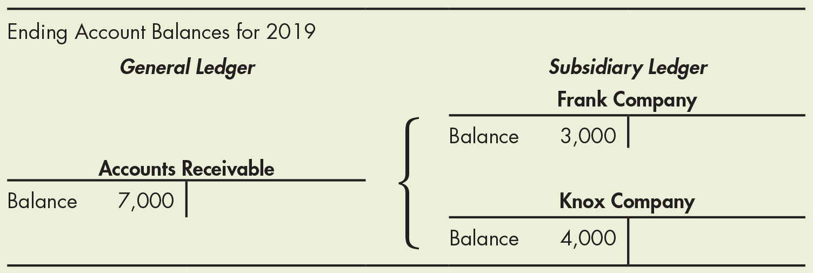
Control Account and
Subsidiary Ledger Illustration
Notes:
Example 3.13 on page 3-34, Accounts Receivable Control Account and Subsidiary Ledger. A table shows the ending account balances for 2019. A T account is drawn under general ledger. Account name, Accounts receivable is centered above the horizontal line. A vertical line is centered perpendicular below a horizontal line. To the left of the vertical line, on the debit side of the T account reads, Balance, 7000. Two T accounts are drawn under subsidiary ledger. In the first T account, the account name, Frank Company is centered above the horizontal line. A vertical line is centered perpendicular below a horizontal line. To the left of the vertical line, on the debit side of the T account reads, Balance, 3000. In the second T account, the account name, Knox Company is centered above the horizontal line. A vertical line is centered perpendicular below a horizontal line. To the left of the vertical line, on the debit side of the T account reads, Balance, 4000.

Slide 54
Special Journals
Special journals enable a company to record specific types of frequent, similar transactions.
  Divide the accounting tasks
  Reduce the time needed for accounting activities
  Create a chronological listing of similar transactions
The four most common types of special journals are:
  Sales Journal – record all (and only) sales of merchandise on credit
  Purchases Journal – record all (and only) purchases of merchandise on credit
  Cash Receipts Journal – record all cash receipts
  Cash Payments Journal – record all cash payments

Slide 55
Appendix 3.1 Cash-Basis Accounting
Learning Objective #11
Cash-basis accounting
  A company records revenues when it collects cash from sales and records expenses when it pays cash for its operations
Net income equals net operating cash flow for the period
Not allowed under GAAP or IFRS
Companies may need to convert from a cash-basis to an accrual-basis

Slide 56
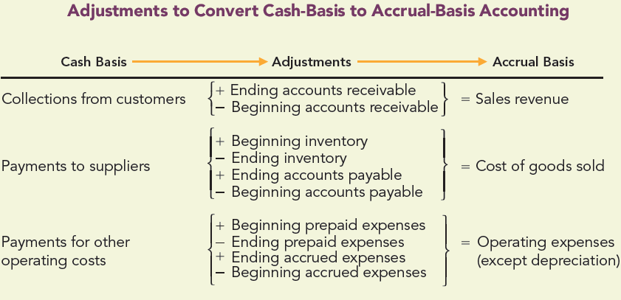
Cash-Basis Accounting
Notes:
Exhibit 3.11 on page 3-36, Adjustments to Convert Cash-Basis to Accrual-Basis Accounting. A table shows the conversion of cash basis to accrual basis. Cash basis leads to adjustments which further leads to accrual basis is shown above the horizontal line. Data in the table corresponds under each header are as follows: Row 1: Collection from customers; a left and right curly brace groups + ending accounts receivable and minus beginning accounts receivable; equals sales revenue. Row 2: Payments to suppliers; a left and right curly brace groups + beginning inventory, minus ending inventory, + ending accounts payable, minus beginning accounts payable; equals cost of goods sold. Row 3: Payments for other operating costs; a left and right curly brace groups + beginning prepaid expenses, minus ending prepaid expenses, + ending accrued expenses, minus beginning accrued expenses; equals operating expenses (except depreciation).

