Slide 1
Introduction to Global Business
Chapter 9 Control of Global Business

Slide 2
After studying this chapter, you should be able to:
Discuss the importance of mission statements and the difference between shareholder and stakeholder orientations in such statements and in general corporate strategy formulation.
Explain tactical versus operational plans in implementing corporate strategy, and Miles’ and Snow’s four basic types of longer-term strategic implementation.
Analyze various impediments to the coordination of strategic implementation that might exist for global businesses, and the positive role knowledge management and systems can play in this regard.

Slide 3
After studying this chapter, you should be able to:
Discuss and analyze various types of control systems utilized by global businesses including bureaucratic controls, interpersonal controls, output controls, and measurement systems like six sigma initiatives.
Analyze the role that organizations’ culture plays in controlling organizational activities, and how, when necessary, organizational cultures can potentially be changed.

Slide 4
Strategy Formulation
Mission statement
A written statement of why a company exists and what it plans to accomplish
Provides general guidelines for the firm’s strategy formulation and decision-making processes
Useful in monitoring the firm’s performance against its stated mission and goals
Mission and vision statement video

Slide 5
Shareholders versus Stakeholders
Shareholder model of strategy formulation
The key strategic purpose of a business is to maximize financial returns for its owners/shareholders.
Stakeholder model of strategy formulation
Businesses exist to benefit not just their shareholders, but also various groups, such as employees and customers, that have a meaningful stake in their operations.

Slide 6
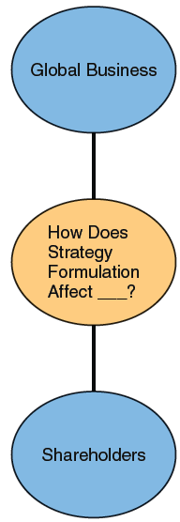
EXHIBIT 9.1 SHAREHOLDERS MODEL OF STRATEGY FORMULATION

Slide 7
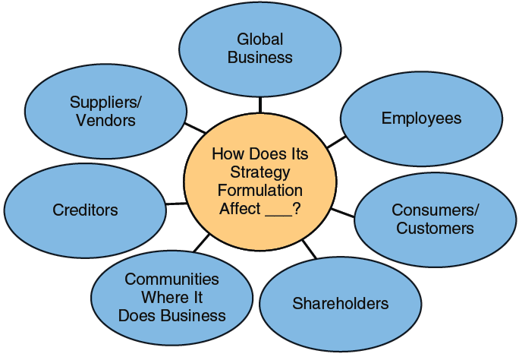
EXHIBIT 9.2 STAKEHOLDER MODEL OF STRATEGY FORMULATION

Slide 8
Strategy Implementation
Operational Plans
Tactical Plans
Strategic Plans
Very short-term (less than one year) plans that support annual goals
One-to-three-year plans formulated for implementing strategic goals
Long-term plans (five or more years) for achieving strategic goals

Slide 9
Strategy Implemenation
Strategy implementation video

Slide 10
Miles and Snow Typology
Prospectors
Defenders
Reactors
Analyzers
Extend their success through global expansions and finding new market opportunities
Concentrate on existing operations and defend their home turfs
Respond to strategic actions initiated by competitors
Take a middle ground between being prospectors and defenders

Slide 11
Coordination
Impediments to Coordination
Legal
Political
Economic
Technological
Other impediments
Six Sigma intro Video
Process improvement

Slide 12
Knowledge Management and Systems
Tacit Knowledge
Explicit Knowledge
Absorptive Capacity
Knowledge that is informal in nature and difficult to communicate
Knowledge that is codifiable and easy to communicate or write down
The ability of organizations to recognize, assimilate, and apply new knowledge

Slide 13
Control Systems
Bureaucratic controls
Systems of rules and regulations promulgated within a global business
Interpersonal controls
Involves executives engaging in personal contact with subordinates as a way of managing an organization
Output controls and measurement
Involves establishing specific goals on given metrics and then measuring to what extent these goals are being achieved at certain time intervals

Slide 14
Output Controls and Measurement
Controlling and Measuring Output
Profits
Growth
Productivity
Market share
Quality control
Corporate social responsibility

Slide 15
Organizational Culture and the Change Control Function
Organizational culture
The personality of a given organization, its shared norms and values
Types of organizational culture:
Strong cultures can either support or resist change.
Weak cultures provide little guidance to employees.
Organizational change
Involves implementation of a different business or cultural path for an organization
Video on Bernard Madoff
Investment Service (BMIS)

Slide 16
Gikinoo’amaagn Odanokiiwin
Start making short videos and taking photos of tribal businesses or business ideas.
Current business
Potential business (youll want to be creative and take pictures of what the product or service might look like)
You may need a photo release for using images of people or other businesses. (available in Canvas)
We will discuss the project more on Nov 13th. Use this week to think about potential global business products/services that are tribally based. Take as many photos and videos as you can. Hold onto them for now, well talk later. Happy hunting!

Slide 17
Homework
1. In what ways are corporate mission statements more than just “public relations”?
2. Do you think global businesses should place more emphasis upon operational or tactical plans? Why?
3. In what positive and negative ways has the Internet changed the conduct and coordination of global business?
4. Do you think six sigma quality control initiatives really work?
5. In what ways did the organizational culture at Bernard Madoff Investment Services company help lead to Madoff’s success for so many years?
6. How would you describe the organizational culture at a tribal business you have worked at?

Slide 18
Key Terms
mission statement
shareholder model of strategy formulation
stakeholder model of strategy formulation
operational plans
tactical plans
prospectors
defenders
reactors
analyzers
tacit knowledge
explicit knowledge
absorptive capacity
bureaucratic controls
interpersonal controls
output controls and measurement
organizational culture
organizational change

