Slide 1
Introduction to Global Business
Chapter 3 Regional Economic Integration

Slide 2
After studying this chapter, you should be able to:
Explain regional economic integration, its evolution, and its benefits and costs.
Identify how economic geography helps explain, promote, and segment regional integration blocs.
Identify the primary reasons why countries are now seeking to pursue regional integration at the expense of multilateral trade liberalization.
Explain why the European Union is seen as the most advanced regional integration bloc.

Slide 3
After studying this chapter, you should be able to:
Describe how NAFTA has affected U.S.–Mexico bilateral trade in goods and services.
Explain the importance of ASEAN and indicate why Asia may become the most important free trade region for this century.
Explain why regional integration in Latin America is challenging and why there is potential for a grouping like MERCOSUR to become more predominant.

Slide 4
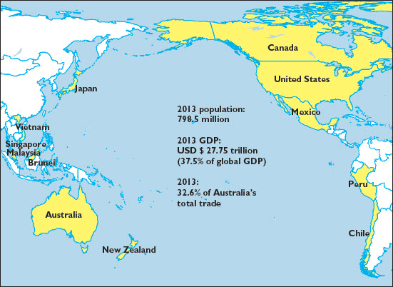
EXHIBIT 3.1 TRANS-PACIFIC PARTERNSHIP AGREEMENT

Slide 5
What Is Regional Economic Integration?
Regional integration
Implementation of a multitude of economic and/or political steps by member states to increase their global competitiveness, including preferential trade access
Spatial transformations
The process of allowing efficient geographic distribution of business activities within and among countries

Slide 6
Stages of Regional Integration
Free- trade area
Customs union
Common (or single) market
Economic and monetary union
Political union

Slide 7
EXHIBIT 3.2 FORM AND STAGES OF REGIONAL INTEGRATION
Stage of Integration | Abolition of Tariffs and Quotas Among Members | Common External Tariff and Quota System | Abolition of Restrictions on Factor Movements | Harmonization and Unification of Economic Policies and Institutions
Free-trade area | Yes | No | No | No
Customs union | Yes | Yes | No | No
Common market | Yes | Yes | Yes | No
Economic union | Yes | Yes | Yes | Yes

Slide 8
Pros and Cons of Regional Integration
Regional Integration
Benefits
Costs

Slide 9
Benefits of Regional Integration
Creating a larger pool of consumers with growing incomes and similar culture, tastes, and social values
Encouraging economies of scale in production, increasing the region’s level of global competitiveness, and enhancing economic growth through investment flows
Freeing the flow of capital, labor, and technology to the most productive areas in the region
Increasing cooperation, peace, and security among countries in the region
Encouraging member states to enhance their social welfare to match that of the most progressive states

Slide 10
Costs of Regional Integration
Undermining the most-favored-nation status rule, an essential principle of the WTO
Imposing uniform laws and regulations that at times do not take into account national economic, cultural, and social differences
Eliminating jobs and increasing unemployment in protected industries
Losing sovereignty, national independence, and identity
Reducing the powers of the national government
Increasing the problems of illegal drugs and terrorism due to the ease of cross-border labor movement

Slide 11
The Economic Geography of Regional Integration
Economic geography
The study of principles that govern the efficient spatial allocation of economic resources and the resulting consequences
Steps to Regional Integration
1
Start small
2
Think global
3
Compensate the least fortunate

Slide 12
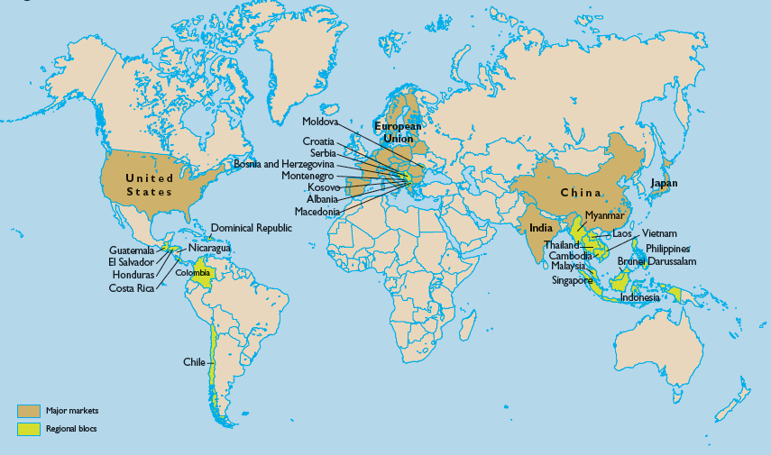
EXHIBIT 3.3 REGIONS CLOSE TO WORLD MARKETS

Slide 13
EXHIBIT 3.4 REGIONS WITH LARGE LOCAL MARKETS BUT LOCATED FAR FROM WORLD MARKETS

Slide 14
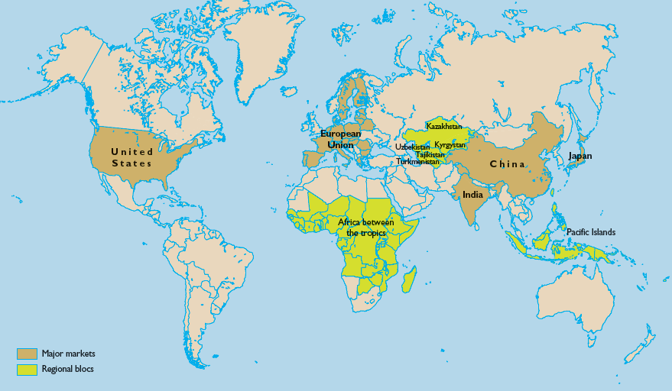
EXHIBIT 3.5 REGIONS WITH SMALL LOCAL MARKETS LOCATED FAR FROM WORLD MARKETS

Slide 15
Does Regional Integration Confound Global Trade?
European Union (EU)
North American Free Trade Agreement (NAFTA)
Association of South East Asian Nations (ASEAN)
Regional Integration in Latin America

Slide 16
The European Union (EU)
EU is most highly evolved regional integration:
EU grew out of European Coal and Steel Community (ECSC).
The Treaty of Rome in 1957 established the European Economic Community (EEC).
The Maastricht Treaty in 1992 created the EU as a full economic union with free movement of labor among its member countries.
The euro was adopted as a common currency in 1992.
Economic coordination and fiscal stability is challenged by the sovereign debt crisis of some members.

Slide 17
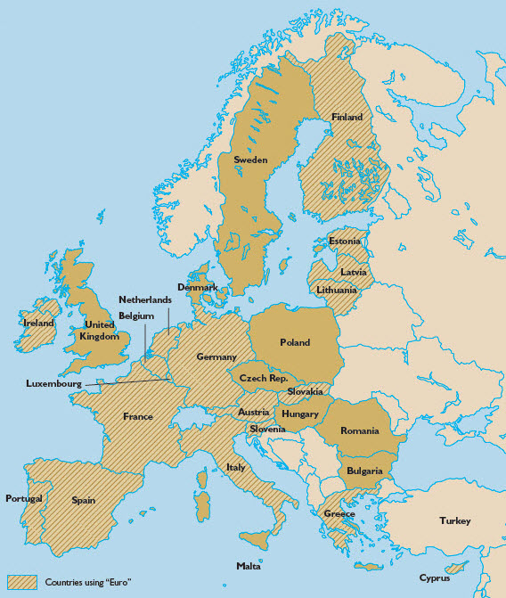
EXHIBIT 3.6 THE EUROPEAN UNION

Slide 18
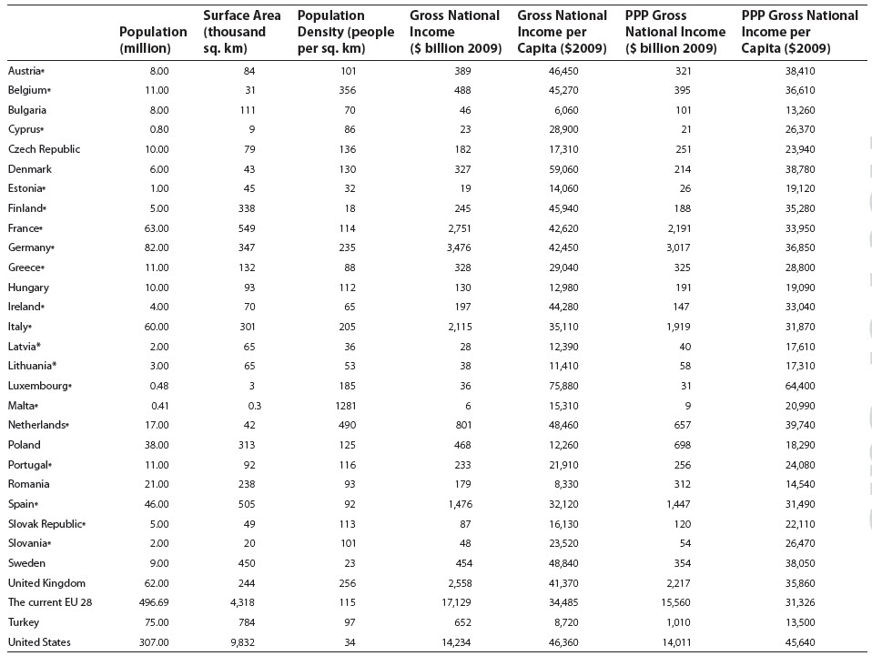
EXHIBIT 3.7 THE EUROPEAN UNION AND THE UNITED STATES: A COMPARISON

Slide 19
The North American Free-Trade Agreement (NAFTA)
Canada, United States, and Mexico reached a comprehensive trade agreement in 1994.
Major NAFTA objectives:
Trade expansion through the phased elimination of all trade barriers
Protection of intellectual property rights
Creation of institutions to address unfair trade practices, trade disputes, environmental protection, worker’s rights, competition policies, and implementation of NAFTA rules and regulations

Slide 20
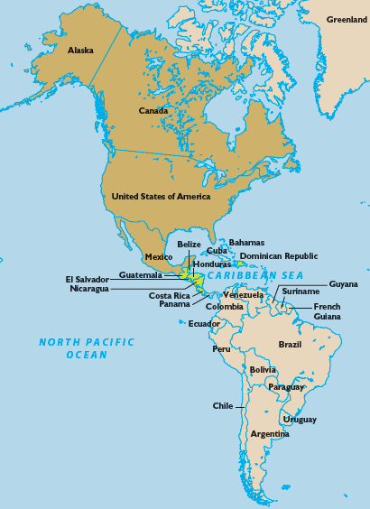
EXHIBIT 3.8 NORTH AMERICAN FREE-TRADE AGREEMENT

Slide 21
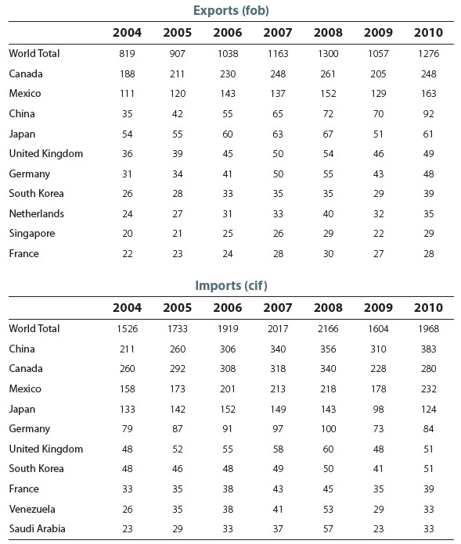
EXHIBIT 3.9 UNITED STATES: EXPORTS OF GOODS TO AND FROM TOP TEN TRADE PARTNERS (BILLIONS OF U.S. DOLLARS)

Slide 22
EXHIBIT 3.9 UNITED STATES: IMPORTS OF GOODS TO AND FROM TOP TEN TRADE PARTNERS (BILLIONS OF U.S. DOLLARS)

Slide 23
Association of South East Asian Nations (ASEAN)
ASEAN’s objectives:
To accelerate economic growth, social progress, and cultural development in the region
To promote peace and stability through the rule of law in relationships among countries in the region
Bases for ASEAN:
ASEAN Security Community (ASC)
ASEAN Economic Community
ASEAN Sociocultural Community

Slide 24
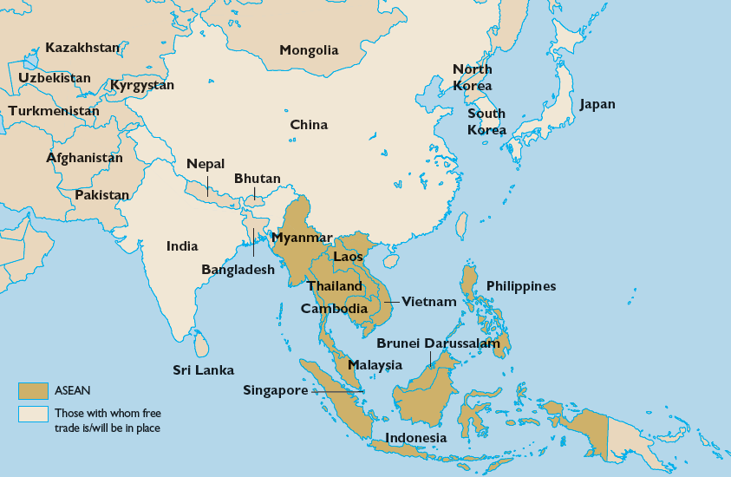
EXHIBIT 3.10 ASSOCIATION OF SOUTHEAST ASIAN NATIONS (ASEAN)

Slide 25
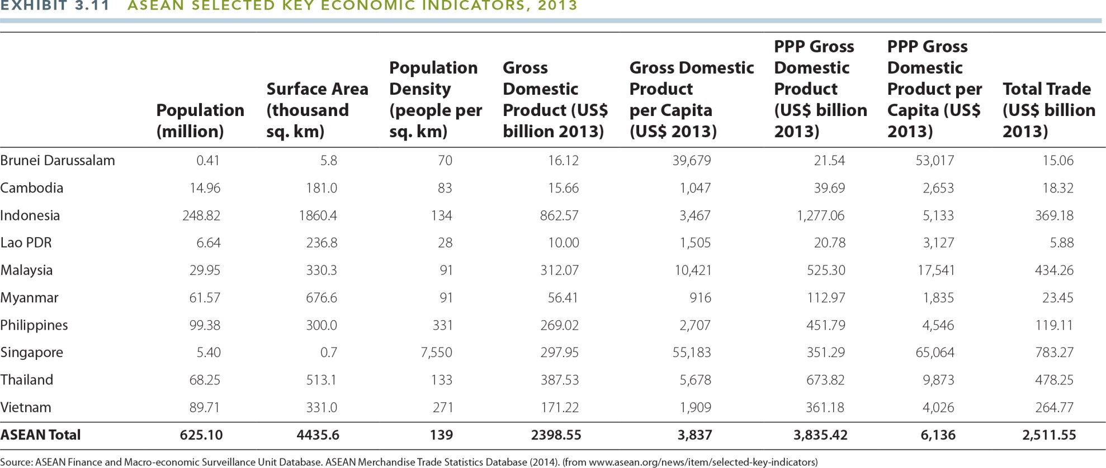
EXHIBIT 3.11 ASEAN SELECTED KEY ECONOMIC INDICATORS, 2013

Slide 26
Regional Integration in Latin America
The Treaty of Montevideo in 1960 created the Latin American Free Trade Association (LAFTA).
Bolivia, Chile, Colombia, Ecuador, and Peru created the Andean Group in 1969.
Treaty of Asunción in 1991 among Argentina, Brazil, Paraguay, and Uruguay, created the Southern Cone Common Market, or MERCOSUR (Mercado Común del Sur).
DR-CAFTA (Dominican Republic and Central American Free Trade Agreement) became effective in 2005.

Slide 27
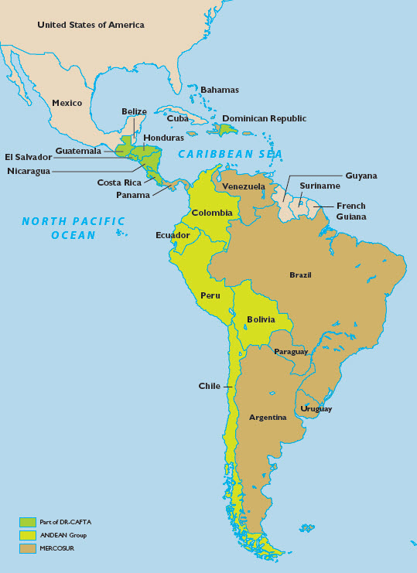
EXHIBIT 3.12 REGIONAL INTEGRATION IN LATIN AMERICA

Slide 28
Key Terms
regional integration
spatial transformations
free-trade area
customs union
common market or single market
economic and monetary union
political union
economic geography

