Slide 1
Accounting Refresher
10/3/19 & 10/8/19

Slide 2
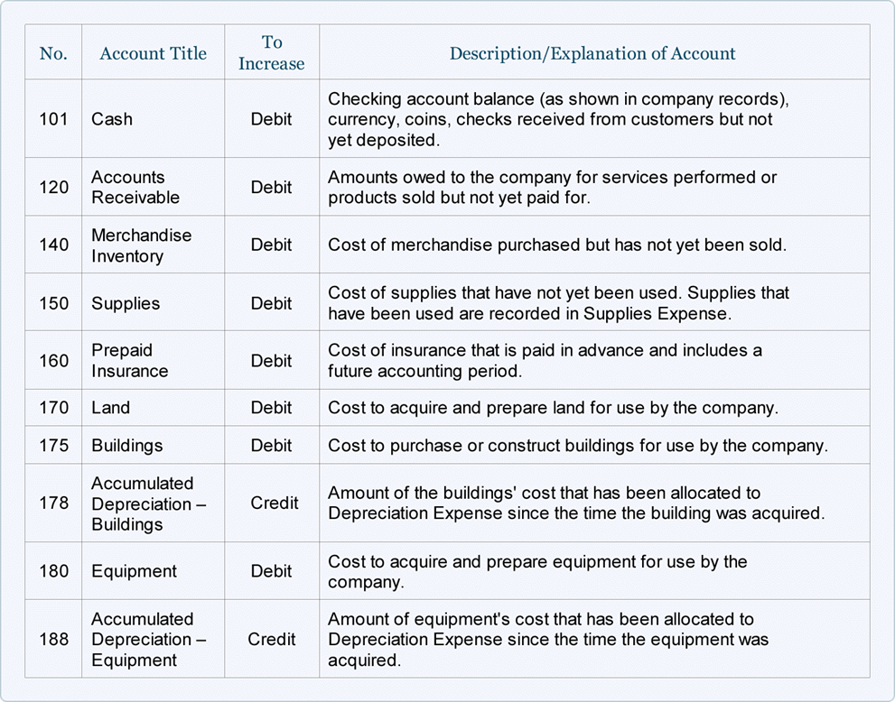
Asset Accounts

Slide 3
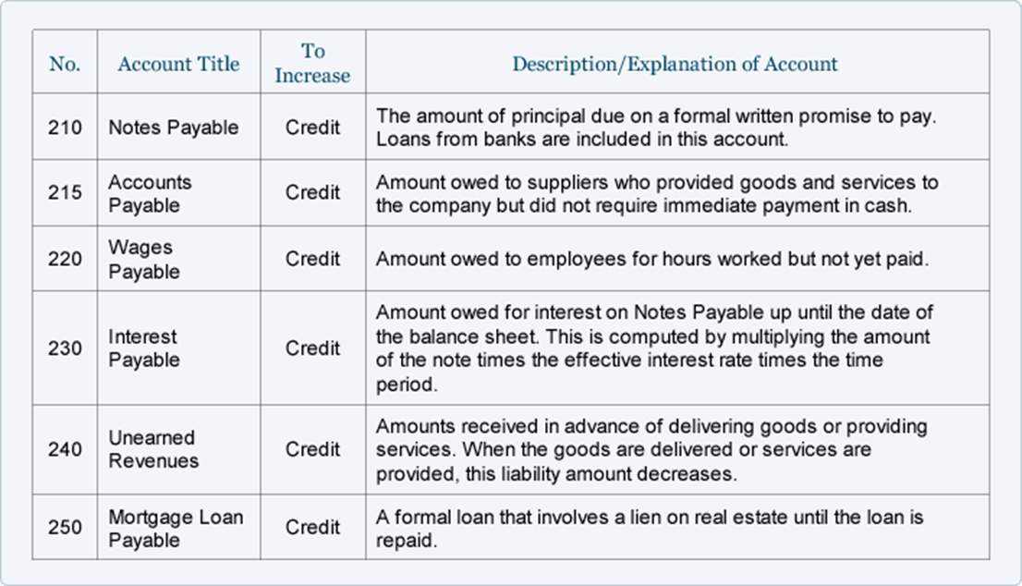
Liability Accounts

Slide 4
Owners Equity Accounts Operating Revenue Accounts

Slide 5
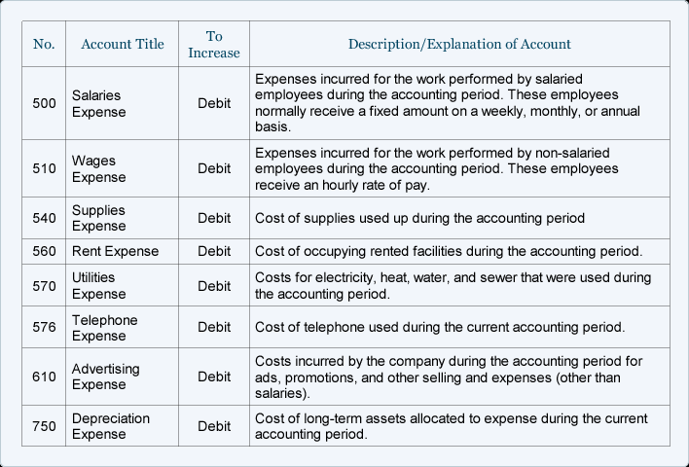
Operating Expense Accounts

Slide 6
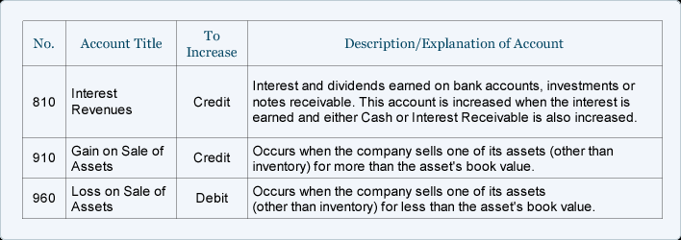
Non-Operating Rev/Exp Gain/Loss

Slide 7
Accounting Equation
Assets are a company's resources—things the company owns. Examples of assets include cash, accounts receivable, inventory, prepaid insurance, investments, land, buildings, equipment, and goodwill. From the accounting equation, we see that the amount of assets must equal the combined amount of liabilities plus owner's (or stockholders') equity.
Liabilities are a company's obligations—amounts the company owes. Examples of liabilities include notes or loans payable, accounts payable, salaries and wages payable, interest payable, and income taxes payable (if the company is a regular corporation). Liabilities can be viewed in two ways:
(1) as claims by creditors against the company's assets, and
(2) a source—along with owner or stockholder equity—of the company's assets.
Owner's equity or stockholders' equity is the amount left over after liabilities are deducted from assets:
Assets - Liabilities = Owner's (or Stockholders') Equity.
Owner's or stockholders' equity also reports the amounts invested into the company by the owners plus the cumulative net income of the company that has not been withdrawn or distributed to the owners.

Slide 8
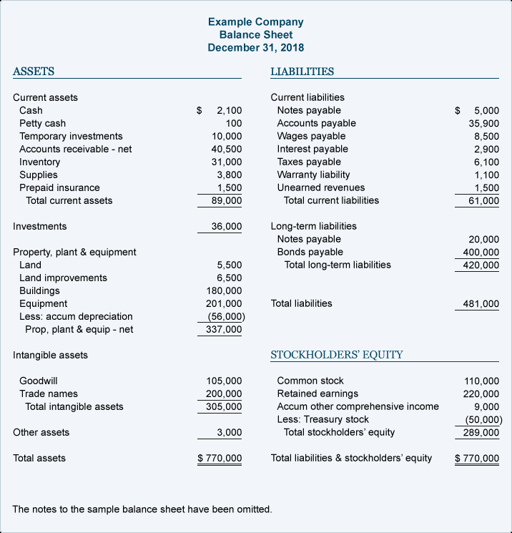
Balance Sheet

Slide 9
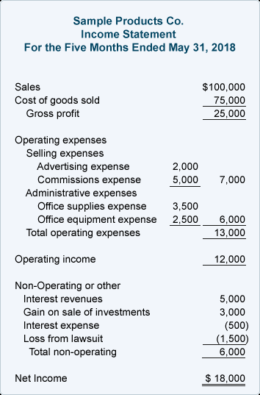
Income Statement

Slide 10
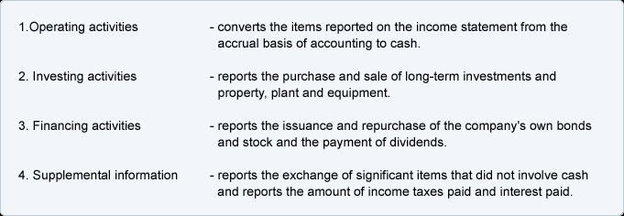
Cash Flow Statement

Slide 11
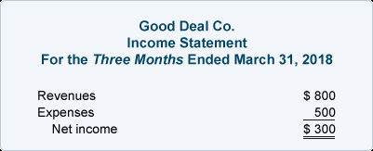
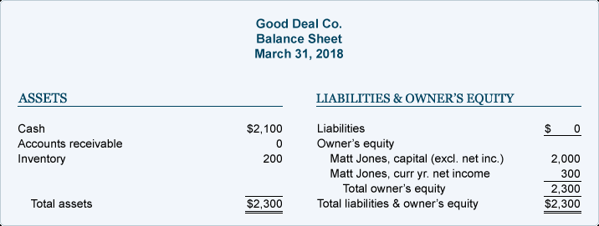
Cash Flow Statement

Slide 12
Double entry
Debits and Credits
After you have identified the two or more accounts involved in a business transaction, you must debit at least one account and credit at least one account.
To debit an account means to enter an amount on the left side of the account. To credit an account means to enter an amount on the right side of an account.
Debit means left
Credit means right

Slide 13
Double entry
Generally these types of accounts are increased with a debit:
Dividends (Draws) Expenses Assets Losses
You might think of D - E - A - L when recalling the accounts that are increased with a debit.
Generally the following types of accounts are increased with a credit:
Gains Income Revenues Liabilities Stockholders' (Owner's) Equity
You might think of G - I - R - L - S when recalling the accounts that are increased with a credit.
To decrease an account you do the opposite of what was done to increase the account. For example, an asset account is increased with a debit. Therefore it is decreased with a credit.
The abbreviation for debit is dr. and the abbreviation for credit is cr.

Slide 14
Chart of accounts
Go to spreadsheet

